Slide 1
SQL Creating and Managing Tables
lecture4

Slide 2
Database Objects Database Objects
Object | Description
Table | Basic unit of storage; composed of rows and columns
View | Logically represents subsets of data from one or more tables
Sequence | Numeric value generator
Index | Improves the performance of some queries
Synonym | Gives alternative names to the other objects

Slide 3
Database Objects
All the previews database objects can be created using CREATE sql statement

Slide 4
Tables
Creating tables
The alter statement
Dropping table

Slide 5
Creating table: Syntax
Database tables created using (CREATE TABLE statement)
The Minimal Syntax is:
You Specify:
tablename : The name you chooses for the table
column : Column name
data type : column data type which specifies the type of data to be stored in this column and column size
DEFAULT expr: specifies a default value if a value is omitted in the INSERT statement
CREATE TABLE tablename (column data type [DEFAULT expr], …..);

Slide 6
Creating table: Naming Rules
Table names and column names:
Must begin with a letter
Must be 1 to 30 characters long
Must contain only A–Z, a–z, 0–9, _, $, and #
Must not duplicate the name of another object owned by the same user
Must not be an Oracle Server reserved word
Note: Names are not case sensitive. (For example, EMPLOYEES is treated as the same name as eMPloyees or eMpLOYEES.)

Slide 7
Creating table: Naming Guideline
Table names and column names:
Use a descriptive names for table as well the other database objects
Names are not case sensitive. (For example, EMPLOYEES is treated as the same name as eMPloyees or eMpLOYEES.)

Slide 8
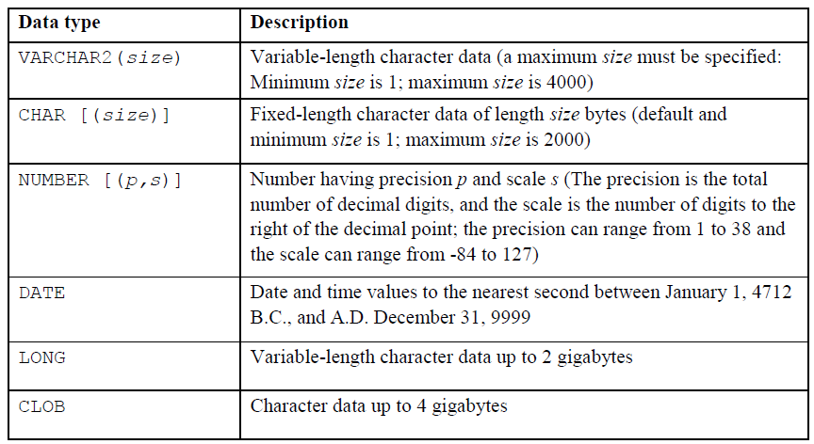
Creating table: Data Types

Slide 9
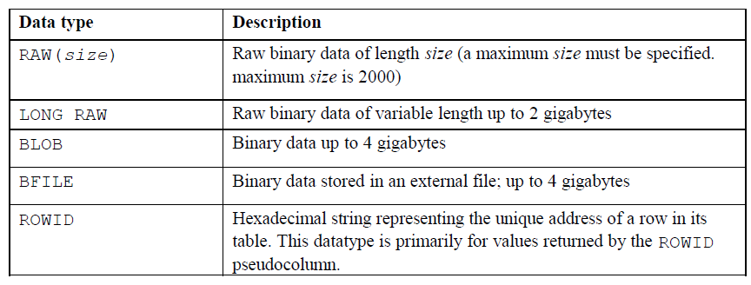
Creating table: Data Types (Cont.)

Slide 10
Creating table: DEFAULT
Specify default value for the column during the INSERT operation → Prevents NULL values from entering the columns if the row entered inserted without a value for the column
For the DEFAULT :
Literal values, expressions, or SQL functions are legal values
Another column’s name or pseudocolumn are illegal values
The DEFAULT value data type must match the column data type

Slide 11
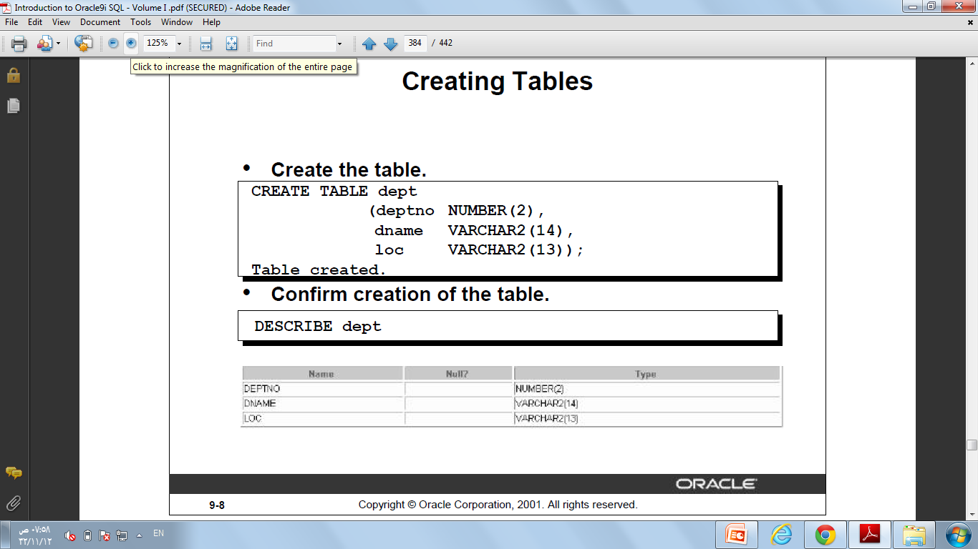
Creating table: Example
Crete a Table
CREATE TABLE dept (dnum NUMBER(2), dname VARCHAR2(14),dlocation VARCHAR2(13));
Table created ← Appears when you run the query
To Confirm the creation
DESCRIBE dept ;

Slide 12
The ALTER TABLE Statement
Use the ALTER TABLE statement to:
• Add a new column
• Modify an existing column
• Define a default value for the new column
• Drop a column

Slide 13
The ALTER TABLE Statement: Syntax
Use the ALTER TABLE statement to add, modify or drop columns.
ALTER TABLE table
ADD (column datatype [DEFAULT expr]
[, column datatype]...);
ALTER TABLE table
MODIFY (column datatype [DEFAULT expr]
[, column datatype]...);
ALTER TABLE table
DROP COLUMN column;

Slide 14
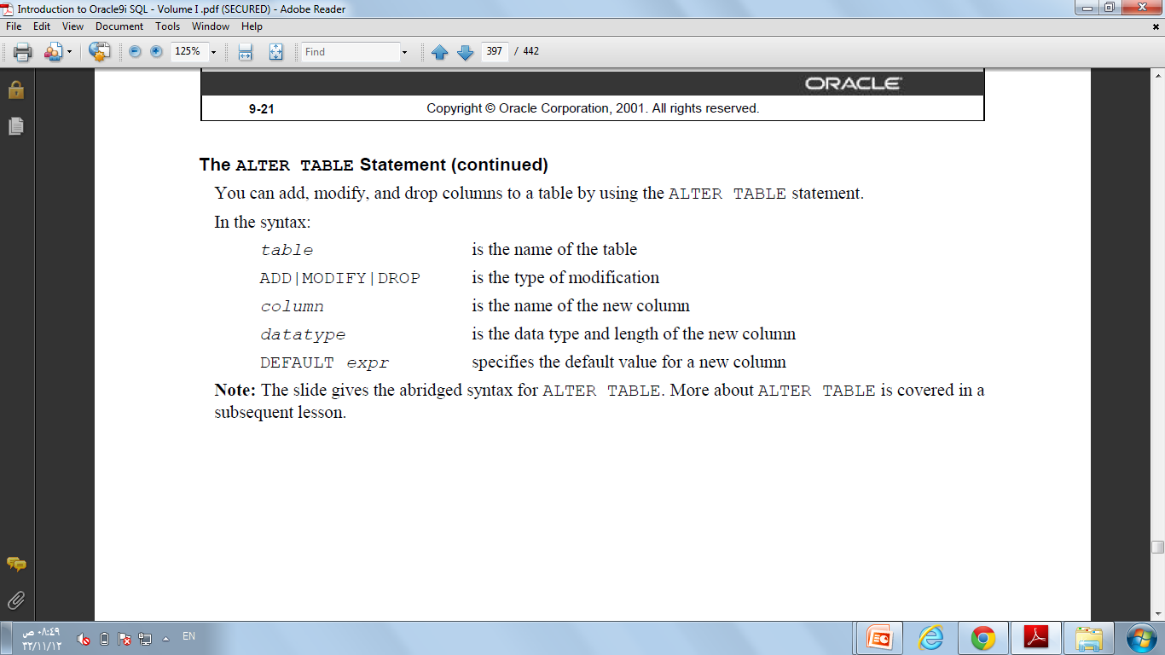
The ALTER TABLE Statement: Syntax

Slide 15
The ALTER TABLE Statement: Example (Add)
Use the ADD clause to add columns.
ALTER TABLE dept80
ADD (job_id VARCHAR2(9));
•Note That
You cannot specify where the new column appear→ The new column becomes the last column directly.
If the table already contains rows when the new column added, then the new column is initialized to NULL (as in this example) or default value (if specified) for all the rows

Slide 16
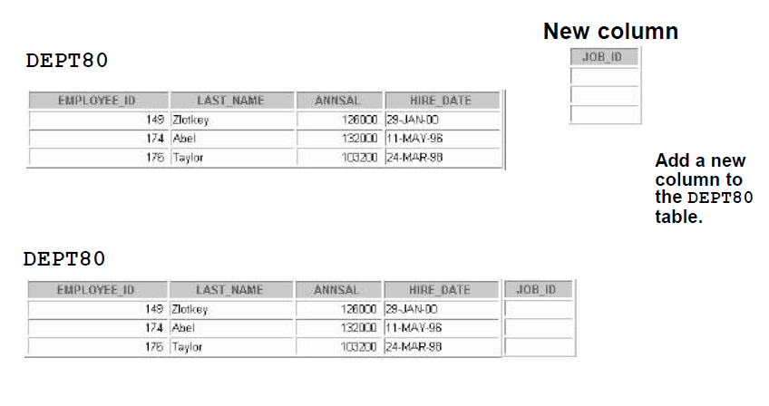
The ALTER TABLE Statement: Example (Add)

Slide 17
The ALTER TABLE Statement: Example (Modify)
You can change a column’s data type, size, and
default value.
ALTER TABLE dept80
MODIFY (last_name VARCHAR2(30));
Note That:
A change to the default value affects only subsequent insertions to the table
You can decrease the width of a column only if the column contains only null values or if the table has no rows.
You can change the data type only if the column contains null values.

Slide 18
The ALTER TABLE Statement: Example (DROP)
Use the DROP COLUMN clause to drop columns you no longer need from the table.
ALTER TABLE dept80
DROP COLUMN job_id;
• Note that:
The column may or may not contain data.
Using the ALTER TABLE statement, only one column can be dropped at a time.
The table must have at least one column remaining in it after it is altered.
Once a column is dropped, it cannot be recovered

Slide 19
Dropping a Table
• All data and structure in the table is deleted.
• You cannot roll back the DROP TABLE statement.
DROP TABLE dept80;

Slide 20
Truncating a Table
• The TRUNCATE TABLE statement:
Removes all rows from a table
Releases the storage space used by that table
TRUNCATE TABLE detail_dept;
•Note That
You cannot roll back row removal when using TRUNCATE.
Alternatively, you can remove rows by using the DELETE statement. (Later)
If the table is the parent of a referential integrity constraint, you cannot truncate the table. Disable the constraint before issuing the TRUNCATE statement.

Slide 21
Exersises
. Create the DEPT table based on the following table instance chart. Place the syntax in a script called lab_1.sql, then execute the statement in the script to create the table.
Confirm that the table is created.
Modify the DEPT table to allow for longer employee last names. Confirm your modification
Empty the table.
Column Name | ID | name
Data type | NUMBER | VARCHAR2
Length | 7 | 25

