Slide 1
Including Constraints
lecture5

Slide 2
Outlines
What are Constraints ?
Constraint Guidelines
Defining Constraint
  NOT NULL constraint
  Unique constraint
  Primary key constraint
  Foreign key constraint
  Check constraint
Adding Constraints

Slide 3
What Are Constraints?
Constraints enforce rules at the table level.
You can use constraints to do the following:
  Enforce rules on the data in a table whenever a row is inserted, updated, or deleted from that table.→ “The constraint must be satisfied for the operation to succeed”.
  Prevent the deletion of a table if there are dependencies from other tables
The following constraint types are valid (Table 1):
  – NOT NULL
  – UNIQUE
  – PRIMARY KEY
  – FOREIGN KEY
  – CHECK

Slide 4
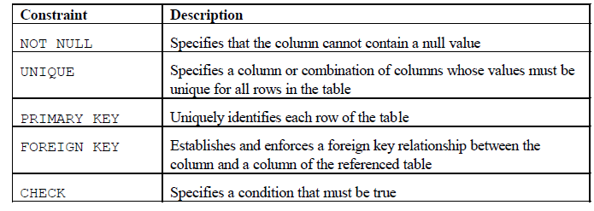
What Are Constraints? (Cont.)
Table 1: Data Integrity Constraint

Slide 5
Constraint Guidelines
Name a constraint or the Oracle server generates a name by using the SYS_Cn format (where n is an integer number so that the constrain names are unique)
Constrain names must follow the standard object naming rules
Create a constraint either:
  – At the same time as the table is created: (at the column or table level).
  – After the table has been created. ”using alter table”
All constrains stores in the data dictionary

Slide 6
Defining constraint
when creating the table
At the column level
At the table level
After creating the table (using Alter table)

Slide 7
Defining Constraints: During Table Creation
Syntax:
CREATE TABLE table
(column datatype [DEFAULT expr][column_constraint],
….
[table_constraint]);
column_constraint: is an integrity constrain as part of the
column definition
table_constraint: is an integrity constrain as part of the
table definition

Slide 8
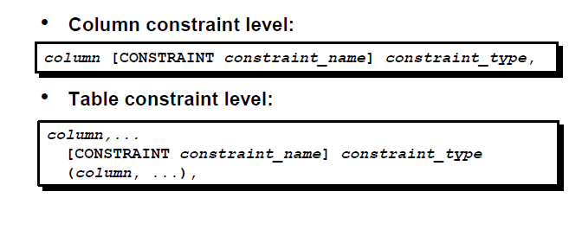
Defining Constraints: During Table Creation

Slide 9
Defining Constraints: During Table Creation
Example1:
CREATE TABLE employees(
employee_id NUMBER(6),
first_name VARCHAR2(20),
job_id VARCHAR2(10) NOT NULL,
CONSTRAINT emp_emp_id_pk PRIMARY KEY (EMPLOYEE_ID));
Column level constraint
System defined nmae
Table level constraint
User defined name
CONSTRAINT: keyword
emp_emp_id_pk : the constraint name
PRIMARY KEY, NOT NULL: constrain type
EMPLOYEE_ID: column name

Slide 10
The NOT NULL Constraint
Ensures that null values are not permitted for the column
Columns without the NOT NULL constraint can contain null values by default.
The NOT NULL constraint can be specified only at the column level, not at the table level.

Slide 11
The NOT NULL Constraint
Example2:
CREATE TABLE employees(
employee_id NUMBER(6),
last_name VARCHAR2(25) NOT NULL,
salary NUMBER(8,2)
);
System named
Note That: last_name column constraint is unnamed, thus the
system will give it a name.

Slide 12
The NOT NULL Constraint
Example2 (Cont.):
SALARY | LAST_NAME | EMPLOYEE_ID
15000 | Al Ghanim | 111111
10258 | Al Mane | 222222
12800 | Bssam | 333333
8450 | Bin Saleh | 444444
allowed
 | Al Ali | 555555
X NOT
Allowed
(Why?)
85642 |  | 666666

Slide 13
The NOT NULL Constraint
Exercise: rewrite the previews query where the NOT NULL constraint
defined on the table level. Is it possible? [Explain]
CREATE TABLE employees(
employee_id NUMBER(6),
last_name VARCHAR2(25),
salary NUMBER(8,2),
hire_date DATE
------------------------------------------------------
);
NOT NULL Constraint can’t be defined on the table level

Slide 14
The UNIQUE Constraint
A UNIQUE key integrity constraint requires that every value in a column or set of columns (key) to be unique
UNIQUE constraints allow the input of nulls unless you also define NOT NULL constraints for the same columns
UNIQUE constraints can be defined at the column or table level. A composite unique key is created by using the table level definition

Slide 15
The UNIQUE Constraint
Example3:
CREATE TABLE employees(
employee_id NUMBER(6),
last_name VARCHAR2(25) NOT NULL,
email VARCHAR2(25),
...
CONSTRAINT emp_email_uk UNIQUE(email));

Slide 16
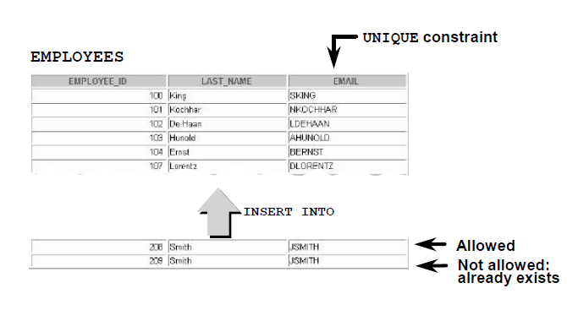
The UNIQUE Constraint
Example3 (Cont.):

Slide 17
The UNIQUE Constraint
Exercise a: rewrite the previews query where the UNIQUE constraint
defined on the column level and give it a name. Is it possible? [Explain]
CREATE TABLE employees(
employee_id NUMBER(6),
last_name VARCHAR2(25) NOT NULL,
email VARCHAR2(25),
);

Slide 18
The UNIQUE Constraint
Exercise b: rewrite the previews query where the UNIQUE constraint
defined on 2 columns ; employee_id and email.
CREATE TABLE employees(
employee_id NUMBER(6),
last_name VARCHAR2(25) NOT NULL,
email VARCHAR2(25),
);

Slide 19
The PRIMARY KEY Constraint
A PRIMARY KEY constraint creates a primary key for the table
The PRIMARY KEY constraint is a column or set of columns that uniquely identifies each row in a table
This constraint enforces uniqueness of the column or column combination and ensures that no column that is part of the primary key can contain a null value
A table can have only one PRIMARY KEY constraint but can have several UNIQUE constraints.
defined at either the table level or the column level

Slide 20
The PRIMARY KEY Constraint
Example 4:
CREATE TABLE departments(
department_id NUMBER(4),
department_name VARCHAR2(30)
CONSTRAINT dept_name_nn NOT NULL,
manager_id NUMBER(6),
CONSTRAINT dept_id_pk PRIMARY KEY(department_id));

Slide 21
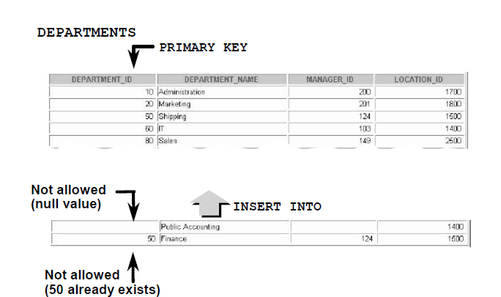
The PRIMARY KEY Constraint
Example4 (Cont.):

Slide 22
The PRIMARY KEY Constraint
Exercise a: rewrite the previews query where the PRIMRY KEY constraint
defined on the column level.
CREATE TABLE departments(
department_id NUMBER(4),
department_name VARCHAR2(30)
CONSTRAINT dept_name_nn NOT NULL,
manager_id NUMBER(6),
));

Slide 23
The PRIMARY KEY Constraint
Exercise b: rewrite the previews query where the PRIMRY KEY constraint
defined on 2 columns ; department_id and dempartment_name.
CREATE TABLE departments(
department_id NUMBER(4),
department_name VARCHAR2(30)
CONSTRAINT dept_name_nn NOT NULL,
manager_id NUMBER(6),
));

Slide 24
The FOREIGN KEY Constraint
The FOREIGN KEY, or referential integrity constraint, designates a column or combination of columns as a foreign key and establishes a relationship between tables
A foreign key value must match an existing value in the parent table or be NULL
Defined at either the table level or the column level
Foreign keys are based on values and purely logical ,not physical, pointers

Slide 25
The FOREIGN KEY Constraint
Example 5:
CREATE TABLE employees(
employee_id NUMBER(6),
last_name VARCHAR2(25) NOT NULL,
department_id NUMBER(4),
CONSTRAINT emp_dept_fk FOREIGN KEY (department_id) REFERENCES departments(department_id),
CONSTRAINT emp_email_uk UNIQUE(email));

Slide 26
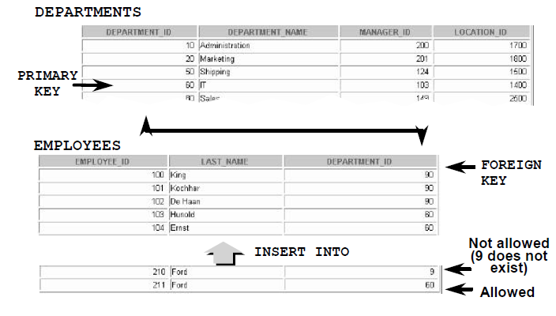
The FOREIGN KEY Constraint
Example 5 (Cont.):

Slide 27
The FOREIGN KEY Constraint
The foreign key can also be defined at the column level, provided the constraint is based on a single column. The syntax differs in that the keywords FOREIGN KEY do not appear. For example:
CREATE TABLE employees
(...
department_id NUMBER(4) CONSTRAINT emp_deptid_fk
REFERENCES departments(department_id),
...)
OR:

Slide 28
FOREIGN KEY Constraint
Keywords
FOREIGN KEY: Defines the column in the child table at the table constraint level
REFERENCES: Identifies the table and column in the parent table

Slide 29
The CHECK Constraint
Defines a condition that each row must satisfy
Example
CREATE TABLE employees
(...
salary NUMBER(8,2) CONSTRAINT emp_salary_min CHECK (salary > 0),
….);

Slide 30
Adding a Constraint Syntax
Use the ALTER TABLE statement to:
  • Add or drop a constraint, but not modify its structure
  • Enable or disable constraints
  • Add a NOT NULL constraint by using the MODIFY clause
ALTER TABLE table
ADD [CONSTRAINT constraintname] type (column);
Note that: You can define a NOT NULL column only if the table is empty or if the column has a value for every row.

Slide 31
Adding a Constraint (Example)
Add a FOREIGN KEY constraint to the EMPLOYEES table to indicate that a department id must already exist as a valid department in the department table.
ALTER TABLE employees
ADD CONSTRAINT emp_dept_fk
FOREIGN KEY(dept_id) REFERENCES department(dept_id);

