Slide 1
Living environment
Lecture 9

Slide 2
Objectives
Define the living environment
Injuries
Susceptible groups
Types of injuries
Prevention

Slide 3
Housing and health
Urban living and time spent indoors – 80 to 90% of time.
Homes, schools, workplace, hospitals.
Housing – place that provides shelter or cover.
Living environment – individual and communal places for living, working and carrying out daily activities.
Health risks related to the living environment:
Injury risks, exposure to environmental contaminants/pollutants.
Contaminated indoor air, toxins, pests, mold/moisture, social environment as a source of stress.
Who is at greater risk?
Elderly, disabled, children, poor.

Slide 4
Housing and health
Housing
Health care facilities
Housing conditions affect health.
Substandard housing – housing that is not fit for living.
Building structure in poor condition.
Pests, mold, toxic compounds.
Injury or death
At greater risk
Infants, elderly, poor – low-income, ethnic minorities, refugees.
Patients specially susceptible to environmental hazards.
Toxic chemicals in health care facilities.
Sterilizing and sanitizing chemicals.
Medications for chemotherapy or specialized tests may be toxic.
Building design and condition can help prevent errors and improve performance by health care workers.

Slide 5
Housing and health
Housing and lifestyle
Housing living conditions affect health.
At greater risk
Infants, elderly, poor – low-income, ethnic minorities, refugees.
Presence or absence of hazards –injury or death.
Substandard housing – housing that is not fit for living.
Building structure and surroundings in poor condition.
Crime rate in the area.
Air quality, ventilation, natural light, noise level.
Cleanliness and absence clutter.
Presence of pests, mold, toxic compounds.
Privacy/crowding.
Lifestyle, personal habits – food, sleep, physical activity.
Moeller DW. Environmental Health. 2005. Third Edition. Harvard University Press

Slide 6
Housing and health
School buildings
Building conditions affect health and academic performance.
Structurally safe.
Ventilation and Air quality – pests, mold, toxic substances.
CO₂, VOCs, dust mites, allergens.
Lighting.
Heating/cooling.
Physical security – entrance and exit doors, emergency exits.
Overcrowding.
Excessive noise.
Working bathrooms.
Play areas – sport and recreational injuries
Cafeteria area.
Safe surroundings, crime-free area.
Moeller DW. Environmental Health. 2005. Third Edition. Harvard University Press

Slide 7
What is an injury?

Slide 8
Injuries
Injuries refer to physical damage to the person’s body, caused by acute exposure to a level of energy that causes harm, or by depriving the body of one of the vital elements (air, water, warmth).
Non-fatal injuries are those that do not result in death.
The time of exposure to the source and the appearance of the injury is usually short.
Mechanical, thermal, electrical, chemical, radiant are sources of energy that can cause injuries.
Car crashes, heat exposure, electric shock are forms of injuries.

Slide 9
Injuries
Cut, pierce, stab – sharp instruments, tools, knives, furniture, weapons.
Inhalation, ingestion, suffocation – objects blocking the airways.
Natural, environmental – heat/cold extremes, lightning, sunstroke, natural disasters.
Poisoning – ingestion, inhalation, skin absorption, injection/drug overdose.
Struck by/against or crushed – by a person, animal or object.
Transportation-related – car accidents.

Slide 10
Injuries
Unintentional injuries can result in harm or death.
Most unintentional injuries are preventable.
Accidents on the other hand are random events that cannot be anticipated.
Can lead to harm or death.
Traffic, workplace, home, outdoors.
Preventive safety measures can reduce the incidence of unintentional injuries.
Example – laws requiring seat belts and air bags in cars and reduction in driver and passenger deaths in car crashes (accidents).
Laws against drinking and driving.
Laws against speeding.

Slide 11
Injuries
Factors that increase the risk of injuries in the living environment
Unsafe housing environment – poisoning, fires, falls, electric shock, drowning.
Lack of public infrastructure – sidewalks, paved streets, pedestrian zones, poor public transportation system facilities.
Unsafe social conditions – homicides, aggression, violence.
The implications of the injuries can affect the health system and the individual’s life.
Financial cost to the individual and to the government.
Health care and Rehabilitation services.
Social support system.
Permanent disability and loss of independence.
Chronic pain.
Stress – person and family members.

Slide 12
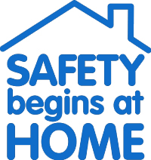
Indoor injury risk factors
The elderly, children and those with physical limitations and increased risk of injuries.
Electrical outlets in poor condition or within children’s reach.
Stoves with no security features – fires, CO poisoning.
Freezers with no locks.
Space heaters close to furniture.
Falls – especially in homes.
Stairs with no handrails – elderly and children at risk.
Cluttered stairways and exits.
Slippery floors – bathrooms.
Windows in upper floors with no safety guards.
Uneven surfaces – hard floors, carpeting.
Tripping hazards – electrical cords.

Slide 13
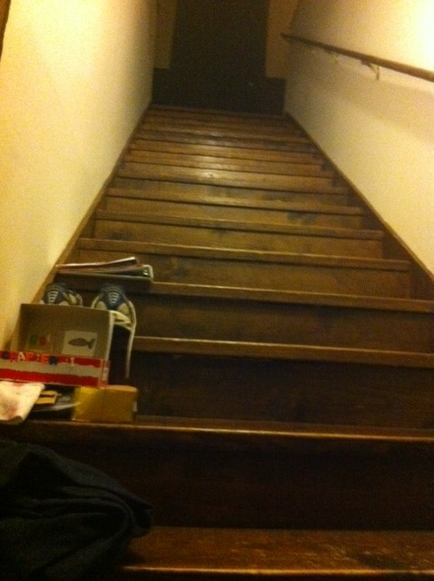

Slide 14
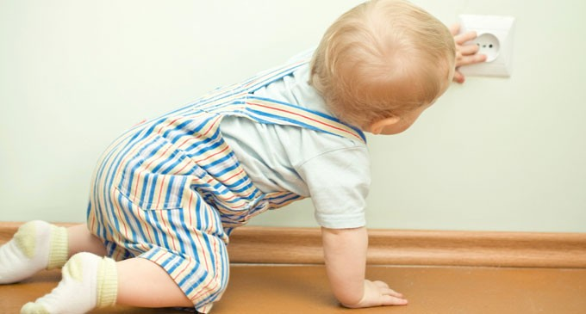
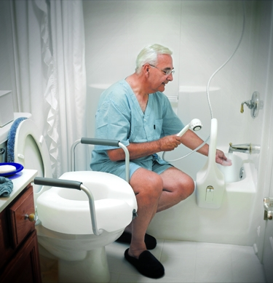
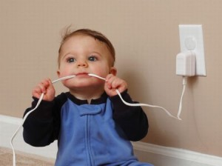
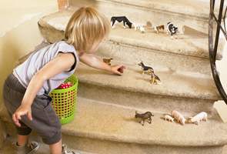

Slide 16
Indoor health risks
Adequate lighting – comfort and safety.
Avoid falls and injuries.
Find emergency exits.
Use of daylight in buildings – improve health and performance; reduces energy costs.
Excessive bright light –Headaches.
Dim light – eye strain.
Flickering – headaches and discomfort.
Lighting
Even source of light.
Natural daylight or electric light.
Good lighting promotes health, well-being and improves academic performance.
Hospitals – ICU patients recover faster in rooms with windows.
Office workers in rooms with windows – better health and job satisfaction.

Slide 17
Indoor health risks
Pests
Insects and rodents
Cockroach allergy and asthma in children.
Flies and foodborne pathogens – salmonella.
Rodents
Vectors for viruses, rabies, plague.
May damage electrical cables and cause fires.
Prevention
Pesticide use, cleanliness and proper disposal of waste.
Window screens, mosquito nets, cover or eliminate sources of standing water.
Keep living areas clean of clutter and trash.
Proper garbage disposal.

Slide 18
Indoor health risks
Household cleaners
Tobacco smoke
Chronic exposure.
Blood and liver toxicity, skin and eye irritation, possible carcinogens.
Find substitute cleaners.
Regular soap and water, vinegar.
Sick building syndrome – usually related to chemical exposure.
Cause?
Increased risk of cancer, cardiovascular disease (CVD), asthma and respiratory diseases.
Second-hand smoke and health problems in both adults and children, including lung cancer, asthma, heart disease, colds, ear infections, and pneumonia.

Slide 19
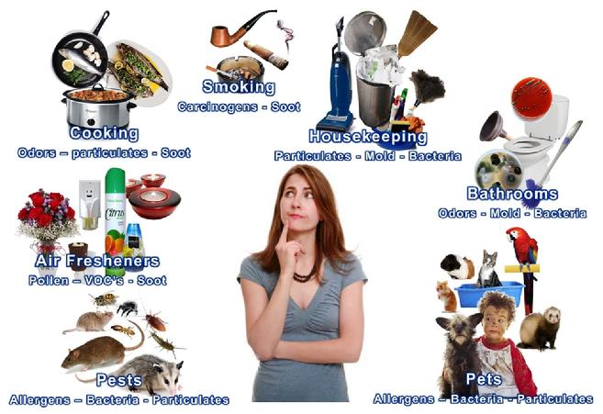
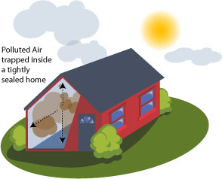
Indoor health risks

Slide 20
Indoor health risks
Crowding
Feeling of inability to control interactions with surrounding people.
Interference with activities such as reading, conversing, or studying.
Loss of privacy.
Overstimulation.
Increased psychological distress and dysfunction.
Effect on mental health
Increased aggressivity.
Crowded schools affect children and instructors.
Children most affected.
Behavioral and learning problems in school.
College students in crowded dorms and lower academic performance.

Slide 21
Other health risks
Other factors affecting mental health
Neighborhood surroundings
Surrounding areas and houses.
Access to services and parks.
Paved streets.
Sidewalks.
Municipal sewage.
Trash pickup services.
Cleanliness/clutter.
Presence or absence of hazards.
Building structural quality.
Recreational and open areas.

Slide 22
Reducing indoor injury risks
Timely home repairs and maintenance.
Consider the people who use the building/house – elderly, children.
Install handrails in stairs, non-slippery mats and guard rails in bathrooms.
Store medications and cleaning chemicals safely.
Secure access to swimming pools.
Do not smoke in bed.
Have emergency exit plan and clear exits in case of fire.
Install smoke and CO alarms.
Install safety guards in stoves.
Maintain gas appliances to reduce risk of CO poisoning.
In school and commercial buildings fire drills are essential.

Slide 23

Injuries affecting the elderly
Falls are the leading cause of injury-related visits to emergency room and the primary cause of accidental deaths in persons older than 65 years.
Falls can be markers of poor health and declining function, and they are often associated with significant morbidity.
More than 90 percent of hip fractures occur as a result of falls, with most of these fractures occurring in persons over 70 years of age.
The mortality rate for falls increases dramatically with age in both sexes, accounting for 70 percent of accidental deaths in persons 75 years of age and older.
Fuller, G.F. Falls in the elderly. American Family Physician. http://www.aafp.org/afp/2000/0401/p2159.html

Slide 24
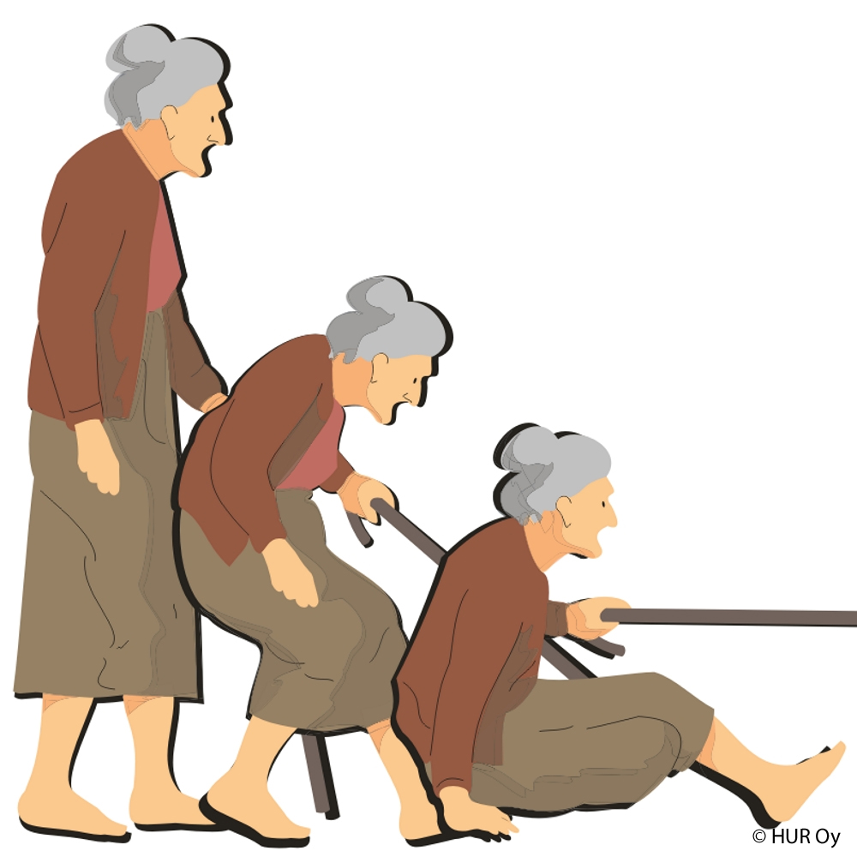
Injuries affecting the elderly
One fourth of elderly persons who sustain a hip fracture die within six months of the injury.
Hip fracture survivors experience a 10 to 15 percent decrease in life expectancy and a meaningful decline in overall quality of life.
The psychologic impact of a fall or near fall often results in a fear of falling and increasing self-restriction of activities.
The fear of future falls often leads to dependence and increasing immobility, followed by functional deficits and a greater risk of falling.

Slide 25
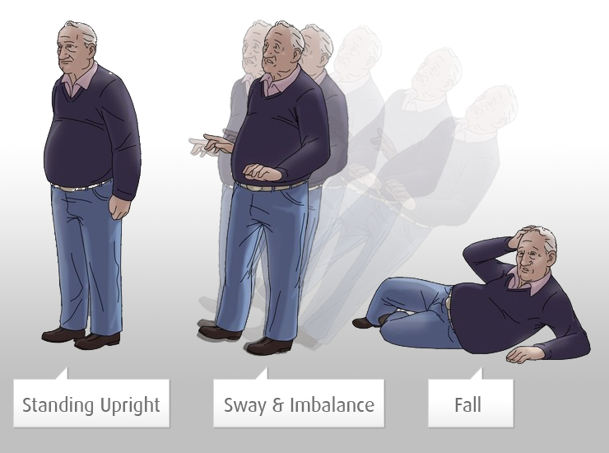
Injuries affecting the elderly – Risk factors
Socio-demographic
Increased age
History of falls
Female
Living alone – lack of supervision
Impaired functions
Poor eyesight
Hearing/ear problems
Tremors, pain, dizziness, vertigo, paralysis, disorientation, impaired judgement.
Gait changes (deviation from normal walking) and reduced balance
Standing, shifting positions
Bending/reaching forward, trying to stand up.

Slide 26
Injuries affecting the elderly – Risk factors
Acute and chronic conditions
Neurological conditions that affect balance
MS, Parkinson’s, Alzheimer’s, stroke, dementia, depression, arthritis, osteoporosis.
Medications side effects
Sedation, slowed reaction time, confusion, dizziness.
Psychological
Increased fear of falls
Risk-taking behavior
Personal
Clothing – shoes, clothes that do not fit well
Lack of exercise
Poor nutrition
Not taking recommended medications

Slide 27
Injuries affecting the elderly – Risk factors
Environmental
Small children, pets
Insufficient lighting
Tripping hazards
Wires on the ground, loose rugs
Clutter
Slippery floors
Furniture design and placement
Inadequate placing of items
Too high or too low – increased risk of falls
Inadequate/faulty equipment
Walking aids, wheel chairs

Slide 28
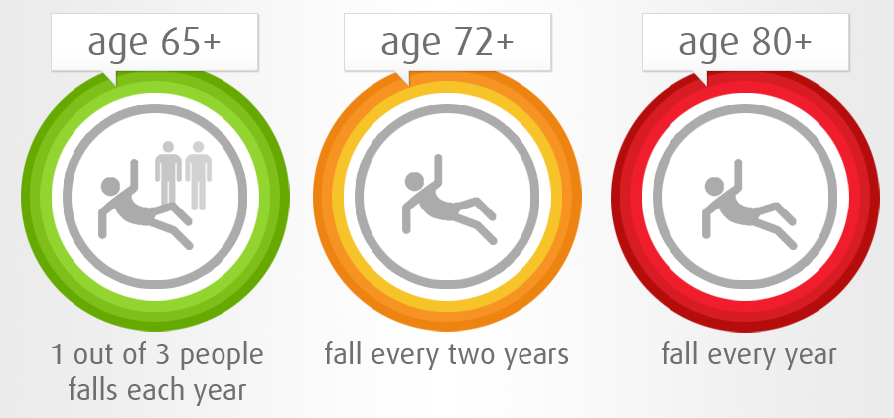
Injuries affecting the elderly - KSA
The three main factors that affect and older persons’ likelihood of falling:
Number of medications taken per day
Sedentary lifestyle
Use of assistive walking devices
The greater the number of risk factors to which an individual is exposed, the greater the probability of a fall.
AlSaif, A., Waly E. and Alsenany S. The Prediction of Falls Among older people in Saudi Arabia. Journal of American Science. 2012;8(6)
http://www.americanscience.org

Slide 29
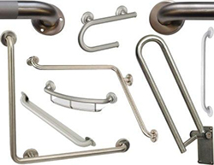
Preventing injuries in the elderly
Need assistance and supervision.
Feeding, bathing, taking medication.
Home environment.
Natural and adequate lighting.
Easy access – entry ways, and furniture placement.
Even walking surfaces.
Slip-resistant surfaces.
Handrails on both sides of the stairs.
Grab bars in bathrooms.
Eliminate tripping hazards.
Extension cords, rugs, furniture, decorations.
Moeller DW. Environmental Health. 2005. Third Edition. Harvard University Press

Slide 30
Road traffic accidents (RTAs)
RTAs as a leading cause of all trauma admissions in hospitals worldwide.
~ 3/4 of overall road deaths occur in developing countries.
Road traffic fatality in the Kingdom of Saudi Arabia (KSA) accounts for 4.7% of all mortalities, compared to 1.7% in Australia, UK, or USA.
The WHO has identified 5 Road Safety Pillars:
Road safety management policy
Road infrastructure (*)
Safe vehicles (*)
Road users’ safe behavior (*)
Post-crash care
First responders handling the injured, hospital trauma care, rehabilitation.
(*)Most common causes of RTAs.

Slide 31
Road traffic accidents (RTAs)
In KSA
Number of deaths from RTAs accident to death ratio is 32:1 versus 283:1 in USA.
Road injuries have an accident to injury ratio of 8:6, compared with the international ratio of 8:1.
RTAs are considered to be the country’s main cause of death for 16-30-year-old males.
RTA among males ~30X higher than deaths due to RTA among females.
Preventive measures in KSA:
Laws on seat belt put into practice.
Fully operational speed camera systems in large cities under the control of police departments.
Police department record keeping of road mortalities and collisions.
The reporting system shows a rise in the magnitude of the problem over the years.
Mansuri et al. doi: 10.15537/smj.2015.4.10003

Slide 32
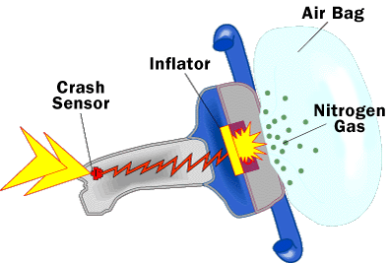
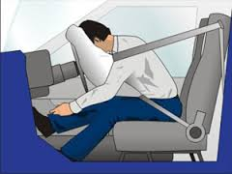
Air bags and seat belts
Airbags are only safe if seatbelts are worn.
Frontal airbags are placed in the dashboard
They can cushion the impact of a crash, reducing the risk of serious injury.
But they can cause injury or even death if not used properly.
Airbags deploy at speeds as high as 200 miles per hour.
Air bag safety requires riders:
To be properly seated - upright and both feet on the ground.
To wear their seat belts - both the lap belt and shoulder belt should be firmly and properly in place.
Frontal airbags are not designed for youngsters.
People shorter than 1.45m and weighing less than 35 kg should not ride in the front seat.

Slide 33
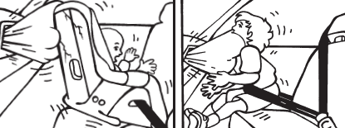
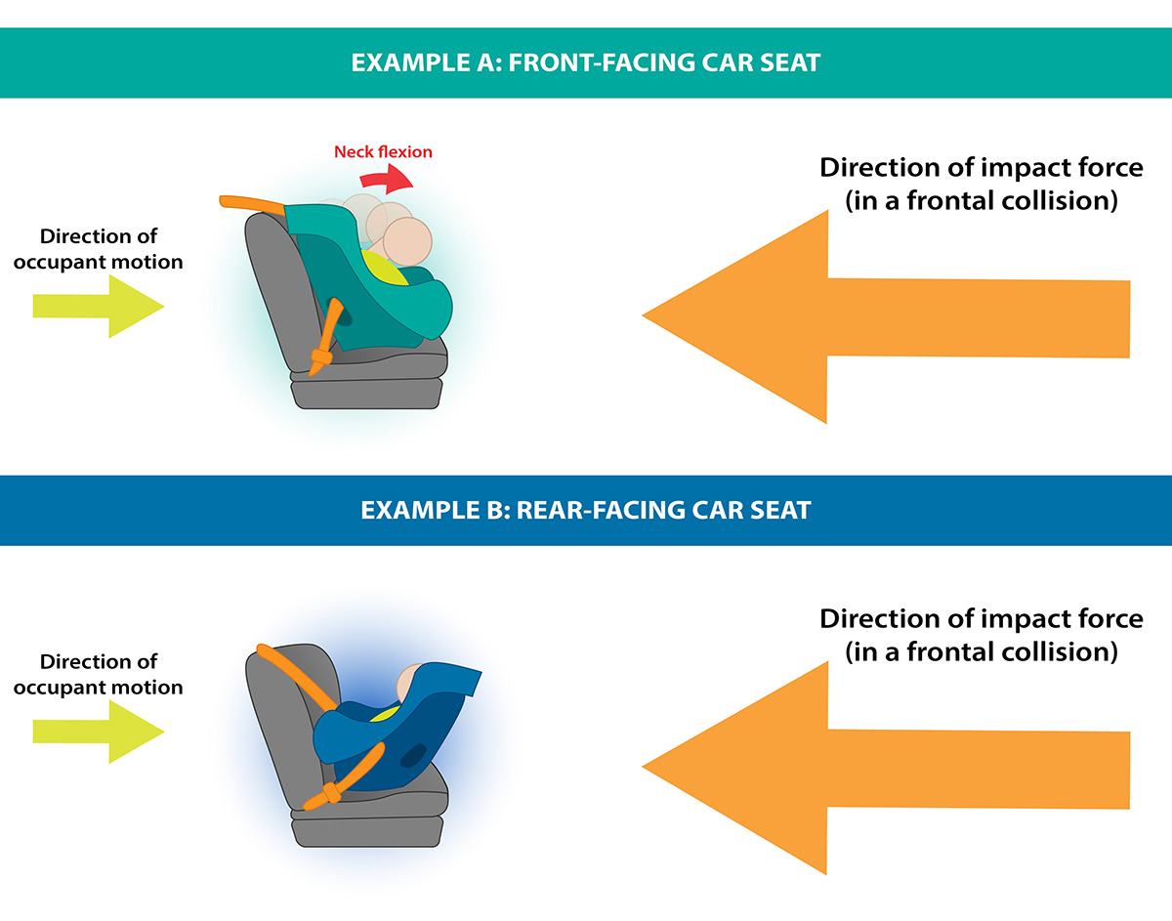
Child safety on the road
The first rule for safe frontal airbags is that they are not designed for youngsters.
Frontal airbags can be dangerous or even fatal to:
Any child or person under 1.45 m/35 kg – usually children under 12 years.
Infants or babies in backward-facing child seats.
Small children in forward-facing child seats.
Older children belted only by the waist-belt, but not the shoulder belt.

Slide 34
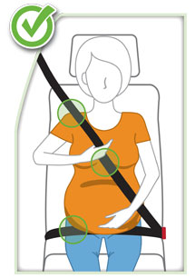
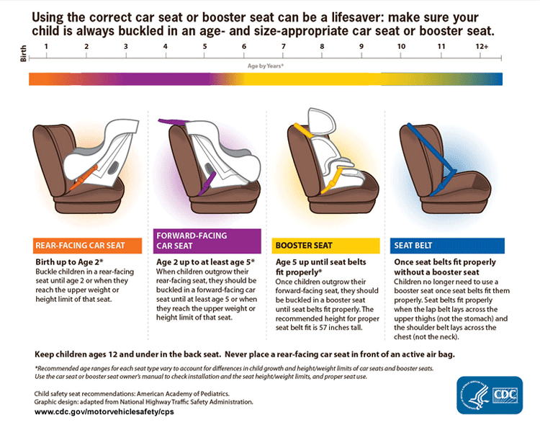
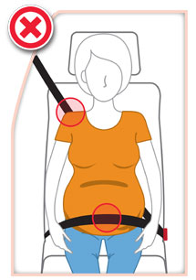

Slide 35
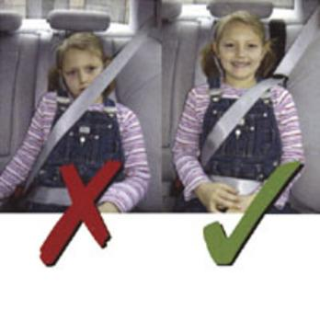
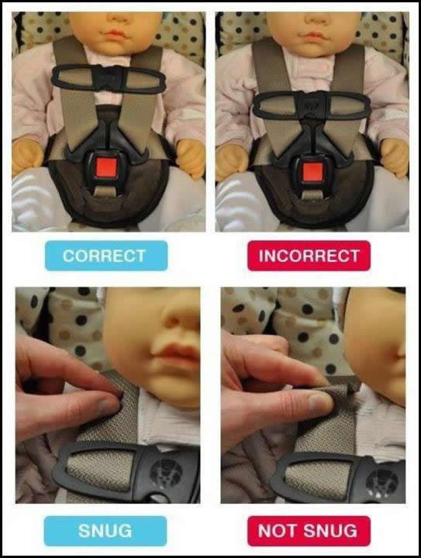
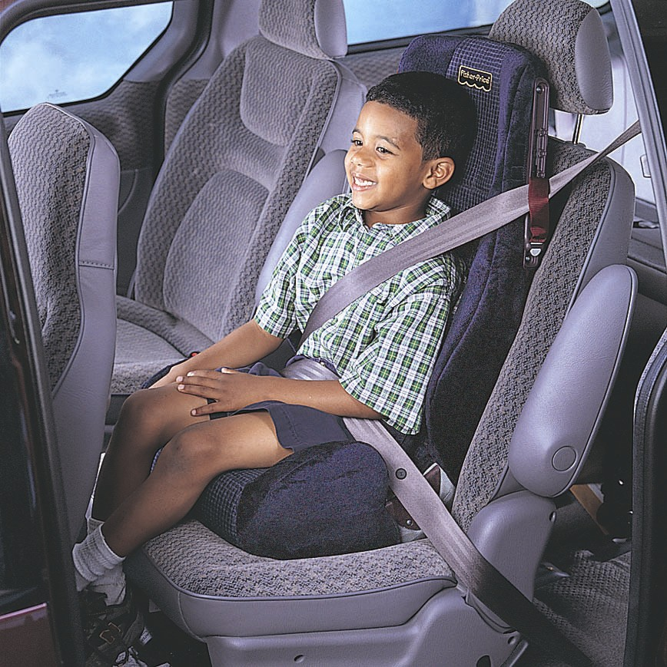

Slide 36
Questions????????

Slide 37
References
Friis, R.H. Essentials of Environmental Health. Second Edition. 2012. Jones & Barlett Learning.
Frumkin H. Environmental Health: From Global to Local. Second Edition. 2010. Jossey-Bass. John Wiley and Sons, Inc.
Fuller, G.F. Falls in the elderly. Am Fam Physician. 2000 Apr 1;61(7):2159-2168. http://www.aafp.org/afp/2000/0401/p2159.html
Moeller DW. Environmental Health. 2005. Third Edition. Harvard University Press
Mansuri, F.A., Al-Zabani, A.H., Zalat,M.M. and Qabshawi, R.I. Road safety and road traffic accidents in Saudi Arabia: A systematic review of existing evidence. Saudi Med J. 2015; 36(4): 418–424. doi: 10.15537/smj.2015.4.10003
NINDS Shaken Baby Syndrome Information Page http://www.ninds.nih.gov/disorders/shakenbaby/shakenbaby.htm

