Slide 1
LIPASE ASSAY
(USING TURBIDIMETRIC METHOD)

Slide 2
LIPASE
ACTIVITY
❖ Objective:
- To determine Lipase activity.

Slide 3
❖ INTRODUCTION:
Lipase is defined as a group of enzymes which hydrolyze the glycerol; esters of long chain fatty acids so it can be easily absorbed.
Lipase is produced by the pancreas, liver, intestine, tongue, stomach, and many other cells.
Lipase is produced by the pancreas in large quantity and secrete them into the small intestine.
- Lipase testing is indicated in acute pancreatitis and pancreatic cyst.
- The measurement of lipase activity in serum and other fluids evaluate the conditions associated with pancreas.

Slide 4
- Serum lipase concentration:
- Lipase concentrations is increased with pancreatic duct obstruction, pancreatic cancer, and other pancreatic disease as well as with gallbladder inflammation.
Lipase concentrations are increased in pancreatitis up to 3 times normal.
- The common bile duct and the pancreatic duct join together to transport digestive enzymes and bile to the small intestine.
-A gallstone in the common bile duct can cause back pressure in the pancreatic duct leading to pancreatitis.
- Therefore, acute pancreatitis elevates blood lipase levels.

Slide 5
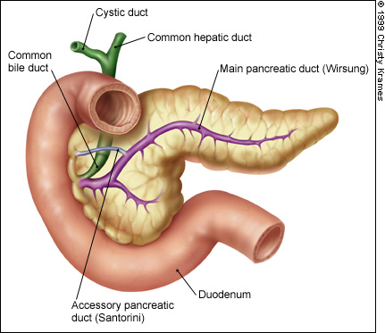

Slide 6
- A low level of lipase in the blood may indicate permanent damage to the lipase-producing cells in the pancreas and this can occur in chronic diseases that affect the pancreas such as cystic fibrosis.
- Symptoms of pancreatitis may include:
Severe abdominal pain
Back pain
Fever
Nausea
Vomiting
Loss of appetite

Slide 7
- Principle:
- Serum lipase hydrolyzes the olive oil emulsion.
- The decrease in turbidity at 400 nm ( after incubation( is proportional to lipase activity in the specimen.

Slide 8
SPECIMEN COLLECTION STORAGE
- Use fresh serum specimens.
- Hemolyzed specimens should not be used.
- Lipase activity in serum is stable at room temperature for one week and may be stored for three weeks in the refrigerator (4-8°C) and for several months if frozen.
- Caution!
- Bacterial contamination of the specimens may result in an
increase in lipase activity.

Slide 9
- Normal range:
- In adults: 10-150 U/L
- In old individuals (more than 60 years): 18-180 U/L

Slide 10
- METHOD:
- Two test tubes:
Blank | Test
3 ml | 3 ml | Lipzyme reagent buffer
Pre-incubate for 5 min. at 37 ֯ C
--- | 0.1 ml | Serum
Read the absorbance (A◦) immediately at 400 nm.
Then transfer to water bath pre-incubate for 5 min. at 37 ֯C .
Then read the absorbance (A₁) at 400 nm against distilled water.

Slide 11
- CALCULATIONS:
- Example:
A₁ TEST = 0.454 A ◦ TEST = 0.464
A₁ Blank = 0.334 A ◦ Blank= 0.332
Normal
- Note:
- Reagent blank: if (A◦ – A₁) is a negative value, it should be considered as zero. However, it should normally be between 0.000 and 0.005.

Slide 12
Thank
you

