Slide 1
Life Table

Slide 2
Outline:
What is a life table
What does a life table look like
Calculations in a life table
Life expectancy

Slide 3
A life table is a table which shows, for a person at each age, what the probability is that they die before their next birthday
A number of statistics can be derived and be included in the table as:
The probability of surviving any particular year of age.

Slide 4
The remaining life expectancy for people at different ages
The proportion of the original birth cohort still alive
Life tables are also used in biology

Slide 5
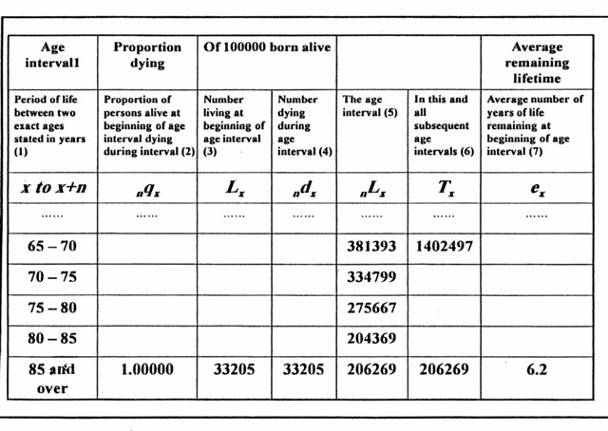
Average number alive between age interval

Slide 6
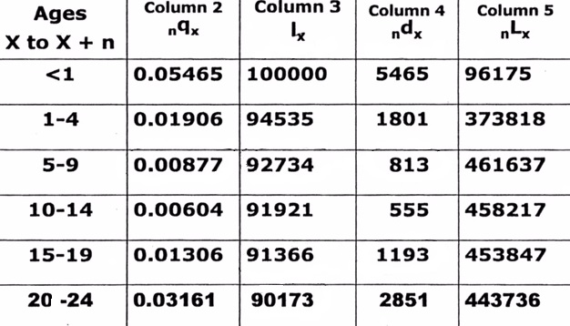
What does a life table look like?

Slide 7
First four columns of the life table:
Life table variables :
Age interval (e.g. 1year, 1-4 years, etc.)
( nqₓ ) the percent of dying between ages x and age x+n
( lₓ) Number of alive at an exact age x
n dₓ Number of deaths between ages x and x+n

Slide 8
How to calculate ndₓ :
How to calculate number of deaths ndₓ between exact ages x to x+n
This is column 4
We multiply column 2 by column 3 to obtain column 4, that is:

Slide 9
( column 4) =
nqₓ (Column 2) x lₓ (Column 3)
This is multiplying:
(lₓ), number alive at the start of age interval by
The proportion of dying in that interval (nqₓ )

Slide 10
Example: How to calculate ndₓ
Ages X to X + n | Column 2 nqₓ | Column 3 Iₓ | Column 4 ndₓ | Column 5 nLₓ
5-9 | .00877 | 92734 | 813 | 461637
₅q₅
I₅
₅d₅
.00877 x 92,734 =
813

Slide 11
Example:
ndₓ = ( Iₓ ) x (nqₓ )
nd₅ =( l₅ ) x (₅q₅ )
I₅ = 92,734
₅q₅ = .00877
₅d₅ = .00877 x 92,734 = 813

Slide 12
The number dying in an age interval can also be expressed as the difference between two adjacent lₓ values. That is:
ndₓ = lₓ - lₓ₊₅
₅d₅ = l₅ - l₁₀

Slide 13
Ages X to X + n | Column 2 nqₓ | Column 3 lₓ | Column 4 ndₓ | Column 5 nLₓ
5-9 | .00877 | 92734 | 813 | 461637
10- 14 | .00604 | 91921 | 555 | 458217
l₅= 92,734
l₁₀ = 91, 921
₅d₅ = l₅ - l₁₀ = 92,734 - 91, 921 = 813

Slide 14
Ages X to X + n | Column 2 nqₓ | Column 3 lₓ | Column 4 ndₓ | Column 5 nLₓ
15-19 | .01306 | 91366 | 1193 | 453847
20-24 | .03161 | 90173 | 2851 | 443736
I ₁₅= 91366
I ₂₀ = 90173
₅d₁₅ = I₁₅ - I ₂₀ = 91366 - 90173 = 1193

Slide 15
5. nLₓ
Average number alive between exact ages x to x + n
Can be calculated as the:
Average of the lₓ values at the start (lₓ) and end of the interval (lₓ₊n)
nLₓ = $\frac{n}{2}$ (lₓ + lₓ₊₅)

Slide 16
Ages X to X + n | Column 2 nqₓ | Column 3 Iₓ | Column 4 ndₓ | Column 5 nLₓ
10-14 | 0.00604 | 91921 | 555 | 458217
15-19 | .01306 | 91366 | 1193 | 453847
20-24 | .03161 | 90173 | 2851 | 443736
l₁₅= 91366
l₂₀ = 90173
₅L₁₅ = $\frac{5}{2}$ (I₁₅ + I₂₀)

Slide 17
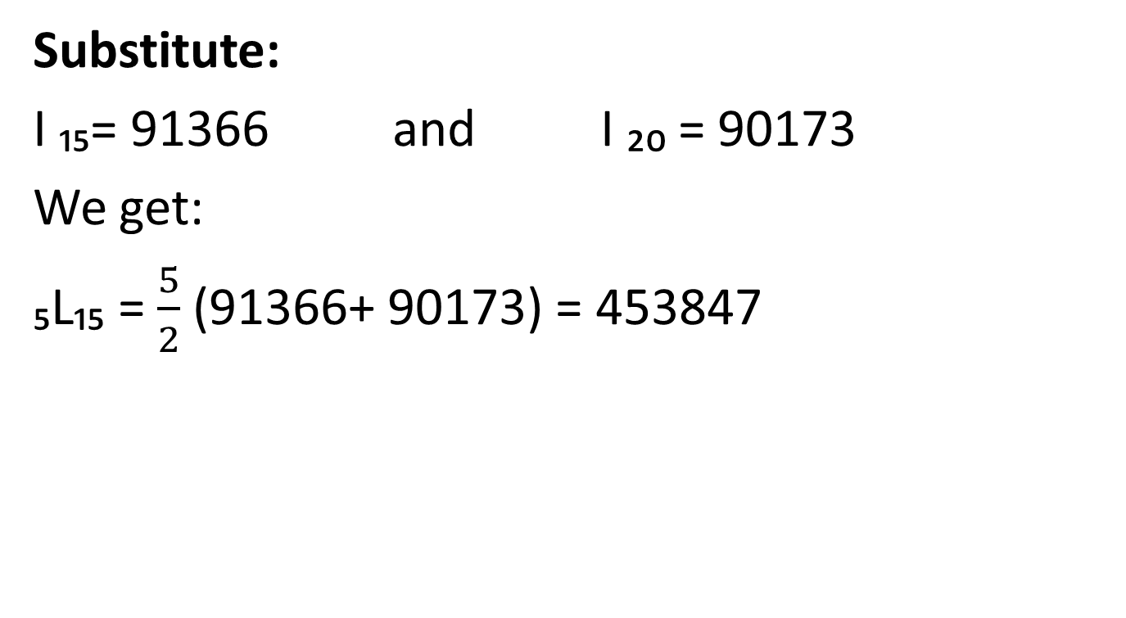
Substitute:
I ₁₅= 91366 and I ₂₀ = 90173
We get:
₅L₁₅ = $\frac{5}{2}$ (91366+ 90173) = 453847

Slide 18
Total population aged x and over (Tₓ)
Obtained from the nLₓ values.
Defined as the total population aged x years and over.

Slide 19
T₆₅= L₆₅ + L₇₀ + L₇₅ + …………..
T₇₀= L₇₀ + L₇₅ + L₈₀+ ………….
T₆₅= 381393 + 334799 + 275667 + 204369 + 206269 = 1402497

Slide 20
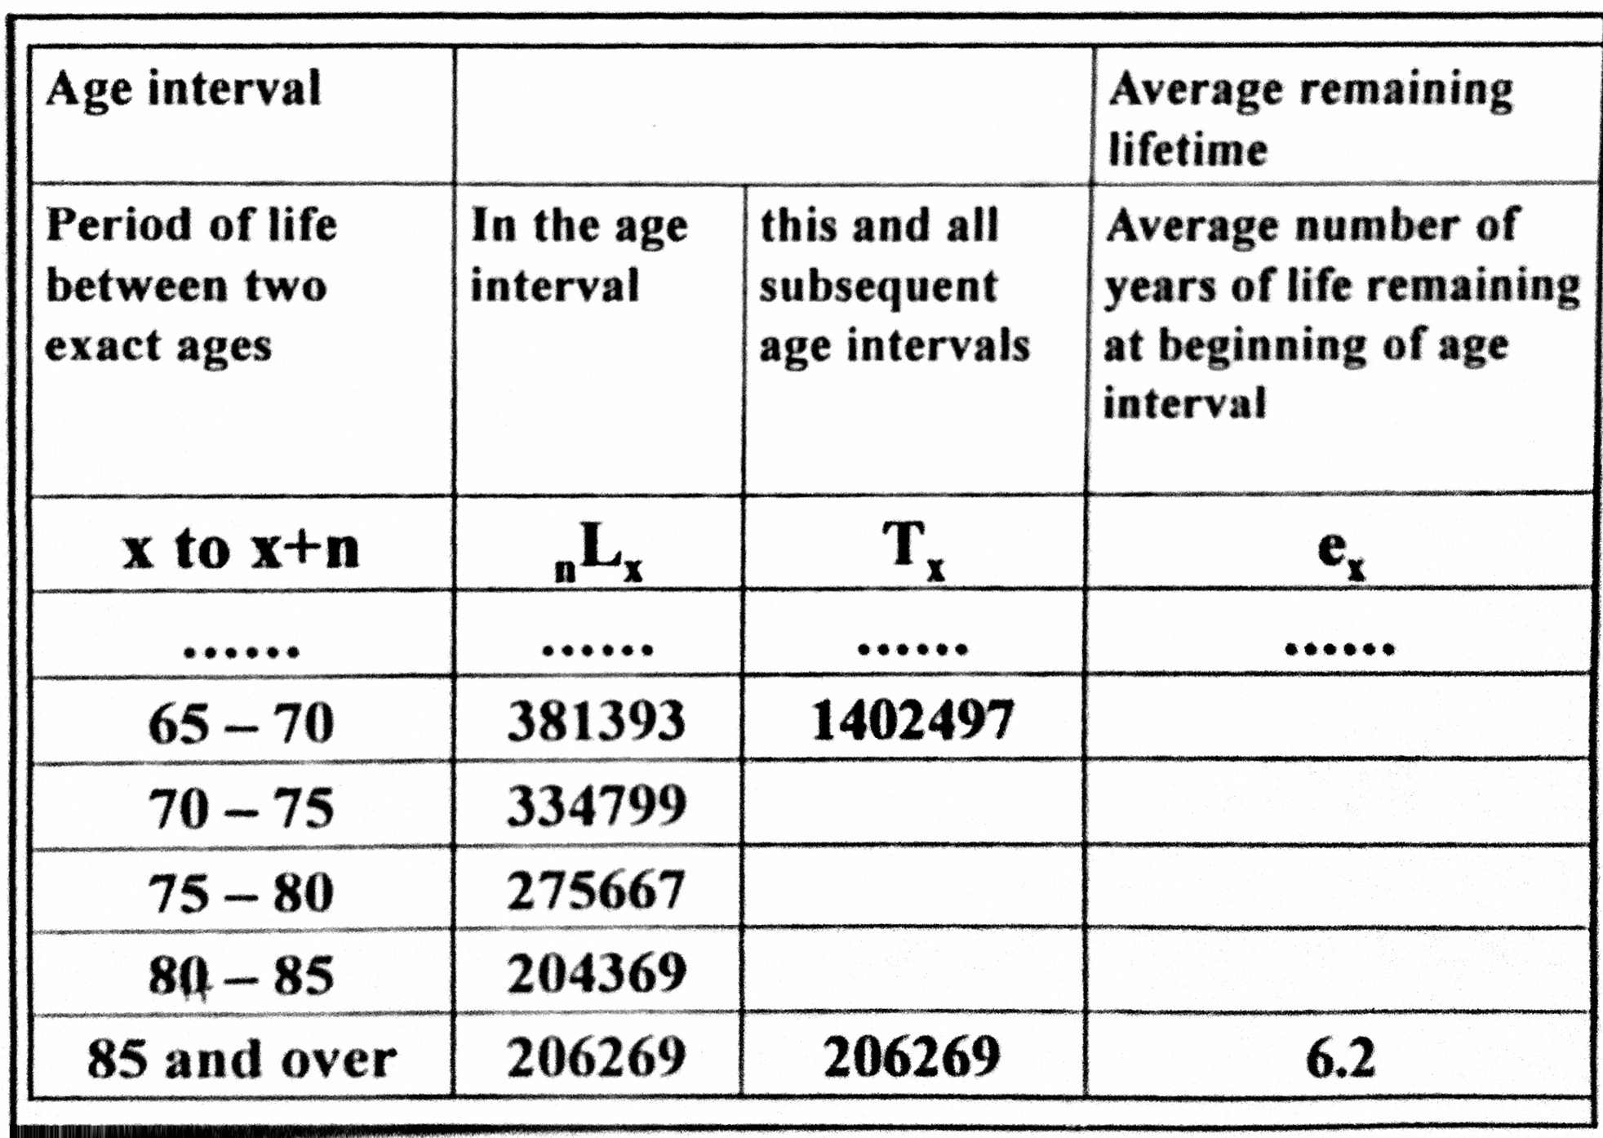

Slide 21
What is L₀?
We noted that of those who die aged 0, the average age at death is usually much less than 6 months.
A better approximation to reality, but still simple, for the first year of life is:
L₀= .3l₀ + .7I₁ i.e.
L₀= I₁ + .3 ( I₀ - I₁)
Note that this counts 0.3 of a year for each child that dies aged 0.

Slide 22
What is life expectancy?
Life expectancy at birth in KSA is now 76.3 years.
This means that a baby born now will live 76.3 years if the baby experiences the same age-specific mortality rates as are currently operating in KSA

Slide 23
How to calculate life expectancy ( eₓ)
The life table function eₓ refers to life expectancy from an exact age x.
For example, e₃₀ is the life expectancy at exact age 30, or the average number of years lived from the 30th birthday

Slide 24
Equation for eₓ=
Total person-years of life lived after exact age x ( Tₓ) Divided by the total persons alive at the exact age x ( lₓ)
This represents the number if years lived by people aged x:
eₓ= Tₓ / Lₓ

Slide 25
Ages X to X + n | Column 2 Iₓ | Column 3 Tₓ | Column 4 eₓ
60-64 | 90547 | 1989624 | 21.97
65-69 | 86208 | 1547738 | 17.95
70-74 | 79646 | 1133102 | 14.23
I₆₅= 86208
T₆₅= 1547738
e₆₅= 1547738 / 86208 = 17.95

Slide 26
Example1:
Find e₆₅ the life expectancy at the exact age 65:
e₆₅ = T₆₅ / I ₆₅
e₆₅= 1547738 / 86208 = 17.95

Slide 27
Ages X to X + n | Column 2 Iₓ | Column 3 Tₓ | Column 4 eₓ
60-64 | 90547 | 1989624 | 21.97
65-69 | 86208 | 1547738 | 17.95
70-74 | 79646 | 1133102 | 14.23
I₇₀= 79646
T₇₀=1133102
e₇₀= 1133102 / 79646 = 14.23

Slide 28
Example:
Find e₇₀ the life expectancy at the exact age 70:
e ₇₀ = T ₇₀ / I ₇₀
e₇₀= 1133102 / 79646 = 14.23

