Slide 1
Hand Washing
is most effective way to control infection
Hand Hygiene
a general term that applies to routine hand washing, antiseptic hand wash, antiseptic hand rub, or surgical hand antisepsis.

Slide 2
different types of Hand `Hygiene`
• Routine Hand wash
• Antiseptic Hand wash
• Antiseptic Hand rub
• Surgical Antisepsis {Removal/destroying up of `Bacterial Infection`}

Slide 3
Indications for hand hygiene
• Before and after treating each patient (e.g., before glove placement and after glove removal).
• After barehanded touching of inanimate objects likely to be contaminated by blood, saliva, or respiratory secretions.
• When hands are visibly soiled.
• Before re-gloving, after removing gloves that are torn, cut, or punctured.

Slide 4
Purposes of hand washing :
1- To reduce the number of micro-organism on the hands .
2- To reduce the risk of transmission of microorganisms to oneself and the clients.
3- To reduce the risk of cross contamination among clients .

Slide 5
Preparation :
1-Nails should be kept short .
2-Remove jewelry .
3- Check hands for breaks in the skin

Slide 6
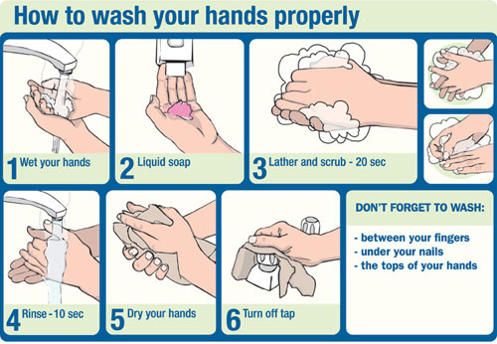
Performance of the procedure

Slide 7
Reference:
Craven & Hirnle. Fundamentals of Nursing Human Health and function

