Slide 1
EE 201 Review

Slide 2
Summary - CH 2 and CH 4
I = Q/t
V = W/Q
Number of electrons = Q/($1.6x{10}^{−19}$)
P = W/t
$P_{loss}=P_{input}−P_{output}$
Efficiency =$\frac{P_{output}}{P_{input}} ×100$
$I=V/R$
$P=V I=I^{2}R=\frac{V^{2}}{R}$
I = voltage in Amperes (A)
Q = charge in Coulomb (C)
t = time in second (s)
V = voltage in Volts (V)
W = work or energy in Joules (J)
P = power in Watts (W)
R = Resistance in ohm
Batteries:

Slide 3
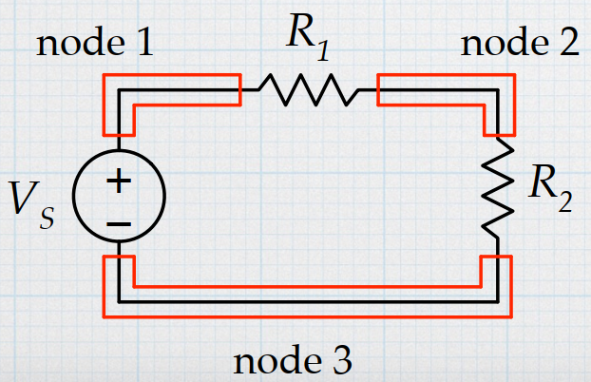
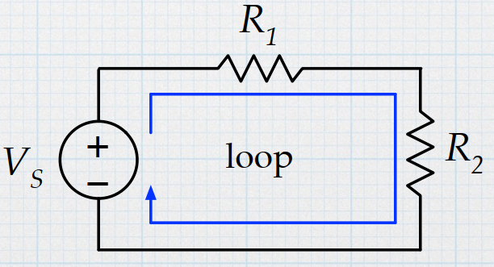
Circuit
The points connected by wires (nodes) have the same voltage
Elements in series have the same current
A broken path (open circuit) has no current.
http://tuttle.merc.iastate.edu/ee201/topics/fundamentals/kirchoff.pdf

Slide 4
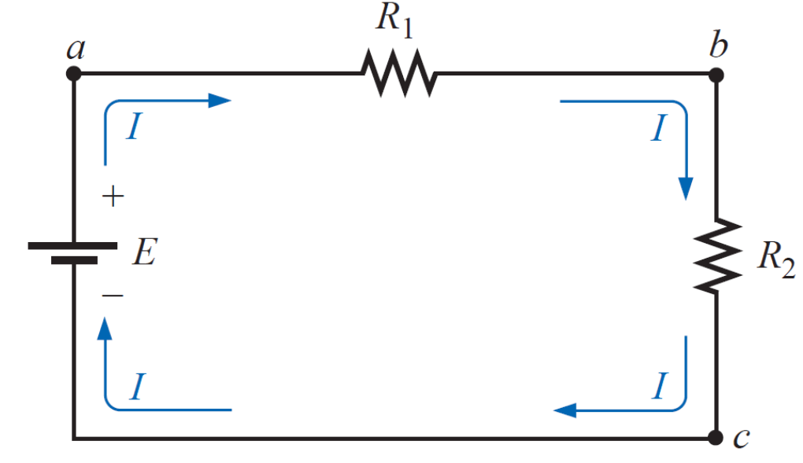
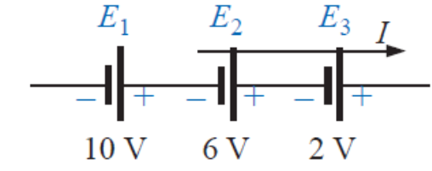
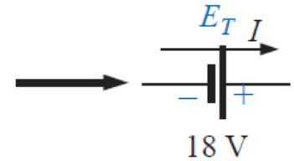
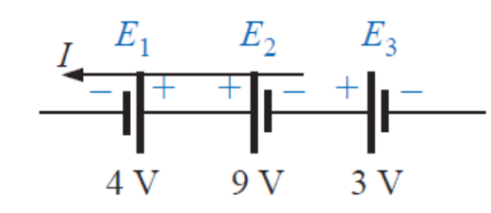
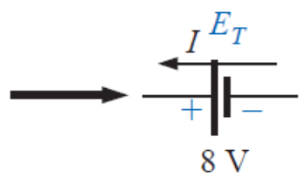
Series Circuit
Two resistances are in series if they have the same current and have a single common node
If $R_{1}$ and $R_{2}$ are in series, then $R_{T}=R_{1}+R_{2}$
Voltage sources can be added if they are in series

Slide 5
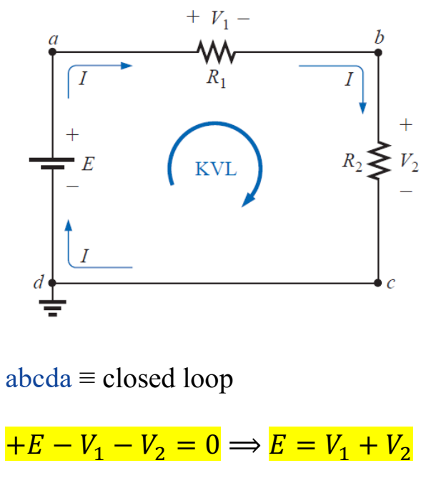
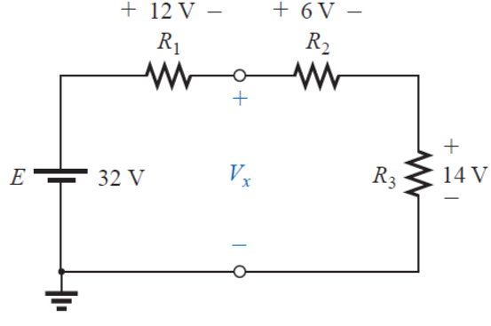
Kirchhoff’s voltage law
Sum of the voltages in a closed loop or path is equal to 0
$∑V=0$

Slide 6
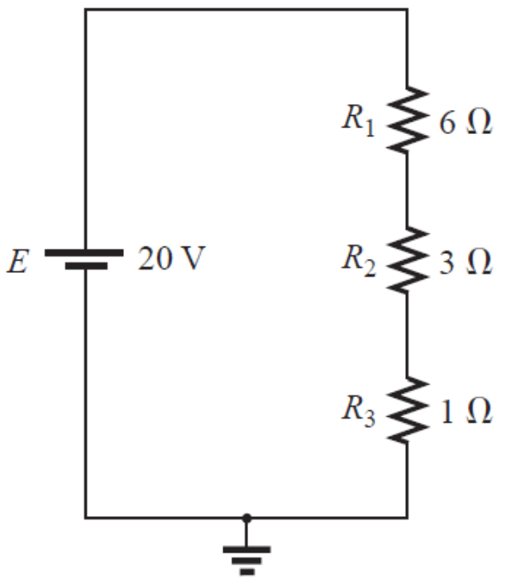
Voltage divider rule
The voltage is divided between resistors which are connected in series in direct proportion to their resistance
Find the voltage on $R_{1}, R_{2}$ and $R_{3}$
$I_{R_{1},R_{2},R_{3}}=\frac{E}{R_{1}+R_{2}+R_{3}}$
$V_{R_{1}}=$ $I_{R_{1} }×R_{1}=\frac{E}{R_{1}+R_{2}+R_{3}}×R_{1}$
$V_{R_{2}}=$ $I_{R_{2} }×R_{2}=\frac{E}{R_{1}+R_{2}+R_{3}}×R_{2}$
$V_{R_{3}}=$ $I_{R_{3} }×R_{3}=\frac{E}{R_{1}+R_{2}+R_{3}}×R_{3}$

Slide 7
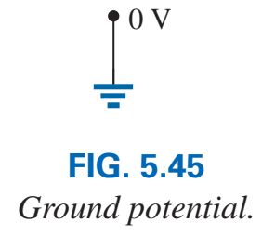
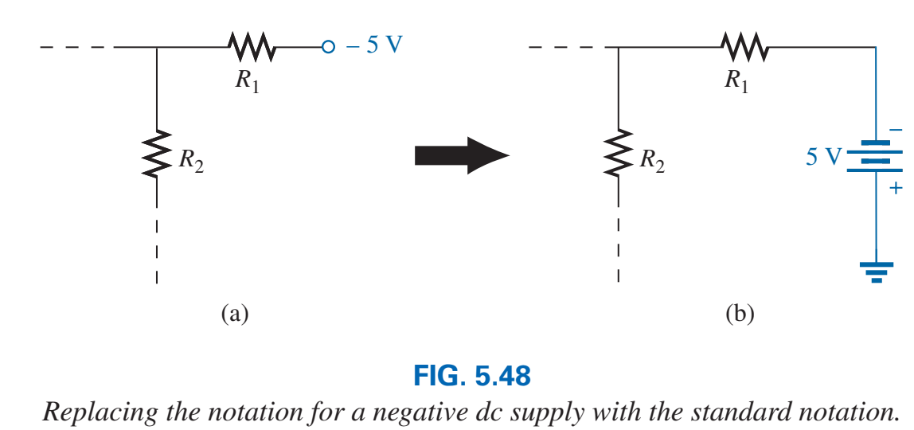
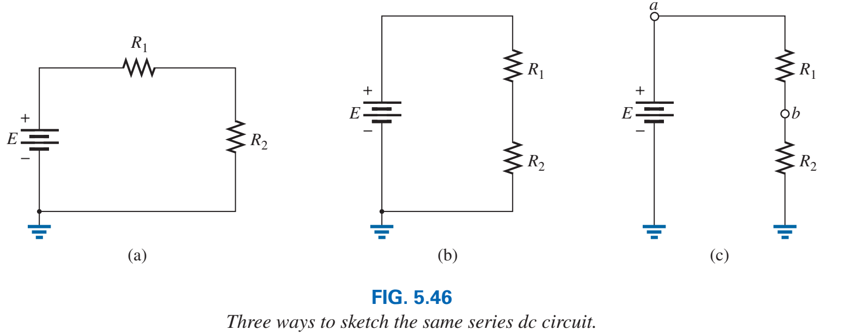
Notations and grounding
Electrical and electronic systems are grounded for reference and safety purposes.

Slide 8
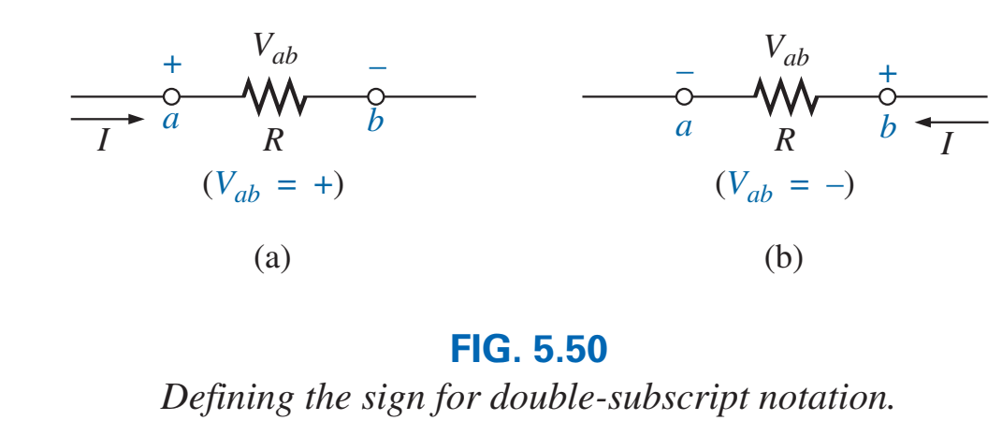
Double-subscript notation

Slide 9
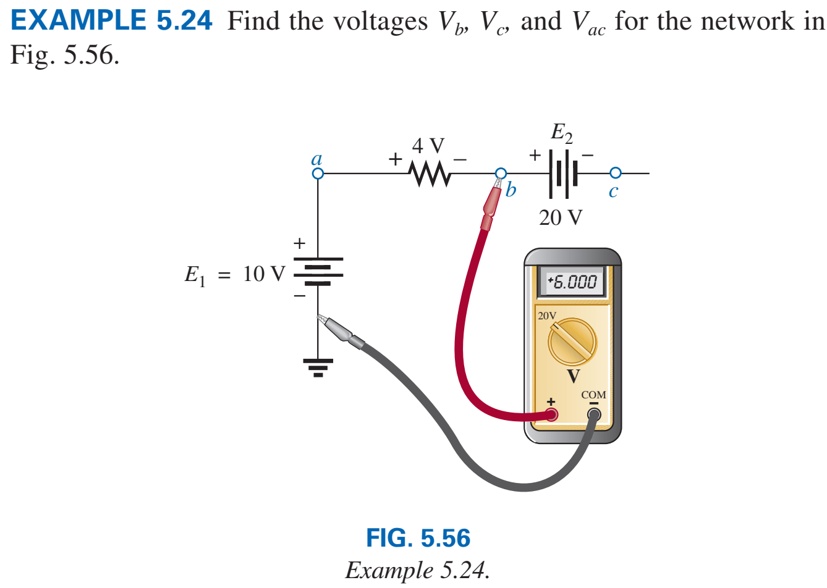
Single-subscript notation
The notation $V_{a}$ is the voltage between node $a$ and the ground
$V_{a}$ =$V_{a}−0$

Slide 10
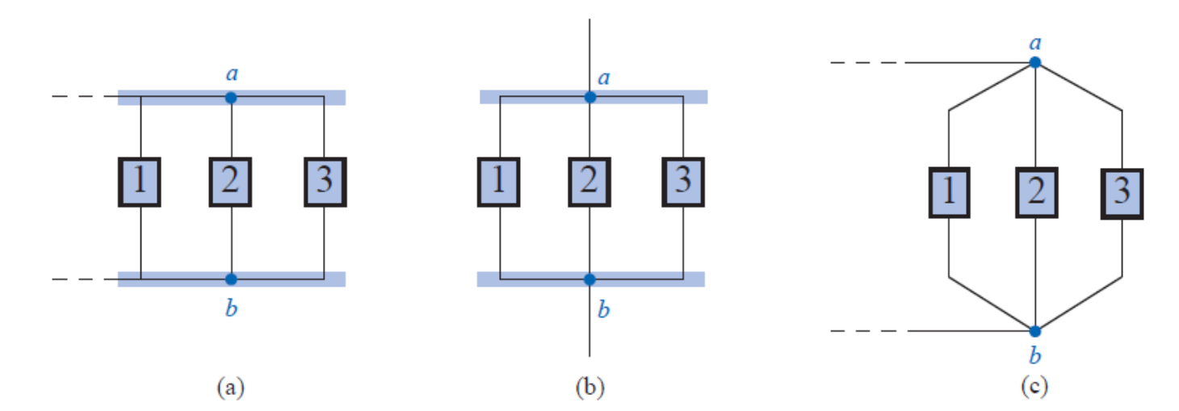
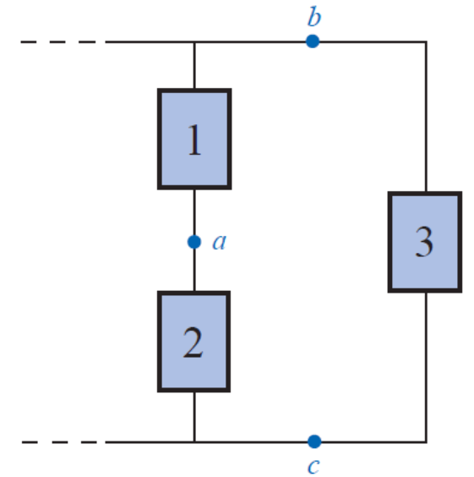
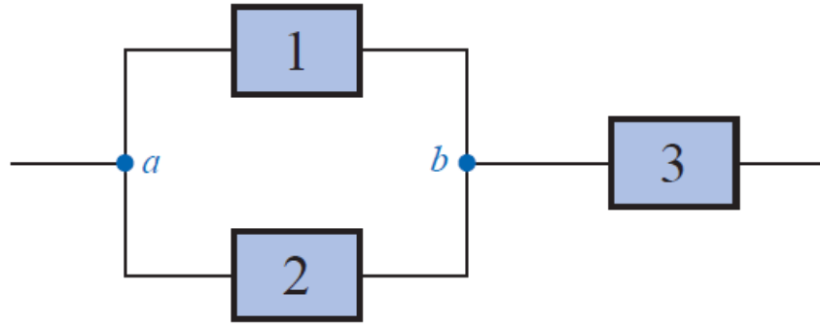
Parallel Circuit
Two elements, branches, or networks are in parallel if they have two points/nodes/terminal in common.

Slide 11
Adding parallel resistance

Slide 12
Adding parallel resistance

Slide 13
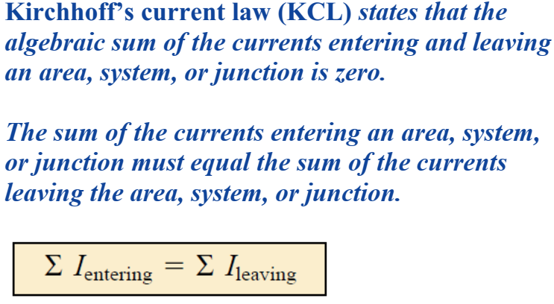
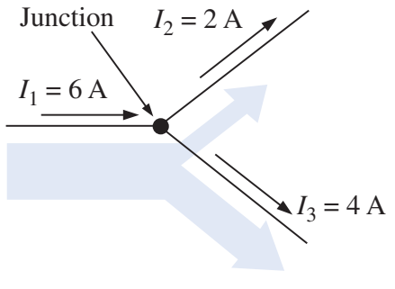
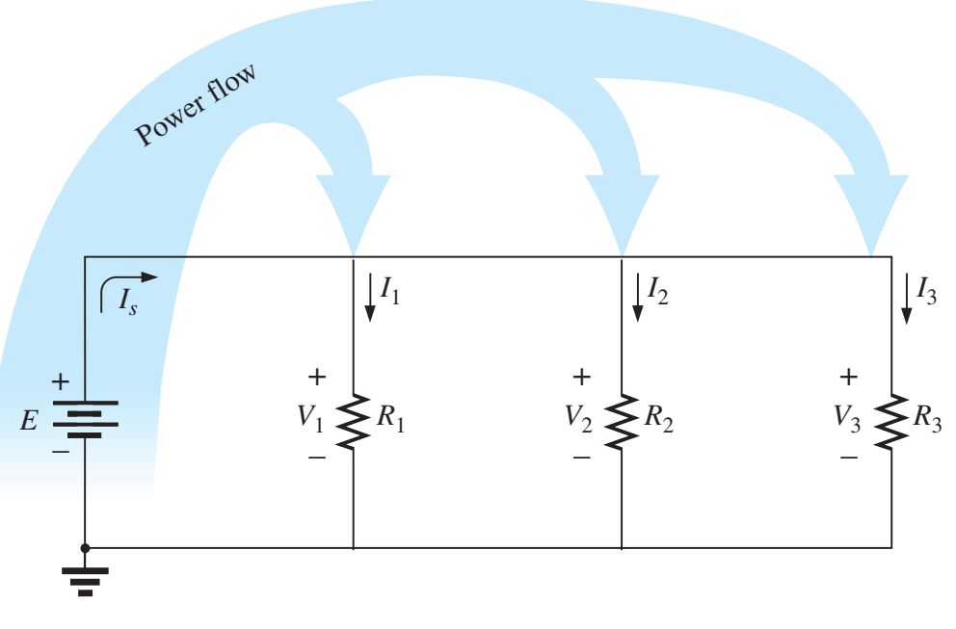
Kirchhoff’s Current Law

Slide 14
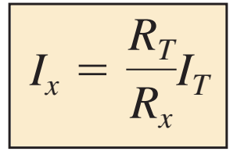
Current Divider Rule
$V=I_{T} R_{T}$
$V=I_{1} R_{1}→I_{1} R_{1}=I_{T}R_{T}$
$I_{1}=I_{T} ×\frac{R_{1}}{R_{T}}$

Slide 15
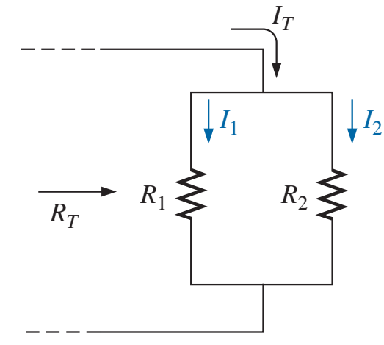
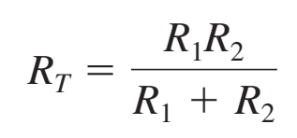
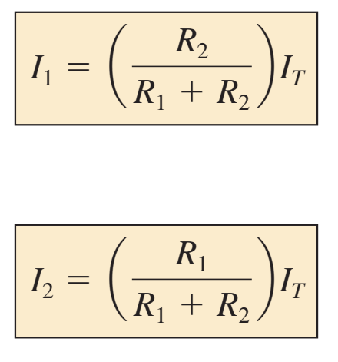
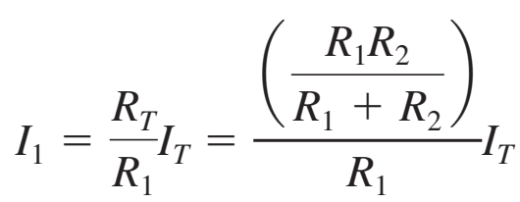
Current Divider Rule

Slide 16
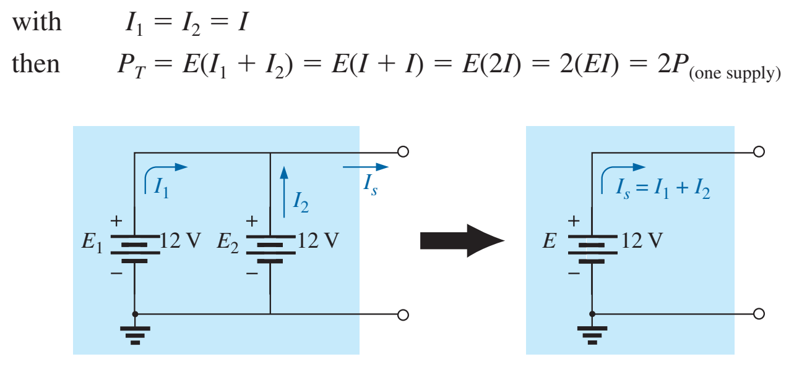
Parallel Voltage Sources
Voltage source are placed in parallel only if they have the same voltage rating.
Primary reason to increase the current rating, increase power.
If two batteries of different terminal voltages were placed in parallel, both would be left ineffective or damaged:

Slide 17
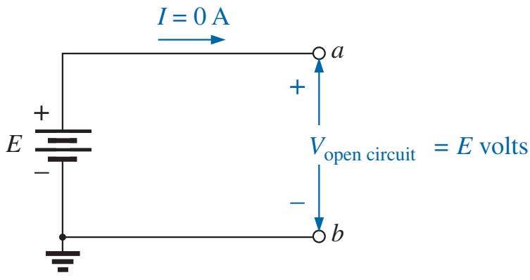
Open circuit

Slide 18
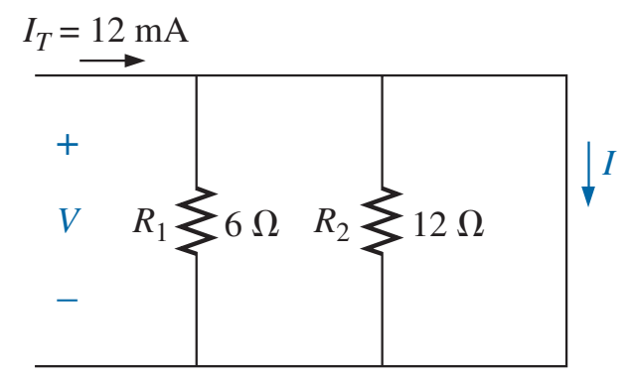
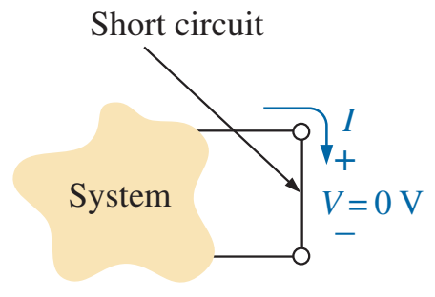
Short circuit

Slide 19
Source Conversion

Slide 20
Current Sources in Parallel

Slide 21
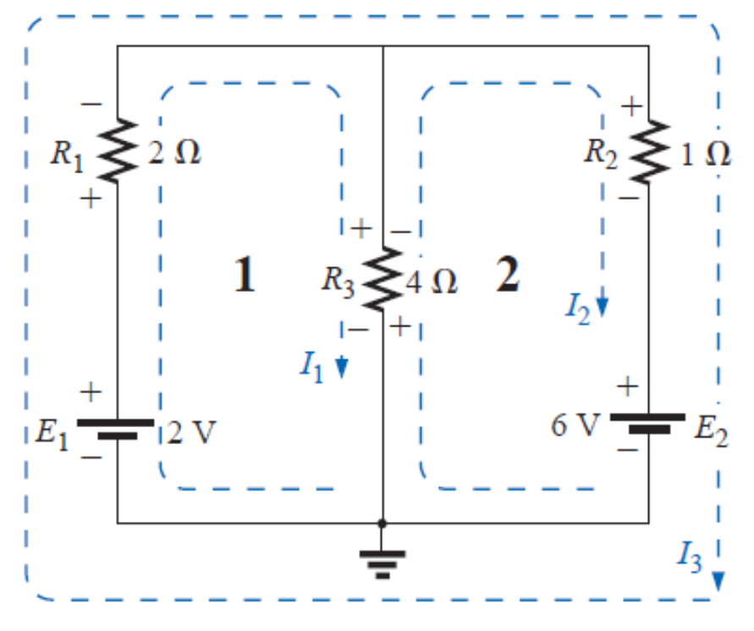
Mesh Analysis
Step 1: Two loop currents (I1 and I2) are assigned in the clockwise direction in the windows of the network.
Step 2: Polarities are drawn within each window to agree with assumed current directions.
Step 3: Kirchhoff’s voltage law is applied around each loop in the clockwise direction.

Slide 22
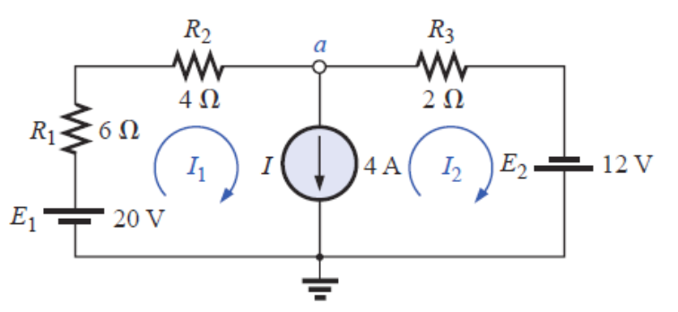
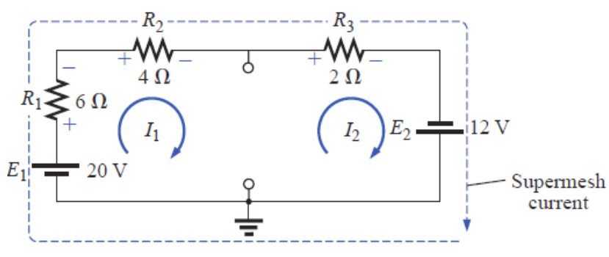
Supermesh

Slide 23
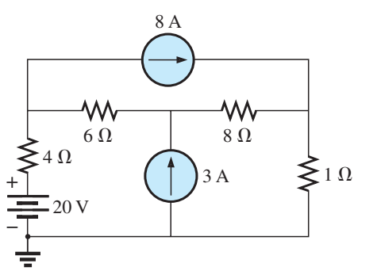
Example 3
$supermesh loop:$
$$10 I_{1}+9I_{2}−14I_{3}=20$$
$I_{3}=8 A$
$I_{1}−I_{2}=−3→I_{1}=I_{2}−3$
$−30+10 I_{2}+9I_{2}−112=20$
$I_{2}=8.526 A, I_{1}=5.526 A$
$I_{6Ω}=2.47 A \left(left\right)$
$I_{8Ω}=0.526 A (right)$

Slide 24
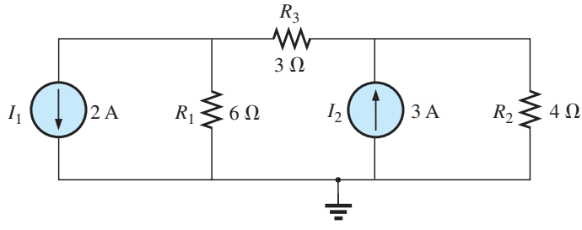
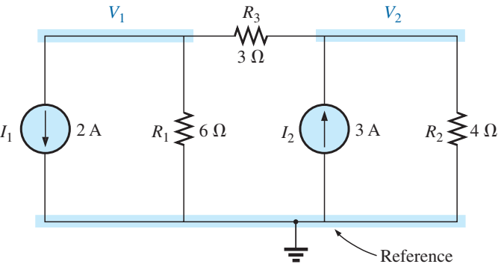
Nodal Analysis (formatted)
Identify the nodes
Identify the voltages
$$Node 1: \left(\right)V_{1}−\left(\right)V_{2}=\left(\right)$$
$$Node 2: −\left(\right)V_{1}+\left(\right)V_{2}=\left(\right)$$
$$Node 1: \left(\frac{1}{6}+\frac{1}{3}\right)V_{1}−\left(\frac{1}{3}\right)V_{2}=\left(−2\right)$$
$$Node 2: −\left(\frac{1}{3}\right)V_{1}+\left(\frac{1}{3}+\frac{1}{4}\right)V_{2}=\left(3\right)$$

Slide 25
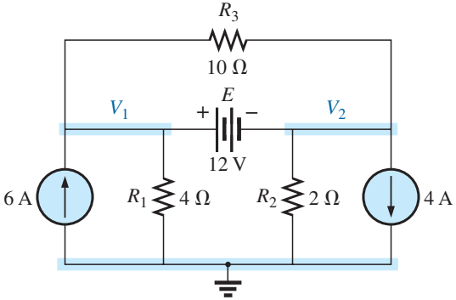
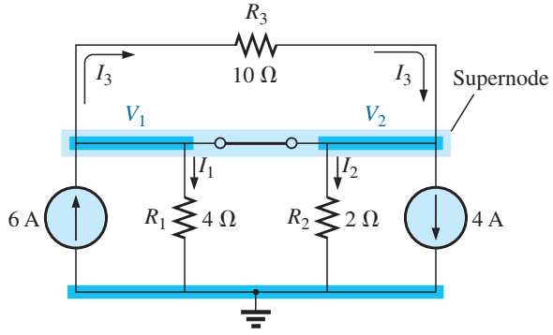
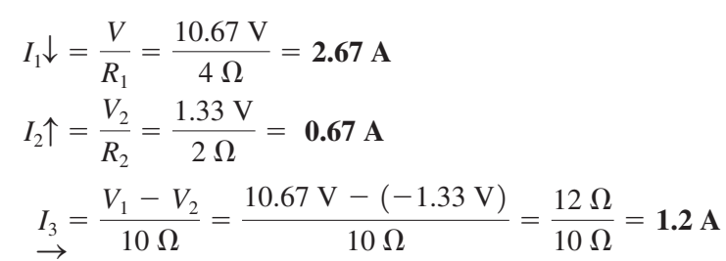
Supernode
Supernode
Currents in = currents out
$$6+I_{3}=I_{1}+I_{2}+4+I_{3}$$
$$2=\frac{V_{1}}{4}+\frac{V_{2}}{2}$$
$$12=V_{1}−V_{2}$$

Slide 26
Bridge Networks Introduction

Slide 27
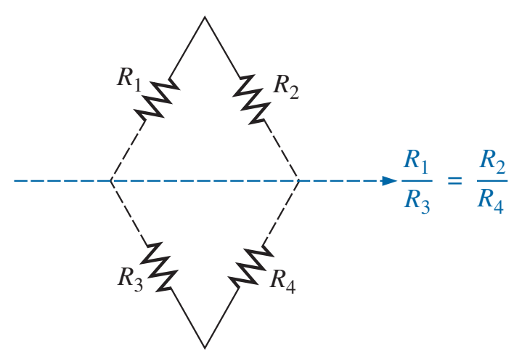
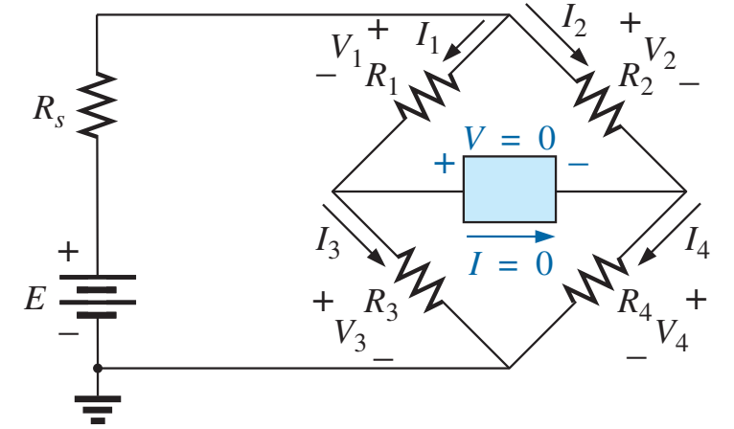
Bridge Network Summary
This conclusion states that if the ratio of $R_{1}$ to $R_{3}$ is equal to that of $R_{2}$ to $R_{4}$, the bridge is balanced, and I = 0 A or V = 0 V.

Slide 28
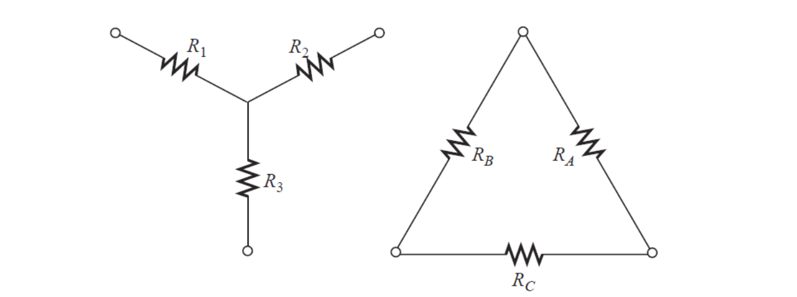
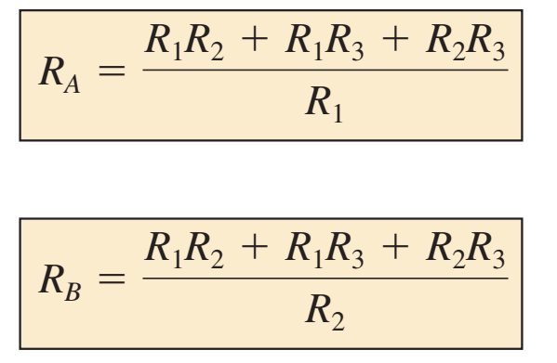
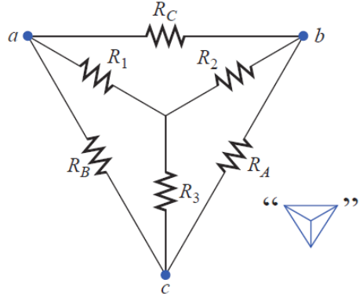
Y-$Δ$ Conversion

Slide 29
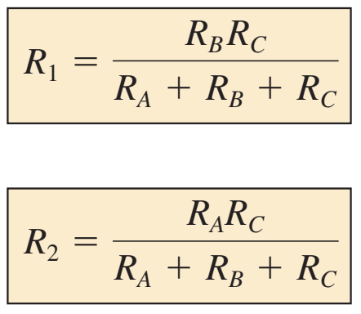
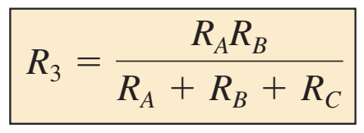
$Δ−Y$ Conversion

Slide 30
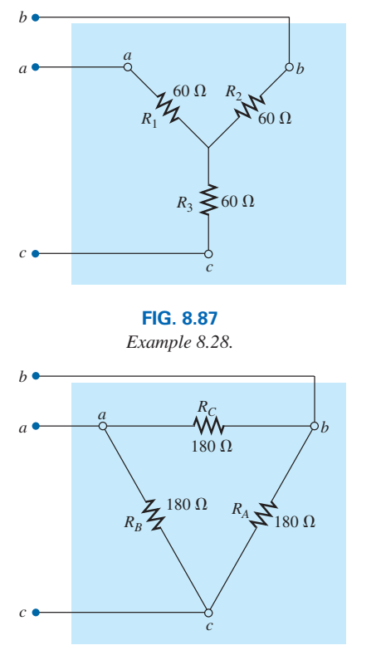
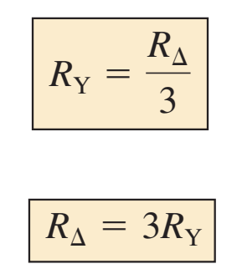
Y-$Δ$ and $Δ−Y$ Conversion
If all the values of $Δ$ or Y were the same

Slide 31
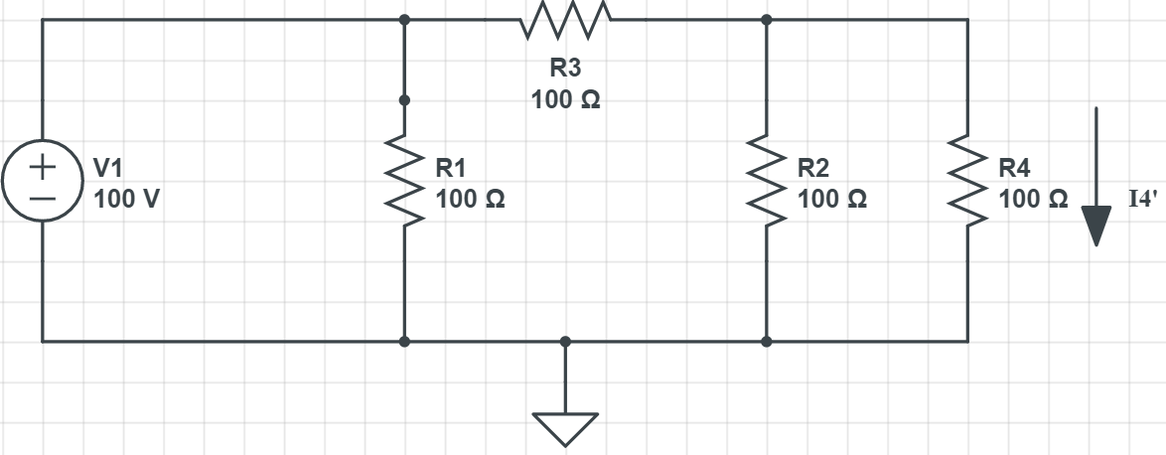
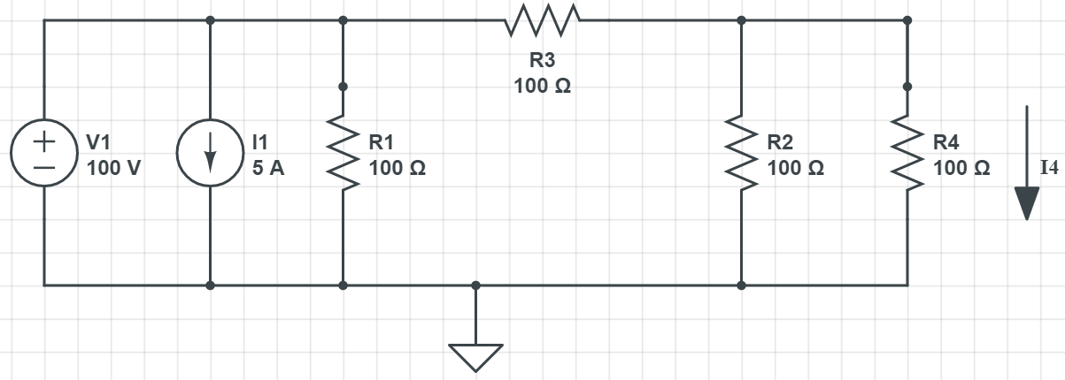
Superpostion - Introduction
What’s the current on R4?
$$I4=I4^{′}+I4′′$$

Slide 32
Superpostion
The superposition theorem can be used to find solution to networks with many sources.

Slide 33
Superpostion

Slide 34
Superpostion
$$P_{T}≠ P_{1}+P_{2}$$

Slide 35
Thévenin’s theorem - Example
Find the Thevenin equivalent circuit for the shaded area.
Step 1: Remove that portion of the network where the Thévenin equivalent circuit is found.
Step 2: Mark the terminals of the remaining two-terminal network.

Slide 36
Thévenin’s theorem - Example
Find the Thevenin equivalent circuit for the shaded area.
Step 3: Calculate $R_{TH}$ by first setting all sources to zero and then finding the resultant resistance between the two marked terminals.

Slide 37
Thévenin’s theorem - Example
Step 4: Find $E_{TH}$ (open-circuit voltage) by measuring the voltage between the two marked terminals.

Slide 38
Thévenin Resistance – Alternative Method
The Thévenin resistance can also be determined by placing a short circuit across the output terminals and finding the current through the short circuit.

Slide 39
Norton’s Theorem
$$R_{N}=R_{TH}$$
$$I_{N}=I_{sc}$$

Slide 40
Norton’s Theorem – Example 1

Slide 41
Maximum Power Transfer Theorem

Slide 42
Maximum Power Transfer Theorem

Slide 43
Maximum Power Transfer Theorem - Example
1 - Find the value of $R_{L}$ for maximum power to the load
2 - Find the maximum power to the load
3 - Find the value of $R_{L}$ that would result in an efficiency of 75%
$$(1)$$
$$(2)$$
$$η=0.75=\frac{P_{L}}{P_{E}}=\frac{I_{L}^{2} R_{L}}{I_{L}^{2} (R_{L}+R_{TH})}$$
$$(3)$$
$$R_{L}=\frac{0.75 R_{TH}}{1−0.75}=45 Ω$$

