Slide 1
Chapter 18 Network Theorems (ac)
Superposition
Thevenin
Norton
Maximum Power Transfer

Slide 2
Revision on Dependent Sources

Slide 3
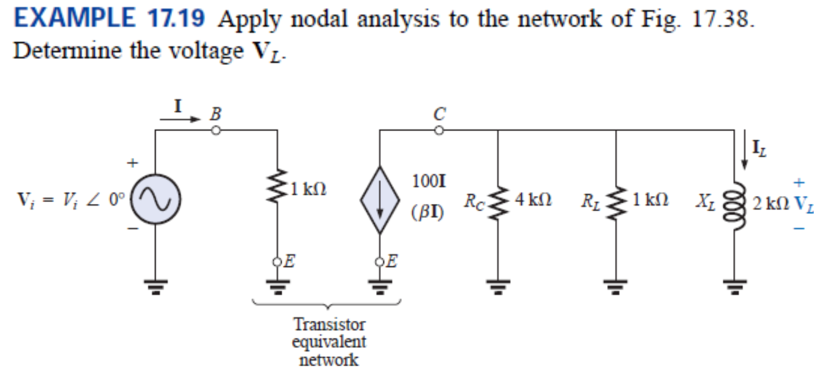
Revision on Dependent Sources

Slide 4
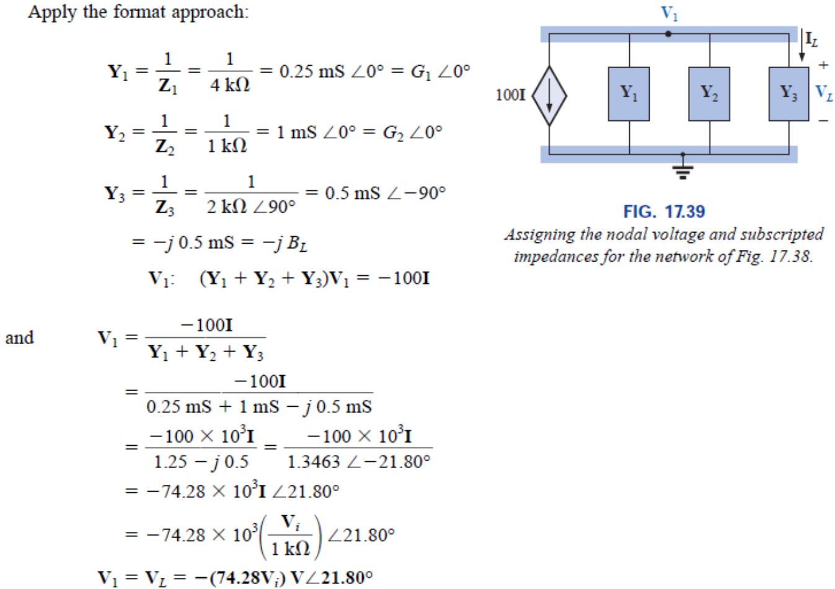
Revision on Dependent Sources

Slide 5
L and C with DC sources
DC steady-state (meaning the circuit has been in the same state for a long time), we've seen that capacitors act like open circuits and inductors act like shorts if there are no AC sources.

Slide 6
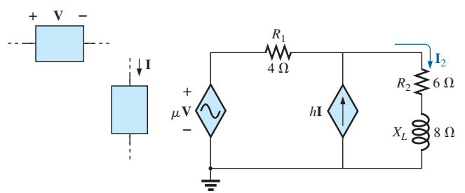
Superposition (AC)
The only variation in applying this theorem to ac networks with independent sources is that we will now be working with impedances and phasors instead of just resistors and real numbers.
For dependent sources in which the controlling variable is not determined by the network to which the superposition theorem is to be applied, the application of the theorem is the same as for independent sources.
If the dependent source is controlled by a variable in the network, then we do not use superposition on the dependent source.
Dependent sources are not sources of energy in the sense that, if all independent sources are removed from a system, all currents and voltages must be zero.

Slide 7
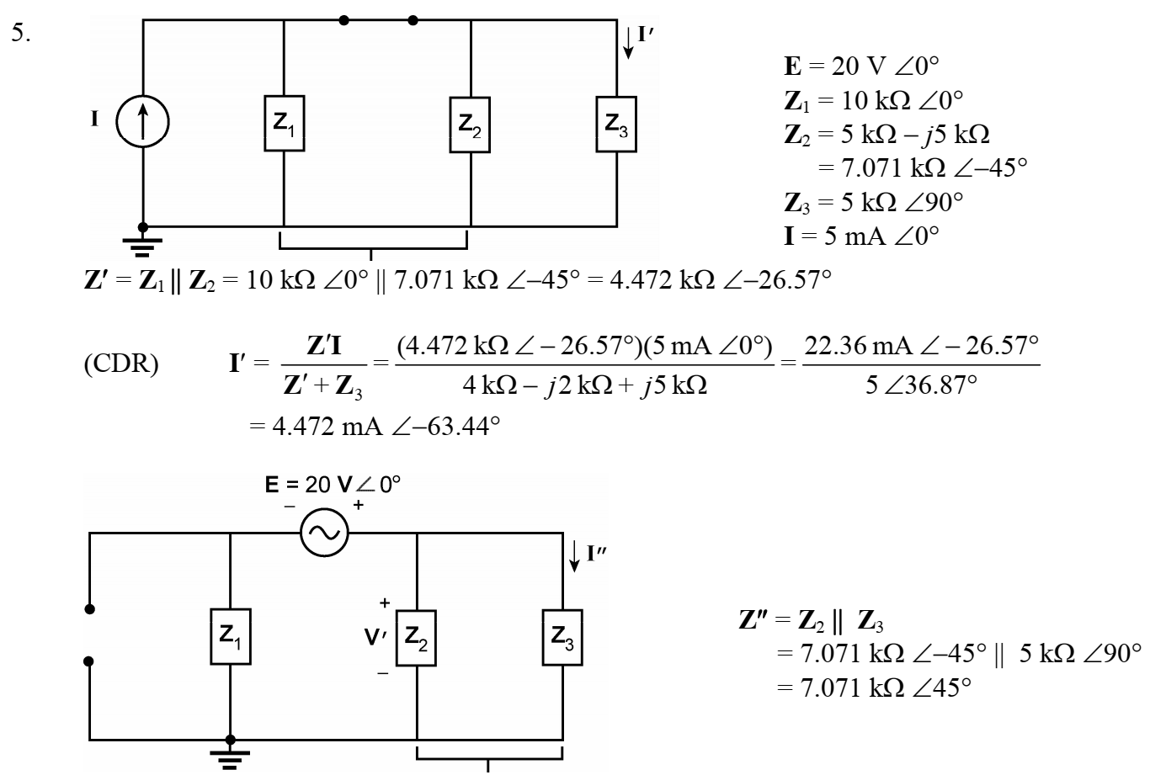
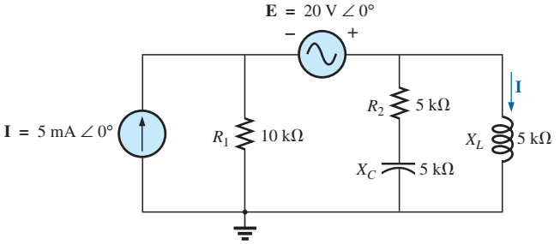
Example 1

Slide 8
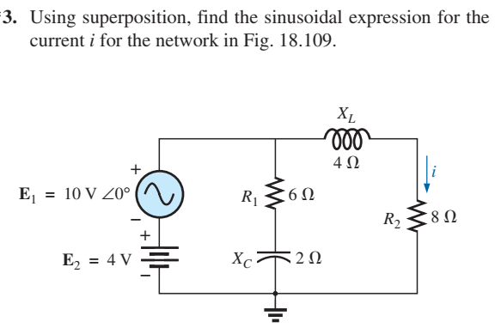
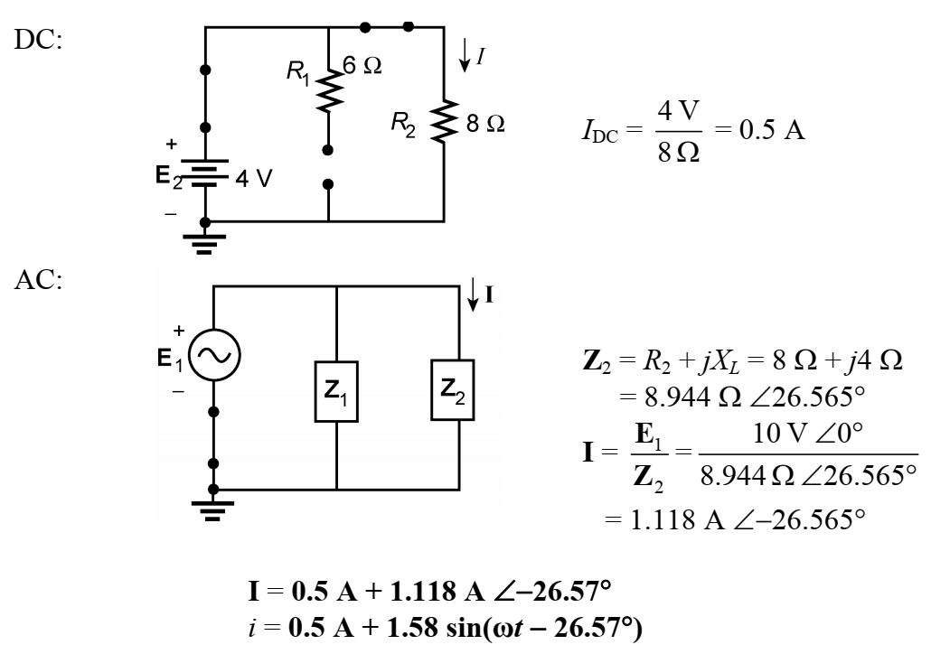
Example 2 – With Both DC and AC sources

Slide 9
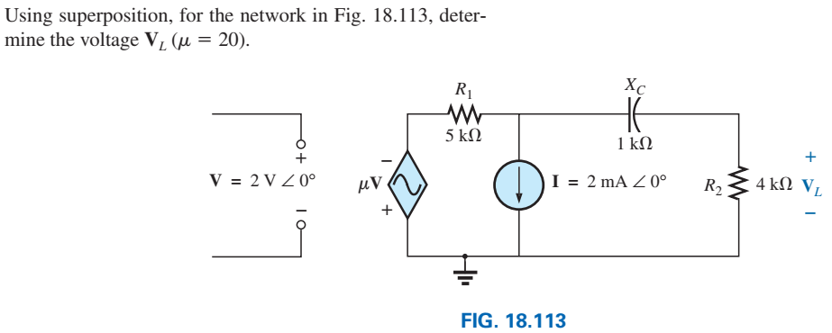
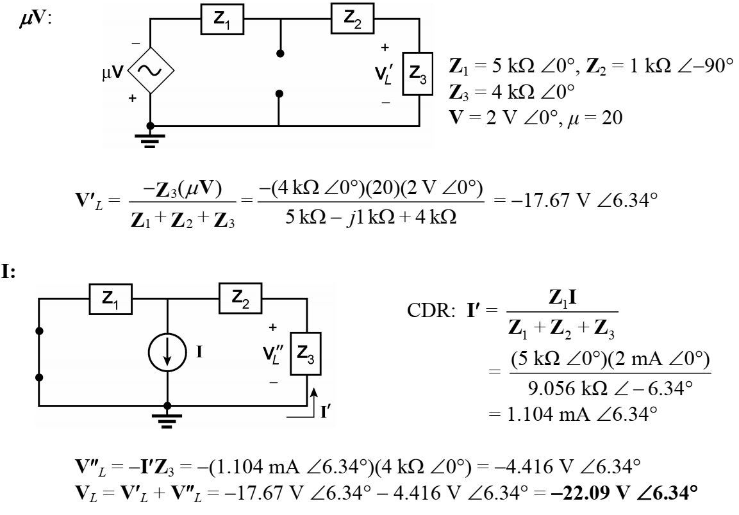
Example 3 – With dependent sources

Slide 10
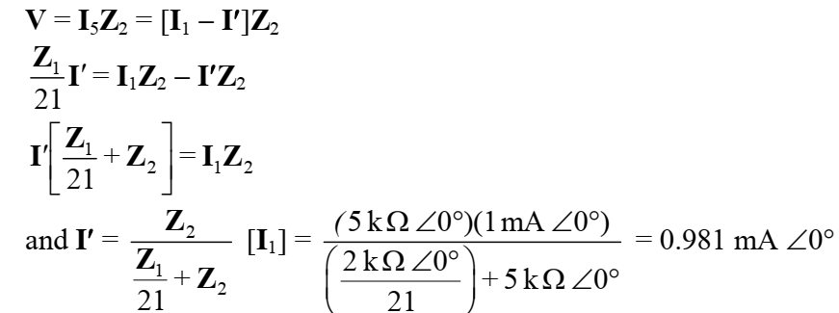
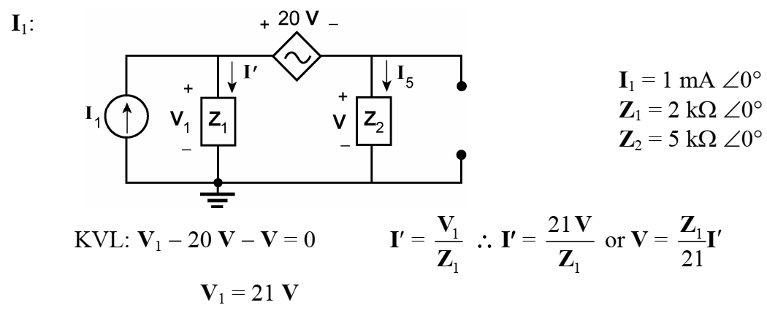
Example 4 – With dependent sources

Slide 11
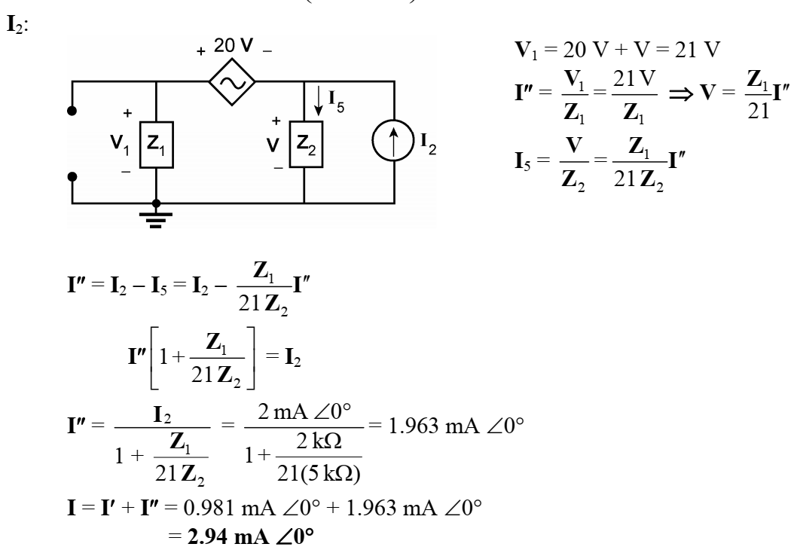
Example 4 – With dependent sources

Slide 12
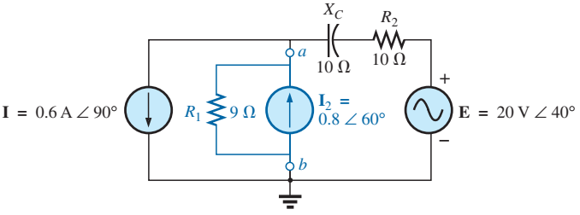
Thevenin (AC) – Example
$$Z_{th}=10−j10$$
$$E_{th}+\left(0.6∠90\right)∗\left(10−j10\right)−20∠40=0$$
$$E_{th}=11.57∠{36.34}^{o}$$

Slide 13
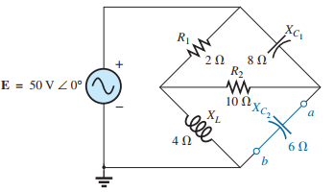
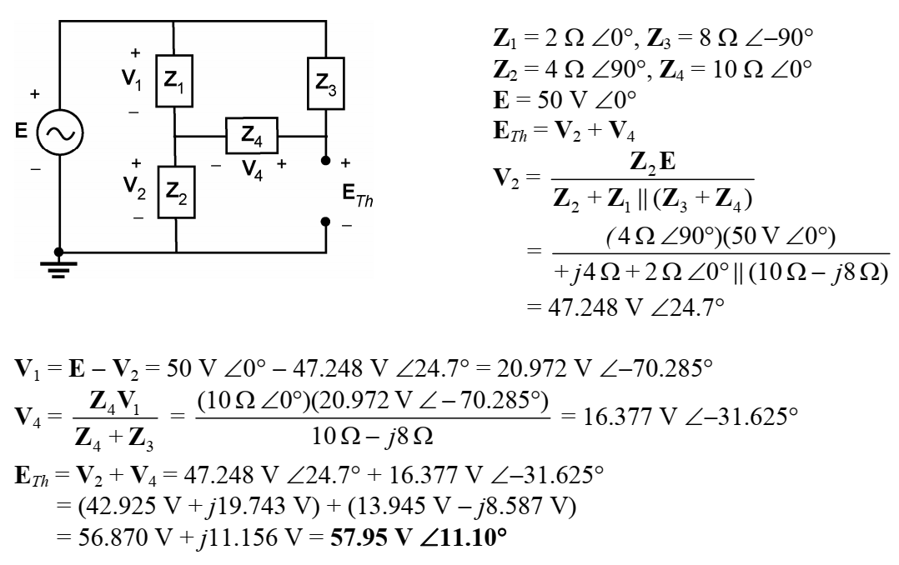
Thevenin (AC) – Example 2
$$Z_{th}=(R_{1}|\left|X_{L}+R_{2}\right)||X_{C}$$
$$Z_{th}=6.81∠−54.23$$

Slide 14
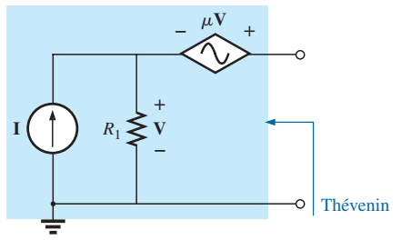
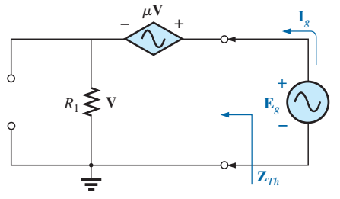
Thevenin – Dependent Sources
Dependent Sources
$E_{th}$ and $I_{N}$ can be found the same way as the DC case
If the controlling variable is in a different circuit, then we can apply Thevenin theorem normally to find $Z_{th}$
If the controlling variable is in the circuit, then there are two methods for $Z_{th}$:
Method 1:
Find $E_{oc}$ or $E_{th}$
Find $I_{sc}$ or $I_{N}$
$Z_{Th}=E_{oc}/I_{sc}$
Method 2:
Apply new voltage $E_{g}$ at the selected terminal
Remove independent sources and dependent sources if applicable (controlling variable not in the circuit)
Find the current from the voltage source $I_{g}$
$Z_{th}=E_{g}/I_{g}$

Slide 15
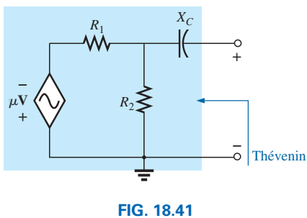
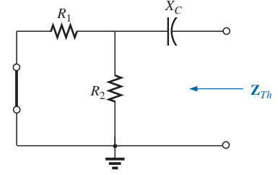
Thevenin – Dependent Source Example

Slide 16
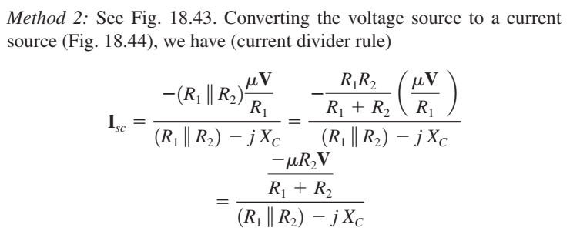
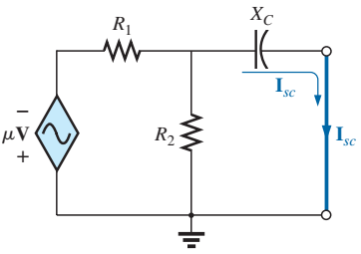
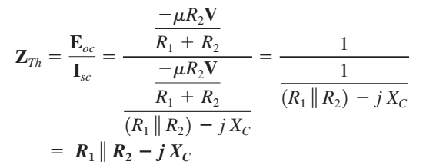
Thevenin – Dependent Source Example

Slide 17
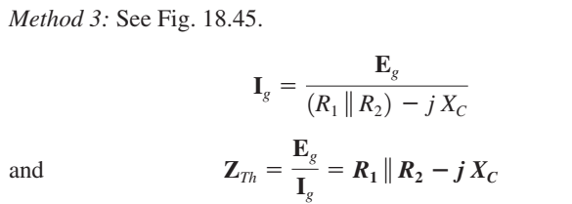
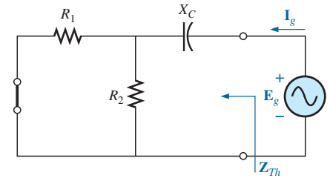
Thevenin – Dependent Source Example

Slide 18
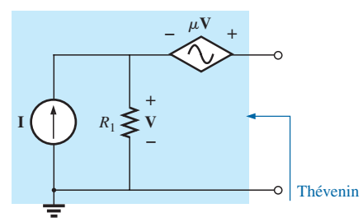
Thevenin – Dependent Source Example 2

Slide 19
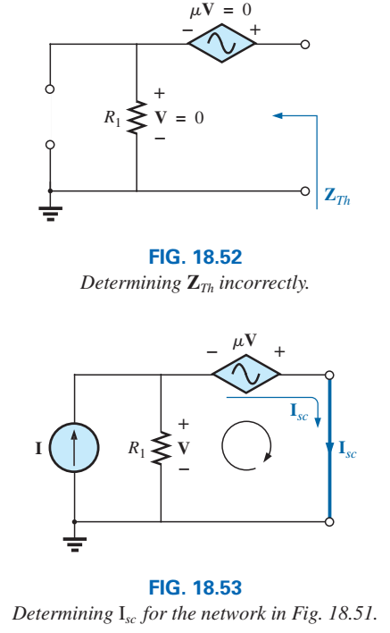
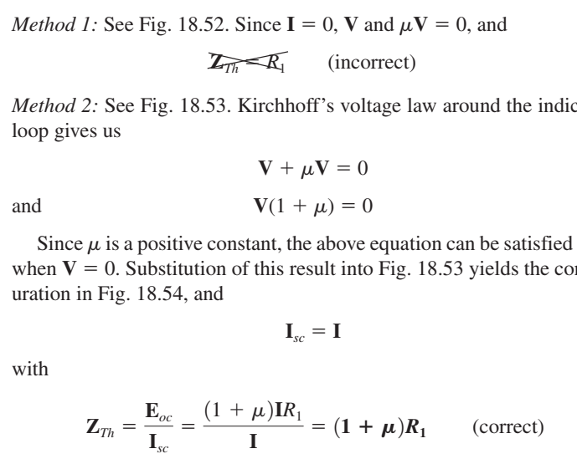
Thevenin – Dependent Source Example 2

Slide 20
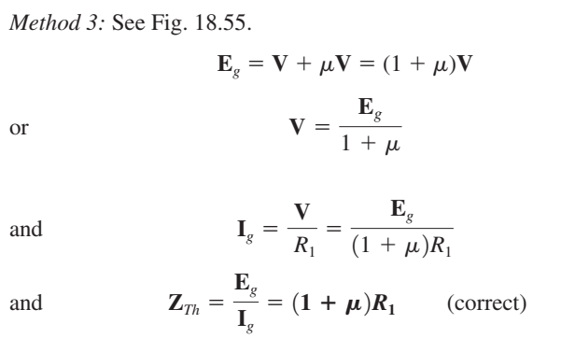
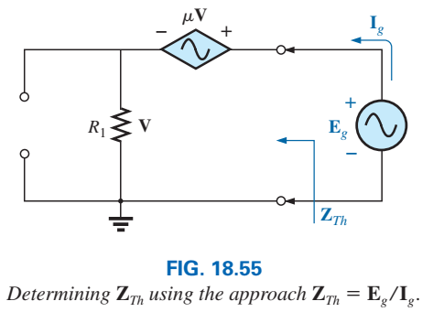
Thevenin – Dependent Source Example 2

Slide 21
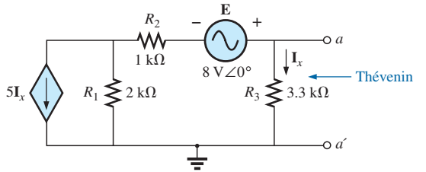
Thevenin – Dependent Source Example 3

Slide 22
Thevenin – Dependent Source Example 3

Slide 23
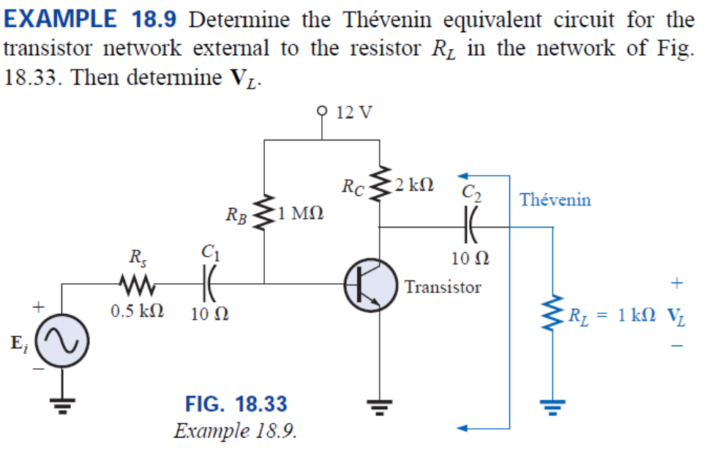
Thevenin – Dependent Source Example 4
For the DC source:
$V_{L}=0$, because $C_{2}$ will be open.

Slide 24
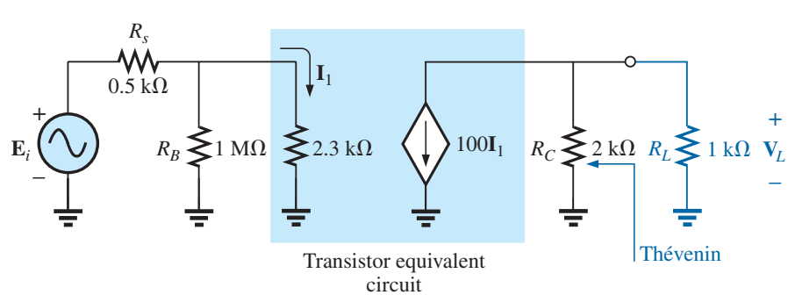
Thevenin – Dependent Source Example 4
Note in Fig. 18.35 the absence of the coupling capacitors for the ac analysis. In general, coupling capacitors are designed to be open circuits for dc analysis and short circuits for ac analysis. The short-circuit equivalent is valid because the other impedances in series with the coupling capacitors are so much larger in magnitude that the effect of the coupling capacitors can be ignored. Both RB and RC are now tied to ground because the dc source was set to zero volts (superposition) and replaced by a short-circuit equivalent to ground.

Slide 25
Thevenin – Dependent Source Example 4

Slide 26
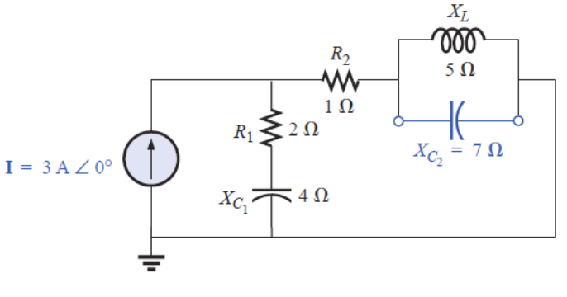
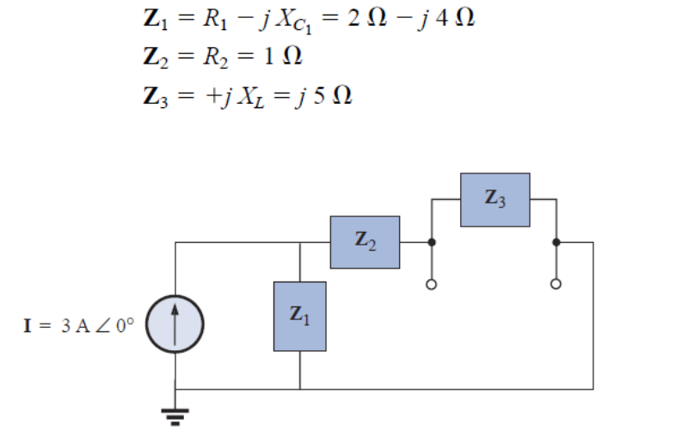
Norton (AC)
The same conditions as the Thevenin method are applied for the Norton equivalent
Example:

Slide 27
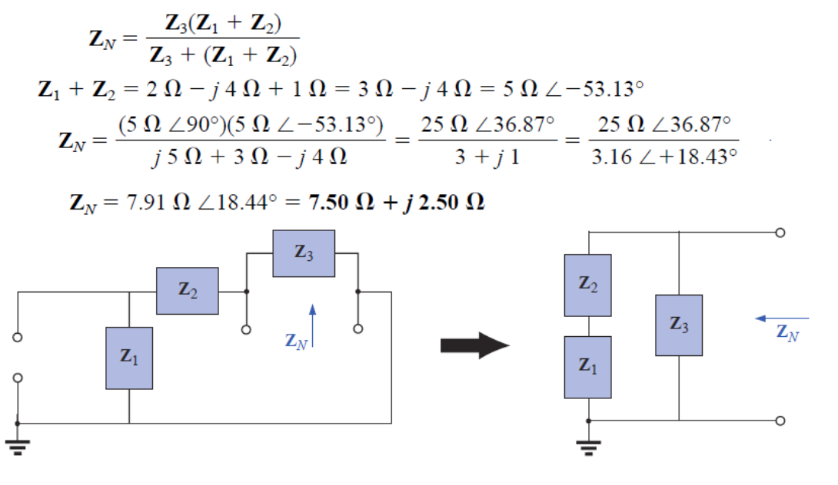
Norton (AC)

Slide 28
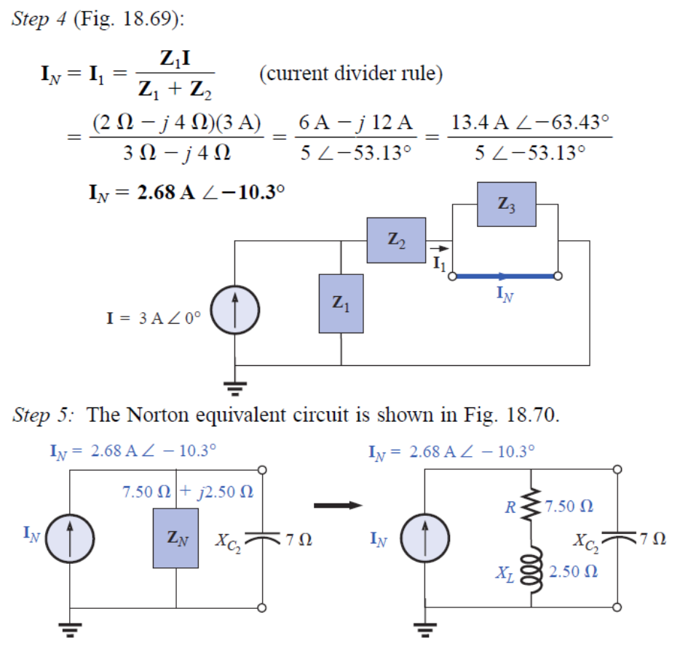
Norton (AC)

Slide 29
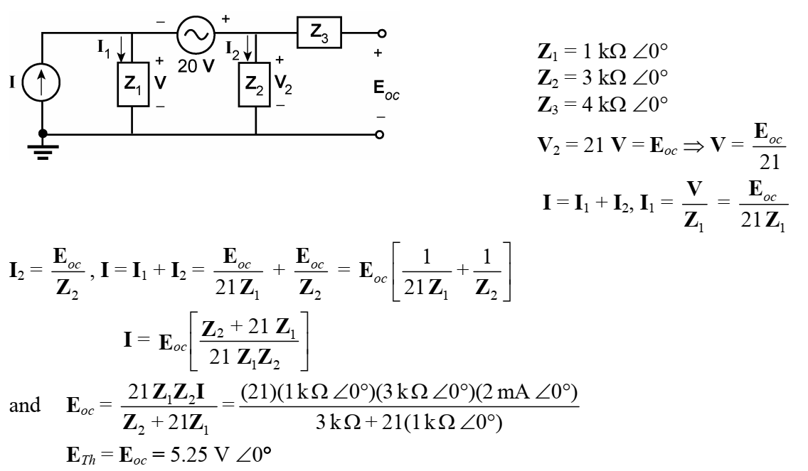
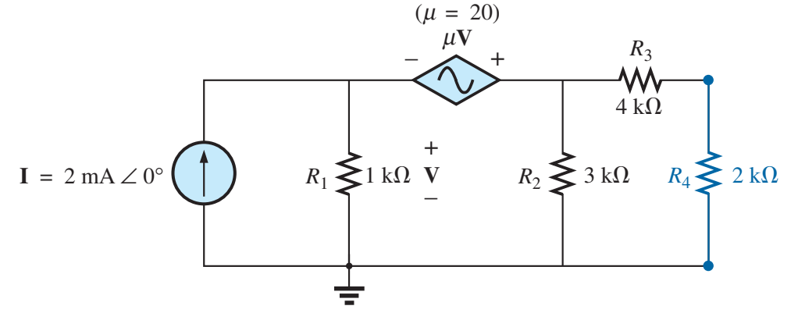
Norton (AC) – Dependent Source Example

Slide 30
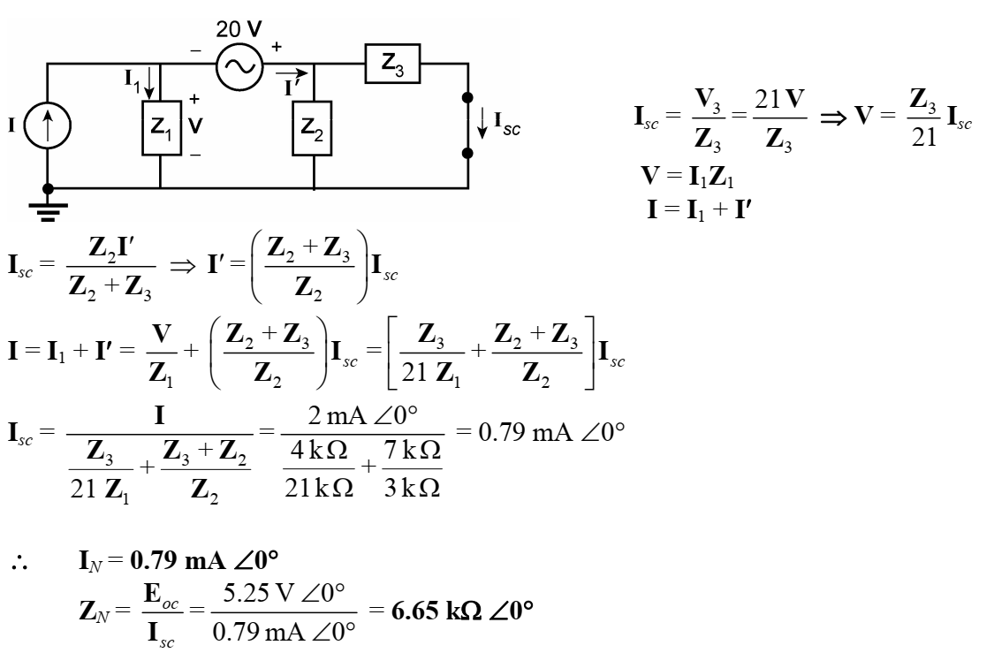
Norton (AC) – Dependent Source Example

Slide 31
Norton (AC) – Dependent Source Example

Slide 32
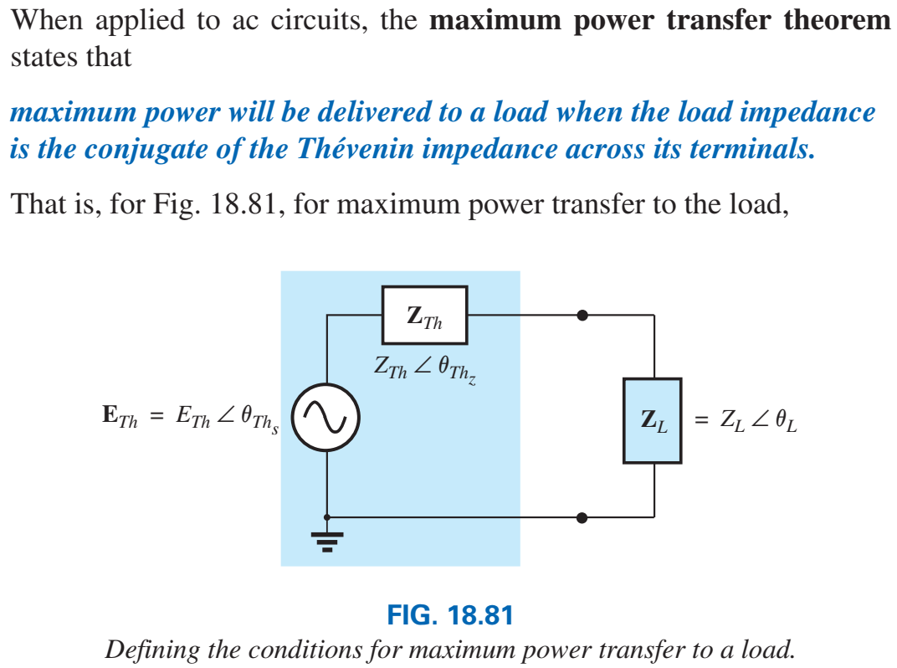
Maximum Power Transfer Theorem

Slide 33
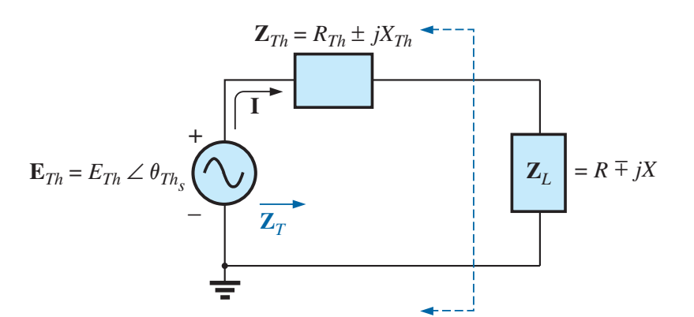
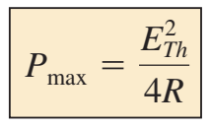
Maximum Power Transfer Theorem

Slide 34
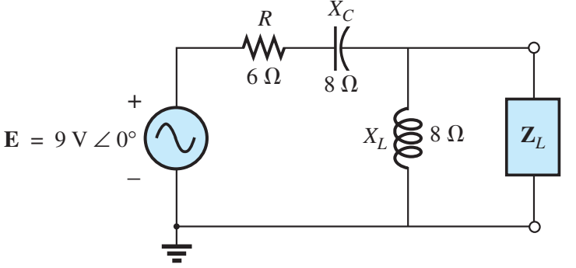
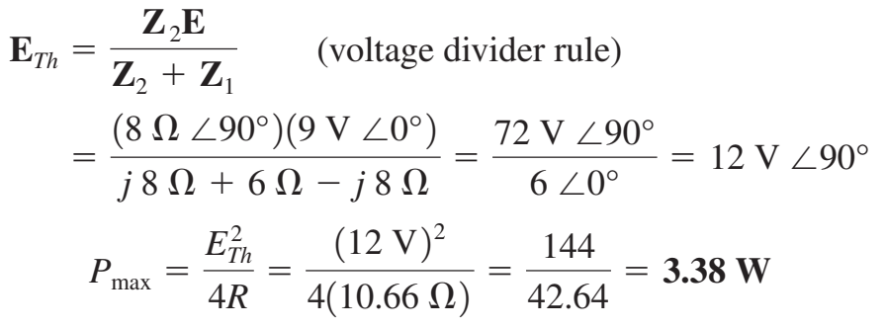
Example

Slide 35
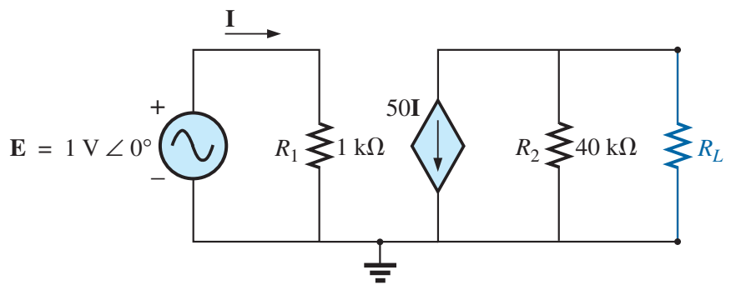
Example

Slide 36
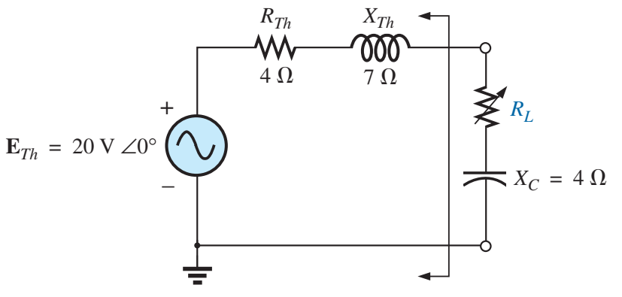
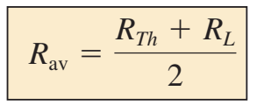
Special Case
If you cannot match the reactance of the load to $X_{th}$

Slide 37
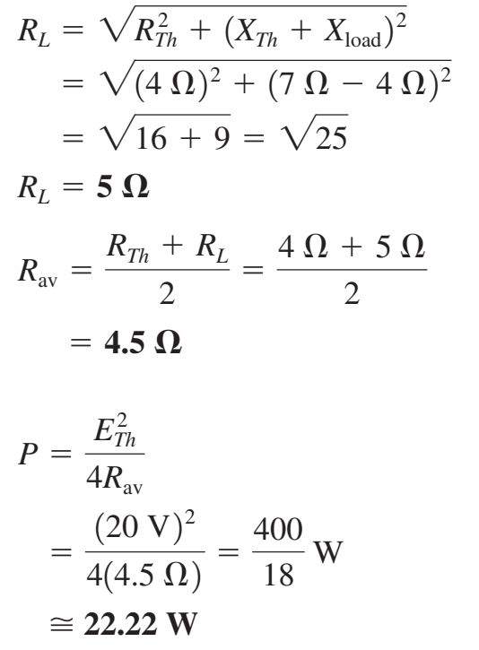
Special Case

