Slide 1
EE 201 Lecture 8 -Week 5

Slide 2
Chapter 8 Methods of Analysis and Selected Topics (dc)
Nodal analysis (general approach) Nodal analysis (formatted approach)

Slide 3
Nodal Analysis
For mesh analysis we used Kirchhoff’s voltage law around each closed loop.
Now we employ Kirchhoff’s current law to develop the method: nodal analysis.
Nodal analysis method:

Slide 4
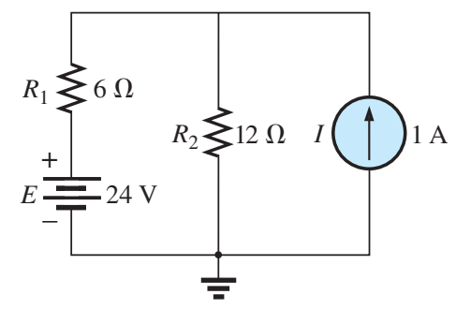
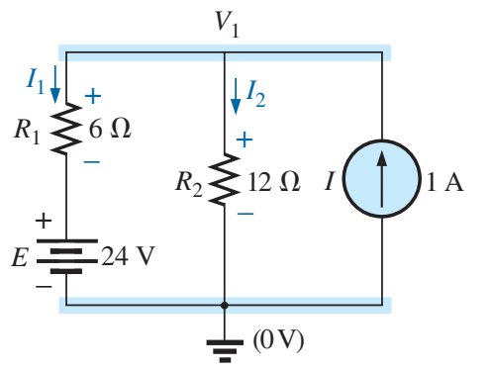
Nodal Analysis
Number of nodes is two
The ground is selected as the reference node
Apply KCL
$$I=I_{1}+I_{2}$$
$$I=1 A$$
$$I_{1}, I_{2}= ?$$
$$I_{1}=\frac{V_{1}−E}{R_{1}}, I_{2}=\frac{V_{1}}{R_{2}}$$
$$\frac{V_{1}−24}{6}+\frac{V_{1}}{12}=1→V_{1}=20$$
4. Use $V_{1}$ to find $I_{1}$ and $I_{2}$

Slide 5
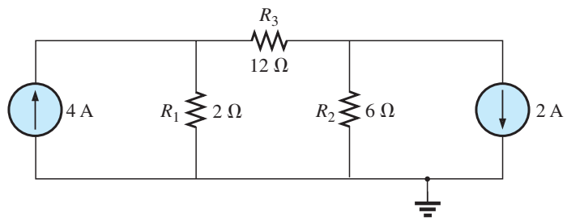
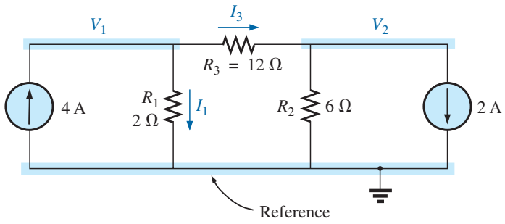
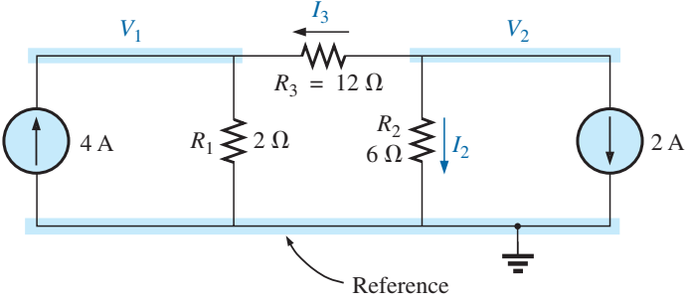
Nodal Analysis
Node 1:
$$4=I_{1}+I_{3}$$
$$\frac{V_{1}}{2}+\frac{V_{1}−V_{2}}{12}=4→\left(\frac{1}{2}+\frac{1}{12}\right)V_{1}−\left(\frac{1}{12}\right)V_{2}=4$$
Node 2:
$$I_{3}+I_{2}+2=0$$
$$\frac{V_{2}−V_{1}}{12}+\frac{V_{2}}{6}=−2→−\left(\frac{1}{12}\right)V_{1}+\left(\frac{1}{12}+\frac{1}{6}\right)V_{2}=−2$$

Slide 6
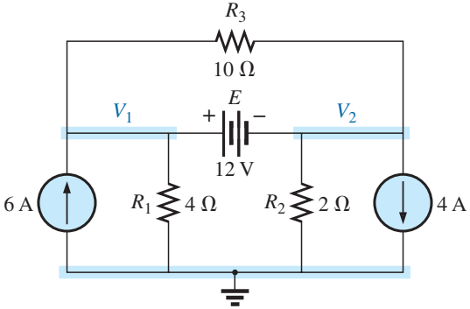
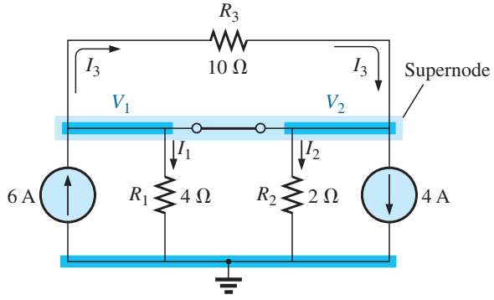
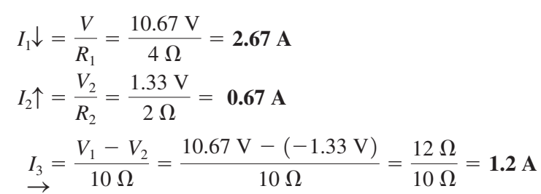
Supernode
Supernode
Currents in = currents out
$$6+I_{3}=I_{1}+I_{2}+4+I_{3}$$
$$2=\frac{V_{1}}{4}+\frac{V_{2}}{2}$$
$$12=V_{1}−V_{2}$$

Slide 7
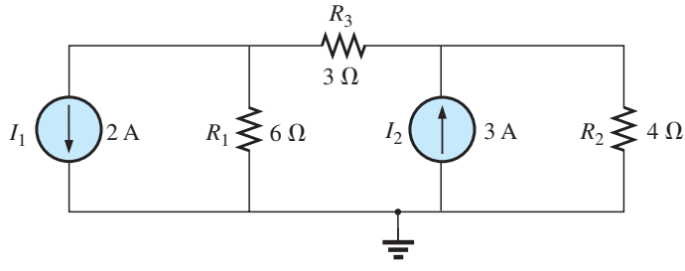
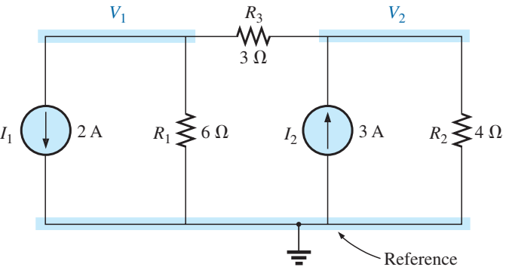
Nodal Analysis (formatted)
Identify the nodes
Identify the voltages
$$Node 1: \left(\right)V_{1}−\left(\right)V_{2}=\left(\right)$$
$$Node 2: −\left(\right)V_{1}+\left(\right)V_{2}=\left(\right)$$
$$Node 1: \left(\frac{1}{6}+\frac{1}{3}\right)V_{1}−\left(\frac{1}{3}\right)V_{2}=\left(−2\right)$$
$$Node 2: −\left(\frac{1}{3}\right)V_{1}+\left(\frac{1}{3}+\frac{1}{4}\right)V_{2}=\left(3\right)$$

Slide 8
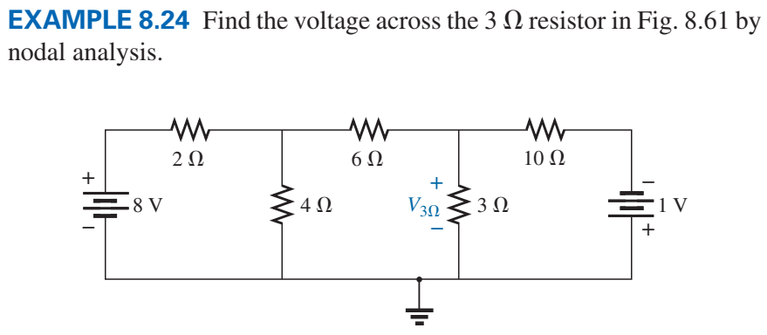
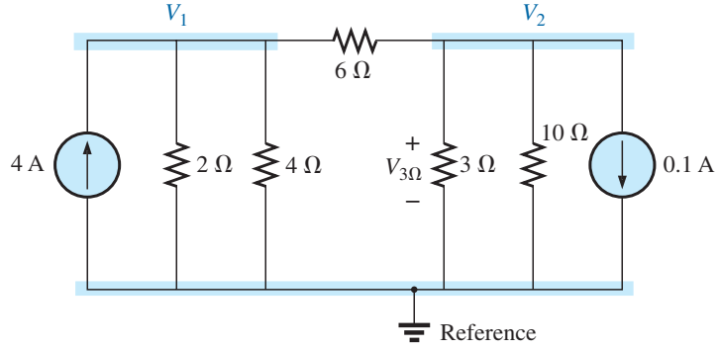
Example 1
Voltage sources are converted to current sources
$8 V→\frac{8}{2}=4 A, 1 V→\frac{1}{10}=0.1 A$
$$Node 1: \left(\frac{1}{2}+\frac{1}{4}+\frac{1}{6}\right)V_{1}−\left(\frac{1}{6}\right)V_{2}=\left(4\right)$$
$$Node 2: −\left(\frac{1}{6}\right)V_{1}+\left(\frac{1}{3}+\frac{1}{10}+\frac{1}{6}\right)V_{2}=−\left(0.1\right)$$

Slide 9
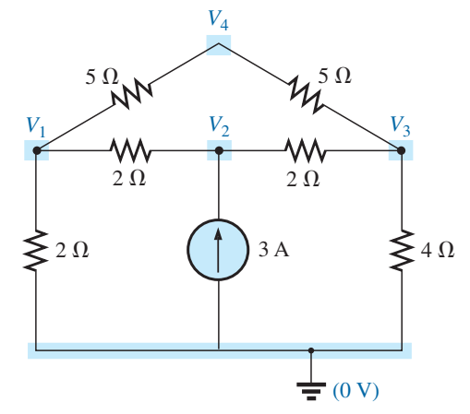
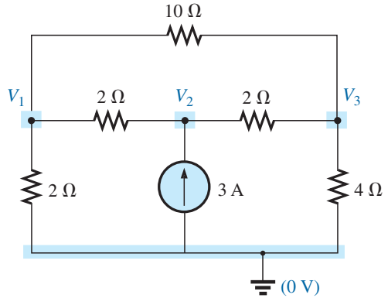
Example 2
Identify nodes and remove extra unnecessary nodes
$$Node 1: \left(\frac{1}{2}+\frac{1}{2}+\frac{1}{10}\right)V_{1}−\left(\frac{1}{2}\right)V_{2}−\left(\frac{1}{10}\right)V_{3}=\left(0\right)$$
$$Node 2: − \left(\frac{1}{2}\right)V_{1}+\left(\frac{1}{2}+\frac{1}{2}\right)V_{2}−\left(\frac{1}{2}\right)V_{3}=\left(3\right)$$
$$Node 3: −\left(\frac{1}{10}\right)V_{1}−\left(\frac{1}{2}\right)V_{2}+\left(\frac{1}{10}+\frac{1}{2}+\frac{1}{4}\right)V_{3}=\left(0\right)$$

Slide 10
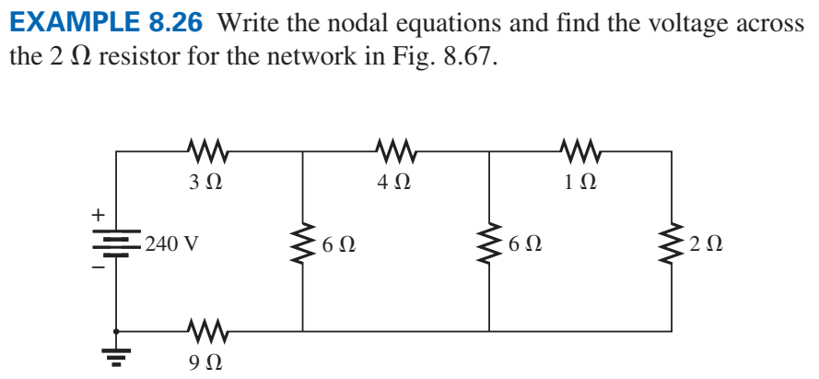
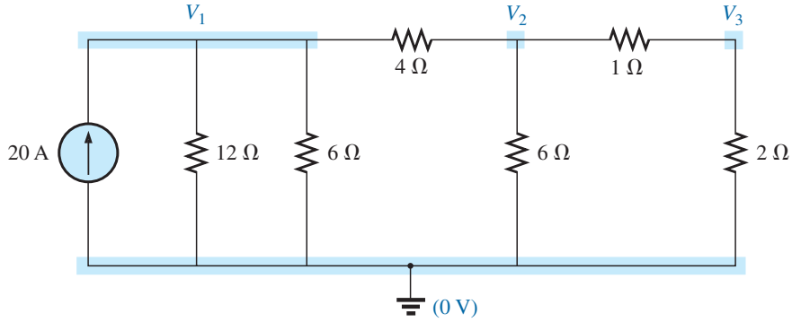
Example 3

Slide 11
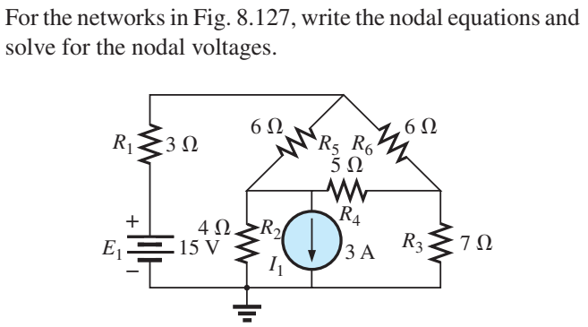
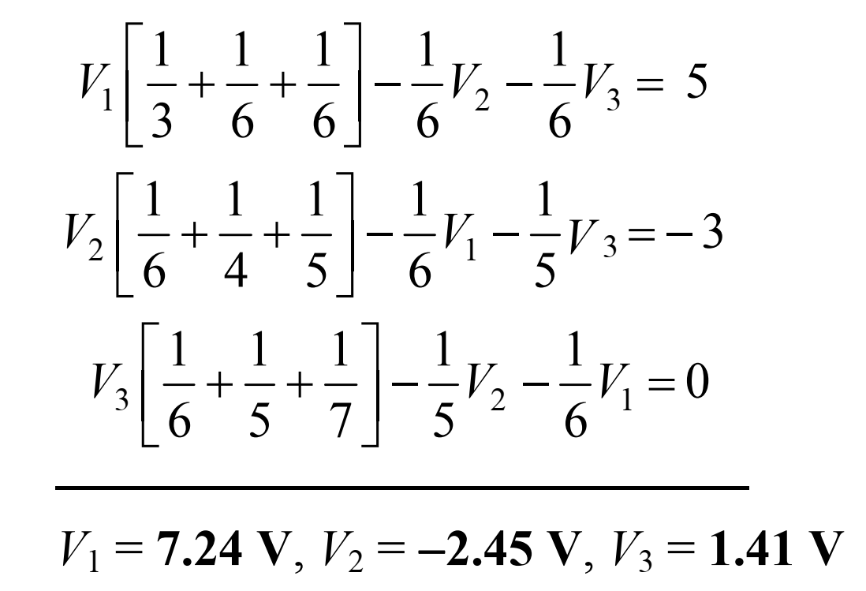
Example 4

