Slide 1
Chapter 14
Normalization

Slide 2
Chapter 14 - Objectives
The potential problems associated with redundant data in base relations.
The concept of functional dependency, which describes the relationship between attributes.
How to undertake the process of normalization.
How to identify the most commonly used normal forms, namely First Normal Form (1NF), Second Normal Form (2NF), and Third Normal Form (3NF).
Pearson Education © 2014

Slide 3
normalization
Normalization is a bottom up approach to database design that begins by examining the relationships between attributes.
Normalization is often performed as a series of test on a relation to determine whether it satisfy or violates the requirements of a given normal form .
The process of normalization is a formal method that identifies relations base on their primary or candidate keys and the functional dependencies among their attributes.

Slide 4
Data Redundancy and Update Anomalies
Major aim of relational database design is to group attributes into relations to minimize data redundancy.
Relations that contain redundant information may potentially suffer from update anomalies.
Types of update anomalies include:
Insertion
Deletion
Modification
Pearson Education © 2014

Slide 5
Functional Dependencies
Important concept associated with normalization.
Functional dependency describes relationship between attributes.
For example:
If A and B are attributes of relation R, B is functionally dependent on A (denoted A → B), if each value of A in R is associated with exactly one value of B in R ( A and B may each consist of one or more attributes)
Pearson Education © 2014

Slide 6
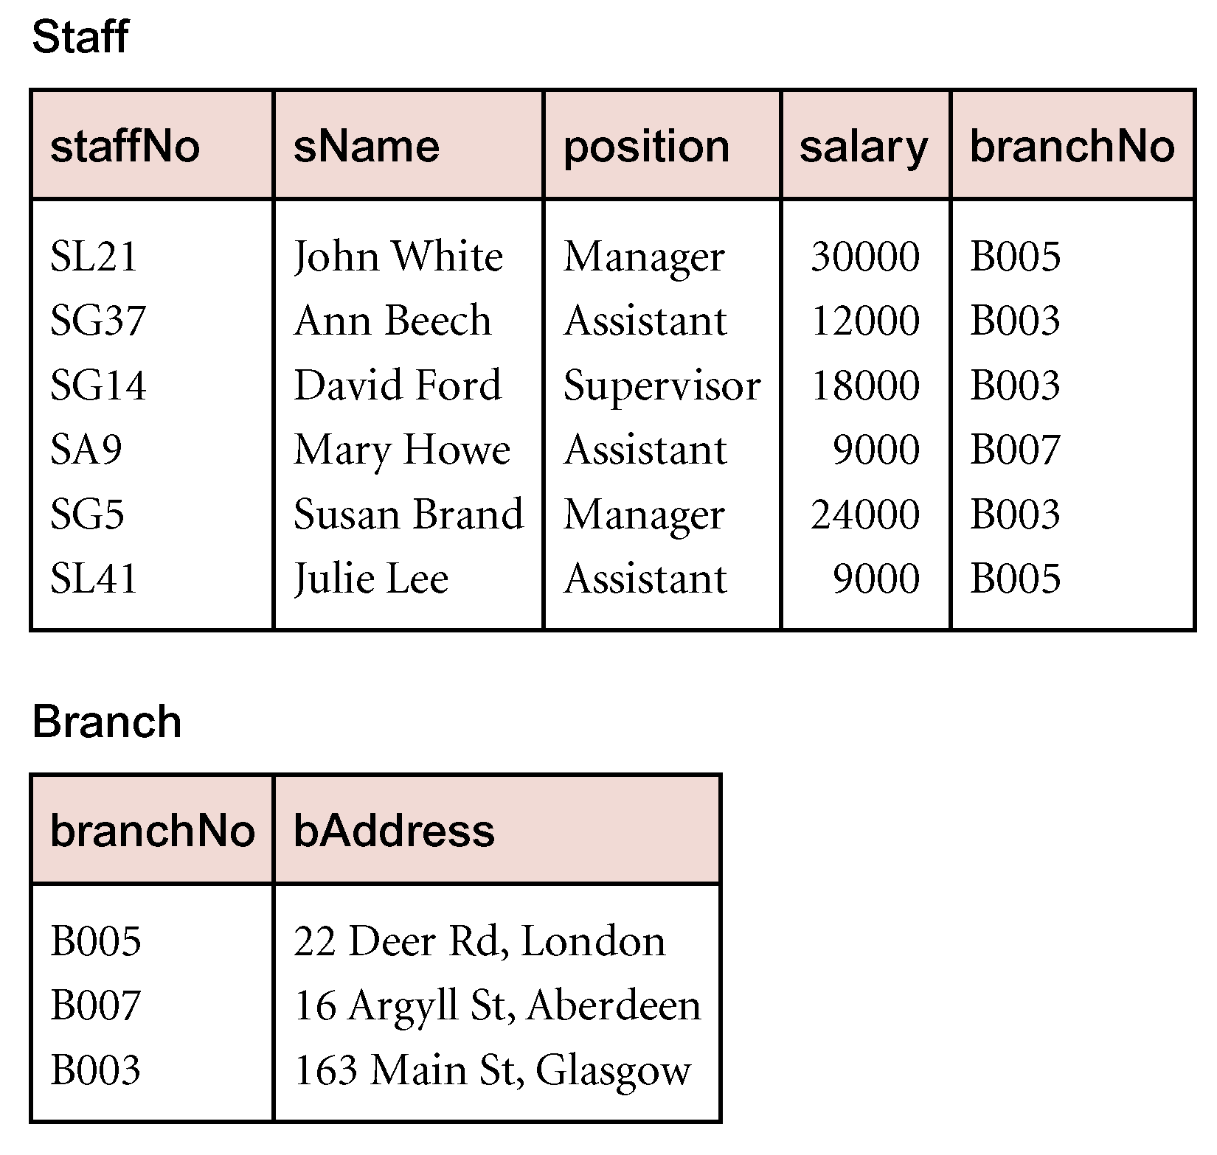
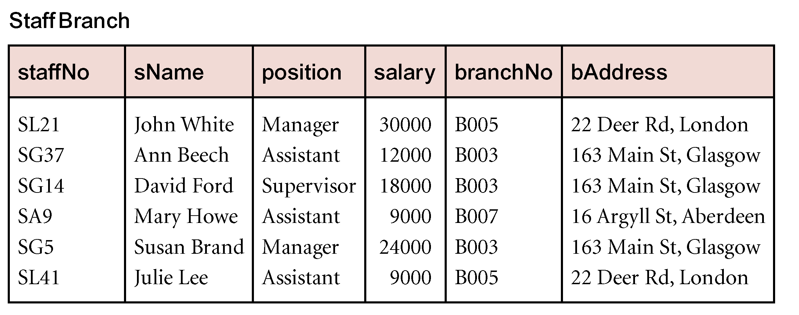
SAMPLE DATA
Pearson Education © 2014

Slide 7
Functional Dependencies
Diagrammatic representation.
The determinant of a functional dependency refers to the attribute or group of attributes on the left-hand side of the arrow.
Pearson Education © 2014

Slide 8
An Example Functional Dependency
Pearson Education © 2014

Slide 9
Characteristics of Functional Dependencies
Determinants should have the minimal number of attributes necessary to maintain the functional dependency with the attribute(s) on the right hand-side.
This requirement is called full functional dependency.
Full functional dependency indicates that if A and B are attributes of a relation, B is fully functionally dependent on A, if B is functionally dependent on A, but not on any proper subset of A.
Pearson Education © 2014

Slide 10
Example Full Functional Dependency
Exists in the Staff relation.
staffNo, sName → branchNo
True - each value of (staffNo, sName) is associated with a single value of branchNo.
However, branchNo is also functionally dependent on a subset of (staffNo, sName), namely staffNo. Example above is a partial dependency.
Pearson Education © 2014

Slide 11
Characteristics of Functional Dependencies
Main characteristics of functional dependencies used in normalization:
There is a one-to-one relationship between the attribute(s) on the left-hand side (determinant) and those on the right-hand side of a functional dependency.
Holds for all time.
The determinant has the minimal number of attributes necessary to maintain the dependency with the attribute(s) on the right hand-side.
All attributes that are not part of the primary key should be functionally dependent on the key.
Pearson Education © 2014

Slide 12
Transitive Dependencies
Important to recognize a transitive dependency because its existence in a relation can potentially cause update anomalies.
Transitive dependency describes a condition where A, B, and C are attributes of a relation such that if A → B and B → C, then C is transitively dependent on A via B (provided that A is not functionally dependent on B or C).
Pearson Education © 2014

Slide 13
Example Transitive Dependency
Consider functional dependencies in the StaffBranch relation (see Slide 5).
staffNo → sName, position, salary, branchNo, bAddress
branchNo → bAddress
Transitive dependency, branchNo → bAddress exists on staffNo via branchNo.
Pearson Education © 2014

Slide 14
The Process of Normalization
Formal technique for analysing a relation based on its primary key and the functional dependencies between the attributes of that relation.
The technique involves a series of rules that can be used to test individual relations so that a database can be normalized
to any degree.
When a requirement is not met, the relation violating the requirement must be decomposed into relations that individually meet the requirements of normalization.
Often executed as a series of steps. Each step corresponds to a specific normal form..
Pearson Education © 2014

Slide 15
Example
Examine semantics of attributes in StaffBranch relation. Assume that position held and branch determine a member of staff’s salary. With sufficient information available, identify the functional dependencies for the StaffBranch relation as:
staffNo → sName, position, salary, branchNo, bAddress
branchNo → bAddress
bAddress → branchNo
branchNo, position → salary
bAddress, position → salary
Pearson Education © 2014

Slide 16
The Process of Normalization
Normalization is a bottom-up approach to database design that begins by examining the relationships between attributes. It is performed as a serious of tests on a relation to determine whether it satisfies or violates the requirements of a given normal form.
Purpose: Guarantees no redundancy due to FDs
Normal Forms:
First Normal Form (1NF)
Second Normal Form (2NF)
Third Normal Form (3NF)
Pearson Education © 2014

Slide 17
The Process of Normalization
Pearson Education © 2014

Slide 18
Process of normalization
In the following sections describe the process of normalization in detail. Figure 13.8 page 402 provides an overview of the process and highlights the main actions taken in each step of the process.
The number of the section that covers each step of the process is also shown in that figure.

