Slide 1
GE105
Introduction to Engineering Design College of Engineering
King Saud University
Lecture 7.
Problem Formulation Case Studies
Spring 2016

Slide 2
Remember!
Need Analysis
Literature
Interview/Survey
Market Studies
Focus Groups
Interpret and Summarize
Specifications
Objectives
Constraints
Criteria
Customer Statement
Problem Formulation
Before solving a problem, answer:
Why (very few know this)
How (some know this)
What (everyone knows this)

Slide 3
Example 1:
What
Machine
Why
Wash clothes
How
Automatic
Dry clothes
Capacity up to 5 kg
Can use voltage 110V/220V
Low power consumption/wattage less than 100 Watts
Portable washing machine
Noise level must not exceed 65dB
Must be safe
Filter for the water
Water inlet and outlet
Cost must not exceed SR500
Weight must be less than 100N
Statement:
Needs:
Device to wash clothes
Can be easily operated
Can be started by operating the timer manually
Variation of rotating speed for different types of clothes

Slide 4
Constraints
Capacity Up to 5kg
Noise level less than 65 dB
Size : 1mx 0.9mx0.5m
Weight not more than 100N (10kg mass)
Cost less than SR500
After drying no water drop from the clothes
110/220 volts
Portable
Life more than 5 Years
Electric consumption less than 100 W.h (Watt-hours)
Criteria
High effectiveness of cleaning the clothes
High durability
Easy to use (simple)
High number of cloth types

Slide 5
Safety specifications
If overloaded, the machine shouldn’t start
Maximum water level to prevent water waist and dangerous current short-cuts.
Electrical grounding
Stop spinner if the door is opened
Kids protection by motor isolation

Slide 6
Problem Formulation [paragraph(s)]
Design a simple washing machine that can wash different types of clothes and dry them by various spinning speeds. The machine should be 5kg capacity and easily manipulated. Its size should be limited to 1m/0.9m/0.5m and its weight is not to exceed 100N. The washing machine must be portable and able to function using 110V or 220V voltage. The machine consumption and cost should be respectively limited to 100 watt-hours and to 500SR. The minimum life duration of the machine should be 5 years.
The machine should have a water level to prevent water waist and be grounded to avoid electrical shortcuts. Besides, it shouldn’t start If overloaded and must stop spinning if its door is open. A motor isolation for kids protection is also a must.

Slide 7
Needed Information to be gathered :
Motor power to be used
Speed for various types of clothes
Timing needed to clean common types of clothes and dry them
Common types of clothes to be washed
Characteristics of each type of clothes (spinning speed, adequate washing temperature…etc.)

Slide 8
Example 2
Statement: Need a simple device to crash cans
Needs Analysis:
Design a simple device to crash cans (soft drinks)
The final product is recycling (green design)
Does not occupy large space
High strength material
It costs 80 – 100 S.R.
High safety
Design for kids
Light weight (portable)
Easy to use
Easy to maintain
Heavy and large base (does not tip over)
Will be used by human power (foot, hands or both)
Using available materials/components

Slide 9
Primary objective:
To design a simple ,easy to use device to crash cans
Secondary objective:
The device should be easy to construct, easy to maintain, marketable and portable
Constraints:
The cost should not exceed 100 S.R.
The weight should not exceed 5 kg.
Applied Force should be less than 30 N
Does not tip over

Slide 10
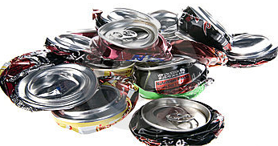
Criteria :
Low cost
Light weight
Low force
High Safety
Simple to manufacture
Needed Information:
Type of materials used
Typical existing devices in the market
Different can sizes
Mechanism for applying force

Slide 11
Need Analysis
Example # 3
Statement: Need a device for securing a coffee cup near the driver's seat of an automobile
Coffee cup holder for car (near the driver seat)
Locking system to prevent the cup from spilling
It does not interfere with the proper operation of the car
Adaptable to a wide variety of vehicles
Detachable (Designed to be unfastened or disconnected without damage)
Easy to use
Durable material for various temperatures
No need to modify car interior
Cost not exceed SR 50
Flexibility of coffee cup size

Slide 12
Primary Objectives
A device for securing a coffee cup near the driver’s seat of an automobile
Secondary Objectives:
The device should be detachable
No modification of car interior is needed

Slide 13
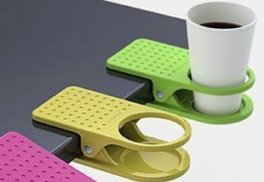
Constraints
Spilling free
Does not interfere with the driver
Size max 200 x 150 x 150 mm (HxWxL)
Weight not to exceed 0.5 kg
Cost less than SR 50
2 years lifetime
Criteria
Simple
Easy to install and dispatch
Durable
Strong attachment to the car
High adaptability to car types
High adaptability to cup sizes

Slide 14
Problem Formulation
Design a simple device for securing a coffee cup near the driver’s seat of an automobile that prevents the cup from spilling. The device should not interfere with the proper operation of the driver and should be adaptable to a wide variety of vehicles and coffee cup size. The device should be easy to install and detach and no interior modification of the car should be needed. The maximum size and weight if the device are respectively 200 x 150 x 150 mm³ and 2 kg. It should also be durable offering a minimum of two years lifetime and cost less than 50 SR.

Slide 15
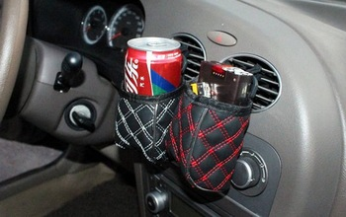
Needed Information
Average amount of coffee in cup
Average coffee cup size and weight
Coffee cup material
General car interior layout/design
Temperature inside the car (max/min)
Available relevant holder design in the market

