Slide 1
RENAL CALCULI

Slide 2
What are Renal Calculi ? (kidney stones) A kidney stone is a solid mass made up of tiny crystals. .
Urine passes away from the kidneys, down a tube on each side called the ureters, and into the bladder. From here, the urine is discharged through the urethra
If there is too much of certain waste products in the urine, these substances form crystals
Crystals can then combine to form stones.

Slide 3
Kidney Stone Formation
Kidney stones result from crystals in the urine
aggregating together when the urine becomes highly
concentrated.
If these stones become large enough, they cause
obstruction of the kidney drainage system which may
result in severe pain, bleeding, infection,
Factors that exacerbate stone formation include
concentrated urine, acidity of urine.
Example of crystal found in acidic urine: uric acid
Example of crystal found in alkaline urine: calcium
phosphate.

Slide 4
Types of kidney stones
Most common types of kidney stone:
Calcium stones:
When calcium combines with another mineral, insoluble crystals which are either calcium oxalate or calcium phosphate.
This may happen if there is too much calcium in the diet from milk, cheese or bread.
Other people may have an overactive parathyroid gland (hyperparathyroidism). This results in calcium being leached out of the bones and it has nowhere else to go but the urine.

Slide 5
Uric acid stones:
- These form crystals in the urine.
They are commonly due to high purine diet, in patients who suffer from gout.
A diet rich in purine may increase uric acid in urine.
If uric acid becomes concentrated in the urine, it can settle and form a stone
These stones form in acidic urine.
A study has shown that consuming animal protein is associated with increased serum and urine uric acid in healthy individual.

Slide 6
Oxalate stones
can occur if there is too much oxalate in the diet (e.g spinach, chocolates and certain nuts).
They are more likely occur in people who have a bowel problem in which fat is not being absorbed properly.

Slide 7
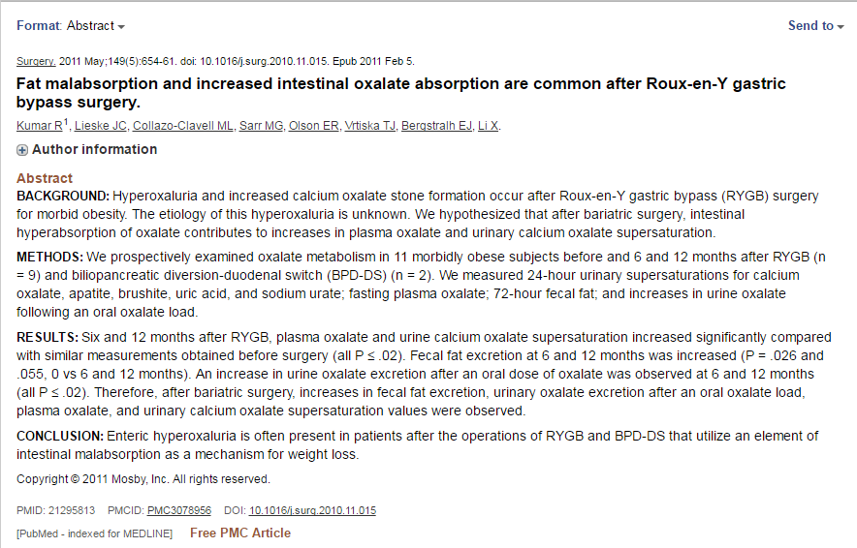
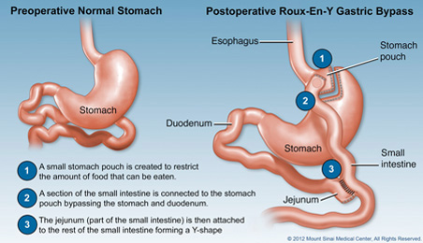

Slide 8
Cystine stones:
These are rare stone where the kidneys leak high quantities of the amino acid cystine.
An excess of cystine crystals are found in the urine of affected patients which clump together to form stones.

Slide 9
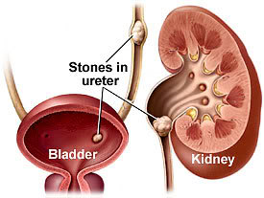

Slide 10
Symptoms
Sudden severe back pain and radiating towards the groin.
May be associated with nausea, vomiting, abdominal bloating, possible blood in urine, pain during urination, chills and fever.
Stones in the urinary tract can be one of the most painful conditions known to humankind.

Slide 11
Different factors can increase risk of developing
kidney stone:
Examples:
- dehydration
- certain diet:
(Too much sodium in diet increases the
amount of calcium).

Slide 12
Why do Renal Calculi occur?
Inherited tendency
Infections
Low urine flow.
Kidney stones form when a change occurs in the normal balance of water, salts, and minerals.
The most common cause of kidney stones is not drinking enough water.

Slide 13
Tests to diagnose kidney stones
●Blood test:
Blood tests may reveal too much calcium or uric
acid in blood.
●Urine test:
-High or low levels of chemicals that inhibit or
promote stone formation.
presence of red blood cell
- crystals
(crystals in urine sample are examined under a microscope)

Slide 14
Tests to diagnose kidney stones
Imaging test:
may show kidney stones in urinary tract.
Example:
- CT scan (computed tomography scan)
[kidneys, ureter, and bladder].
- (IVP)

Slide 15
Microscopic Examination (urine test)
The kidney stones obtained from the urine sample are examined under a microscope.
The crystal formations are often specific enough so that the doctor is able to identify the substance causing the stone.

Slide 16
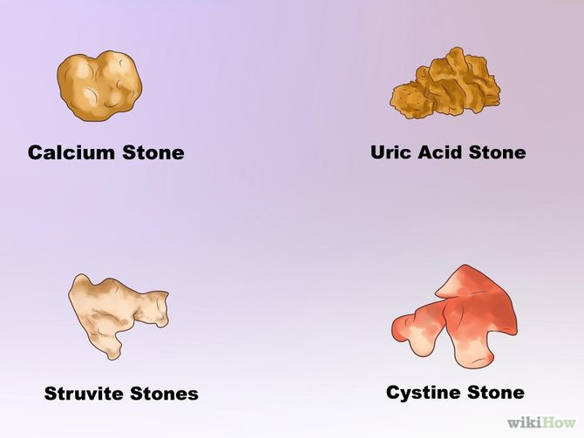

Slide 17
Testing the Acidity of Urine
Testing whether urine is acidic or alkaline helps to identify the specific type of stone:
A solution with a low pH (below 7.0) is acidic. (A low pH favors uric acid and cystine stones.)
A solution with a high pH is alkaline. (A high pH favors calcium phosphate stones.)

Slide 18
Testing for Blood in the Urine
A dipstick test for blood in the urine (called hematuria) is typically performed when patients appear in the emergency room with flank pain (the primary symptom of kidney stones).
About a third of kidney stone patients do not show blood in the urine, so other tests may be needed.

Slide 19
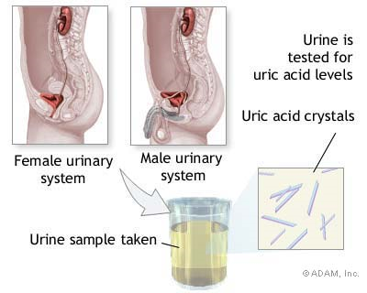

Slide 20
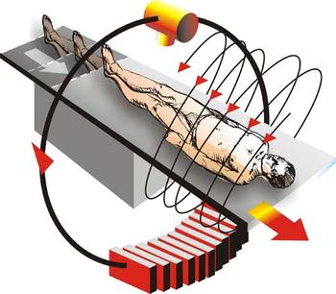
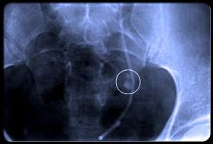
Spiral CT scan
Imaging test:

Slide 21
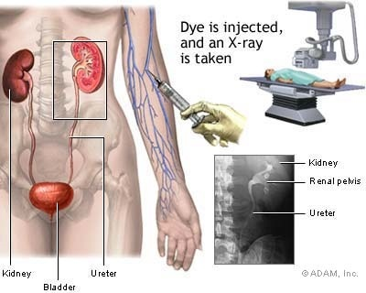
Intravenous pyelogram (IVP)
Imaging test

Slide 22
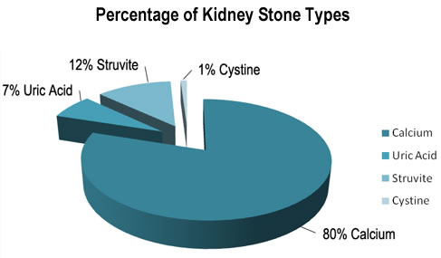

Slide 23
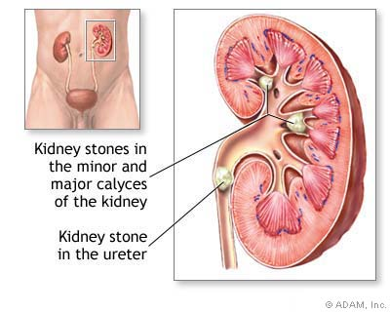

Slide 24
Treatment of small stones
Drinking water. Drinking as much as 2.0 to 2.8 liters a day may help flush out your urinary system.
Pain relievers. Passing a small stone can cause some discomfort. To relieve mild pain, your doctor may recommend pain killers.
Medical therapy. Your doctor may give you a medication to help pass your kidney stone. This type of medication, known as an alpha blocker, relaxes the muscles in your ureters, helping you to pass the kidney stone more quickly and with less pain.

Slide 25
Treatment of large stones
Using sound waves to break up stones. For certain kidney stones — depending on size and location — your doctor may recommend a procedure called extracorporeal shock wave lithotripsy (ESWL).
ESWL uses sound waves to create strong vibrations (shock waves) that break the stones into tiny pieces that can be passed in your urine.
The procedure lasts about 45 to 60 minutes and can cause moderate pain, so you may be under sedation or light anaesthesia to make you comfortable.

Slide 26
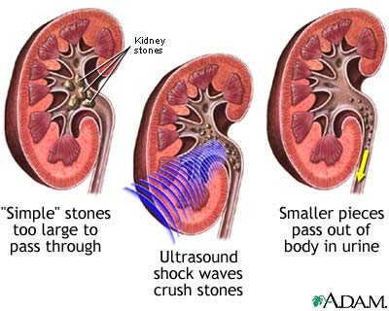
Lithotripsy procedure

Slide 27
Surgery to remove very large stones in the kidney. involves surgically removing a kidney stone using small telescopes and instruments inserted through a small incision in your back.
Using a scope to remove stones. To remove a smaller stone in your ureters or kidney, your doctor may pass a thin lighted tube (ureteroscope) equipped with a camera through your urethra and bladder to your ureter.

Slide 28
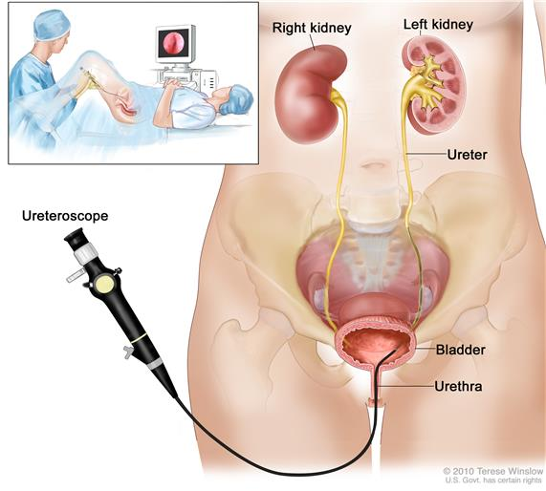
Uterscope

Slide 29
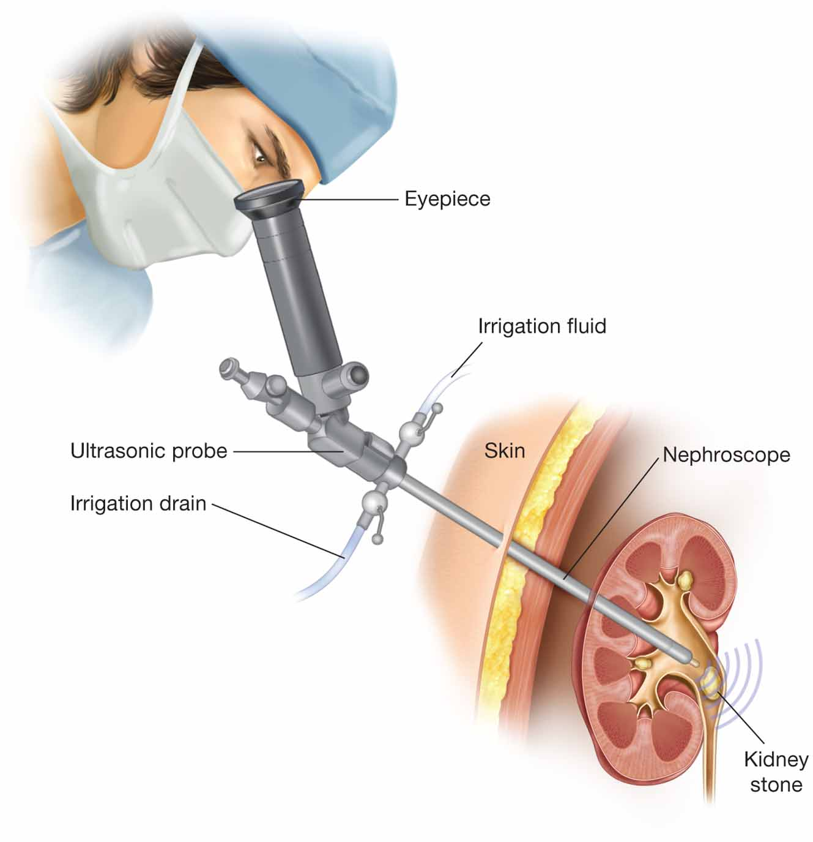
Telescope

Slide 30
https://www.youtube.com/watch?v=PV7K_C63Orc

