Slide 1
Phylum: Apicomlexa Toxoplasmosis, Cryptosporidum and Cyclospora cayetanensis .
Phylum: Microspora
Microsporidia

Slide 2
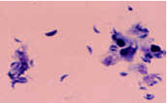
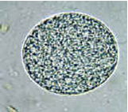
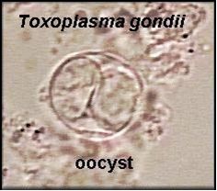
Toxoplasma gondii: Morphology
Three forms of parasite involve man:
Trophozoite (tachyzoite):
Bradyzoite (true cyst):
oocysts:

Slide 3
Life cycle and Epidemiology:

Slide 4
Clinical picture:
1- majority are asymptomatic.
2- acute toxoplasmosis: fever, lymphadenopathy ; can rarely cause specific organ inflammation, e.g. encephalitis, myocarditis.
3- reactivation toxoplasmosis.
4- choreoretinitis.
5- congenital toxoplasmosis.
6- Children toxoplasmosis.

Slide 5
Diagnosis and treatment:
Serology (IgG & IgM) or PCR is the usual means of diagnosis.
biopsy of organ, e.g. brain reveal the trophozoites (tachyzoites).
biopsy of lymph nodes reveals suggestive pathology but rarely trophozoites.
immunofluorescent staining of biopsy sections.
Treatment: antifolates or spiramycin.

Slide 6
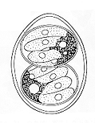
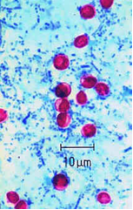
Cryptosporidum parvum:
Habitat: small intestine.
oocyst (4-6 µm), rounded with 4 sporozoites.

Slide 7
Life cycle:

Slide 8
Clinical picture:
asymptomatic - maybe the majority.
symptomatic - acute diarrhea of 1-2 weeks, which is self limiting in normally immune persons.
chronic diarrhea , malabsorption and electrolyte disturbance most commonly in immunocompromized which may be fatal.

Slide 9
Diagnosis and treatment:
Stool examination - special stains (modified Ziehl-Neelsen, fluorescent).
Small intestinal biopsy.
Duodenal aspiration.
Cryptosporidium antigen detection in stool.
Treatment: no effective treatment, Spiramycin is experimentally tested and start to give positive results.

Slide 10
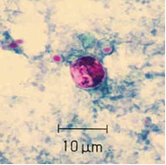
Cyclospora cayetanensis:
Habitat: small intestine
Oocyst is unsporulated and 10 µm.

Slide 11
Life cycle:

Slide 12
Clinical picture:
Asymptomatic.
Symptomatic: acute diarrhea of several weeks, which is self limiting in normally immune persons, but it is severe and may be fatal in immunodeficient individuals.

Slide 13
Diagnosis and treatment:
Stool examination and concentration; modified Ziehl-Neelsen stains
Small intestinal biopsy.
Treatment: Septra (trimethoprin - sulfa).

Slide 14
Phylum Microspora Microsporidia :
They are spore-forming obligate intracellular parasites.
Causing intestinal and extraintestinal diseases in both immunocompetent and immunosuppressed individuals.
Seven genera have been recognized in humans which affect the small intestine.

Slide 15
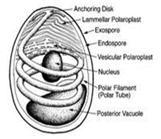
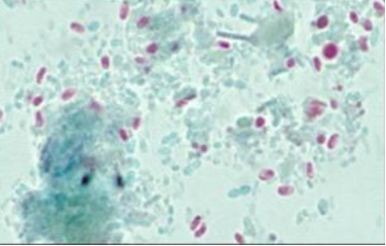
Habitat: Multiple organ systems according to the species.
Morphology:
The spores are very resistant, having thick wall, 1x1.5 microns, oval in shape.

Slide 16
Life cycle:

Slide 17
Clinical picture:
According to the species. It can produce diarrhea, malabsorption, keratoconjunctivitis, peritonitis, hepatitis, myositis, sinusitis, infection of the kidney and gall bladder.
It is a severe disease in immunocompromized patients and must be considered as a significant cause of death.

Slide 18
Diagnosis and treatment:
Microscopic identification of the spores in faeces, urine and other body secretions by Modified Trichrome stain.
Serology as IFAT, ELISA.
Molecular techniques (Diagnosis, species differentiation).
Treatment: Albendazole is effective in some species.

