Slide 1
EE 201 Lecture 6 -Week 3

Slide 2
Chapter 8 Methods of Analysis and Selected Topics (dc)
Current sources
Source conversions
Current sources in parallel
Current sources in series

Slide 3
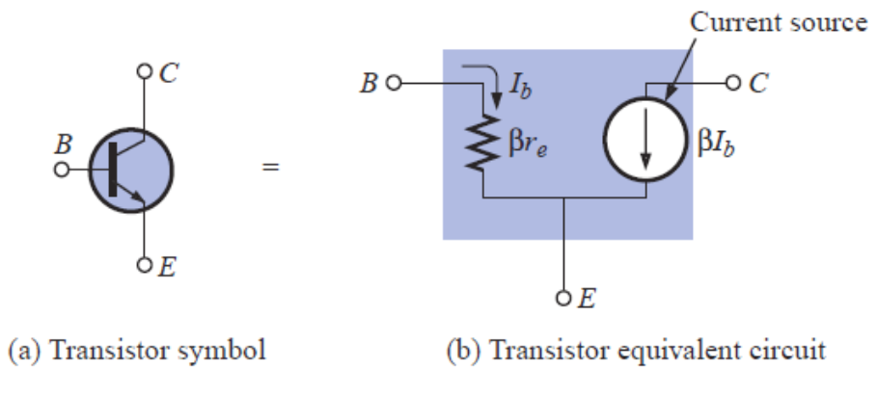
Current Sources
Current source is the dual of the voltage source:
Current source supplies fixed current to the branch in which it is located; the voltage across its terminal can vary.
The interest in current source is due to semiconductor devices (transistors)

Slide 4
Example

Slide 5
Source Conversion

Slide 6
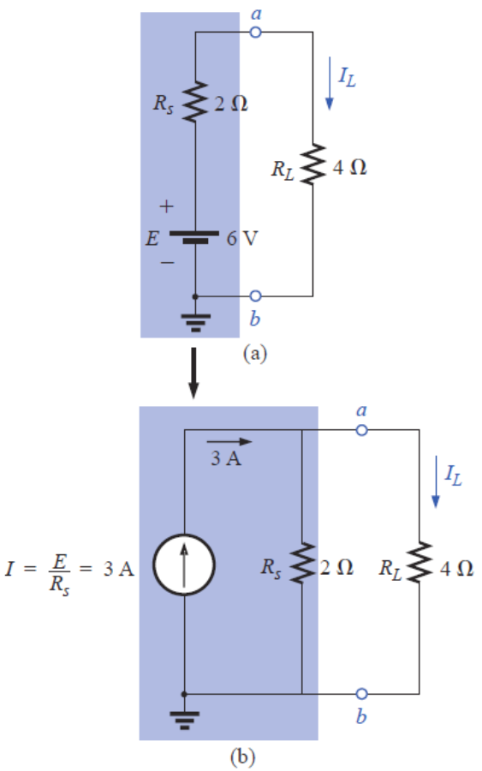
Example

Slide 7
Current Sources in Parallel

Slide 8
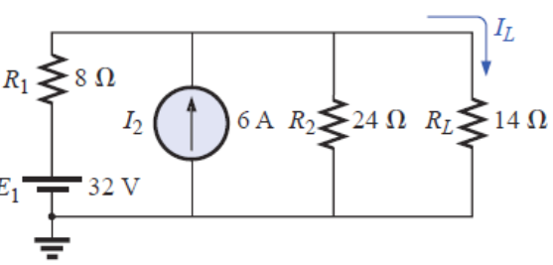
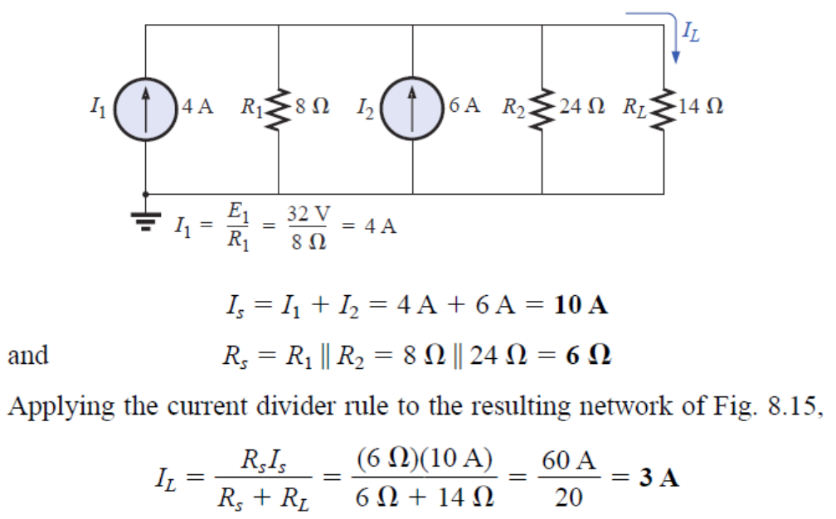
Example

Slide 9
Current Sources in Series

Slide 10
Quiz 1

