Slide 1
Chapter 5:
Some Discrete Probability Distributions

Slide 2
Discrete Uniform Distribution
If the discrete random variable X assumes the values $x_{1}$, $x_{2}$, …, $x_{k}$with equal probabilities, then X has the discrete uniform distribution given by:

Slide 3
Note:
• $f(x)=f(x;k)=P(X=x)$
• $k$is called the parameter of the distribution.

Slide 4
Example
Experiment: tossing a balanced die.
• Sample space: $S=\{1,2,3,4,5,6\}$
• Each sample point of $S$occurs with the same probability 1/6.
• Let X= the number observed when tossing a balanced die.
• The probability distribution of X is:

Slide 5
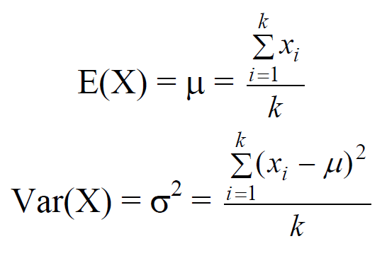
Theorem
If the discrete random variable X has a discrete uniform distribution with parameter k, then the mean and the variance of X are:

Slide 6
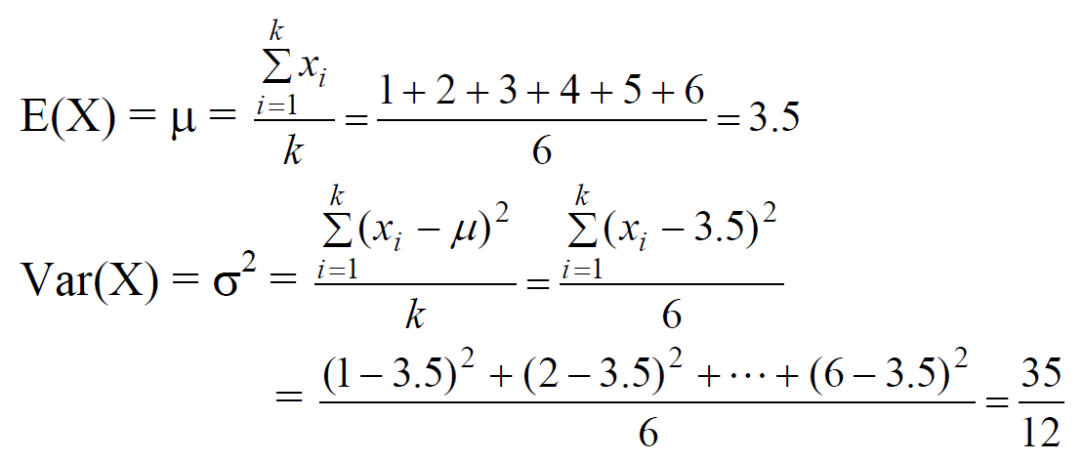
Example
Find E(X) and Var(X) in the previous example
Solution:

Slide 7
Bernoulli Process
Bernoulli process is an experiment that must satisfy the following properties:
1. The experiment consists of n repeated Bernoulli trials.
2. The probability of success, $P(s)=p$, remains constant from trial to trial.
3. The repeated trials are independent; that is the outcome of one trial has no effect on the outcome of any other trial

Slide 8
Binomial Distribution
Consider the random variable :
X = The number of successes in the n trials in a Bernoulli process.
The random variable X has a binomial distribution with parameters n (number of trials) and p (probability of success), and we write:
$$X \sim Binomial(n,p) or X\sim b(x;n,p)$$

Slide 9
The probability distribution of X is given by:

Slide 10
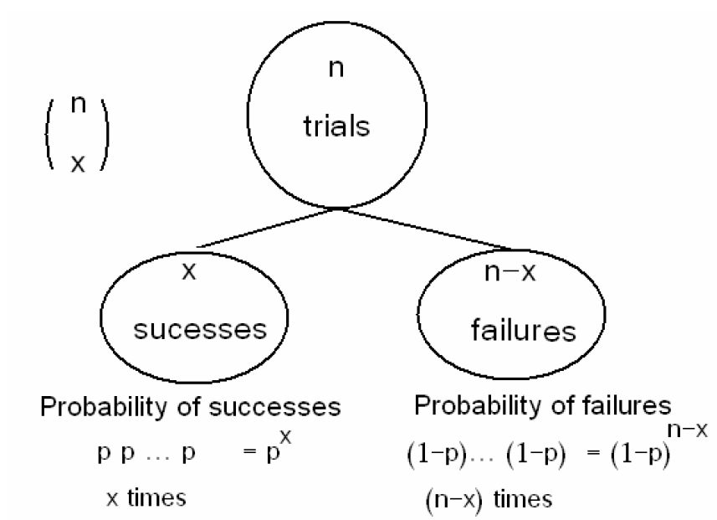

Slide 11
Theorem
The mean and the variance of the binomial distribution $b(x;n,p)$ are:
$$μ = n p$$
$$σ2 = n p (1 −p)$$

Slide 12
Example:
Suppose that 25% of the products of a manufacturing process are defective. Three items are selected at random, inspected, and classified as defective (D) or non-defective (N). Find
The probability distribution of the number of defective items.
The expected value (mean) and the variance of the number of defective items.

Slide 13
3. The probability of getting at least two defective items.
4. The probability of getting at most two defective items.

Slide 14
Solution:
• Experiment: selecting 3 items at random, inspected, and classified as (D) or (N).
• The sample space is S={DDD,DDN,DND,DNN,NDD,NDN,NND,NNN}
• Let X = the number of defective items in the sample.
The experiments is a Bernoulli process with:
• number of trials: $n=3$
• Probability of success: $p=1/4=0.25$
• $X \sim Binomial(n,p)=Binomial(3,1/4)$

Slide 15
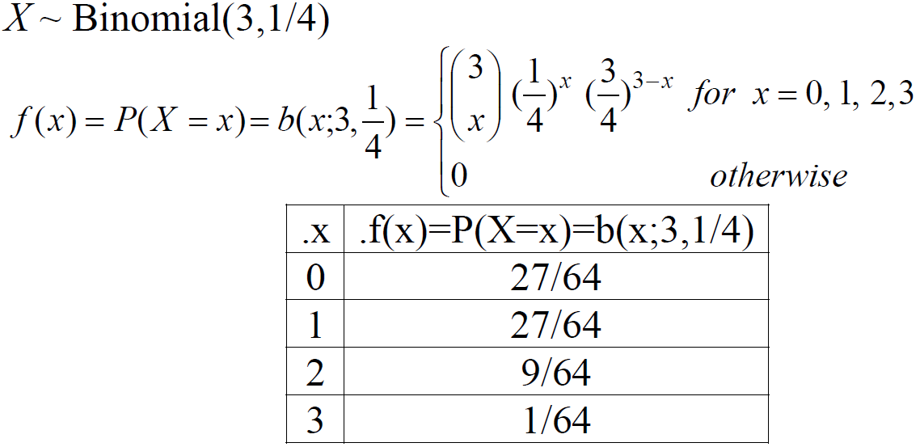
1. The probability distribution of X is given by:

Slide 16
2. The expected number of defective items is
$$E(X)=μ = n p = (3) (1/4) = 3/4 = 0.75$$
The variance of the number of defective items is
$$Var(X)=σ2 = n p (1 −p) = (3) (1/4) (3/4) = 9/16 = 0.5625$$

Slide 17
3. The probability of getting at least two defective items:
$$P\left(X≥2\right)=P\left(X=2\right)+P\left(X=3\right)= f\left(2\right)+f\left(3\right)=\frac{9}{64}+\frac{1}{64}=\frac{10}{64}$$
4. The probability of getting at most two defective item:
$$P(X≤2) = P(X=0)+P(X=1)+P(X=2)$$
$$= f\left(0\right)+f\left(1\right)+f\left(2\right)=\frac{27}{64}+\frac{27}{64}+\frac{9}{64}=\frac{63}{64}$$
or
$$P\left(X≤2\right)= 1−P\left(X>2\right)= 1−P\left(X=3\right)= 1− f\left(3\right)= 1−\frac{1}{64}=\frac{63}{64}$$

Slide 18
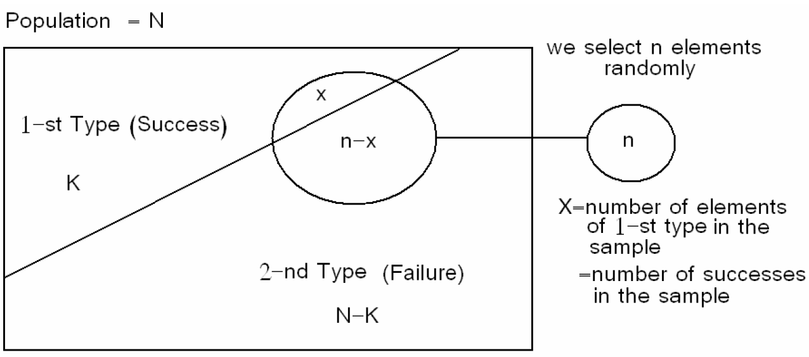
Hypergeometric Distribution
Suppose there is a population with 2 types of elements: 1-st Type = success 2-nd Type = failure
• N= population size • K= number of elements of the 1-st type
• N −K = number of elements of the 2-nd type
• We select a sample of n elements at random from the population
• Let X = number of elements of 1-st type (number of successes) in the sample
• We need to find the probability distribution of X.

Slide 19
There are to two methods of selection:
1. selection with replacement
2. selection without replacement
(1) If we select the elements of the sample at random and with replacement, then
$X \sim Binomial(n,p);$where $p=\frac{k}{N}$
(2) Now, suppose we select the elements of the sample at random and without replacement. When the selection is made without replacement, the random variable X has a hypergeometric distribution with parameters N, n, and K. and we write $X\sim h(x;N,n,K).$

Slide 20
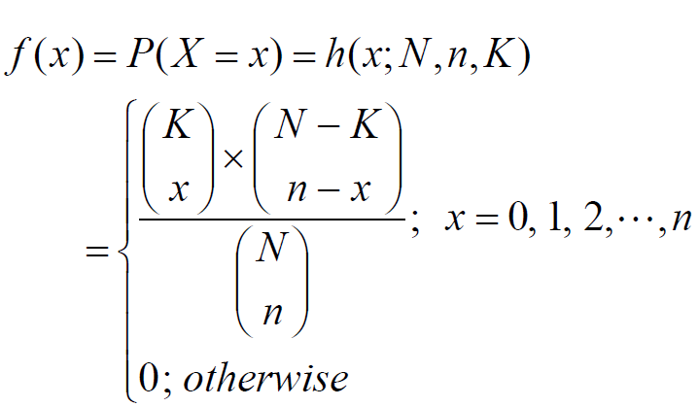
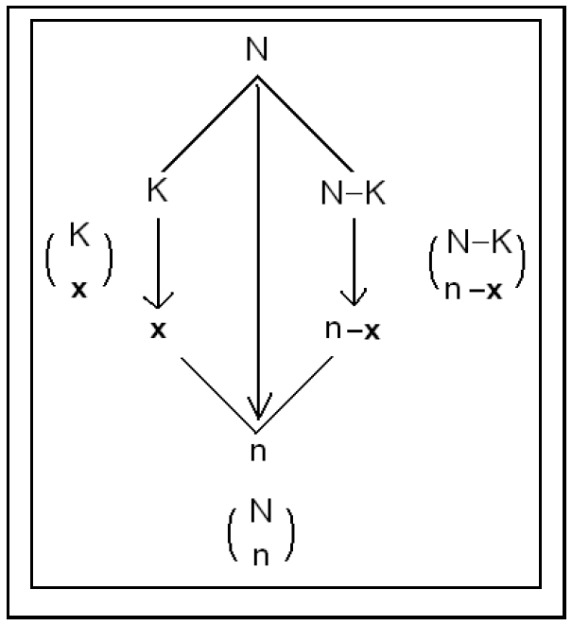

Slide 21
Note that the values of X must satisfy:
$$0≤x≤K and 0≤n−x≤ N−K$$
$$⇔$$
$$0≤x≤K and n−N+K≤ x≤ n$$

Slide 22
Example
Lots of 40 components each are called acceptable if they contain no more than 3 defectives. The procedure for sampling the lot is to select 5 components at random (without replacement) and to reject the lot if a defective is found. What is the probability that exactly one defective is found in the sample if there are 3 defectives in the entire lot.

Slide 23
Solution:
Let X= number of defectives in the sample
• $N=40, K=3, and n=5$
• X has a hypergeometric distribution with parameters $N=40, n=5, and K=3.$
• $X\sim h(x;N,n,K)=h(x;40,5,3).$
• The probability distribution of X is given by:

Slide 24
But the values of X must satisfy:
$$0≤x≤K and n−N+K≤ x≤ n ⇔ 0≤x≤3 and −32≤ x≤ 5$$
Therefore, the probability distribution of X is given by:

Slide 25
Now, the probability that exactly one defective is found in the sample is

Slide 26
Theorem
The mean and the variance of the hypergeometric distribution $h(x;N,n,K)$ are:
$$μ=n\frac{k}{N}$$
$σ^{2}=$$n\frac{k}{N} \left(1−\frac{k}{N}\right)\frac{N−n}{N−1}$

Slide 27
Example
In the previous example, find the expected value (mean) and the variance of the number of defectives in the sample.
Solution:
• X = number of defectives in the sample
• We need to find E(X)=μ and Var(X)=σ²
• We found that $X \sim h(x;40,5,3)$
• $N=40, n=5, and K=3$

Slide 28
The expected number of defective items is

Slide 29
Poisson Distribution:
Poisson experiment is an experiment yielding numerical values of a random variable that count the number of outcomes occurring in a given time interval or a specified region denoted by t.
X = The number of outcomes occurring in a given time interval or a specified region denoted by t.

Slide 30
Examples:
1. X = number of field mice per acre ($t= 1$acre)
2. X= number of typing errors per page ($t=1$ page)
3. X=number of telephone calls received every day ($t=1$ day)
4. X=number of telephone calls received every 5 days ($t=5$ days)

Slide 31
Let λ be the average (mean) number of outcomes per unit time or unit region ($t=1$).
The average (mean) number of outcomes (mean of X) in the time interval or region t is:
$$μ = λ t$$

Slide 32
The random variable X is called a Poisson random variable with parameter $μ (μ=λt),$and we write $X\sim Poisson(μ)$, if its probability distribution is given by:

Slide 33
Theorem
The mean and the variance of the Poisson distribution $Poisson(x;μ)$ are:
$$μ=λ.t$$
$$σ^{2}=μ=λ.t$$

Slide 34
Note:
• λ is the average (mean) of the distribution in the unit time ($t=1$).
• If X=The number of calls received in a month (unit time $t=1$ month) and $X\sim Poisson(λ)$, then:
(i) Y = number of calls received in a year.
$$Y \sim Poisson (μ); μ=12λ (t=12)$$
(ii) W = number of calls received in a day.
$$W \sim Poisson (μ); μ=λ/30 (t=1/30)$$

Slide 35
Example:
Suppose that the number of typing errors per page has a Poisson distribution with average 6 typing errors.
(1) What is the probability that in a given page:
(i) The number of typing errors will be 7?
(ii) The number of typing errors will be at least 2?
(2) What is the probability that in 2 pages there will be 10 typing errors?
(3) What is the probability that in a half page there will be no typing errors?

Slide 36
Solution:
(1) X = number of typing errors per page.
$$X \sim Poisson (6) (t=1, λ=6, μ=λt=6)$$

Slide 38
(2) X = number of typing errors in 2 pages
$$X \sim Poisson(12) (t=2, λ=6, μ=λt=12)$$

Slide 39
(3) X = number of typing errors in a half page.
$$X \sim Poisson (3) (t=1/2, λ=6, μ=λt=6/2=3)$$

