Slide 1
Storage
Chapter 6
By
Hussein Alhashimi

Slide 2
Storage
Chapter 6
Storage holds data, instructions and information for future use.
Storage medium, also called secondary storage,
Is the physical material on which a computer keeps data, instructions and information.
For Example: hard disks, floppy disks, Zip disks, CDs and DVDs, tape, Pc Cards, flash memory cards, USB flash devices and microfilm.

Slide 3
Storage
Chapter 6
Capacity is the number of bytes (characters) a storage medium can hold.
Storage Term | Approximate number of bytes | Exact number of bytes
Kilobyte (KB) | 1 thousand | 2¹⁰ Or 1,024
megabyte (MB) | 1 million | 2²⁰
Gigabyte (GB) | 1 Billion | 2³⁰
Terabyte (TB) | 1 trillion | 2⁴⁰
Petabyte (PB) | 1 quadrillion | 2⁵⁰
Exabyte (EB) | 1 quintillion | 2⁶⁰
Zettabyte (ZB) | 1 sextillion | 2⁷⁰
Yottabyte (YB) | 1 septillion | 2⁸⁰

Slide 4
Storage
Chapter 6
Storage device is the computer hardware that records and/or retrieves items to and from storage media.
Writing is the process of transferring data, instructions, and information from memory to a storage medium.
Reading is the process of transferring these items from a storage medium into memory.

Slide 5
Storage
Chapter 6
The speed of storage devices is defined by access time.
Access time measures the amount of time it takes a storage device to locate an item on a storage medium.
The access time of storage device is slow (millisecond) , compared with the access time of memory (nanosecond ).

Slide 6
Storage device 1-Magnetic Disks
Chapter 6
Use magnetic particles to store items such as data, instructions and information on a disk’s surface.
Store data and instructions in tracks and sectors.
Track is a full circle on the surface of the disk.
typically stores up to 512 bytes of data.
Three type of magnetic disks are Hard disks ,Floppy disks and Zip disks.
Some of these disks are portable which means you can remove the medium from one computer and carry it to another computer; others are not.

Slide 7
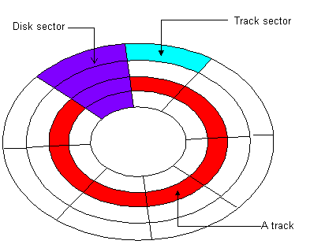
Chapter 6

Slide 8
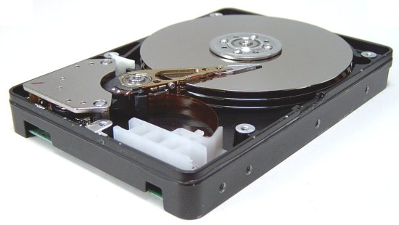
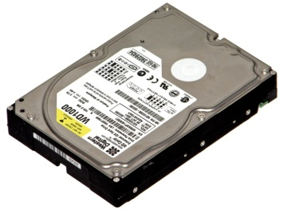
A- Hard Disks
Chapter 6
Is a storage device that contains one or more inflexible, circular platter that store data, instructions and information.
The System unit on most desktop and notebook computers contains at least one hard disk.
The entire device is enclosed in an airtight, sealed case to protect it from contamination.
A hard disk that is mounted inside the system unit sometimes is called a fixed disk because it is not portable.
Current personal computer hard disks have storage capacities from 80 to 500 GB and more.

Slide 9
Characteristics of a Hard Disks
Chapter 6
The capacity of a hard disk is determined from the number of platters it contains.
Platter is made of aluminum, glass, or ceramic.
On desktop computer, platters most often have size of approximately 3.5 inches in diameter.
While the computer is running, the platters rotate at a high rate of speed.
The platters typically continue to spin until power is removed from the computer.
On many computers, the hard disk stops spinning after a specified time to save power.
Backup is a duplicate of a file, program, or disk that you can use in case the original is lost, damaged, or destroyed.
http://www.youtube.com/watch?v=9eMWG3fwiEU

Slide 10
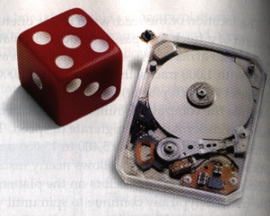
Miniature Hard Disks
Chapter 6
Many mobile device and consumer electronics include miniature hard disks.
These tiny hard disks are found in devices such as audio players, digital cameras, smart phones, and PDAs.
It has a greater storage capacities than flash memory.
Miniature hard disk have storage capacities that range from 2 GB to 120 GB.

Slide 11
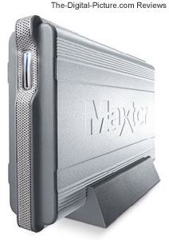
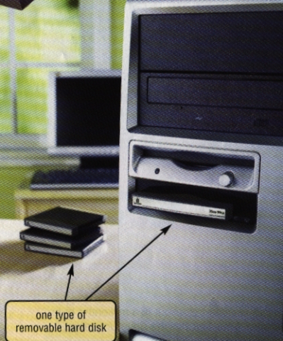
Portable Hard Disks
Chapter 6
Its either are external or removable and have storage capacities up to 500 GB or higher.
The entire hard disk is enclosed in an airtight, sealed case.
External hard disk is a separate freestanding hard disk that connects with a cable to a USB port or FireWire port on the system unit.
Removable hard disk is a hard disk that you insert and removed from a drive.

Slide 12
Online Storage
Chapter 6
Is a service on the web that provides hard disk storage to computer users usually for a minimal monthly fee.
User subscribe to an online storage service for a variety reasons:
To access files on the Internet hard disk from any computer or device that has Internet access.
To share these file with other people instead of e-mailing the files to them.
To store backups of data.

Slide 13
Online Storage

Slide 14
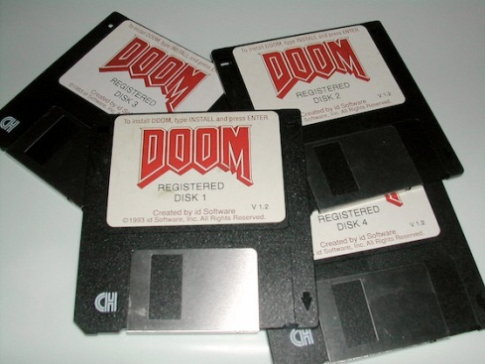
B- Floppy Disks, also called Diskette
Chapter 6
Is a portable, inexpensive storage medium that consists of a thin, circular, flexible plastic film with a magnetic coating enclosed in square shape plastic shell
A typical floppy disk is 3.5 inches wide and can store up to 1.44 MB.
You can read from/ write on a floppy disk any number of times.

Slide 15
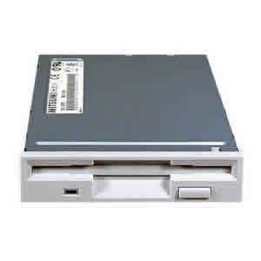
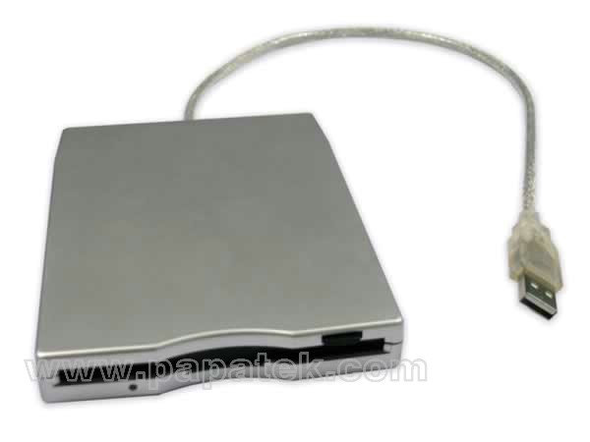
Floppy disk drive
Chapter 6
Is device that read from/write on floppy disk.
User inserts diskette in and removes it from floppy device.
In past PCs and notebook computers had a floppy drive installed inside the system unit.
Most computer today do not include a floppy disk driver as standard equipment. On these computer you can use external floppy disk drive.

Slide 16
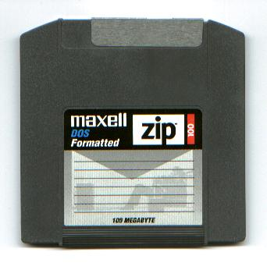
C- Zip Disks & Zip Drive
Chapter 6
Is a type of portable magnetic media that can store from 100 MB to 750 MB of data.
Zip Drive
Is a high capacity disk drive developed by Iomega Corporation that reads from and writes on a Zip disk.

Slide 17
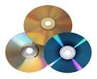
2-Optical Discs
Chapter 6
Is a type of optical storage media that consists of a flat, round, portable, disc made of metal, plastic.
The Disc Size usually are 4.75 inches in diameter.
Some Optical disc formats read only, others are read/write.
Every PC today includes some type of optical disc drive installed in a drive bay.
With some discs, you can read and / or write on one side only. Other discs are double-sided.

Slide 18
Optical Discs
Chapter 6
Many different formats of optical discs exist today. DVDs having a much greater storage capacity than CDs.
Optical Disc | Read | Write | Erase
CD-Rom | Y | N | N
CD-R | Y | Y | N
CD-RW | Y | Y | Y
DVD-ROM | Y | N | N
DVD-R /DVD+R | Y | Y | N
DVD-RW / DVD+RW/ DVD+RAM | Y | Y | Y

Slide 19
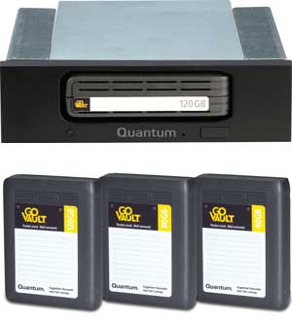
TAPE
Chapter 6
One of the first storage media used with mainframe computer was tape.
Tape is a magnetically coated ribbon of plastic capable of storing large amounts of data and information at a low cost.
Tape no longer is used as a primary storage.
A tape drive reads and write data and information on a tape.
Tape storage requires sequential access, which refers to reading or writing data one after the other.
You must forward or rewind the tape to a specific point to access a specific piece of data.

Slide 20
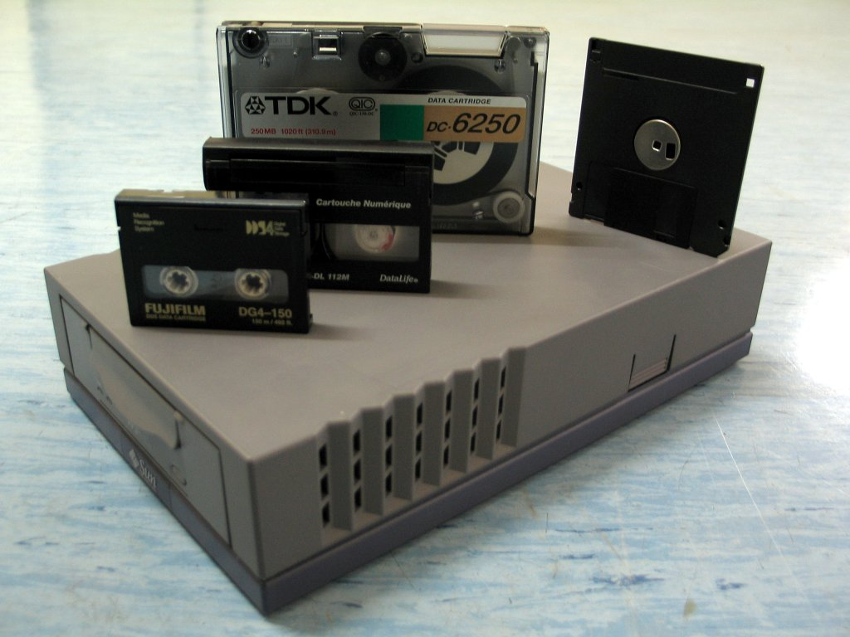
TAPE

Slide 21
Direct Access
Chapter 6
Hard disks , CDs and DVDs all use direct access.
Direct access mean that the device can locate a particular data item or file immediately.
When writing or reading specific data, direct access is much faster than sequential access.

Slide 22
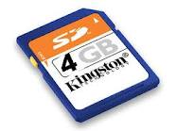
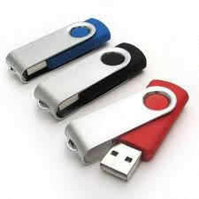
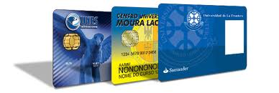
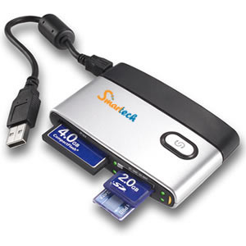
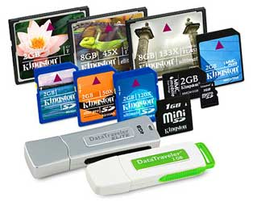
Miniature Mobile Storage Media
Chapter 6
Three types of Miniature mobile storage media:
Flash memory cards
USB flash drives
and smart cards.

Slide 23
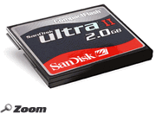
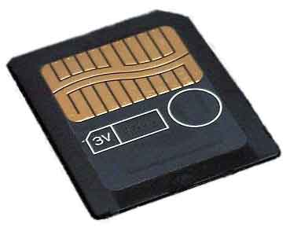
Flash memory Cards
Chapter 6
Media Name | Storage Capacity | Use
CompactFlash | 64 MB to 8 GB | Digital Cameras, PDAS, Smart phone, photo printers, audio players, notebook computers, Desktop computer
Smart Media | 32MB to 128 MB | Digital Cameras, photo printers, audio players.

Slide 24
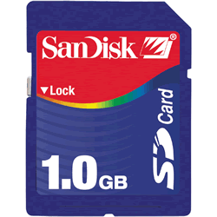
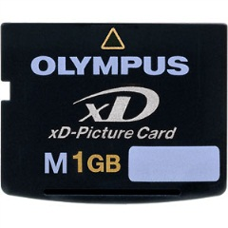
Flash memory Cards
Chapter 6
Media Name | Storage Capacity | Use
Secure Digital | 64 MB to 1 GB | Digital Cameras, PDAS, Smart phone, photo printers, music players, Digital video camera
xD Picture Card | 64 MB to 1 GB | Digital Cameras, photo printers.

Slide 25
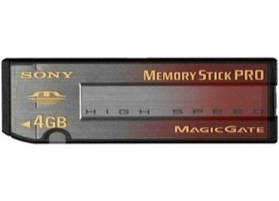
Flash memory Cards
Chapter 6
Media Name | Storage Capacity | Use
Memory Stick | 256 MB to 4 GB | Digital Cameras, PDAS, Smart phone, photo printers, handheld game consoles, notebook computer

Slide 26
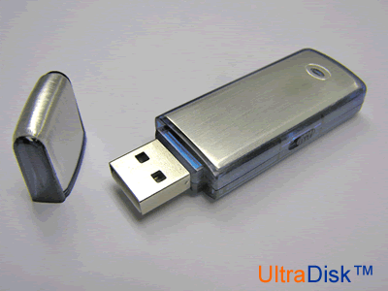
USB Flash Drives
Chapter 6
Sometimes called a pen drive, is a flash memory storage device that plugs in a USB port on a computer or mobile device.
Become the mobile user’s primary storage device.
Current USB flash drive have storage capacities up to 256 GB.

Slide 27
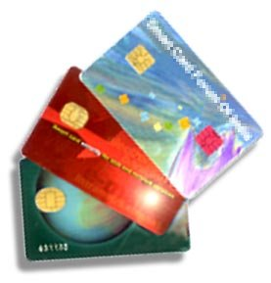
Smart Cards
Chapter 6
Which is similar in size to a credit card or ATM card, stores data on a thin microprocessor embedded in the card.
Smart cards contain a processor and have input , process, output , and storage capabilities.
Uses of smart cards include storing medical records, and other health-care or identification information; tracking information such as customer purchases or employee attendance.
http://www.youtube.com/watch?v=gdGtlAgwcxU
http://news.cnet.com/8301-19882_3-20016433-250.html

