Slide 1
EE 201 Lecture 5 -Week 3

Slide 2
Review of Short Circuit

Slide 3
Review of Short Circuit

Slide 4
Series & Parallel Circuit Analysis

Slide 5
Reduce and Return Approach

Slide 6
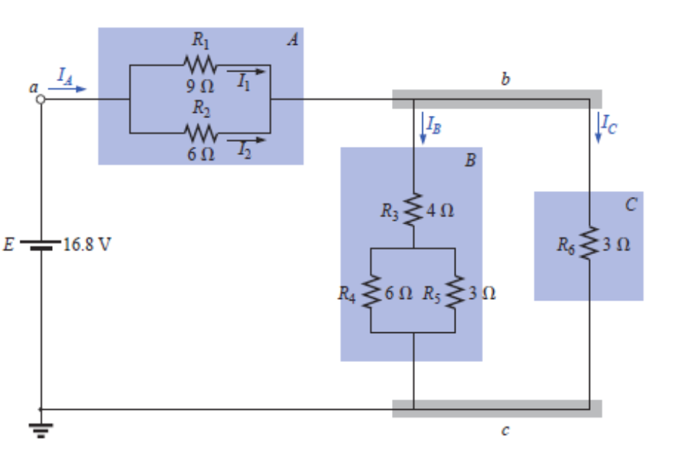
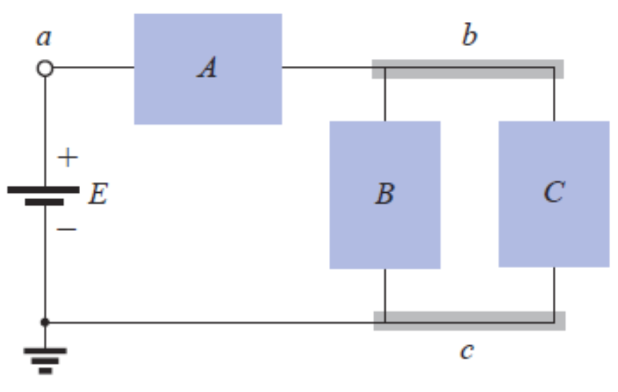
Block Diagram Approach

Slide 7
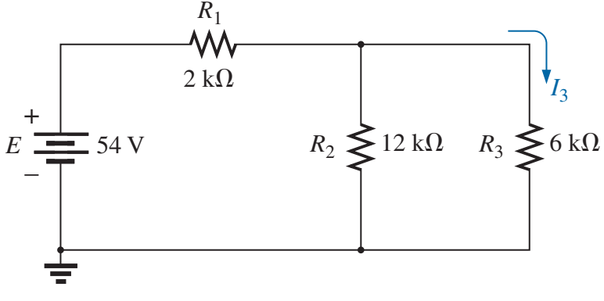
Example 1

Slide 8
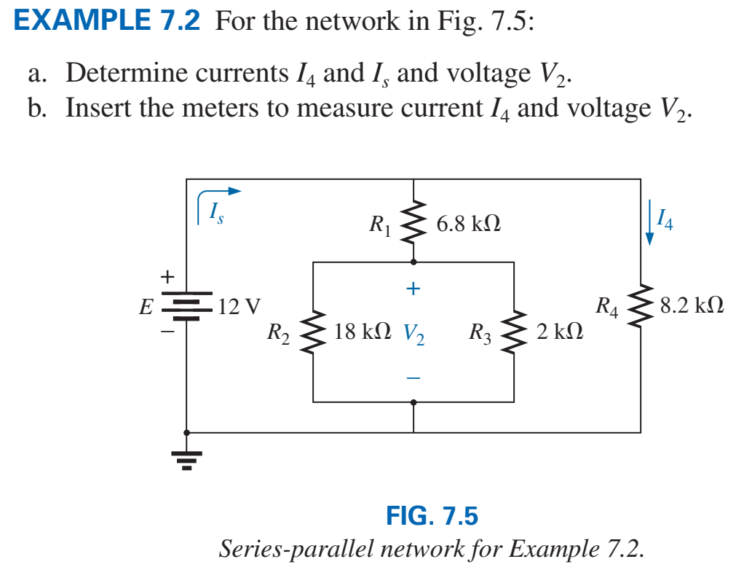
Example 2

Slide 9
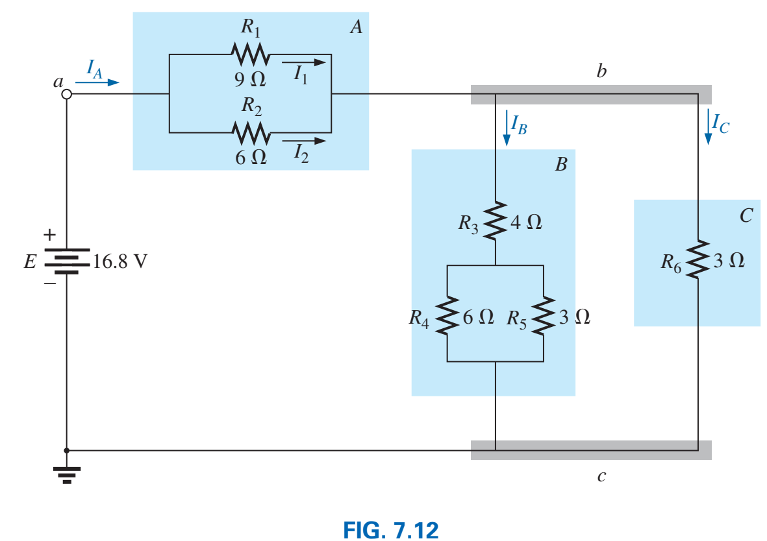
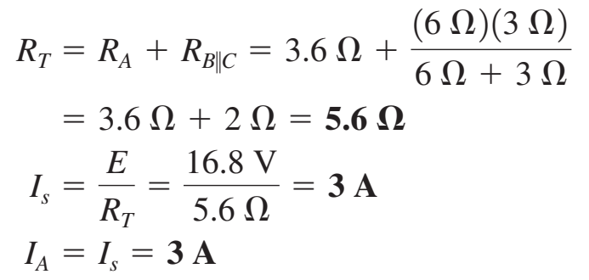
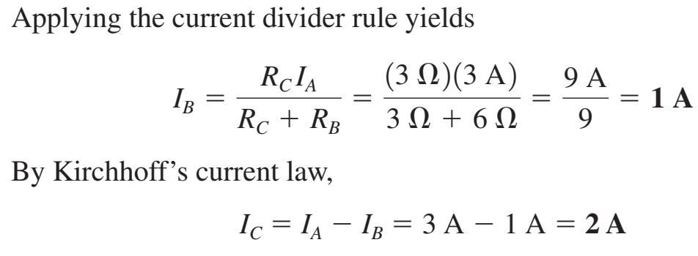
Example 3

Slide 10
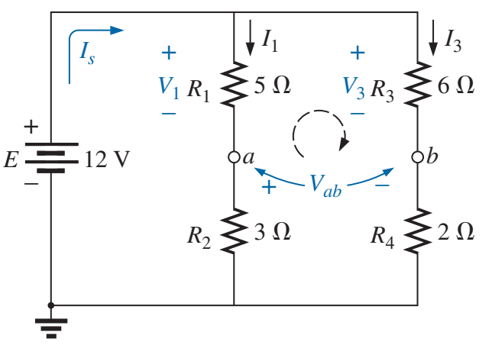
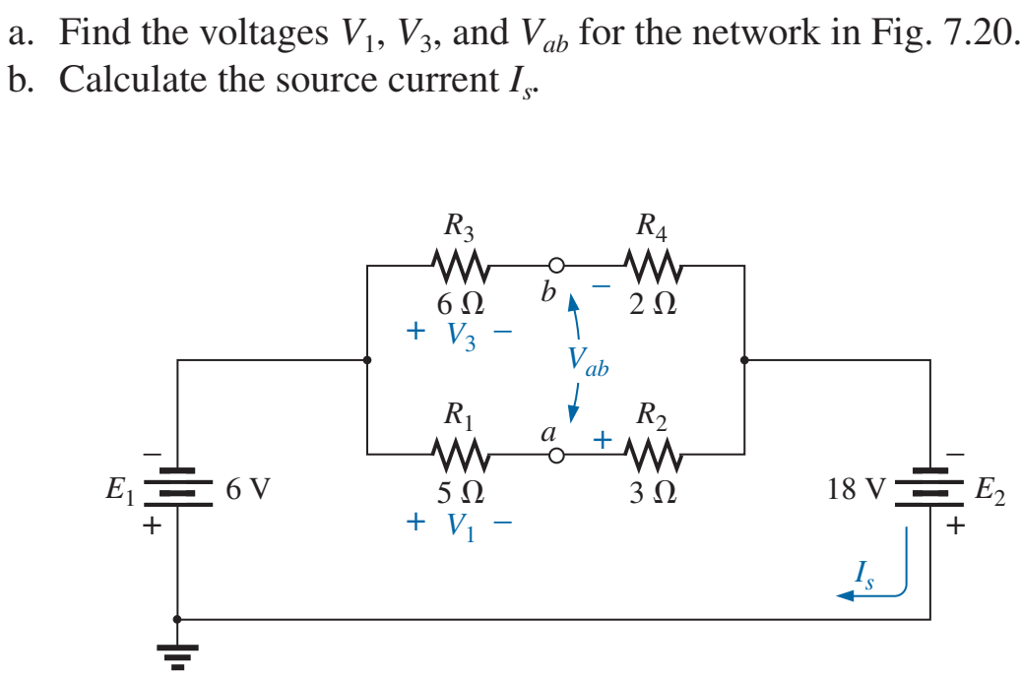
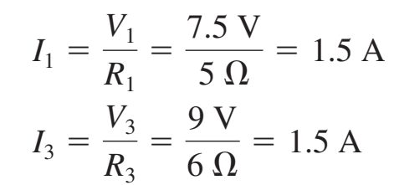
Example 4

Slide 11
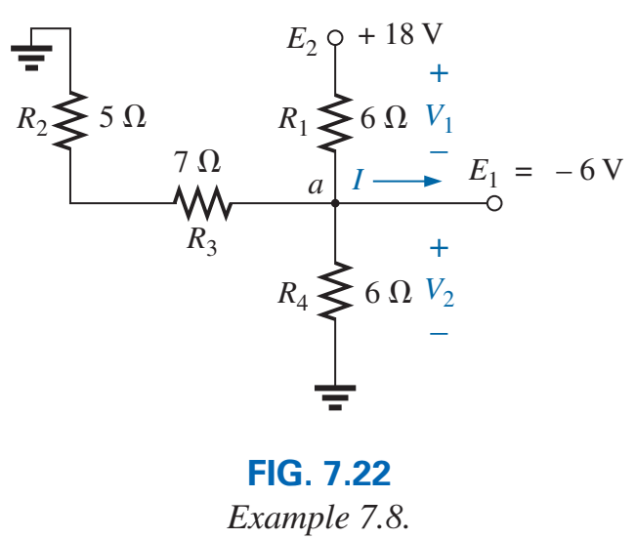
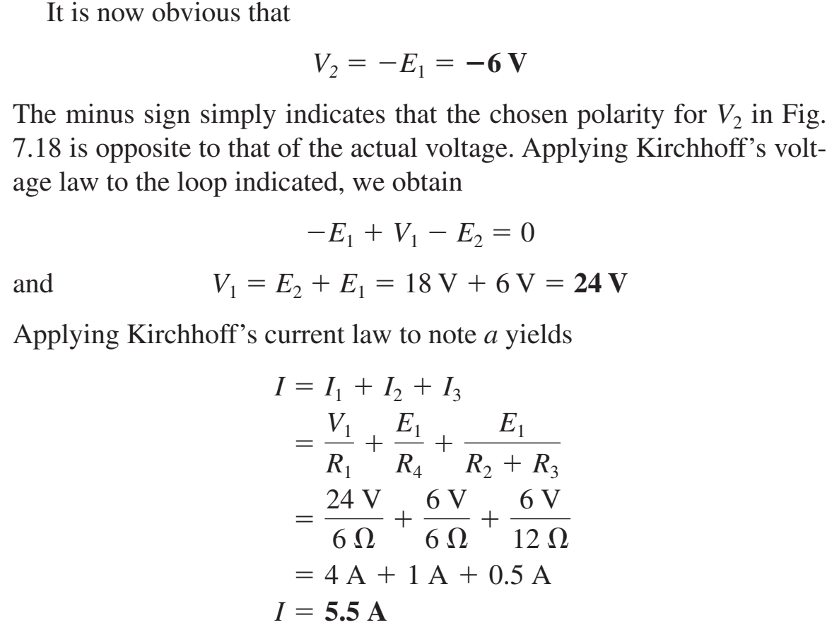
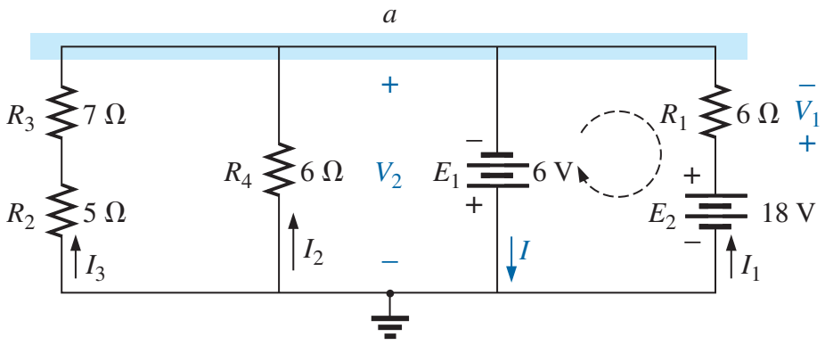
Example 5

Slide 12
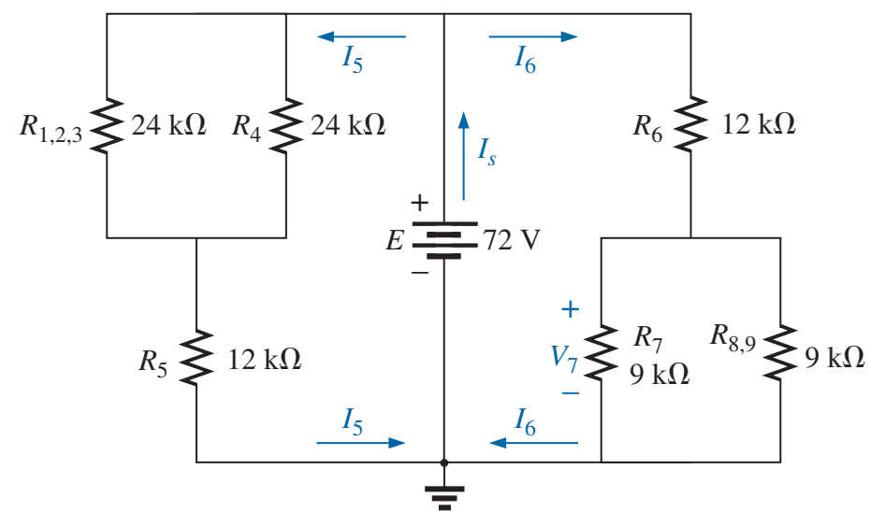
Example 6

Slide 13
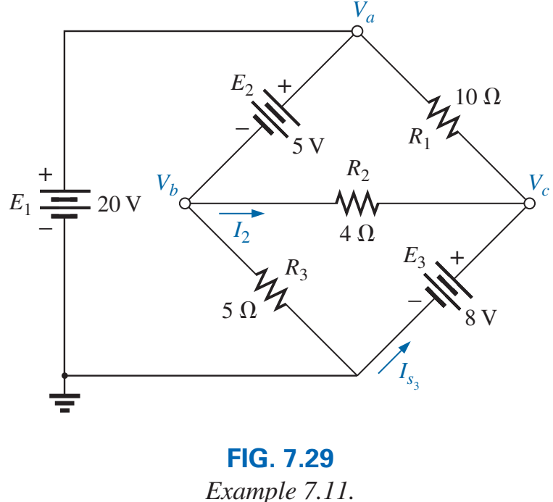
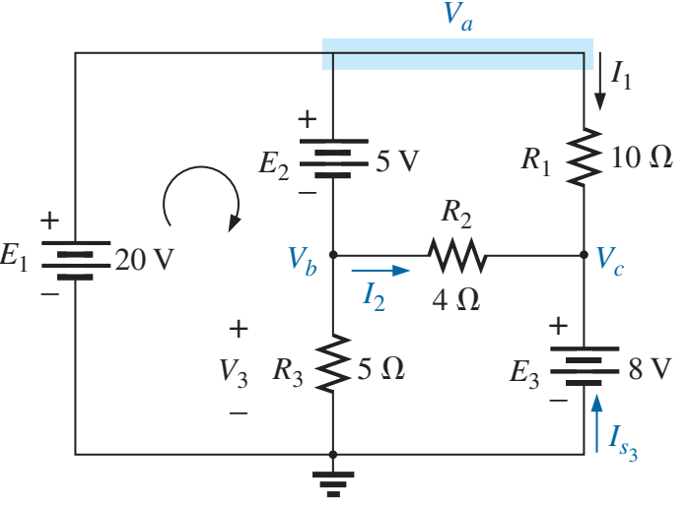
Example 7

Slide 14
Ladder Network

Slide 15
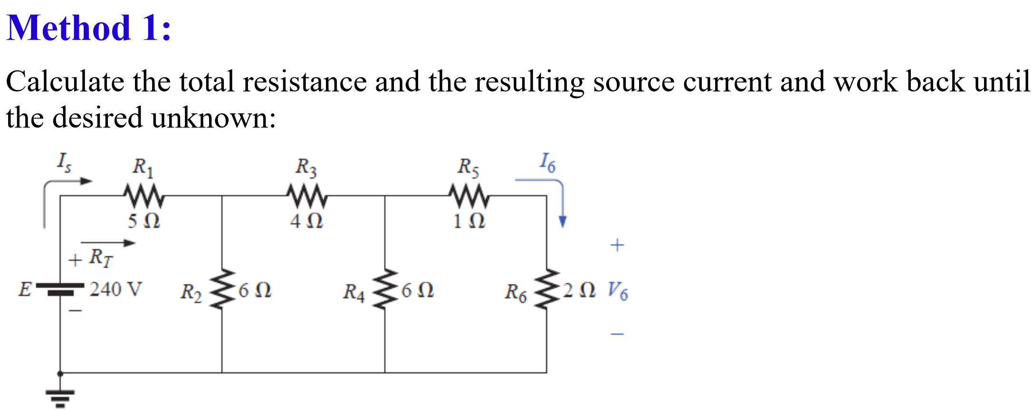
Ladder Network

Slide 16
Ladder Network

Slide 17
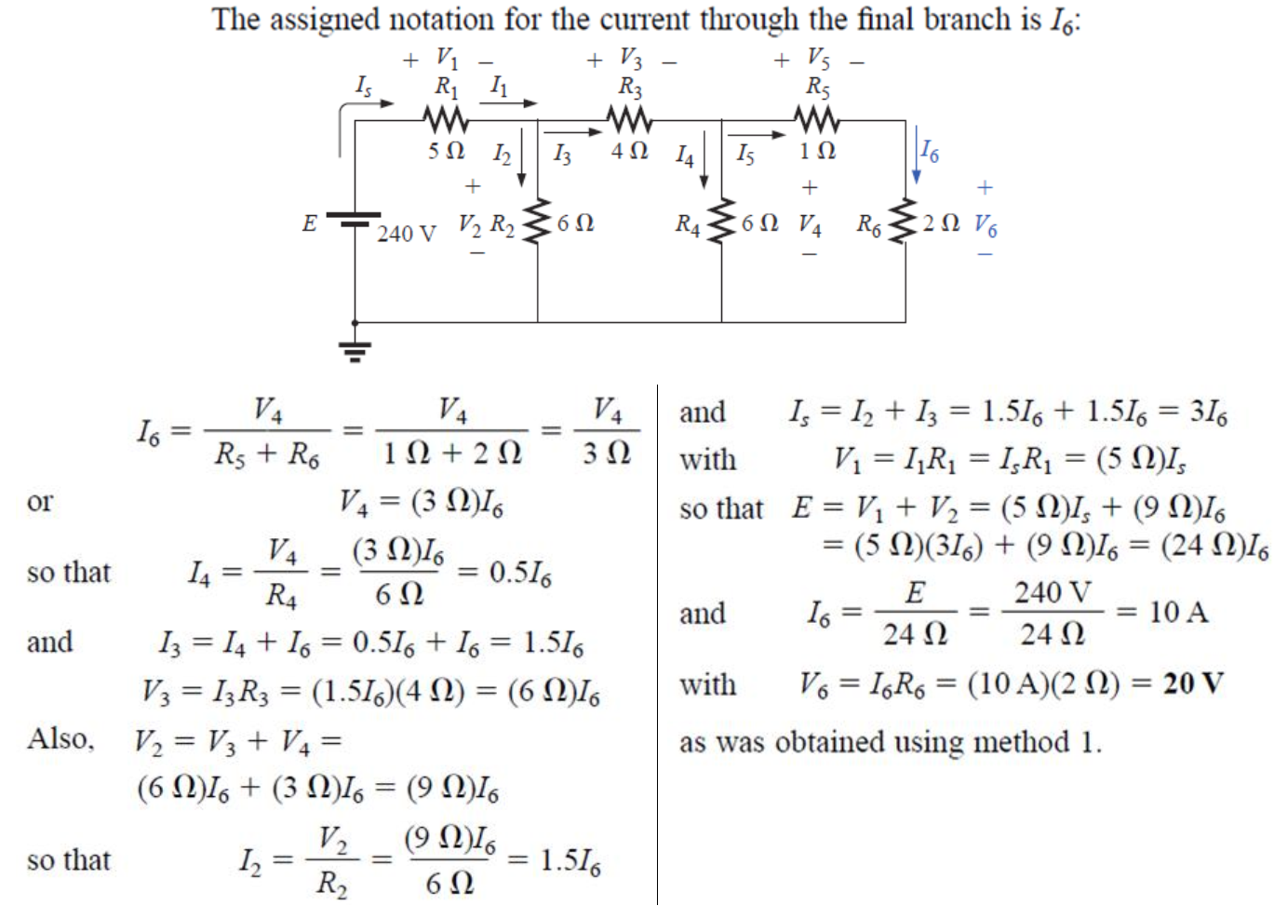
Ladder Network

Slide 18
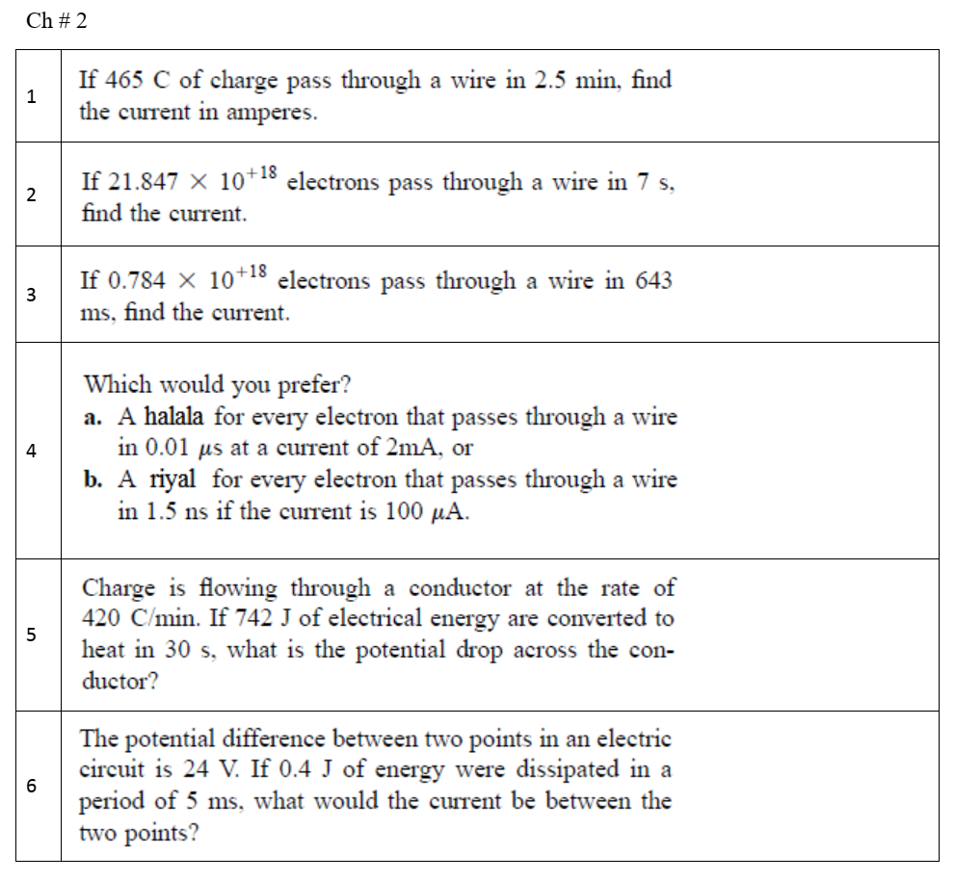
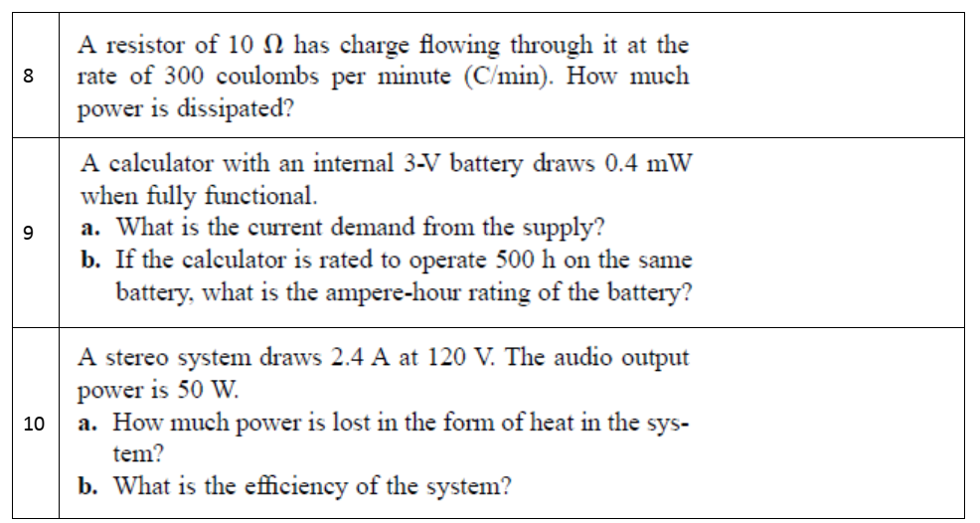
Homework 1 Other Section

Slide 19
Summary - CH 2 and CH 4
I = Q/t
V = W/Q
Number of electrons = Q/($1.6x{10}^{−19}$)
P = W/t
$P_{loss}=P_{input}−P_{output}$
Efficiency =$\frac{P_{output}}{P_{input}} ×100$
$I=V/R$
$P=V I=I^{2}R=\frac{V^{2}}{R}$
I = voltage in Amperes (A)
Q = charge in Coulomb (C)
t = time in second (s)
V = voltage in Volts (V)
W = work or energy in Joules (J)
P = power in Watts (W)
R = Resistance in ohm
Batteries:

Slide 20
Next Lecture
Quiz 1
Q 1: 1 question from CH 2 (Dr. Debbar’s homework)
Q 2: 1 question from CH 4 (Dr. Debbar’s homework)
Q 3-5: circuit analysis (CH 5 and CH 6)

Slide 21
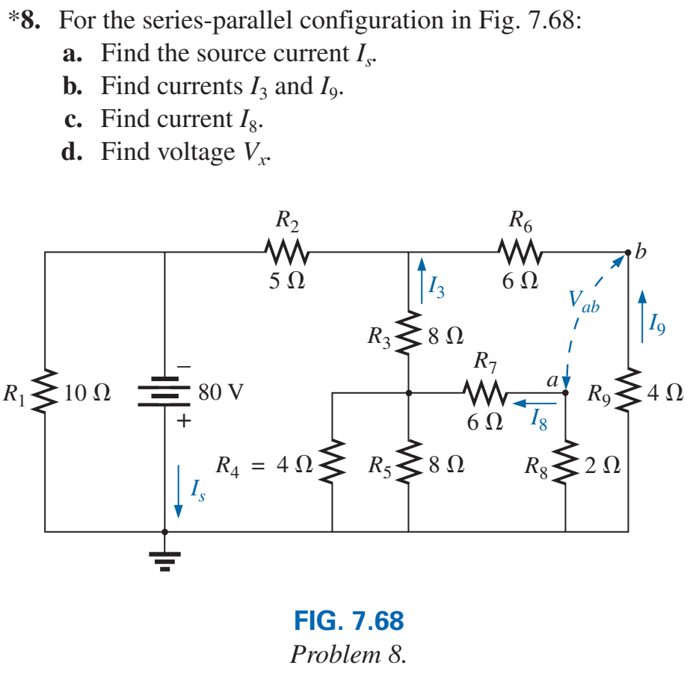
Exercise

