Slide 1
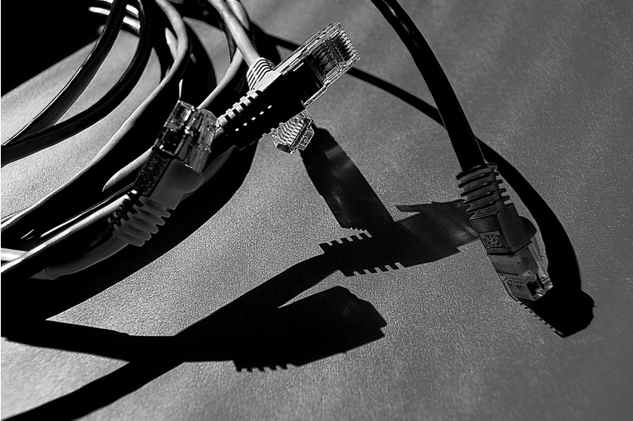
Physical Transmission

Slide 2
Physical Transmission
Physical Transmission
Transmission Media
Wire (guided)
Coaxial cable
Twisted Pair
STP
Fiber Optic
Wireless (unguided)
Radio waves
Microwave
Infrared
Satellite
Laser
Signaling Techniques
Baseband
Transmission
Broadband
Transmission
UTP

Slide 3
Wireless media

Slide 4
II. Wireless Network
Transmission is sent and received through invisible waves
Less expensive than copper or fiber optic lines.
Allows the user to move freely around the office or campus and still remain connected to the network
Fastest-growing segment of network media today

Slide 5
II. Wireless Network
Transmission and reception via antenna
Directional
Signals are sent in one direction.
Use directional antennas - point to point line of sight communications
Omnidirectional
Signal spreads in all directions
Can be received by many antennas

Slide 6
II. Wireless Transmissions
Electromagnetic Spectrum divided to :
Radio waves
Microwave waves
Infrared waves
Satellite
Laser

Slide 7
II. Wireless Transmissions
Radio waves:
It is electromagnetic waves ranging in frequency between 3 KHz and 1 GHz.
Are omnidirectional, they propagate in all directions.
They can penetrate through walls.
Use omnidirectional antenna
Microwave waves:
It is electromagnetic waves ranging in frequency between 1 and 300 GHz.
faster than radio
Are unidirectional
Higher frequency ranges cannot penetrate walls.
Need unidirectional antenna

Slide 8
II. Wireless Transmissions
Infrared waves:
transmits data using infrared (IR) light.
Its frequencies from 300GHz to 400 THz.
Used for short-range communication
Since it have a high frequency, it cannot penetrate walls.
Satellite:
This is a space station that receive microwave signals from an earth-based station, amplifies the signals, and broadcasts the signal back over a wide area to any number of earth-based station.

Slide 9
II. Wireless Transmissions
Laser:
Unidirectional, like microwave
Higher speed than microwave
Uses laser transmitter and receiver at each end
Point-to-point, typically between buildings
Can be adversely affected by weather

Slide 10
Choosing a medium
Copper wire is mature technology and inexpensive; maximum transmission speed is limited
Glass fiber:
Higher speed
More resistant to electro-magnetic interference
Spans longer distances
Requires only single fiber
More expensive
Radio and microwave don't require physical connection
Radio and infrared can be used for mobile connections
Laser also does not need physical connection and supports higher speeds

Slide 11
Data and Signals

Slide 12
Data
Analog data: refers to information that is continuous as human voice.
Digital data: refers to information that has discrete states. Data stored in computer memory in forms of 1s and 0s.
To be transmitted, data (analog or digital) must be transformed to electromagnetic signals.

Slide 13
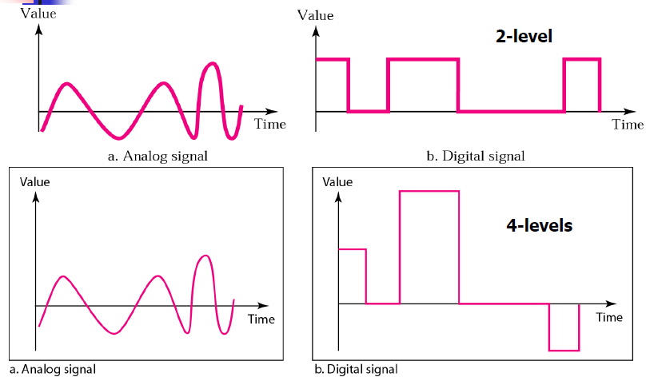
Signals
Signals can be analog or digital.
Analog signals can have an infinite number of values in a range
Digital signals can have only a limited number of values.

Slide 14
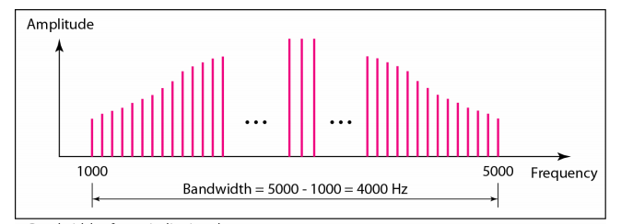
Bandwidth & Bit Rate
Bit Rate: the number of bits sent in one second, expressed in bits per second (bps).
Bandwidth:
The difference between the highest and the lowest frequencies of a signal.

Slide 15
Bandwidth & Bit Rate
Bit rate and bandwidth are proportional to each other.
If we need to send bits faster, we need more bandwidth.
Bandwidth also measures the capacity of information that a medium can carry.
Analog bandwidth: Hertz
Digital bandwidth: bits per second (bps)

Slide 16
Physical Transmission
Physical Transmission
Transmission Media
Wire (guided)
Coaxial cable
Twisted Pair
STP
Fiber Optic
Wireless (unguided)
Radio waves
Microwave
Infrared
Satellite
Laser
Signaling Techniques
Baseband
Transmission
Broadband
Transmission
UTP

Slide 17
b. Signaling Techniques
There are two ways that a signal is sent across a network medium:
I. Baseband Transmission
II. Broadband Transmission

Slide 18
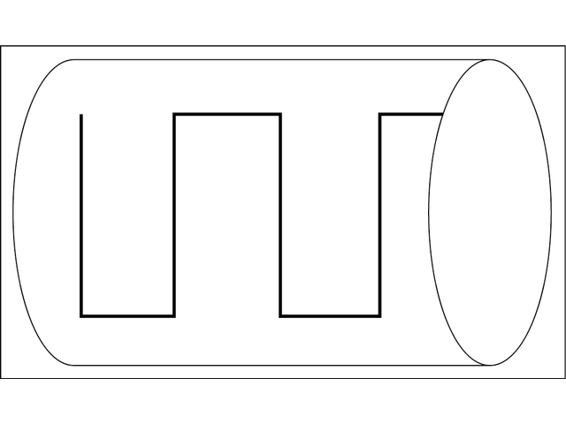
I. Baseband Signaling
Baseband:
A type of digital data transmission in which each medium (wire) carries only one signal, or channel, at a time.
Uses Digital Signaling
Single Frequency
Transmits Bi-directionally
Uses Repeaters

Slide 19
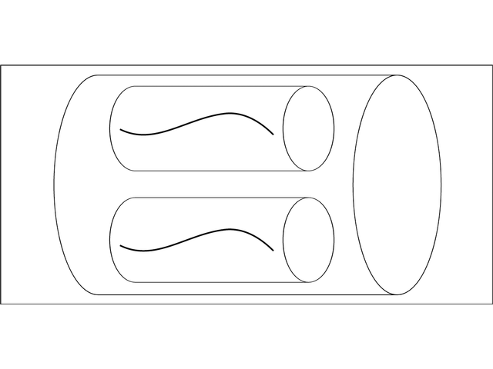
II. Broadband Signaling
Broadband:
enables a single wire to carry multiple signals at the same time.
Uses Analog Signaling
Multiple Frequencies
Transmits Uni-directionally
Uses Amplifiers

Slide 20
Amplifier
An electronic device that increases the power of the signal.
Unlike repeaters, amplifiers strengthen the signal along with its noise.

Slide 21
Repeater
an electronic circuit that receives a signal and retransmits the same signal with a higher power. Therefore, a repeater consists of a signal receiver, an amplifier and a transmitter.
The main purpose of a repeater is to extend the length of the network transmission medium beyond the normal maximum cable lengths.

Slide 22
Amplifier and Repeater
Difference between Amplifier and Repeater:
1. Amplifier is used to magnify a signal, whereas repeater is used to receive and retransmit a signal with a power gain.
2. Repeater has an amplifier as a part of it.
3. Sometimes, amplifiers introduce some noise to the signal, whereas repeaters contain noise eliminating parts.

Slide 23
Transmission Impairments

Slide 24
Transmission Impairments
Signals travel through transmission media which are not perfect.
This means that the signal at the beginning of the medium is not the same as the signal at the end of the medium.
In other words, the signal has changed over the medium..

Slide 25
Impairment Causes
Attenuation
Distortion
Noise

Slide 26
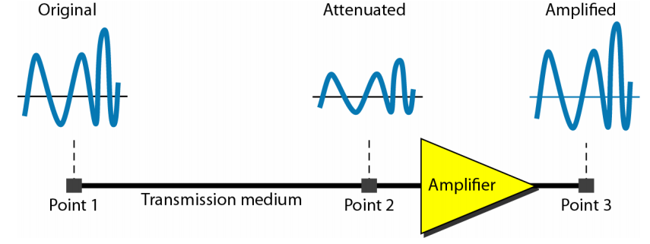
a) Attenuation
Loss of signal power in time

Slide 27
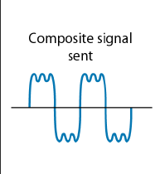
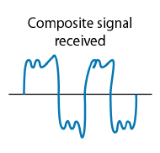
b) Distortion
Distortion : means that signal changes its form or shape.
Sometimes caused by dirty or corroded connectors or bad cables
Sender
Receiver

Slide 28
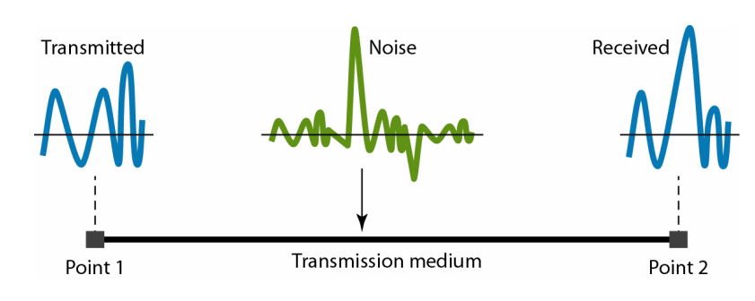
c) Noise
is a general term for unwanted (and, in general, unknown) modifications that a signal may suffer during capture, storage, transmission, processing, or conversion, caused when a strong external signal interferes with a signal.

Slide 29
Types of Noise
Thermal noise : the random motion of electrons in a wire which creates an extra signal not originally sent by the transmitter.
Induced noise: Comes from sources such as motors and appliances
Crosstalk noise: Is the effect of one wire on the other
Impulse Noise: is a spike ( a signal with high energy in a very short time) that comes from power lines, lighting and so on.

