Slide 1
Flame photometry

Slide 2
Introduction
Principle :
1-flame photometry, a branch of atomic spectroscopy is used for determining the concentration of certain metal ions such as sodium, potassium, lithium, calcium, Cesium, etc.
2-The basis of flame photometric working is that, the types of metals are dissociated due to the thermal energy provided by the flame source. Due to this thermal excitation, some of the atoms are excited to a higher energy level where they are not stable.

Slide 3
3-The subsequent loss of energy will result in the movement of excited atoms to the low energy ground state with emission of some radiations as a wavelengths .The emitted wavelengths are specific for specific elements.

Slide 5
1. The solution containing metal to be measure is first aspirated into the burner.
2. The solvent then evaporated leaving fine divided solid particles.
3. This solid particles move towards the flame, where the gaseous atoms and ions are produced.

Slide 6
4. The ions absorb the energy from the flame and excited to high energy levels.
5. When the atoms return to the ground state radiation of the characteristic element is emitted.
6. The intensity of emitted light is related to the concentration of the element.

Slide 8
FP Components
1- Flame : A burner that provides flame and can be maintained in a constant form and at a constant temperature.
2- Nebuliser and mixing chamber: Helps to transport the homogeneous solution of the substance into the flame at a steady rate.
3- Monochromator : helps in isolating the wavelength to be measured from that of any other extraneous emissions.

Slide 9
4. Photo detector: Detect the emitted light and measure the intensity of radiation emitted by the flame. That is, the emitted radiation is converted to an electrical signal with the help of photo detector. The produced electrical signals are directly proportional to the intensity of light.

Slide 10
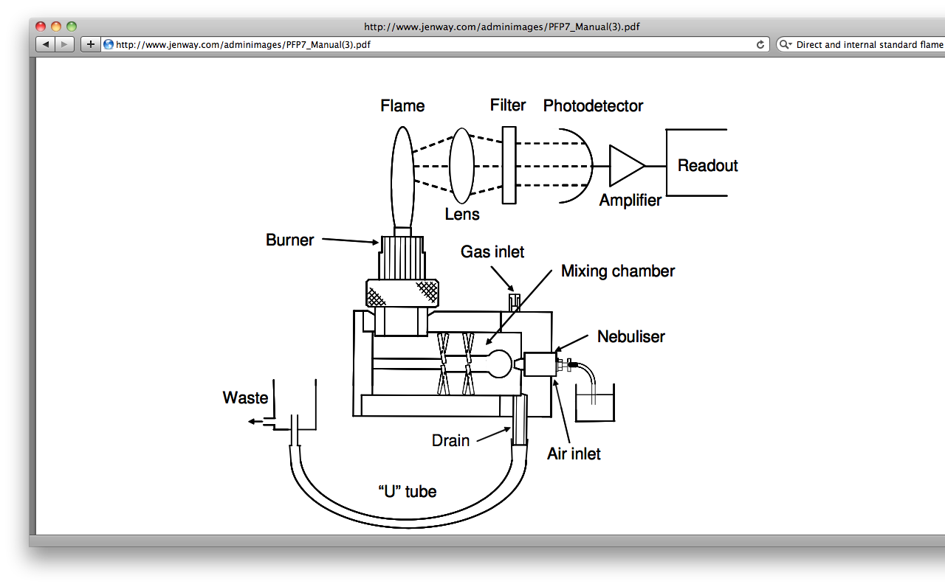

Slide 11
Flame (burner)
Burner used in FP should have the following properties:
The flame should have ability to evaporate the solvent to give a residue(deposit)
- It should convert this residue to gases state atom and finally into individual atoms

Slide 12
The effect of flame depend on the temperature of flame and this temperature can be monitored by following method:
Fuel to air ratio
Type of solvent for preparing sample solution
Amount of solvent which is entering to flame
Type of burner used in FP

Slide 13
Flame (burner)
Flame photometry employs a variety of fuels mainly air, oxygen or nitrous oxide (N₂O) as oxidant.
Burners are of two types:
Total Consumption Burner and Premix or Laminar flow Burner.

Slide 14
The various processes in the flame are discussed below:
Desolvation: The liquid solvent is evaporated, and the metal particles are dehydrated by the flame
Vapourisation: The sample vaporises to a gas .
Atomization: Reduction of metal ions in the solvent to metal atoms by the flame heat.

Slide 15
Excitation: The electrostatic force of attraction between the electrons and nucleus of the atom helps them to absorb a particular amount of energy. The atoms then jump to the exited energy state.
Emission process: Since the higher energy state is unstable the atoms jump back to the stable low energy state with the emission of energy in the form of radiation of characteristic wavelength, which is measured by the photo detector.

Slide 16
Types of FP
1- Direct type:
Standard solution of Na & K are atomised or aspirated into flame to provide a series of meter readings in which our unknown is going to compared with.

Slide 17
Direct type disadvantages
1- Any minor fluctuations in air, gas pressure might change response of instrument and then cause errors.
2- Separate analyses and sometimes separate solutions must be made for Na and K.

Slide 18
2- Internal standard method:
Another element (Li) is added to all standards, blanks and unknowns in equal concentration. This element has a criteria of :
* high emission intensity.
* Is absent from biological fluid.

Slide 19
Applications
1- Determine the availability of alkali and alkaline earth metals which are critical for soil cultivation.
2- In agriculture, the fertilizer requirement of the soil is analyzed by flame test analysis of the soil.

Slide 20
3- In clinical field, Na+ and K+ ions in body fluids, muscles and heart can be determined by diluting the blood serum and aspiration into the flame.
4- Analysis of soft drinks, fruit juices and alcoholic beverages can also be analyzed by using flame photometry.

Slide 21
Advantages:
1.Simple quantitative analytical test based on the flame analysis.
2.Inexpensive.
3.The determination of elements such as alkali and alkaline earth metals is performed easily with most reliable and convenient methods.
4.Quite quick, convenient, and selective and sensitive to even parts per million (ppm) to parts per billion (ppb) range.

Slide 22
FP suffer the same level of interferences as AAS from:
1- Anion due to complexation (chemical interference).
2- Matrix interference.
3- Burner interference.
4- Ionisation interference.
5- emission interference.

Slide 23
limitations
Alteration of light emission because of altered flame temp.
It needs perfect control of flame temperature.
Interference by other elements is not easy to be eliminated
Heavy and transition metals , the number of absorption
and emission lines is enormous and the spectra are complex
Inadequate selectivity of WL.
Differences in viscosity between standards and sample.

Slide 24
Advantages of AAS over FP
1- Sensitivity.
2- Applicability.
3- Smaller flame effect.
4- Less interference from other cations.

Slide 25
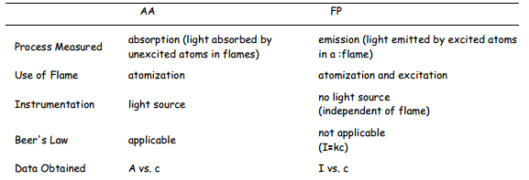
AAS Vs PF

