Slide 1
Output
Prepared by
Hussein Alhashimi

Slide 2
Output
Output is any data that has been processed into a useful form.
Output Device is any hardware component that conveys information to one or more people.

Slide 3
1) Display Devices
Chapter 5
Is an output device that visually conveys text, graphics and video information.
Desktop Computer typically use a monitor as their display device.
Monitor is a display device that is packaged as a separate peripheral.

Slide 4
Display Devices
Chapter 5
Monitor controls allow users to adjust the brightness, contrast, positioning, height, and width of images.
Most mobile computer and devices integrate the display and other components into the same physical case.
Display device usually show text, graphics and video information in color.
Monochrome means the information appears in one color on a different color background.

Slide 5
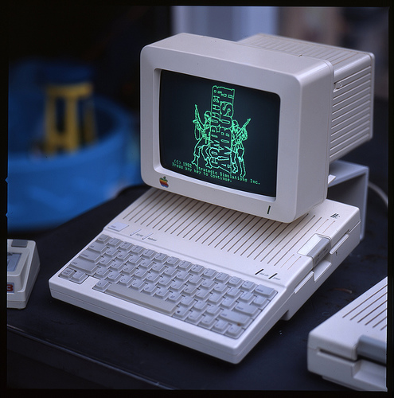
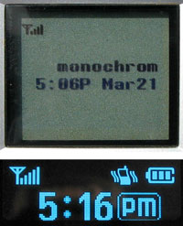
Display Devices
Chapter 5

Slide 6
Display Devices
Chapter 5
Some PDAs and other mobile device use monochrome displays because they require less battery power.
Types of display device include:
LCD monitors and screens.
Plasma monitors.
CRT monitors.

Slide 7
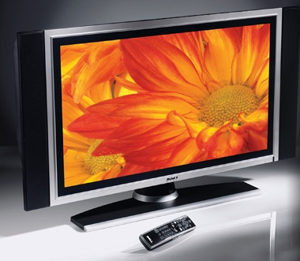
LCD monitors and Screens
Chapter 5
Is a desktop monitor that uses a liquid crystal display to produce images.
also called a flat panel monitor.

Slide 8
LCD and Screens
Chapter 5
It’s available in a variety of sizes:
With the more common being 15”, 17”, 18”, 19”, 20”, 21” and 23 inches- some are 30 or 40 inches.
Notebook computer screen size 14.1, 15.4 and 17 inches.
Tablet screen range from 8.4 to 14.1 inches.
PDA screen average 3.5 inches.
Smart phones screen rang from 2.5 to 3.5 inches.

Slide 9
LCD Technology and Quality
Chapter 5
Resolution
Resolution is the number of horizontal and vertical pixels in a display device.
A higher resolution uses a greater number of pixels and this provides a smoother, sharper, and clearer image.
As the resolution increases some item on the screen appear smaller such as menu bar, toolbars and rulers.
Try it!

Slide 10
Chapter 5

Slide 11
LCD Technology and Quality
Chapter 5
Response time
Response time of an LCD is the time in milliseconds (ms) that it takes to turn a pixel on or off.
LCD response times range from 8 to 25 ms. The lower the number, the faster the response time.

Slide 12
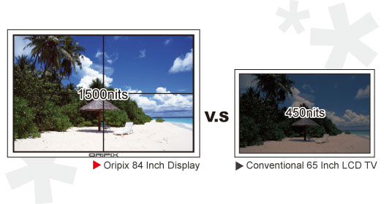
LCD Technology and Quality
Chapter 5
Brightness of LCD is measured in nits.
A nit is a unit of visible light intensity. The higher the nits, the brighter the images.

Slide 13
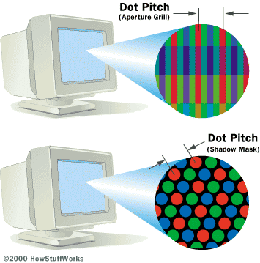
LCD Technology and Quality
Chapter 5
Pixel pitch:
Some times called dot pitch, is the distance in millimeters between pixels on a display device.
Average pixel pitch on LCD should be .28 mm or lower.
The lower the number, the sharper the image.

Slide 14
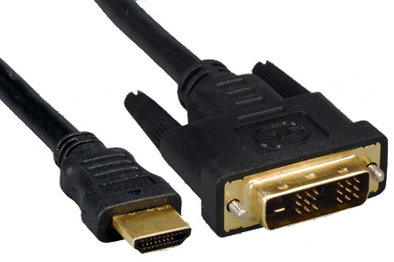
Ports and LCD monitors
Chapter 5
A cable on monitor plugs in a port on the system unit.
LCD monitors use a digital signal to produce a picture.
To display the highest quality images, an LCD monitor should plug in a DVI ( digital Video Interface) port.
DVI enables digital signals to transmit directly to an LCD monitor.
HDMI to DVI
cable

Slide 15
Plasma Monitors
Chapter 5
Is a display device that uses gas plasma technology, which sandwiches a layer of gas between two glass plates.
Large business users or power users sometime have plasma monitors , which often measure more than 60 inches wide.
Plasma monitor offer larger screen size & higher display quality than LCD monitors but are more expensive.
These monitor also can hang directly on a wall.

Slide 16
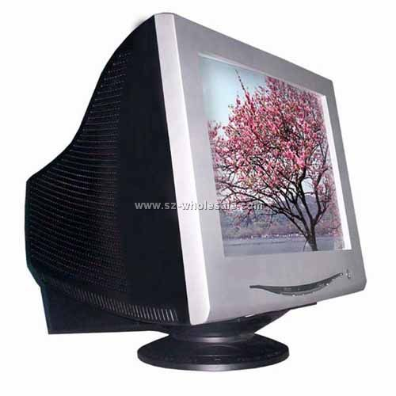
CRT Monitors
Chapter 5
Is a desktop monitor that contains a cathode-ray tube.
Cathode-ray tube (CRT) is a large sealed glass tube. The front of the tube is the screen.
CRT available in various size, with the more common being 15, 17, 19, 21 and 22 inches.

Slide 17
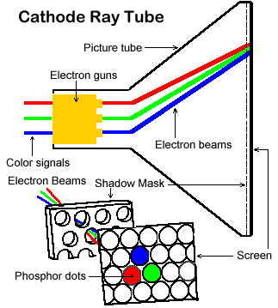
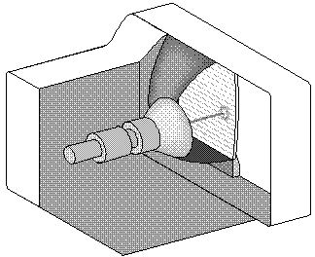
Chapter 5

Slide 18
2 . Printers
Chapter 5
Is an output device that produces text and graphics on a physical medium such as paper or transparency film.
Many different printers exist with varying speed, capabilities and printing method.
There are two type:
Nonimpact Printer such as Ink-jet, Photo, Laser, Thermal, Mobile, Plotters and large format printers.
Impact Printer such as dot-matrix printers and line printers.

Slide 19
Type of printer:
Chapter 5
1 . Nonimpact Printers
Forms characters and graphics on a piece of paper without striking.
Some nonimpact printers spray ink, while others use heat or pressure to create images.

Slide 20
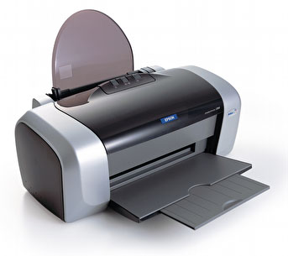
A . Ink-Jet Printers
Chapter 5
Is a type of nonimpact printer that forms characters and graphics by spraying tiny drops of liquid ink onto a piece of paper.
Produce text and graphics in both black and white and color on a variety of paper types.
The resolution determines the quality of an ink- jet printer.

Slide 21
Ink-Jet Printers
Chapter 5
Resolution is measured by the number of dots per inch (dpi) a printer can print.
Most ink-jet can print from 600 to 4800 dpi.
The speed of it is measured by the number of pages per minute (ppm) it can print.
Most ink-jet print from 3 to 26 ppm.

Slide 22
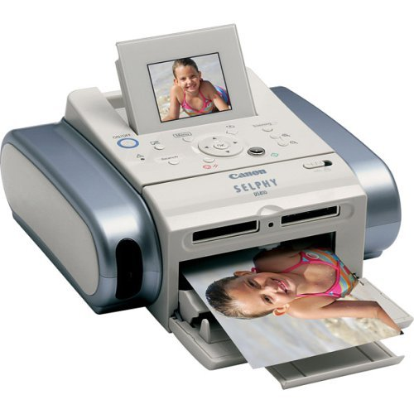
B . Photo Printers
Chapter 5
Is a color printer that produces photo-lab-quality pictures.
Some photo printers print just one or two size of images, for example, 3X5 inches and 4X6 inches.
Many photo printers use ink-jet technology.

Slide 23
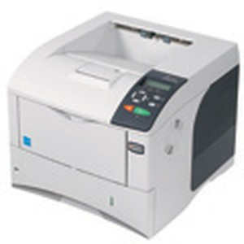
C . Laser Printers
Chapter 5
Is a high-speed, high-quality nonimpact printer.
Printer speeds:
For home and small office --Black & white text
(15 to 50 ppm), Color (4 to 27 ppm).
For large business users print more than 150 ppm.
Color laser printers are slightly higher price than otherwise equivalent black & white laser printers.
Usually cost more than ink-jet printers.

Slide 24
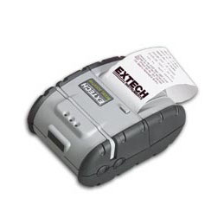
D . Thermal Printers
Chapter 5
Generates images by pushing electrically heated pins against heat-sensitive paper.
Basic thermal printers are inexpensive, but print quality is low and images tend to fade over time.

Slide 25
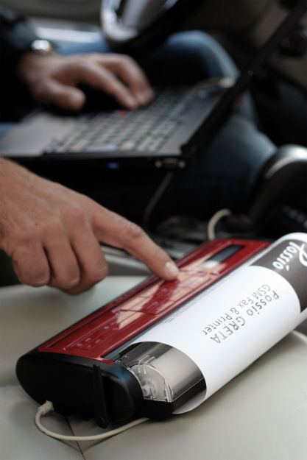
E . Mobile Printers
Chapter 5
Is a small, lightweight, battery-powered printer that allows a mobile user to print from a notebook computer, tablet PC, PDA, or smart phone while traveling.
Mobile printers fit easily in a briefcase alongside a notebook computer.
Mobile printers mainly use ink-jet or thermal technology.

Slide 26
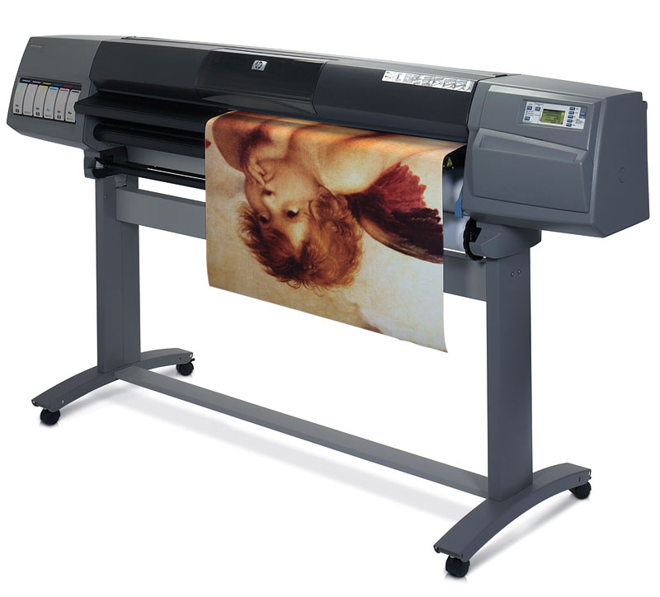
F . Plotters and Large-Format Printers
Chapter 5
Plotters are sophisticated printers used to produce high-quality drawing such as blueprints and maps.
Used in specializes fields such as engineering and drafting and usually are very costly.
Using ink-jet printer technology, but on much larger scale.

Slide 27
Other output devices
Chapter 5
Speakers.
Headphones.
Earphones.
Fax machines and Fax modems.
Multifunction peripherals.
Data projectors.

Slide 28
Speakers, Headphones, and Earphones
Chapter 5
Audio output device is a component of a computer that produces music, speech or other sounds.
Most personal computers have a small internal speaker that usually emits only low-quality sound.
Many PC users add surround sound speakers to their computers to generate a higher-quality sound.

Slide 29
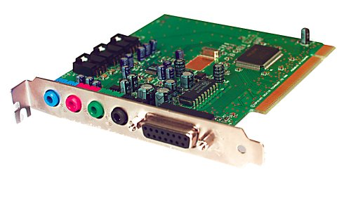
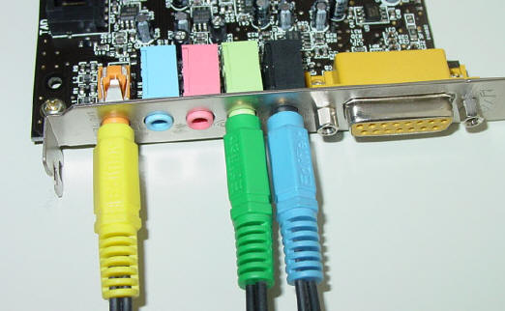
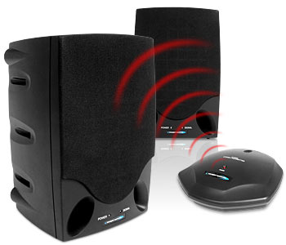
Speakers, Headphones, and Earphones
Chapter 5
Speakers typically have tone and volume controls, allowing users to adjust settings.
In many cases, users connect the speakers to ports on the sound card.
With wireless speakers, they connect wirelessly to the sound card.

Slide 30
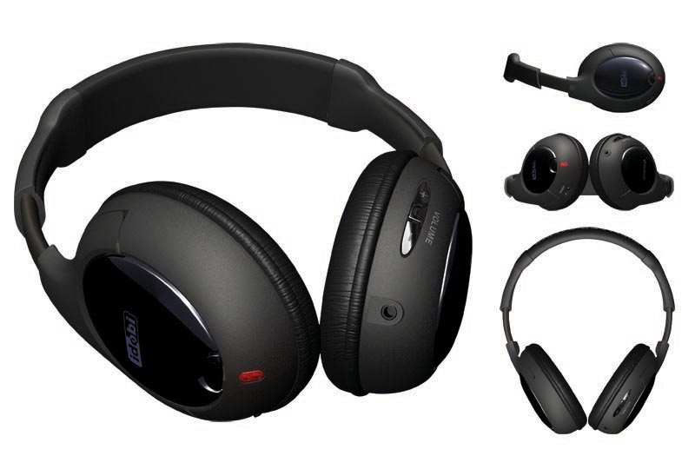
Speakers, Headphones, and Earphones
Chapter 5
Users can plug headphones or earphones in a port on the sound card, in a speaker, or in the front of the system unit.
With headphone or earphones, only the individual wearing the headphone or earphones hears the sound from the computer.

Slide 31
Fax Machines and Fax Modems
Chapter 5
Fax Machines is a device that codes and encodes documents so they can be transmitted over telephone lines.
The document can contain text, drawings or photographs, or can be handwritten.
The term fax refers to document that you send or receive via a fax machine

Slide 32
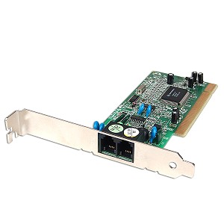
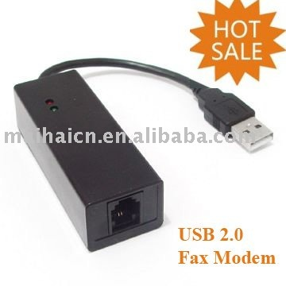
Fax Machines and Fax Modems
Chapter 5
Many computers includes fax capability by using a fax modem.
fax modem transmit computer-prepared documents or documents that have been digitized with scanner or digital camera.
Fax modem transmits these faxes to a fax machine or to another fax modem.

Slide 33
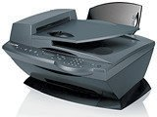
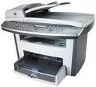
Multifunction Peripherals
Chapter 5
Is a single device that looks like a copy machine but provides the functionality of a printer, scanner, copy machine, and perhaps a fax machine.
Some use color ink-jet printer technology, while others include a black-and-white laser printer.
An advantage of these device is they are significantly less expensive than if you purchase each device separately.
The disadvantage, If the device break down, you lose all four functions.

Slide 34
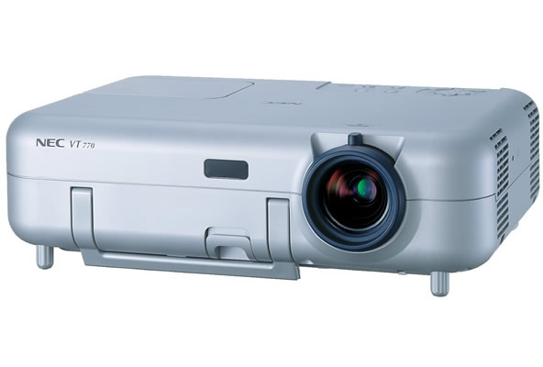
Data Projectors
Chapter 5
Is a device that takes the text and images displaying on a computer screen and projects them on a larger screen so an audience can see the image clearly.
Some data projectors are large devices that attach to a ceiling or wall in an auditorium. Other are small portable device.

Slide 35
Homework
Choose two output devices (listed previously) in lecture (or- you may find something was not discussed). Make a comparison between these devices :
speed?
Price?
Quality or services ?
Connectivity ?
Provide photos of the devices

