Slide 1
Lec-4 : Unified Modeling Language (UML)

Slide 2
Unified Modeling Language (UML)
UML (Unified Modeling Language) is a graphical language that is suit-able to express software or system requirements, architecture, and design.
UML used for both database and software modeling
UML modeling also supports multiple views of the same system.

Slide 3
UML diagrams
Can be categorized as the fallowing:
Structural diagrams:
Show the building blocks of your system—features that don’t change with time.
Ex: Class diagram
Behavioral diagrams:
Show how your system responds to requests or otherwise evolves over time.
Ex: Use case diagram
Interaction diagrams:
Is a type of behavioral diagram.
To depict the exchange of messages within a collaboration (a group of cooperating objects).
Ex: Sequence diagram & Collaboration diagram

Slide 4
UML Diagrams
Another way of categorizing UML diagram:
Static diagrams
to show the static features of the system. (no change)
Dynamic diagrams
to show how your system evolves over time.
Functional diagrams:
to show the details of behaviors and algorithms.

Slide 5
Object-oriented analysis (OOA)
Trying to figure out what the users and customers of a software effort want the System to do.
Builds a “real-world” model from requirements
client interviews, domain knowledge, real-world experience collected in use cases and other simple notations
OOA models address three aspects of the system (its objects)
class structure and relationships
sequencing of interactions and events
data transformations and computations

Slide 6
Static Modeling using the Unified Modeling Language (UML)
UML Class Diagrams

Slide 7
Classes
A class is a description of a set of
objects that share the same attributes,
operations, relationships, and semantics.
Graphically, a class is rendered as a
rectangle, usually including its name,
attributes, and operations in separate,
designated compartments.
ClassName
attributes
operations

Slide 8
Class Names
ClassName
Class naming: Use singular names because each class represents a generalized version of a singular object.
The name of the class is always appears in the top-most compartment.
attributes
operations

Slide 9
Class Attributes
Person
name : String
address : Address
birthdate : Date
ssn : Id
An attribute is a named property of a
class that describes the object being modeled.
In the class diagram, attributes appear in
the second compartment just below the
name-compartment.
An object class is an abstraction over a set of objects with common: attributes (states) and and the services (operations) (methods), provided by each object.

Slide 10
Class Attributes (Cont’d)
Person
Attributes are usually listed in the form:
attributeName : Type
A derived attribute is one that can be
computed from other attributes, but
doesn’t actually exist. For example,
a Person’s age can be computed from
his birth date. A derived attribute is
designated by a preceding ‘/’ as in:
/ age : Date
name : String
address : Address
birthdate : Date
/ age : Date
ssn : Id

Slide 11
Class Operations
Person
What the class knows
name : String
address : Address
birthdate : Date
ssn : Id
eat
sleep
work
play
Operations describe the class behavior
and appear in the third compartment.
What the class does

Slide 12
Depicting Classes
When drawing a class, you needn’t show attributes and operation in every diagram.
Class diagrams provide the representations used by the developers.
Person
Person
Person
name : String
birthdate : Date
ssn : Id
Person
name
address
birthdate
eat()
sleep()
work()
play()
Person
eat
play

Slide 13
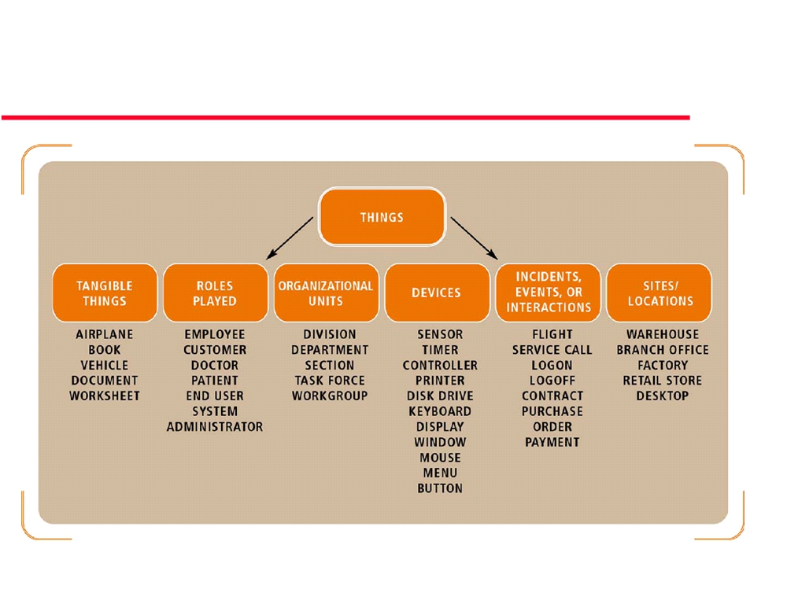
Objects

Slide 14
Generalization Relationships
Person
A generalization connects a subclass to its superclass. It denotes an inheritance of attributes and behavior from the superclass to the subclass and indicates a specialization in the subclass of the more general superclass.
Student

Slide 15
(Cont’d)
UML permits a class to inherit from multiple superclasses.
Student
Employee
TeachingAssistant

Slide 16
Association, aggregation and composition
When considering the 3 relationships: association, aggregation and composition,
•
the most general relationship is association,
•
followed by aggregation
•
and, finally, composition.

Slide 17
Association Relationships
If two classes in a model need to communicate with each other, there must be link between them.
An association denotes that link.
Student
Instructor

Slide 18
(Cont’d)
We can indicate the multiplicity of an association by adding multiplicity adornments to the line denoting the association.
The example indicates that a Student has one or more Instructors:
Student
Instructor
1..*

Slide 19
(Cont’d)
The example indicates that every Instructor has one or more Students:
Student
Instructor
1..*

Slide 20
(Cont’d)
We can also indicate the behavior of an object in an association (i.e., the role of an object) using rolenames.
teaches
learns from
Student
Instructor
1..*
1..*

Slide 21
(Cont’d)
We can also name the association.
membership
Student
Team
1..*
1..*

Slide 22
(Cont’d)
We can specify dual associations.
member of
Student
Team
1..*
1..*
1
president of
1..*

Slide 23
(Cont’d)
Associations can also be objects themselves, called link classes or an association classes.
Registration
modelNumber
serialNumber
warrentyCode
Product
Warranty

Slide 24
(Cont’d)
A class can have a self association.
next
LinkedListNode
previous

Slide 25
Aggregations
We can model objects that contain other objects by way of special associations called aggregations and compositions.
An aggregation specifies a whole-part relationship between an aggregate (a whole) and a constituent part, where the part can exist independently from the aggregate. Aggregations are denoted by a hollow-diamond adornment on the association.
Example: a bank (whole) has customers (as parts) .Deleting a bank does not cascade deleting customers. Customers can move to another bank

Slide 26
Compositions
A composition indicates a strong ownership and coincident lifetime of parts by the whole (i.e., they live and die as a whole). Compositions are denoted by a filled-diamond adornment on the association.
Window
Scrollbar
1
1
Titlebar
1
1
Menu
1
1 .. *

Slide 27
(Cont’d)
Example : A bank (whole) has many branches (parts). Branches can not exist independently of the whole (parts objects can NOT exist independently)
Deleting a bank (whole) cascades deleting branches (parts). But, if a branch (part) is deleted, the bank (whole) may remain.

Slide 28
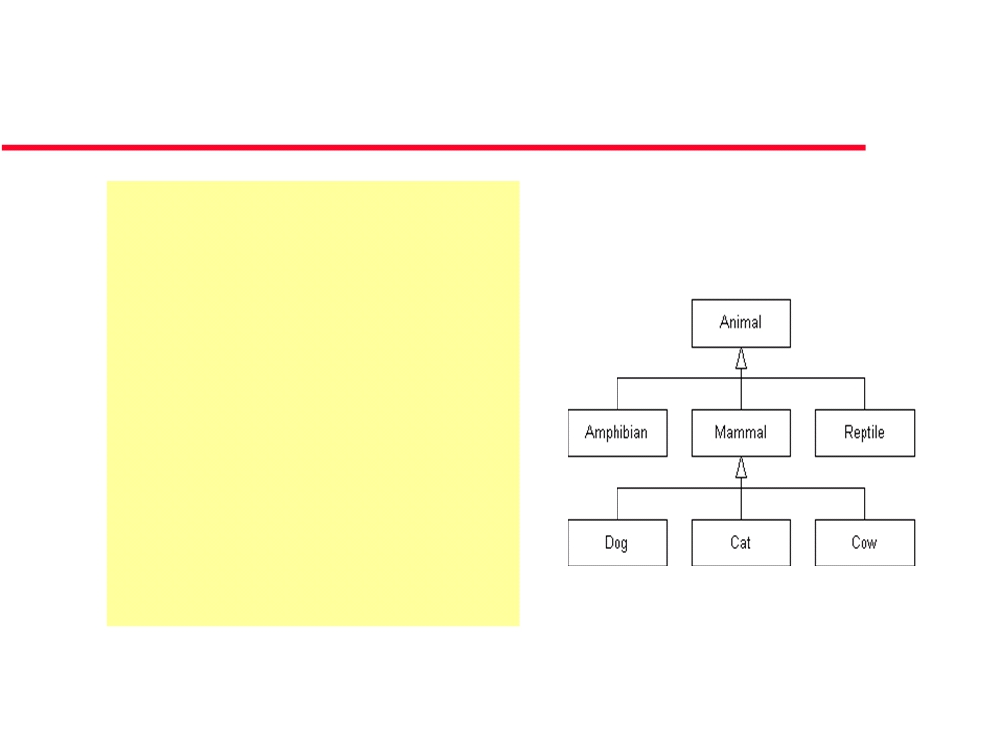
Inheritance: is a
“is a kind of”
is a association.
Child class ‘subclass’ can inherit attributes and operations from parent class‘superclass’.
Example: An inheritance hierarchy in the animal kingdom

Slide 29
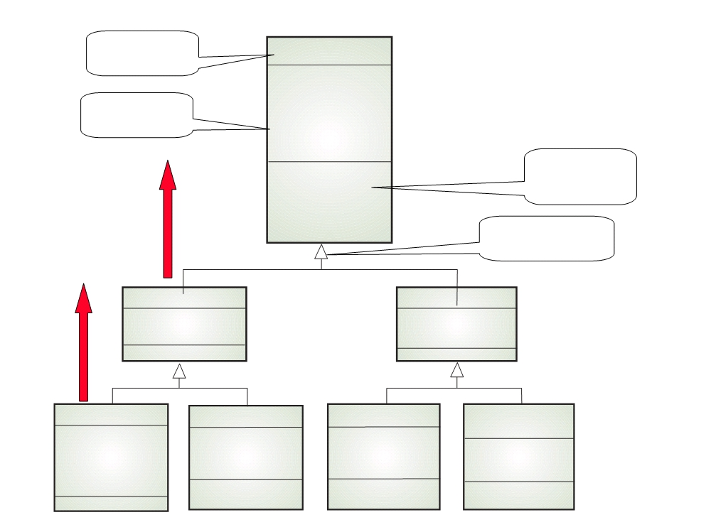
Class name
Library item
Library class hierarchy
Catalogue number Acquisition date Cost
Attributes
Type Status
Number of copies
Methods Operations
Acquire () Catalogue () Dispose () Issue ()
Is a
Return ()
Generalisation
Published item
Recorded item Title
Is a
Title
Publisher
Medium
Book
Magazine
Film Computer
program Director
Author Edition
Year Issue
Date of release Version Distributor
Publication date
Platform
ISBN

Slide 30
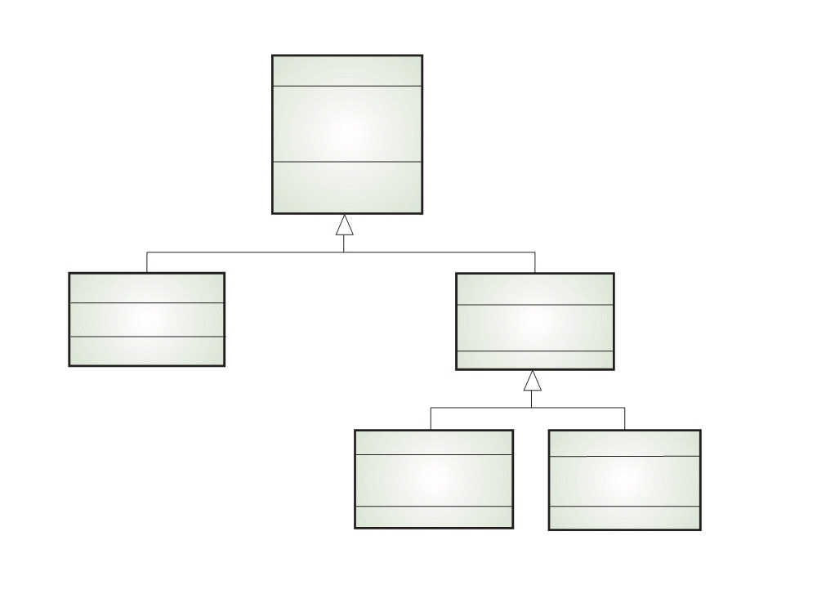
Library user
User class hierarchy
Name
Address Phone
Registration #
Register () De-register ()
Reader
Borrower
Affiliation
Items on loan
Max. loans
Staff
Student
Department
Major subject
Department phone
Home address

Slide 31
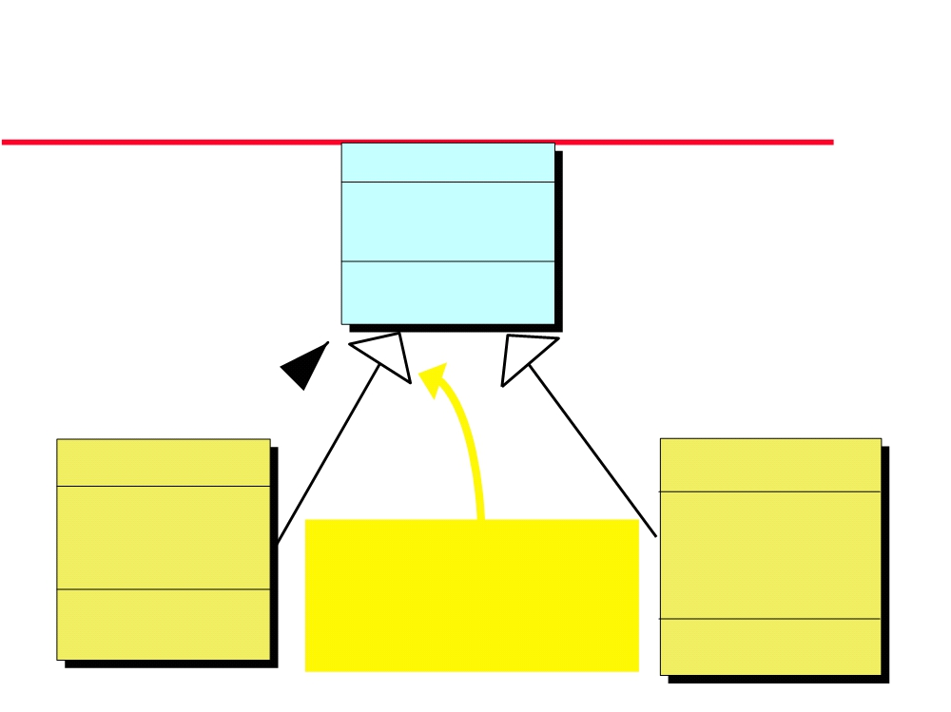
Hierarchy Diagram
(UML notation)
PERSON
Name, Address Phone, Sex
Date of Birth
ChangeAddress EnquireDOB&Sex
ISA
CUSTOMER
EMPLOYEE
Balance
SIN
O/Due 30, 60, 90 Credit Rating
Marital Status
This kind of arrowhead indicates that this
No. of Dependants Date Hired
Date Paid
CheckCrRating AgeBalances
relationship is one of subclassing
Wage Rate GiveRaise
CalcMonthPay

Slide 32
Multiple inheritance
Rather than inheriting the attributes and services from a single parent class, a system which supports multiple inheritance allows object classes to inherit from several super-classes.

Slide 33
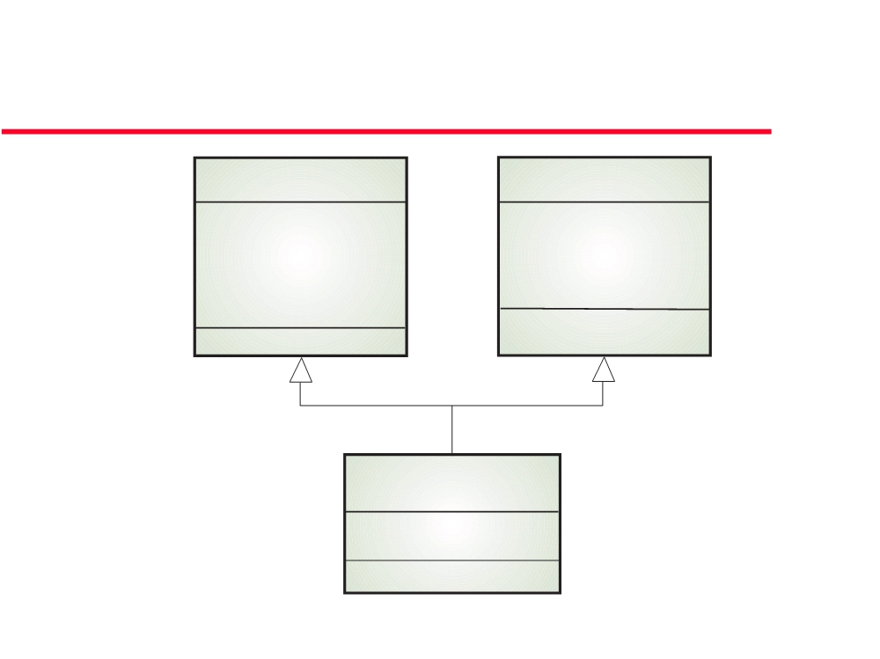
Example: Multiple inheritance
The talking book
Book
Voice recording
Author Edition
Speaker Duration
Publication date ISBN
Recording date
Talking book
# Tapes

Slide 34
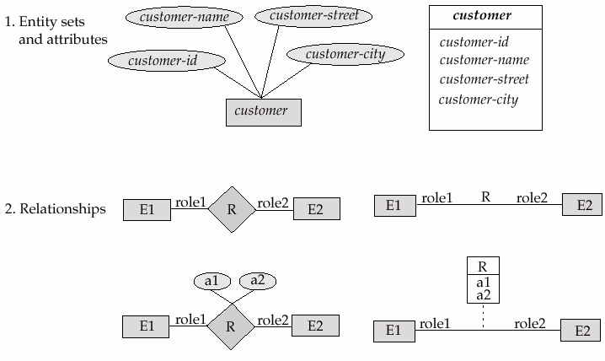
Summary of UML Class Diagram Notation

Slide 35
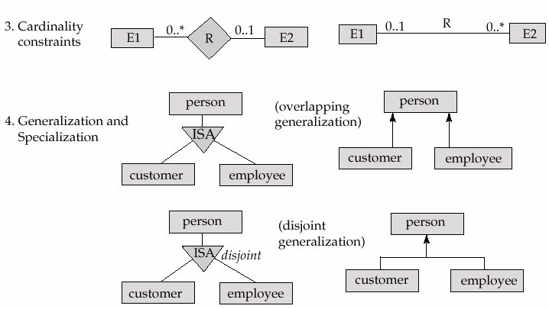
Summary of UML Class Diagram Notation

Slide 36
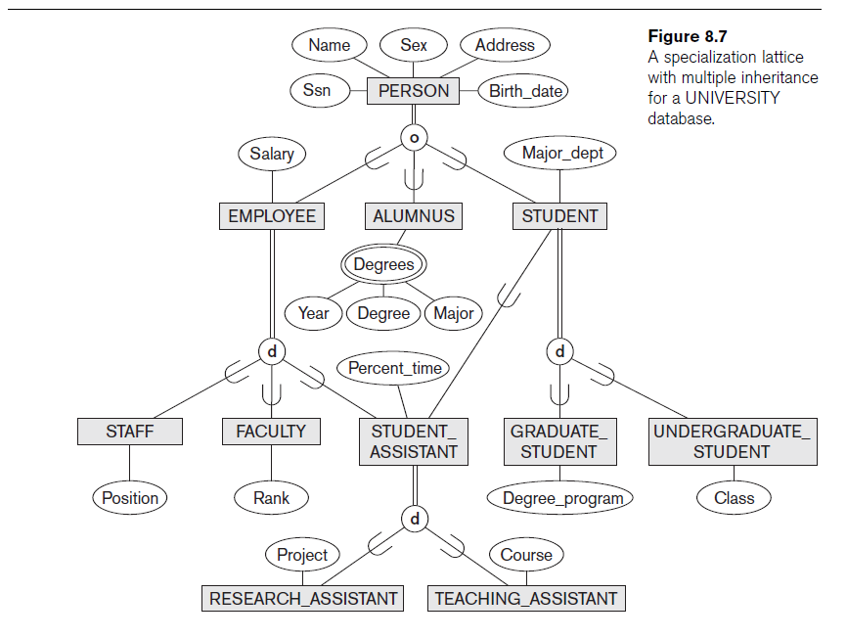

Slide 37
UML Example for Displaying Specialization / Generalization

Slide 38
UML Diagrams
Another way of categorizing UML static diagram:
Component Diagrams
Show the organizations and dependencies among software components.
Deployment Diagrams
Represent the distribution of components across the hardware topology

Slide 39
Component Diagrams

Slide 40
Deployment Diagrams

