Slide 1
Introduction to the Internet
Lecture 4
CSS 1
Sara Almudauh

Slide 2
Driving problem behind CSS
How what font type and size does <h1>Introduction</h1> generate?
Answer: Some default from the browser (HTML tells what browser how)
Early HTML - Override defaults with attributes
<table border="2" bordercolor="black">
Style sheets were added to address this:
Specify style to use rather than browser default
Not have to code styling on every element

Slide 3
What is CSS?
CSS stands for Cascading Style Sheets
CSS defines how HTML elements are to be displayed
Styles were added to HTML 4.0 to solve a problem
CSS saves a lot of work
External Style Sheets are stored in CSS files

Slide 4
Key concept: Separate style from content
Content (what to display) is in HTML files
Formatting information (how to display it) is in separate style sheets (.css files).
Use an element attribute named class to link (e.g. <span class=”test”>)
Result: define style information once, use in many places
Consider can you make all the text in the app slightly bigger?
Or purple is our new company color.
DRY principle: Don't Repeat Yourself

Slide 8
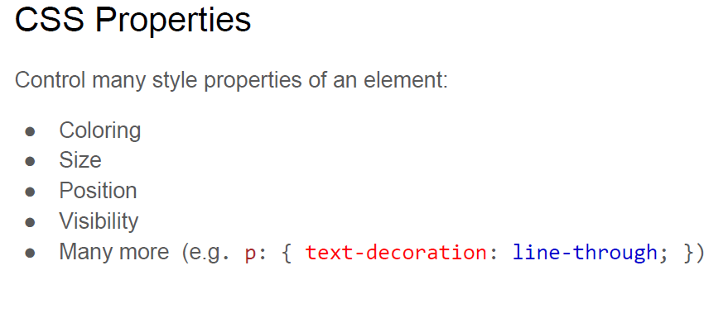

Slide 9
Example
Add the CSS style to your HTML page:
body { background-color: #d0e4fe; } h1 { color: orange; text-align: center; } p { font-family: "Times New Roman"; font-size: 20px; }

Slide 10
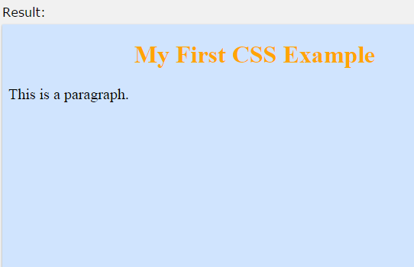
Example
<html>
<head>
<style>
body {
background-color: #d0e4fe; }
h1 {
color: orange;
text-align: center; }
p {
font-family: "Times New Roman";
font-size: 20px; }
</style> </head>
<body>
<h1>My First CSS Example</h1>
<p>This is a paragraph.</p> </body> </html>

Slide 11
CSS Solved a Big Problem
HTML was NEVER intended to contain tags for formatting a document.
HTML was intended to define the content of a document, like:
<h1>This is a heading</h1>
<p>This is a paragraph.</p>
To solve this problem, CSS was created !!

Slide 12
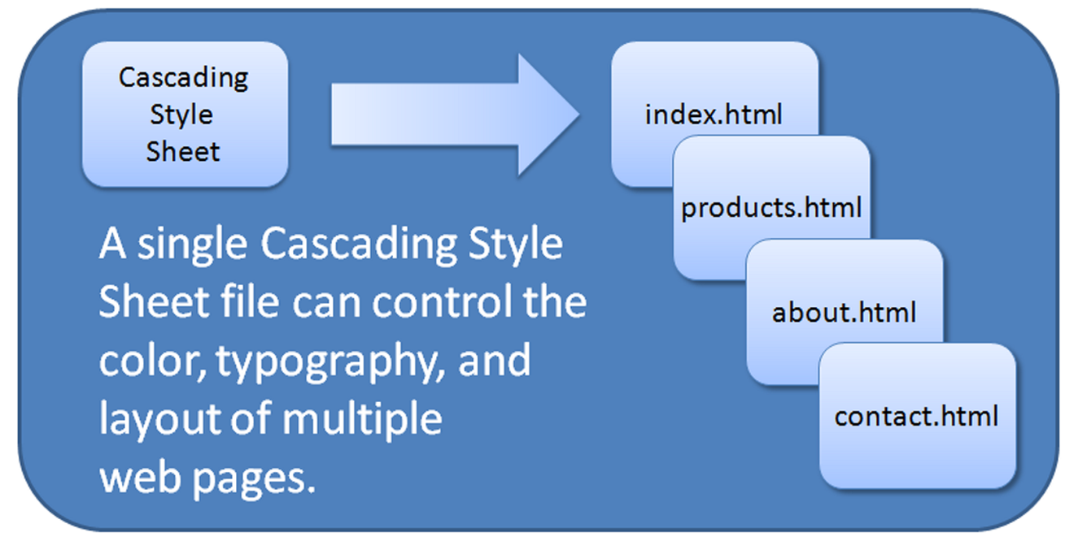
CSS Saves a Lot of Work!
The style definitions are normally saved in external .css files.
With an external style sheet file, you can change the look of an entire Web site by changing just one file!

Slide 13
CSS Syntax
A CSS rule set consists of a selector and a declaration block :
The selector points to the HTML element you want to style.
The declaration block contains one or more declarations separated by semicolons.
Each declaration includes a property name and a value, separated by a colon.
Example:
p {color:red;text-align:center;}

Slide 14
CSS Comments
Comments are used to explain your code,
and may help you when you edit the source code at a later date. Comments are ignored by browsers.
A CSS comment starts with /* and ends with */.
Comments can also span multiple lines:
p { color: red; /* This is a single-line comment */ text-align: center; } /* This is a multi-line comment */

Slide 15
CSS Selectors
CSS selectors allow you to select and manipulate HTML elements.
CSS selectors are used to "find" (or select) HTML elements based on their id, class, type, attribute, and more.
The element Selector
The element selector selects elements based on the element name.
You can select all <p> elements on a page like this: (all <p> elements will be center-aligned, with a red text color)
p { text-align: center; color: red; }

Slide 16
Grouping Selectors
If you have elements with the same style definitions, like this:
h1 { text-align: center; color: red; } h2 { text-align: center; color: red; } p { text-align: center; color: red; }
you can group the selectors, to minimize the code.
To group selectors, separate each selector with a comma.
In the example below we have grouped the selectors from the code above:
h1, h2, p { text-align: center; color: red; }

Slide 21
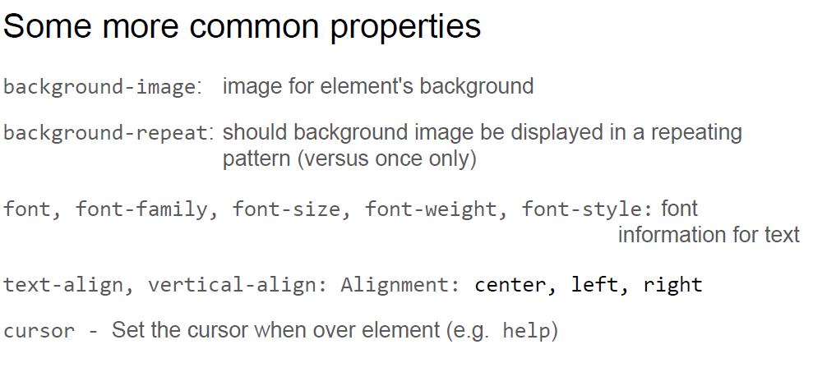

Slide 22
Ways to Insert CSS
There are three ways of inserting a style sheet:
External style sheet
Internal style sheet
Inline style

Slide 23
External Style Sheet
With an external style sheet, you can change the look of an entire website by changing just one file!
CSS style rules are contained in a text file separate from the HTML documents.
Each page must include a reference to the external style sheet file inside the <link> element. The <link> element goes inside the head section:
<head> <link rel="stylesheet" type="text/css" href="mystyle.css"> </head>

Slide 24
External Style Sheet
The External Style Sheet text file:
extension ".css"
contains only style rules
does not contain any HTML tags
The power of External Style Sheet
Configured in a single file that can be associated with many webpages.
When styles need to be modified only ONE file needs to be changed.
Styles can be stored.
Documents are potentially smaller.
This saves the developer so much time and increases the productivity!

Slide 25
External Style Sheet
Multiple web pages can associate with the same external style sheet file.
site.css
index.html
body {background-color:#E6E6FA;
color:#000000;
font-family:Arial, sans-serif;
font-size:90%; }
h2 { color: #003366; }
nav { font-size: 16px;
font-weight: bold; }
clients.html
about.html

Slide 26
External Style Sheet
An example of a style sheet file called "myStyle.css", is shown below:
body { background-color: lightblue; } h1 { color: navy; margin-left: 20px; }

Slide 27
Internal Style Sheet (Embedded)
An internal style sheet may be used if one single page has a unique style.
Internal styles are defined within the <style> element,
inside the head section of an HTML page:
<head> <style> body { background-color: linen; } h1 { color: maroon; margin-left: 40px; } </style> </head>

Slide 28
Internal Style Sheet (Embedded)
Example:
Configure a web page with white text on a black background
<style>
body { background-color: #000000;
color: #FFFFFF;
}
</style>

Slide 29
Internal Style Sheet (Embedded)
<head>
<style>
Body {background-color: #CCFFFF; color: #000033;}
</style>
</head>
<body>
<p> this page is embedded style </p>
</body>

Slide 30
Embedded CSS with Style element
You can style more than one element:
Exercise:
Find out how the Embedded CSS style below styles the web page. Show me your result.
P.S Don’t forget to write the rest of the code
<head>
<style>
Body {background-color: #CCFFFF; color: #000033;}
h1 { background-color: #e6e6fa;}
h2 {background-color: #191970;}
</style>
</head>

Slide 31
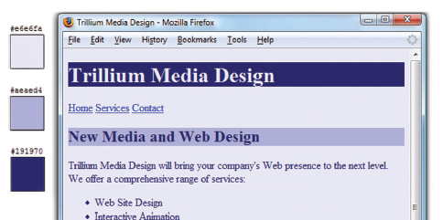
CSS Embedded Styles
The body selector sets the global style rules for the entire page.
These global rules are overridden for <h1> and <h2> elements by the h1 and h2 style rules.
<style>
body { background-color: #E6E6FA;
color: #191970;}
h1 { background-color: #191970;
color: #E6E6FA;}
h2 { background-color: #AEAED4;
color: #191970;}
</style>

Slide 32
Inline Styles
An inline style may be used to apply a unique style for a single element. Such as: <p> or <h1>
Use the style attribute on an HTML tag
The style attribute can contain any CSS property.
It is in body section.
Inline styles is not recommended.
The example shows how to change the color and the left margin of a <h1> element:
<h1 style="color:blue;margin-left:30px;">This is a heading.</h1>

Slide 33
Using colors on CSS
With CSS, a color is most often specified by:
a HEX value - like "#ff0000"
an RGB value - like "rgb(255,0,0)"
a color name - like "red
Where to find hexadecimal color values?
Many websites provide color pickers tools.
For example try: http://www.colorpicker.com/

Slide 34
CSS Background
CSS background properties are used to define the background effects of an element.
CSS properties used for background effects:
background-color
background-image
background-repeat
background-attachment
background-position

Slide 35
Background Color
he background-color property specifies the background color of an element.
The background color of a page is set like this:
body { background-color: #b0c4de; }
In the example below, the <h1>, <p>, and <div> elements have different background colors:
h1 { background-color: #6495ed; } p { background-color: #e0ffff; } div { background-color: #b0c4de; }

Slide 36
Background Image
The background-image property specifies an image to use as the background of an element.
By default, the image is repeated so it covers the entire element.
The background image for a page can be set like this :
body { background-image: url("paper.gif"); }
If the image is repeated only horizontally (repeat-x), the background will look better:
body { background-image: url("gradient_bg.png"); background-repeat: repeat-x; }
The position of the image is specified by the background-position property:
body { background-image: url("img_tree.png"); background-repeat: no-repeat; background-position: right top; }

Slide 37
All CSS Background Properties
Property | Description
background | Sets all the background properties in one declaration
background-attachment | Sets whether a background image is fixed or scrolls with the rest of the page
background-color | Sets the background color of an element
background-image | Sets the background image for an element
background-position | Sets the starting position of a background image
background-repeat | Sets how a background image will be repeated

Slide 38
CSS Text
CSS properties for configuring text:
font-weight
Configures the boldness of text
font-style
Configures text to an italic style
font-size
Configures the size of the text
font-family
Configures the font typeface of the text

Slide 39
CSS Text
Text color:
Text Alignment:
Text can be centered, or aligned to the left or right, or justified. Using text-align
body { color: blue;} h1 { color: #00ff00;} h2 { color: rgb(255,0,0);}
h1 { text-align: center; } p.date { text-align: right; } p.main { text-align: justify; }

Slide 40
CSS Text
Text Decoration
The text-decoration property is used to set or remove decorations from text.
The text-decoration property is mostly used to remove underlines from links for design purposes:
a { text-decoration: none; }
h1 { text-decoration: overline; } h2 { text-decoration: line-through; } h3 { text-decoration: underline; }
It can also be used to decorate text:

Slide 41
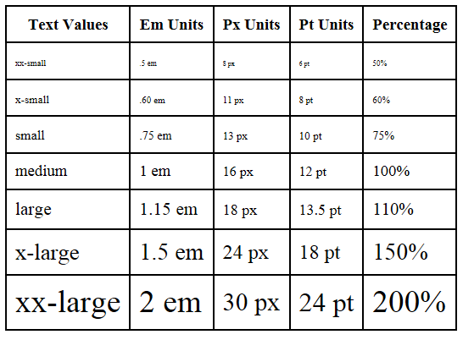
The font-size Property
Accessibility Recommendation: Use em or percentage font sizes – these can be easily enlarged in all browsers by users

Slide 42
The id Selector
The id selector uses the id attribute of an HTML element to select a specific element.
An id should be unique within a page, so the id selector is used if you want to select a single, unique element.
To select an element with a specific id, write a hash character, followed by the id of the element.
The style rule below will be applied to the HTML element with id="para1":
<html>
<head>
<style>
#para1 {
text-align: center;
color: red; }
</style> </head>
<body>
<p id="para1">Hello World!</p>
<p>This paragraph is not affected by the style.</p>
</body></html>
Hello World!
This paragraph is not affected by the style.

Slide 43
The class Selector
The class selector selects elements with a specific class attribute.
To select elements with a specific class, write a period character, followed by the name of the class:
In the example below, all HTML elements with class="center" will be center-aligned
<html>
<head>
<style>
.center {
text-align: center;
color: red;
}
</style>
</head>
<body>
<h1 class="center">Red and center-aligned heading</h1>
<p class="center">Red and center-aligned paragraph.</p> </body> </html>
Red and center-aligned heading
Red and center-aligned paragraph.

Slide 44
The class Selector
You can also specify that only specific HTML elements should be affected by a class.
In the example below, all <p> elements with class="center" will be center-aligned:
<html>
<head>
<style>
p.center {
text-align: center;
color: red;
}
</style>
</head>
<body>
<h1 class="center">This heading will not be affected</h1>
<p class="center">This paragraph will be red and center-aligned.</p>
</body>
</html>
This heading will not be affected
This paragraph will be red and center-aligned.

Slide 45
Questions !! ☺

