Slide 1
Hemoflagellates
Phylum: Sarcomastigophora

Slide 2
2 medically important genera: Trypanosoma and Leishmania
Important pathogens of humans
All pathogenic species transmitted by insects
All have more or less complex cycles alternating from one morphologic form to another

Slide 3
Genus Trypanosoma
2 different species of medical importance:
- Trypanosoma cruzi (American Trypanosoma): causes Chagas' disease in South America
- Trypanosoma brudei gambiense and rhodesiense (African Trypanosoma): causes African trypanosomiasis (African sleeping sickness)

Slide 4
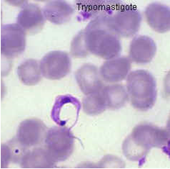
Trypanosoma cruzi (Chagas' Disease, American Trypanosomiasis) Morphology:
Trypomastigotes

Slide 5
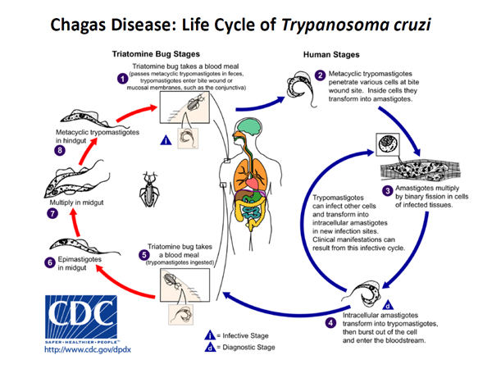
Habitat, Epidemiology and life cycle:

Slide 6
Pathogenesis and clinical picture:
Acute:
Chagoma
Romano’s sign
Generalized lymphadenopathy, hepatomegaly, fever.
Chronic:
Myocardopathy
Megacolon
Megaoesophagus

Slide 7
Diagnosis, treatment and control:
Blood smear for trypomastigotes (Giemsa stain) Serology, PCR Muscle biopsy (deltoid) detect the amastigote form
Culture on N.N.N. media
xenodiagnosis (obsolete)
Treatment: - Nifurtimox (Lampit) a nitrofurone, poorly effective in chronic Chagas
Control: - Concrete walls and floors prevent winged bug infestations, antiparasitic agents added to transfused blood products.

Slide 8
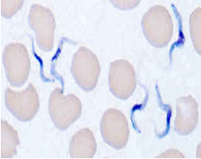
African Trypanosomiasis (African Sleeping Sickness) Morphology:
Trypomastigotes:

Slide 9
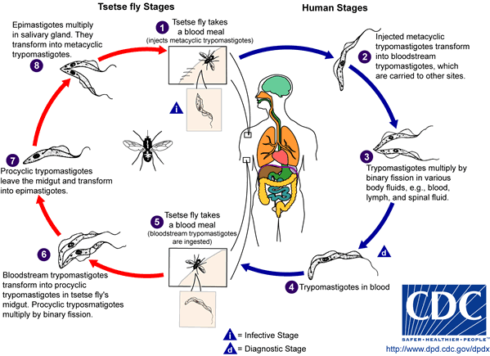
Habitat, Epidemiology and life cycle:
Habitat:
3 habitats according
to the stage of the disease
In early stage,
the organisms are found in
the blood and lymphatics.
As the disease progress,
the organisms are found in
the internal organs.
In the terminal stages,
the organisms are found in the CNS and CSF

Slide 10
Pathogenesis and clinical picture:
Trypanosomal chancre
Parasitemia with lymphadenopathy (especially lymph nodes at the posterior triangle of the neck (winter bottom’s sign), headache, splenomegaly.
Recurrent fever
Kerandel’s sign

Slide 11
Diagnosis, treatment and major problems:
The trypomastigote could be detected in the blood, CSF, fluid aspiration from enlarged lymph nodes. Motile organisms on wet preparations of fresh blood or CSF.
High levels of protein (IgG and IgM) in blood and CSF.
Lymphocytosis in CSF.
Antigen capture or PCR.
Culture on weinman’s media.
Treatment - Pentamidine - Suramin - Eflornithine - Melarseprol
Major problem: vaccine production very difficult because of antigenic variation of trypanosome.

Slide 12
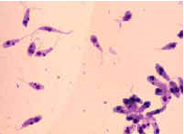
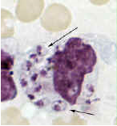
Leishmaniasis, Morphology:
Visceral leishmaniasis
Cutaneous and mucocutaneous leishmaniasis
Promastigote: Amastigote:

Slide 13
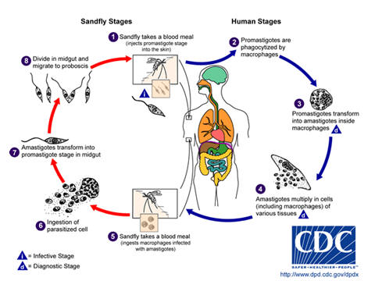
Epidemiology and life cycle:
Epidemiology:
1-Bite of infected sand fly
2-Accidental in lab
3-Mechanical transmission
4-Blood transfusion
5- Congenital

Slide 14
Clinical picture:
Visceral leishmaniasis: (L. donovani) -Early nodule at site of sandfly bite seen at times
- Chronic fever (but the patient is not aware of this fever)
- Splenomegaly (very large), hepatomegaly, lymphadenopathy
-Dark skin = Kala, azar.
- Anemia, leucopenia and thrombocytopenia
- Increase in the globulin and decrease in the albumin (characteristic).

Slide 15
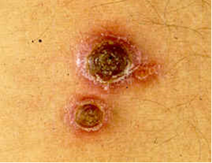
Clinical picture:
Cutaneous leishmaniasis:
L. tropica (urban): dry sore
L. major (rural): wet sore
L.aethiopica

Slide 16
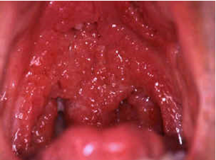
Clinical picture:
Mucocutaneous leishmaniasis:
L. Braziliensis

Slide 17
Diagnosis:
Visceral:
aspirate bone marrow or spleen or lymph nodes or liver.
Blood examination: only on Indian type of kala azar.
Serology.
Formol gel test.
Leishmanin test.
Cutaneous and mucocutaneous:
aspirate material from edge of ulcer and never the floor to avoid contamination and stain (Giemsa).
Biopsy and stain.
Culture in N.N.N media.
Leishmanin test.

Slide 18
Treatment:
Relatively toxic drugs, e.g. antimonials (Pentostam), Pentamidine, Amphoteracin B.
Resistance to all drugs in some geographic areas.

