Slide 1
EE 201 Week 2 – Part 1

Slide 2
Content
Circuit introduction
Nodes
Loops
Ch 5 - Series circuit
Total resistance
Power in a series circuit
Combining voltage sources
KVL
Voltage division
Notation and voltage difference
Examples
Ch 6 – Parallel circuit
Parallel elements
Total conductance and resistance
Parallel networks
KCL
Current divider rule
Voltage sources in parallel
Open and short circuits

Slide 3
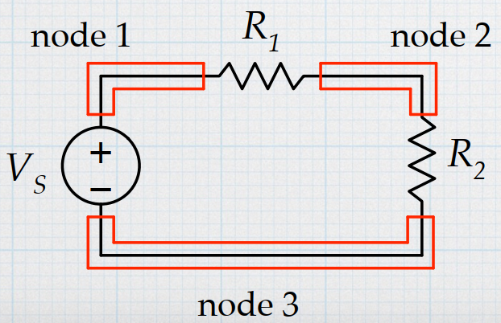
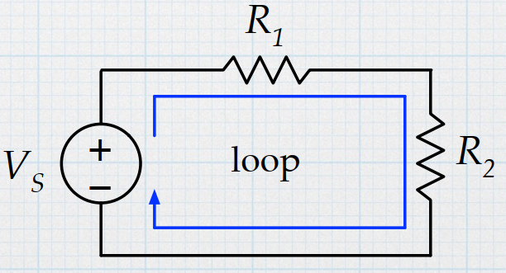
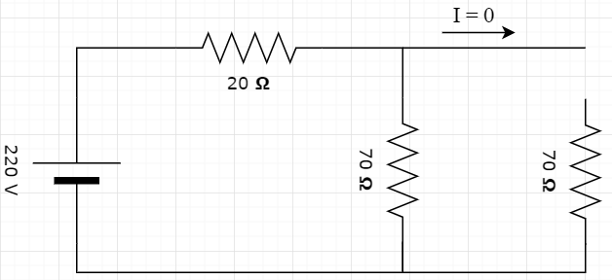
Circuit
A circuit contains various circuit elements, connected by wires
The connections form nodes and loops
The points connected by wires (nodes) have the same voltage
Elements in series have the same current
A broken path (open circuit) has no current.
http://tuttle.merc.iastate.edu/ee201/topics/fundamentals/kirchoff.pdf

Slide 4
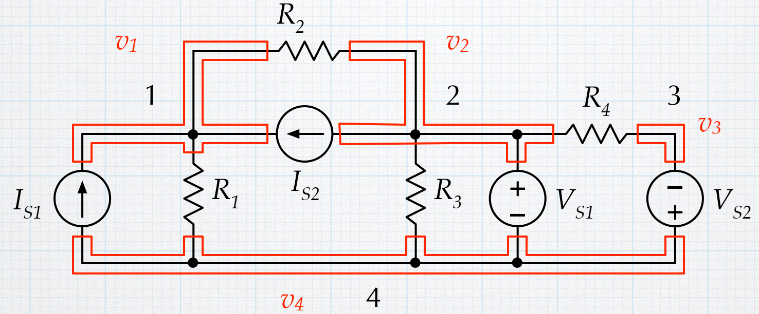
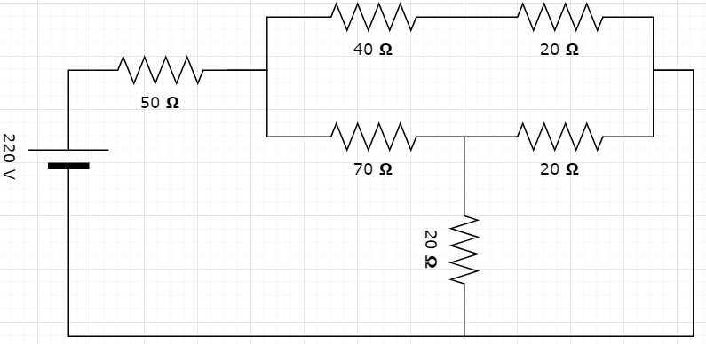
Nodes and Loops
Voltage on $R_{2}$ is ?
$$v_{1}−v_{2}$$
http://tuttle.merc.iastate.edu/ee201/topics/fundamentals/kirchoff.pdf

Slide 5
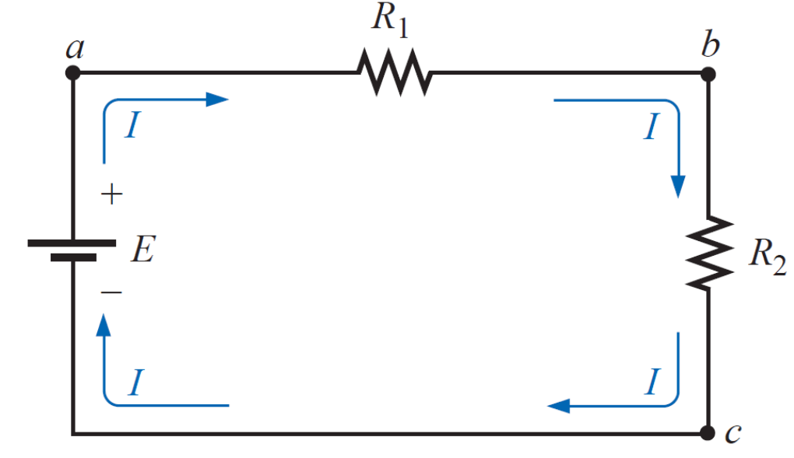
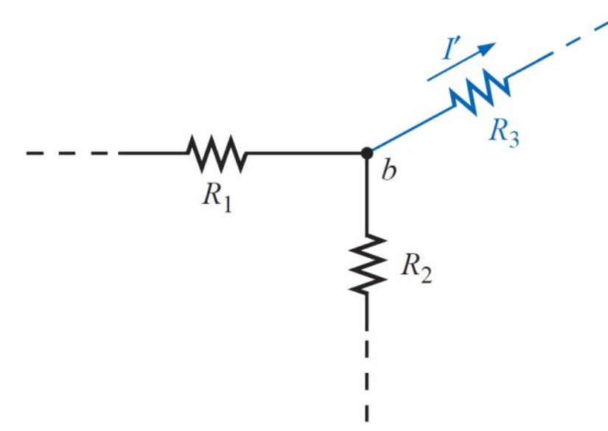
Series Circuit
Two elements are in series if:
1- They have only one node (terminal) in common
2- The common point between them is not connected to another current carrying element.
Series elements have the same current

Slide 6
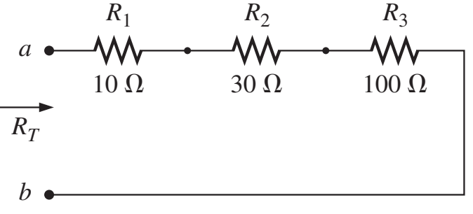
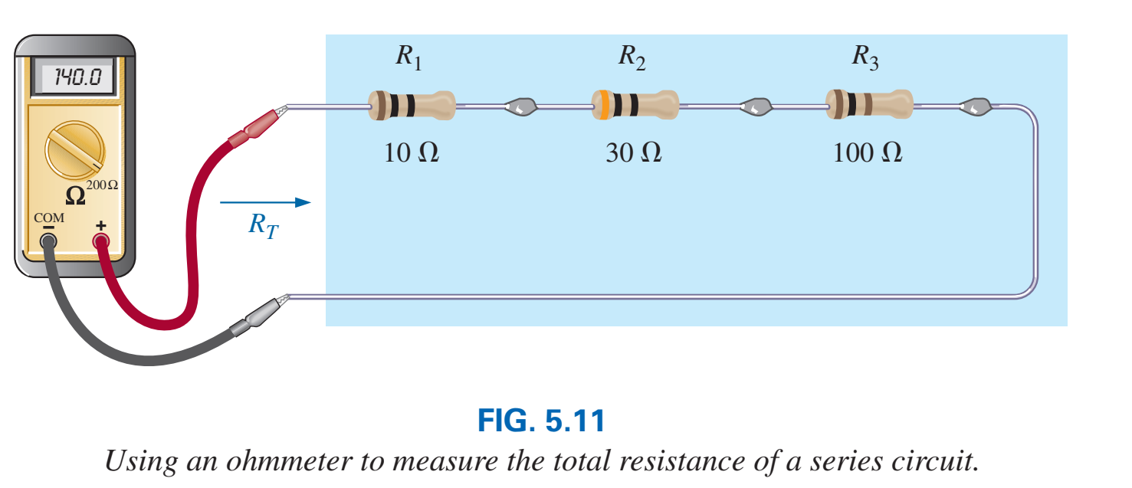
Total resistance
$$R_{T}=140 Ω$$

Slide 7
Total resistance

Slide 8
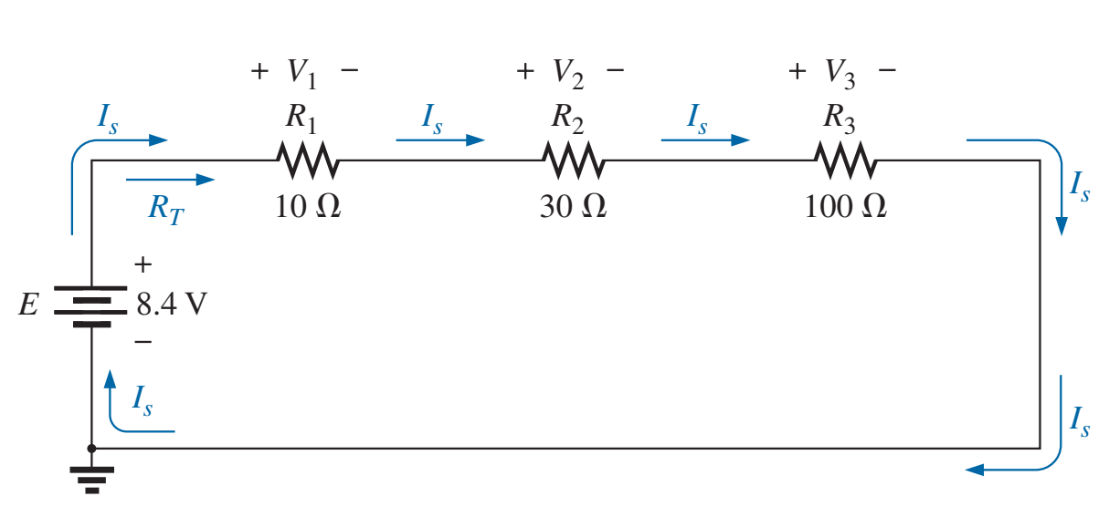
Calculate current and voltages
$$V_{1}=10×0.06=0.6 V$$
$$V_{2}=30×0.06=1.8 V$$
$$V_{3}=100×0.06=6 V$$
Notice:
$$V_{1}+V_{2}+V_{3}=E$$

Slide 9
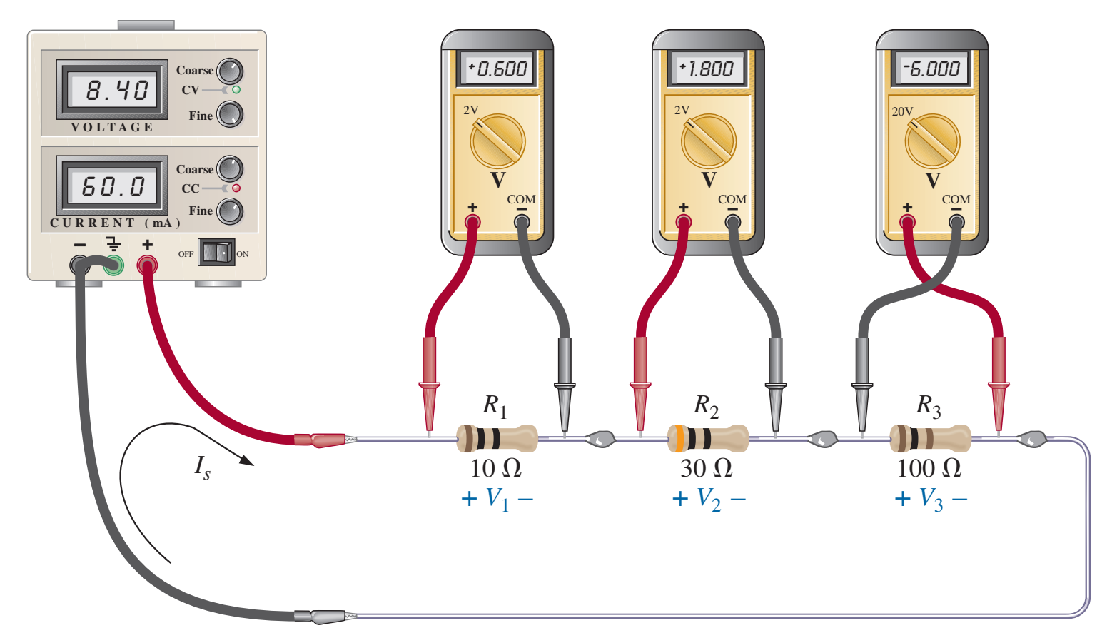
Calculate current and voltages

Slide 10
Calculate current and voltages
Calculate the following:
Resistance between $a$ and $b$
$I_{1}$
$I_{2}$
$V_{R1}$
$V_{R2}$
$V_{R3}$
$$+ V_{R1}−$$
$$+ V_{R2}−$$
$$a$$
$$I_{1}$$
$$−$$
$$V_{R3}$$
$$+$$
$$I_{2}$$
$$b$$

Slide 11
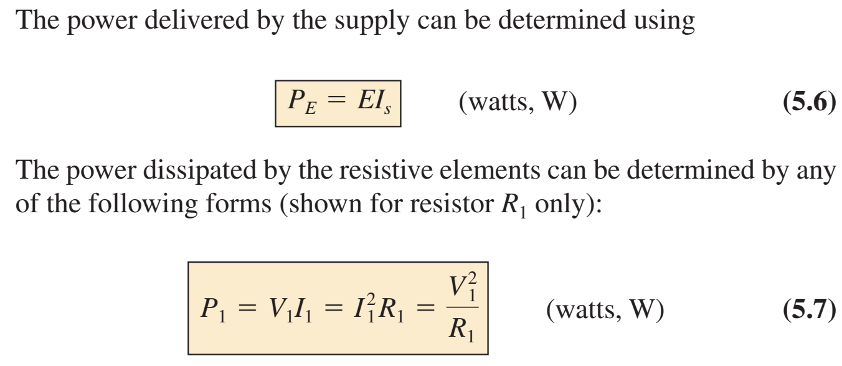
Calculate the power

Slide 12
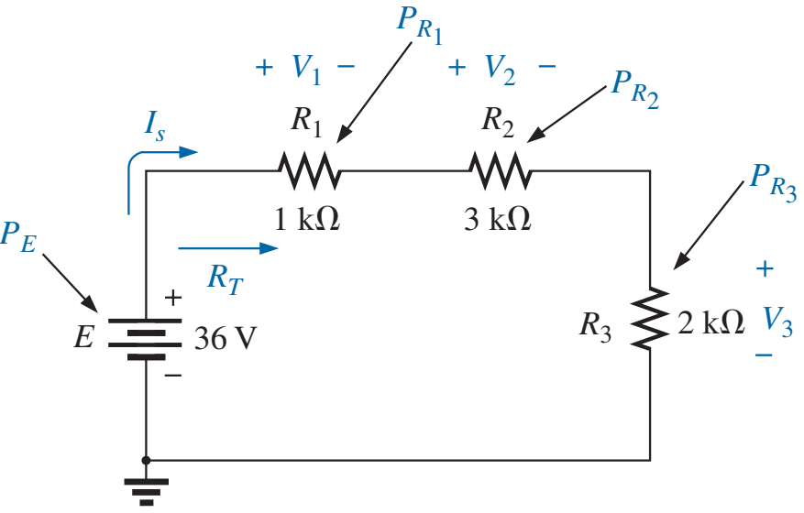
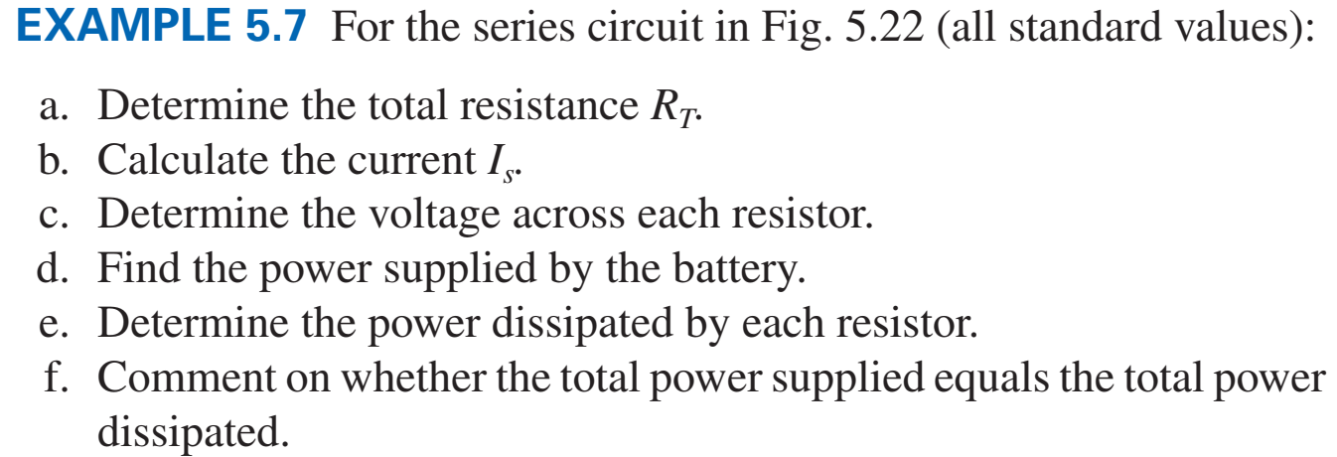
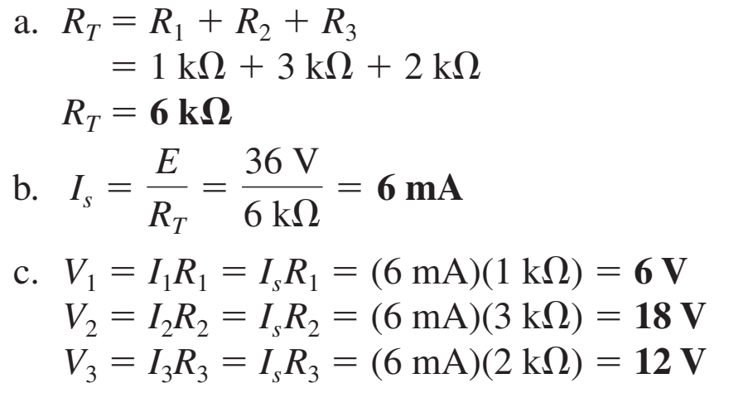
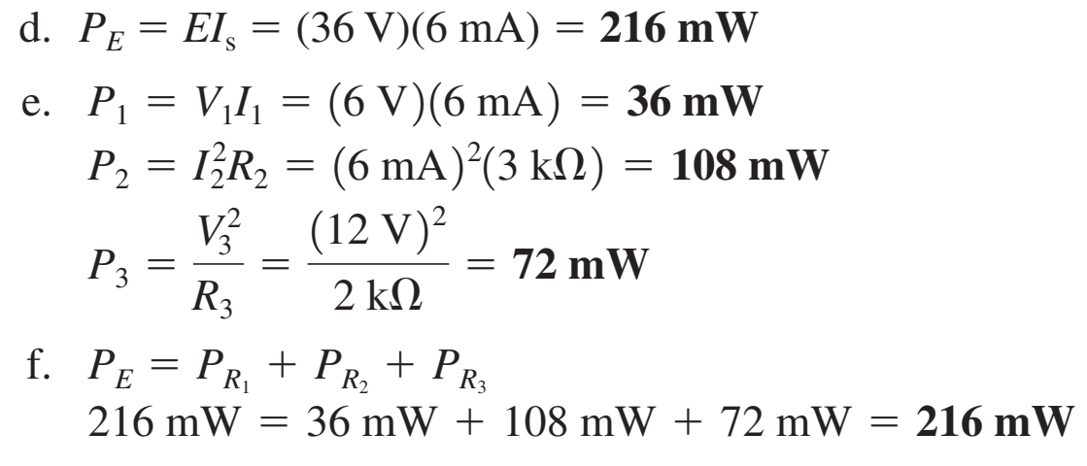
Calculate the power - Example

Slide 13
Power sources in series
Voltage sources can be connected to increase or decrease the voltage
Some the voltage that have the same polarity and subtract from the other
Watch the current
Assume current direction
Current out of positive terminal for $E_{1}→$ $E_{1}$ is positive
Current out of negative terminal for $E_{2}→$ $E_{2}$ is negative
Total voltage $E_{T}$ =$E_{1}−E_{2}$
Polarity of $E_{T}$ is the same as the polarity of the larger $E$
$$E_{1}$$
$$E_{2}$$
If $E_{1}>E_{2}$
If $E_{2}>E_{1}$
$$E_{T}$$
$$E_{T}$$

Slide 14
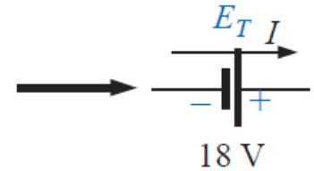
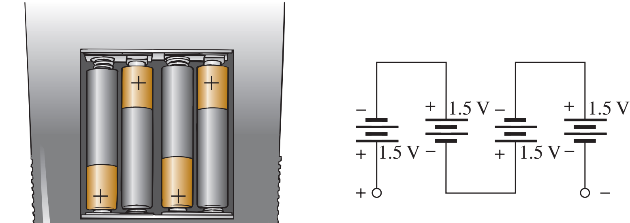
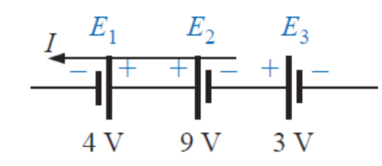
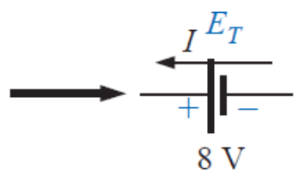
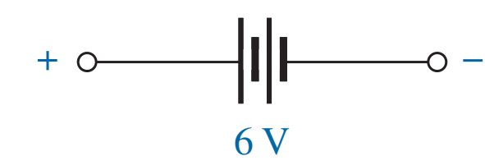
Power sources in series

Slide 15
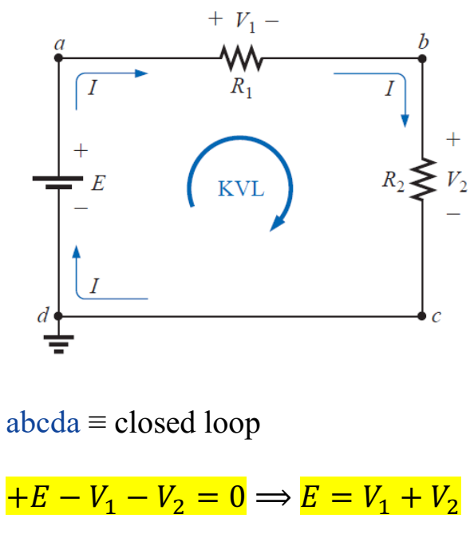
Kirchhoff’s voltage law

Slide 16
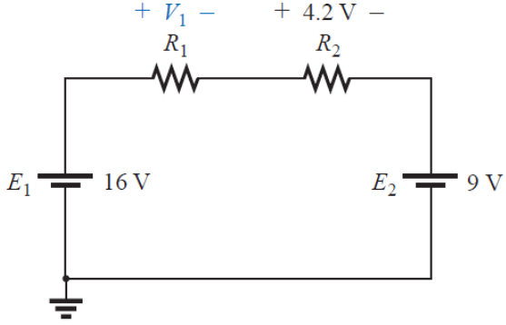
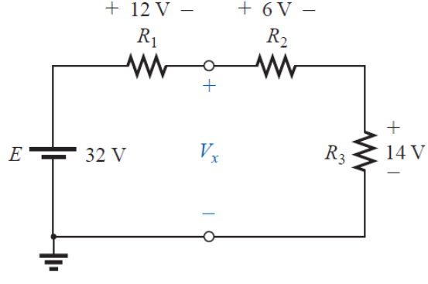
Examples
Calculate $V_{1} ?$
Calculate $V_{x} ?$

Slide 17
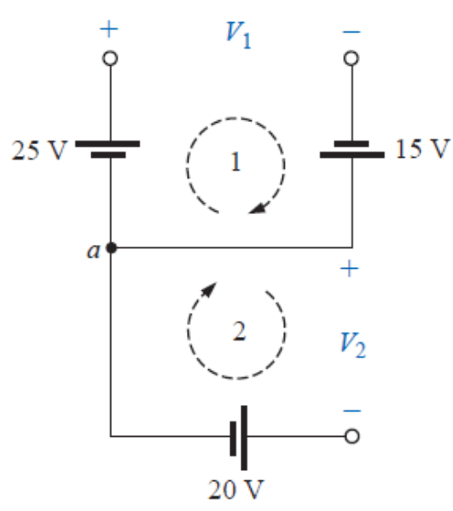
Examples
Calculate $V_{1}$ and $V_{2}$ ?

Slide 18
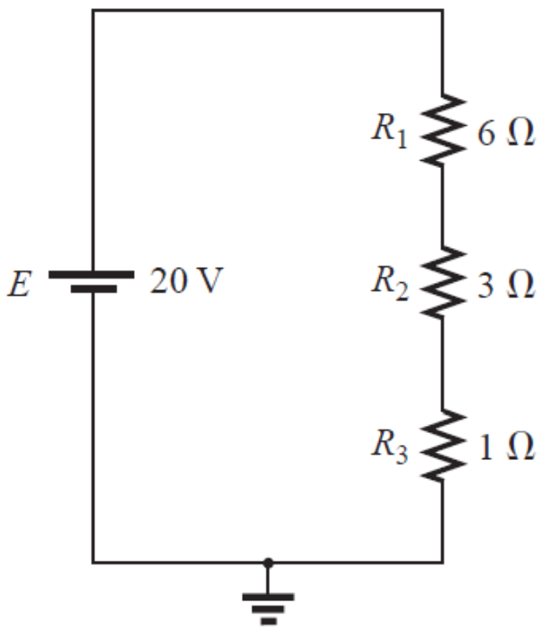
Voltage divider rule
The voltage is divided between resistors which are connected in series in direct proportion to their resistance
Find the voltage on $R_{1}, R_{2}$ and $R_{3}$
$I_{R_{1},R_{2},R_{3}}=\frac{E}{R_{1}+R_{2}+R_{3}}$
$V_{R_{1}}=$ $I_{R_{1} }×R_{1}=\frac{E}{R_{1}+R_{2}+R_{3}}×R_{1}$
$V_{R_{2}}=$ $I_{R_{2} }×R_{2}=\frac{E}{R_{1}+R_{2}+R_{3}}×R_{2}$
$V_{R_{3}}=$ $I_{R_{3} }×R_{3}=\frac{E}{R_{1}+R_{2}+R_{3}}×R_{3}$

Slide 19
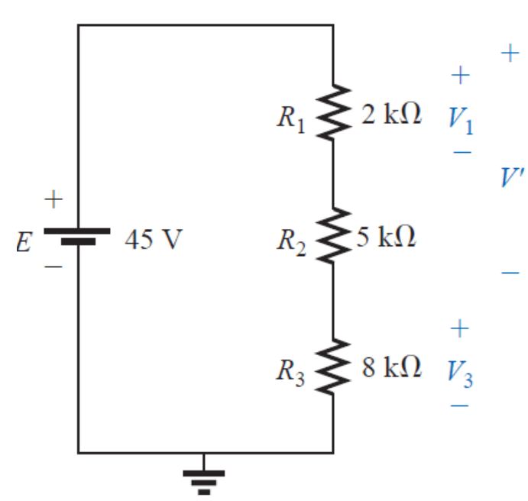
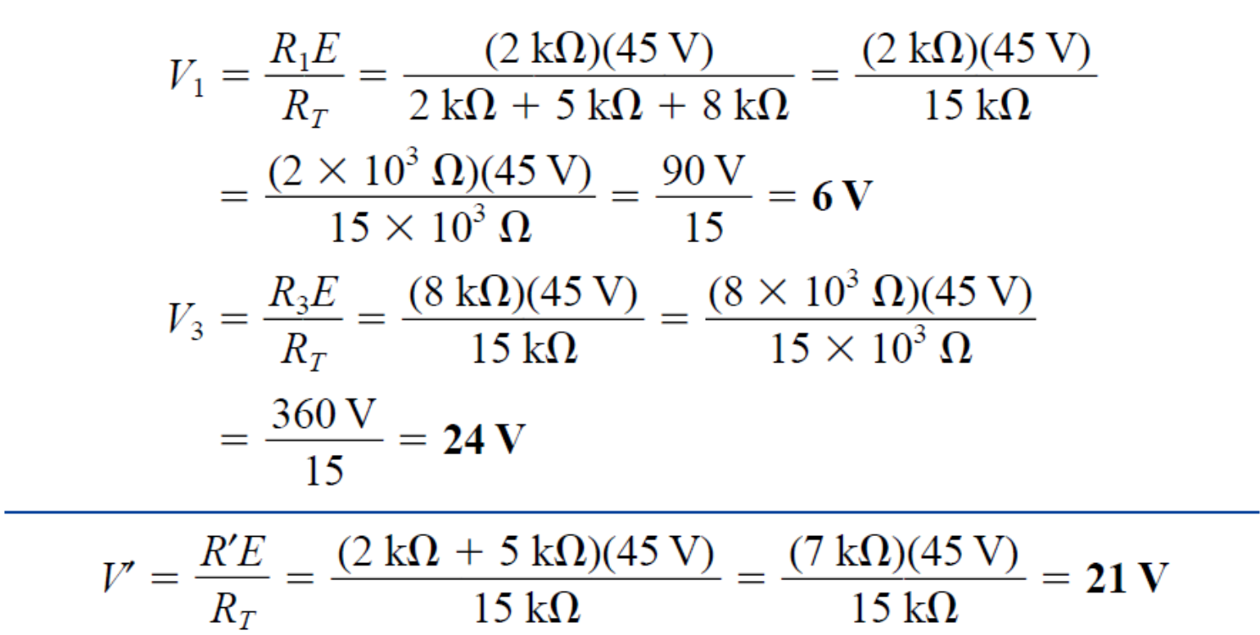
Voltage divider rule

Slide 20
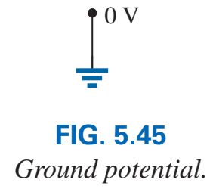
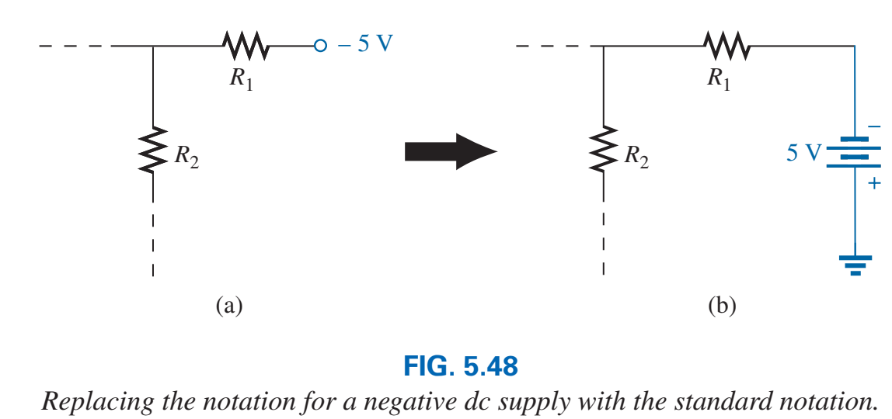
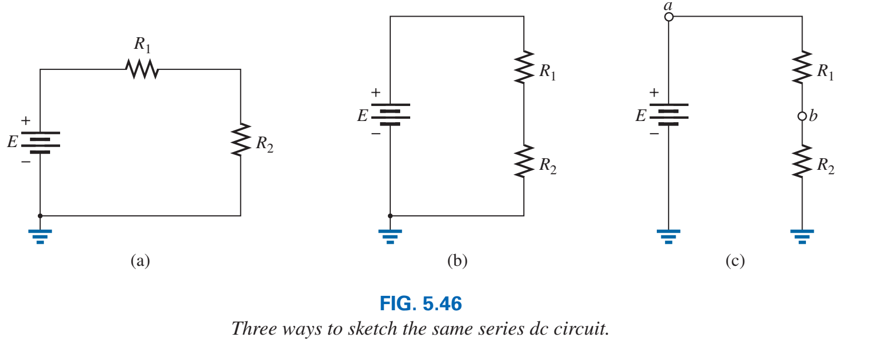
Notations and grounding
Electrical and electronic systems are grounded for reference and safety purposes.

Slide 21
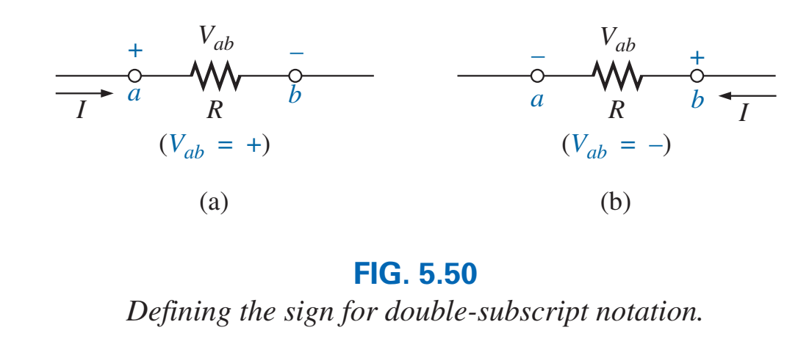
Double-subscript notation

Slide 22
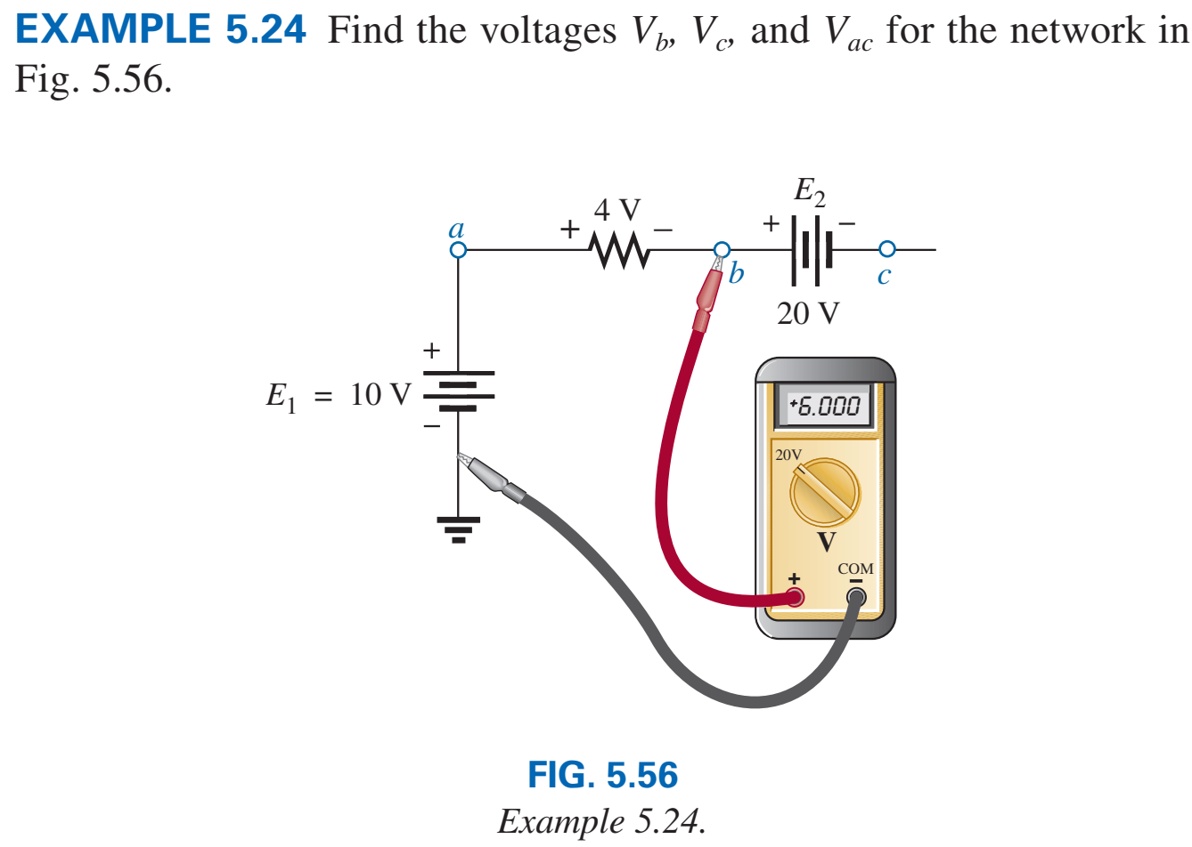
Single-subscript notation
The notation $V_{a}$ is the voltage between node $a$ and the ground
$V_{a}$ =$V_{a}−0$

Slide 23
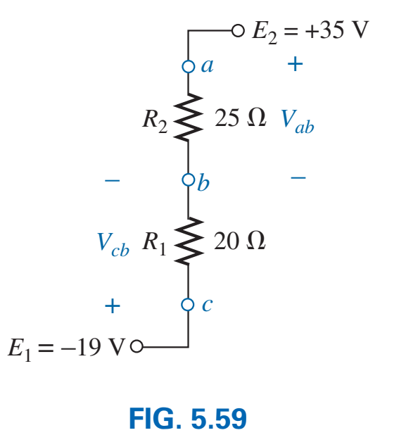
Exercise

Slide 24
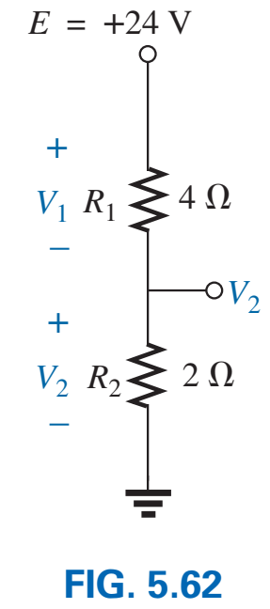
Exercise

Slide 25
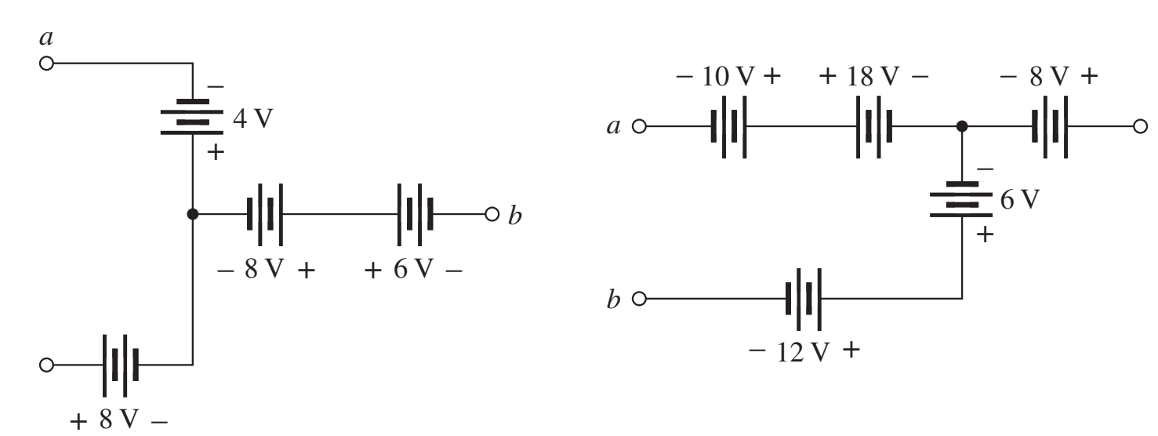
Exercise

Slide 26
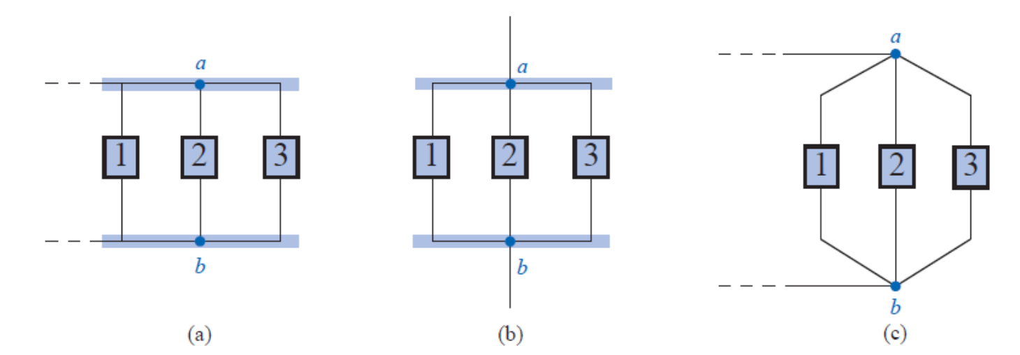
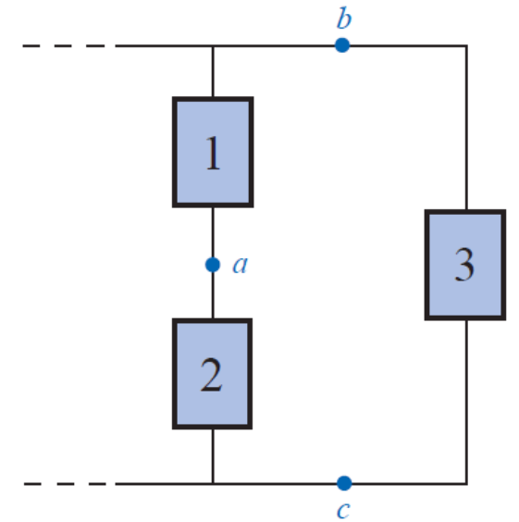
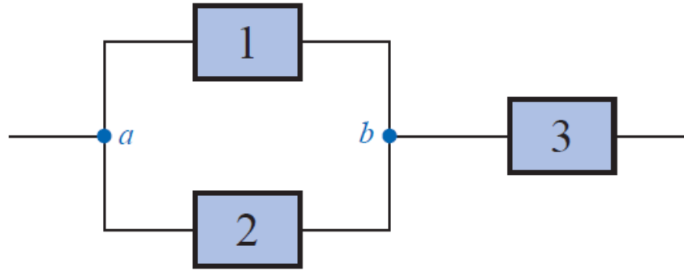
Parallel Circuit
Two elements, branches, or networks are in parallel if they have two points/nodes/terminal in common.

Slide 27
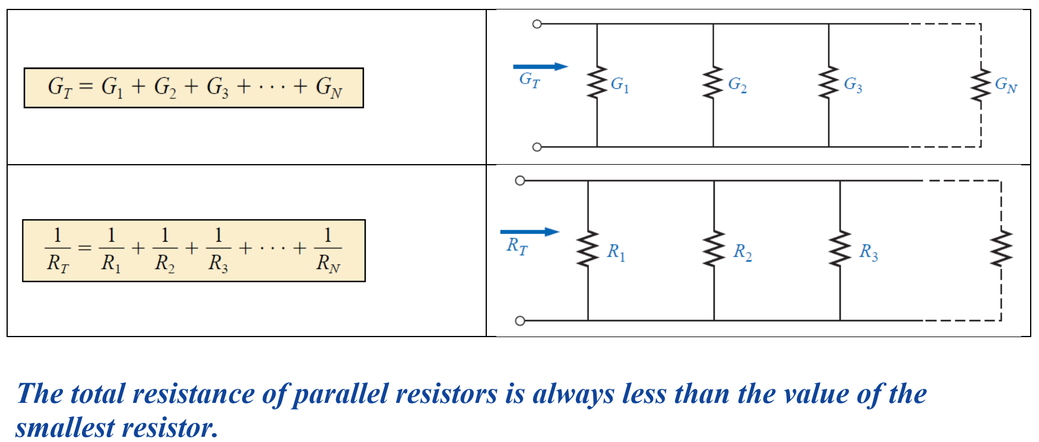
Conductance
Conductance is the degree to which an object conducts electricity

Slide 28
Adding parallel resistance

Slide 29
Adding parallel resistance

Slide 30
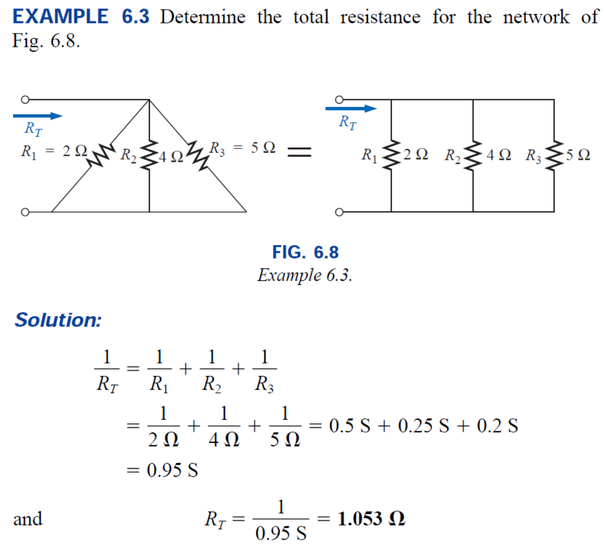
Example

Slide 31
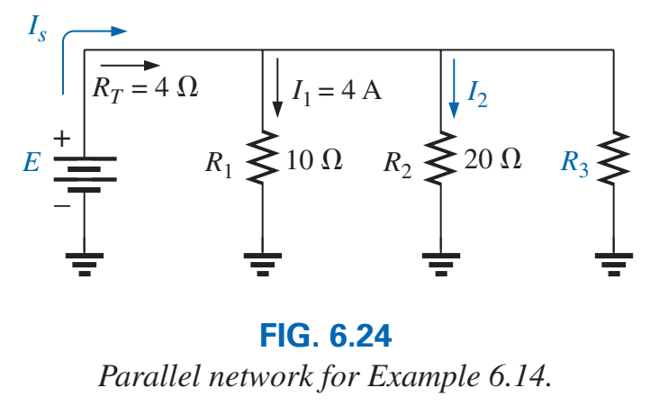
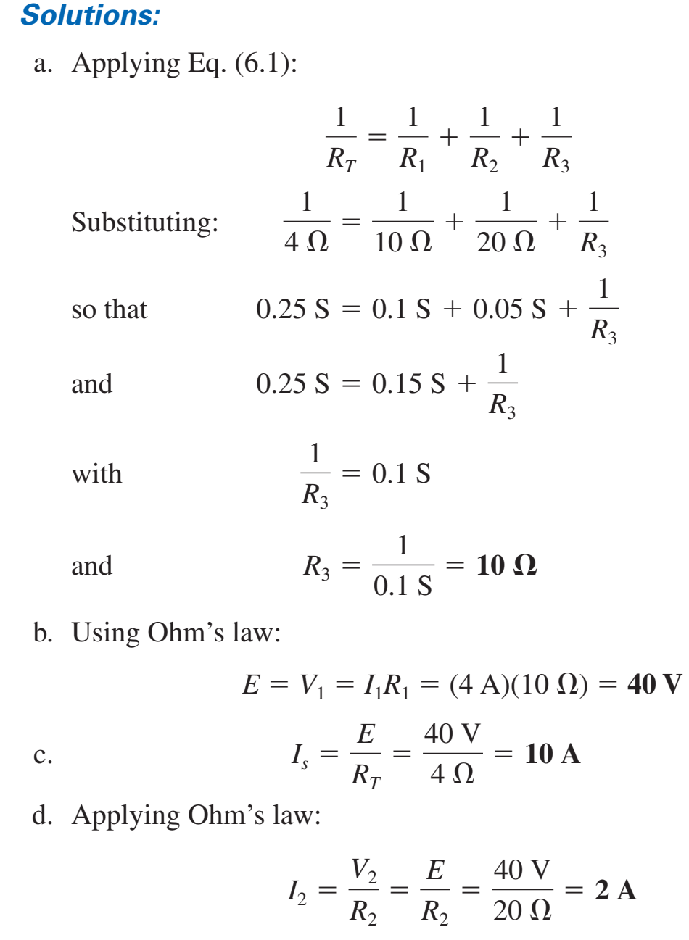
Example

Slide 32
Reference
http://tuttle.merc.iastate.edu/ee201/topics.htm

