Slide 1




College of Science,
Zoology Department

Slide 2



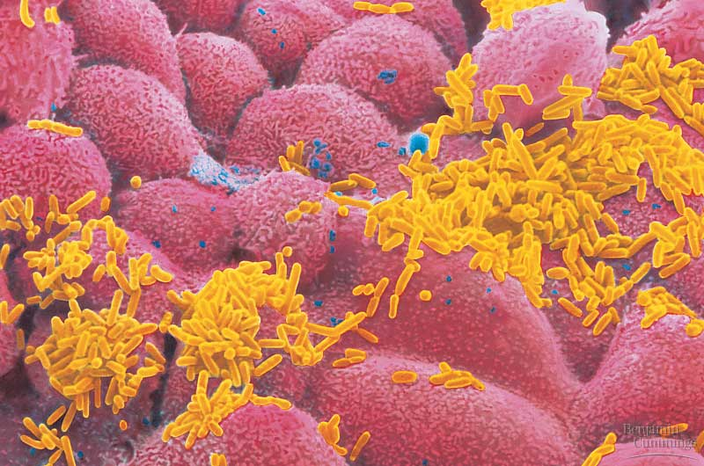
Viruses
Copyright © 2002 Pearson Education, Inc., publishing as Benjamin Cummings

Slide 3
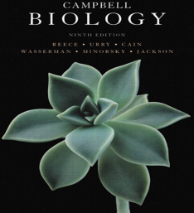

Objectives
Describe why viruses are not considered living organisms.
Describe the basic structure of viruses.
  A virus consists of a nucleic acid surrounded by a protein coat.
    Viral Genomes.
    Capsids and Envelopes.
Viruses replicate only in host cells.
Replicative Cycles of Phages.
  The Lytic Cycle.
  The Lysogenic Cycle.
Compare the lytic and lysogenic cycles of virus replication.

Slide 4
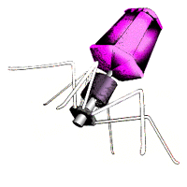
What are viruses?
At the boundary of life, between the macromolecules (which are not alive) and the prokaryotic cells (which are alive), lie the viruses and bacteriophages (phages).
These creatures are parasites responsible for causing many diseases in living things (HIV in humans, as an example).
Viruses are found everywhere.
Viruses consist of a core of nucleic acid, either DNA or RNA, and a protective coat of protein molecules and sometimes lipids.
Viruses show none of the expected signs of life.
Viruses do not respond to stimuli, do not grow, do not do any of the things we normally associate with life.
Viruses are not considered "living" organisms. However, they do show one of the most important signs of life: the ability to reproduce in a host cell.
Copyright © 2002 Pearson Education, Inc., publishing as Benjamin Cummings

Slide 5
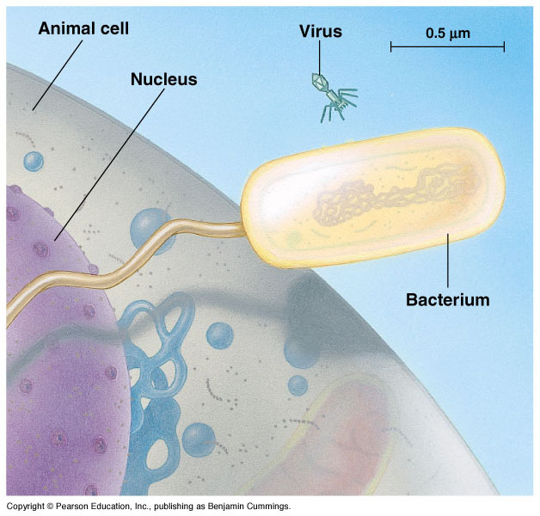
What are viruses?
1- Viruses are much smaller than bacteria
2- Virus is about 20nm in diameter
3- Viruses are not cells
4- A virus is a genome
حامض نووي enclosed in a
protective coat غطاء واقي

Slide 6
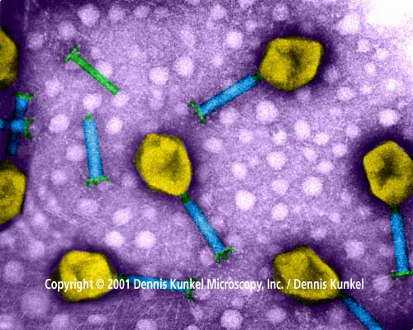
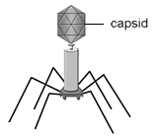
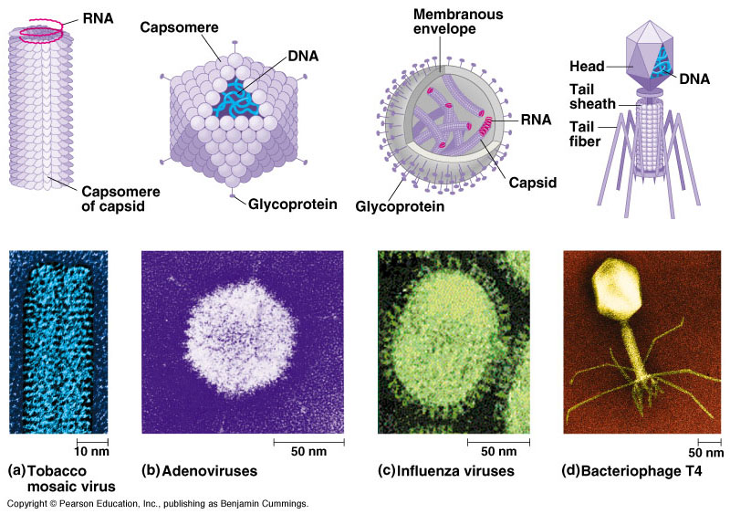
Virus is a genome enclosed in a protective coat
bacteriophages
Genome (DNA/RNA)
Protein coat (capsid)

Slide 7

Viral Capsid and Envelope
A- Capsid
A protein shell that encloses the viral genome.
It is rode-shaped, helical, polyhedral or more complex.
Capsomeres: Are the protein units that form capsid.
Capsomeres (proteins)
Capsid
Membranous envelop (viral envelope)
Sometimes further wrapped يُغَلَّف in a membranous envelope (Viral envelope الغطاء الفيروسي ), eg. Influenza virus.

Slide 8
B- Envelope الغطاء الفيروسي
Some viruses have viral envelopes, membranes cloaking their capsids.
These envelopes are derived from the membrane of the host cell.

Slide 9
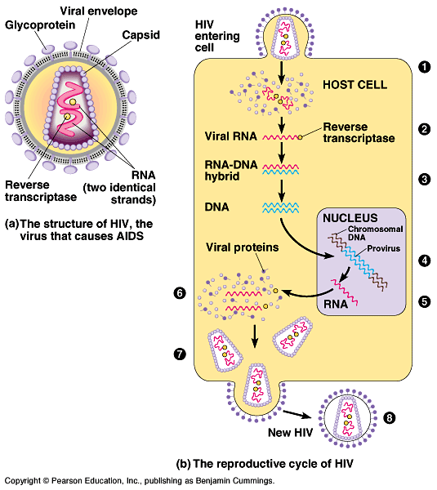
Types of Viral Genome: (Hereditary material المادة الوراثية)
  Viral genomes may consist of:
  - double-stranded DNA (dsDNA),
  - single-stranded DNA (ssDNA),
  - double-stranded RNA (dsRNA),
  - single-stranded RNA (ssRNA).
  depending on the specific type of a virus.
  The viral genome is usually organized as a single linear or circular molecule of nucleic acid.
  The smallest viruses have only four genes, while the largest have several hundred.

Slide 10
Virus-Reproduction within a living host cell
Living Cell
Obligate parasitism التطفل الإجباري
1-Inters the cell and releases its genome
2- Replicates using host nucleotides and enzymes
Viral RNA
3- Produce a new capsid units using host cell resources.
Capsid Proteins
4- The new viral DNA and proteins assemble to form new viruses

Slide 11
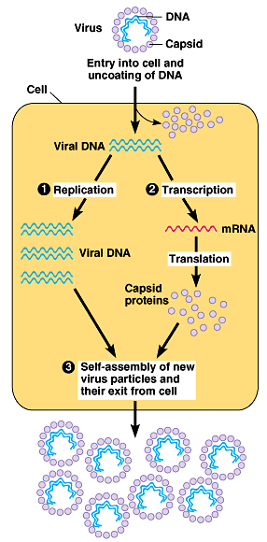
A viral infection begins when the genome of the virus enters the host cell.
Once inside, the viral genome commandeers its host, reprogramming the cell to copy viral nucleic acid and manufacture proteins.
The nucleic acid molecules and capsomeres then self-assemble into viral particles and exit the cell.

Slide 12
Human Immunodeficiency Virus (HIV), the virus that causes AIDS
(Acquired Immuno-Deficiency Syndrome) is a retrovirus.
A retrovirus is an RNA virus that is duplicated in a host cell using the reverse transcriptase enzyme to produce DNA from its RNA genome. The DNA is then incorporated into the host's genome by an integrase enzyme. The viral particle includes:
an envelope with glycoproteins,
a capsid containing
two identical RNA strands as its genome
Two copies of reverse transcriptase.

Slide 13
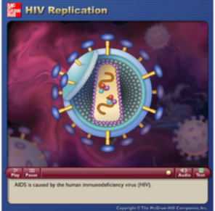
Video: plays in LMS
Source: http://highered.mcgraw-hill.com/sites/dl/free/0072437316/120060/ravenanimation.html

Slide 14
Bacteria infecting Viruses
Viruses that infect bacteria, are called bacteriophages or phages.
It has a 20-sided capsid-head that encloses their DNA and protein tail piece that attaches the phage to the host and injects the phage DNA inside.
Phages reproduce by Lytic Cycle (مميتــــة دورة) and/or Lysogenic cycle ( دورة مميتة أحيانا) .

Slide 15
Bacteriophages (on E. coli)
Phages reproductive cycles within bacteria:
Bacteria
Virus
1)- lytic cycle (التحـللية الدورة) ,
The phage reproductive cycle results in the death of the host.
  In the last stage, the bacterium lyses (breaks open) and releases the phages produced within the cell to infect others.
Virulent phages فيروسات قاتلة reproduce only by a lytic cycle.

Slide 16
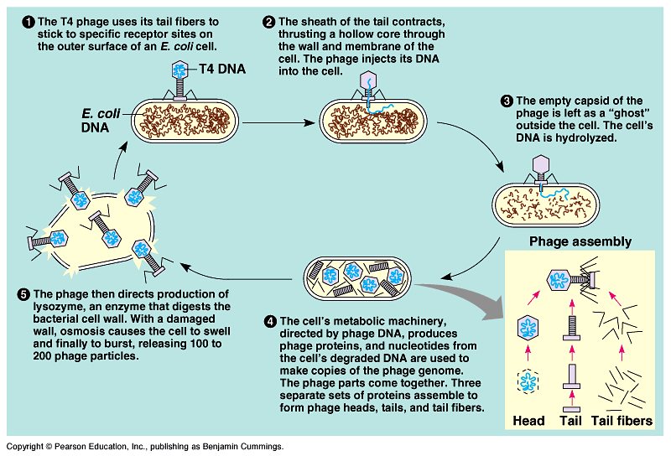
Phage T4
(virulent viruses)
فيروس مميت

Slide 17
2)- lysogenic cycle (التحـللية الدورة غير)
Phage lambda (ג)
The phage genome replicates without destroying the host cell.
Temperate phages, like phage lambda (ג), may use both lytic and lysogenic cycles.
Within the host, the virus’ circular DNA engages in either the lytic or lysogenic cycle.
During a lytic cycle, the viral genome immediately turns the host cell into a virus-producing factory, and the cell soon lyses and releases its viral products.
Temperate
virus
فـيــروس غير مميت

Slide 18
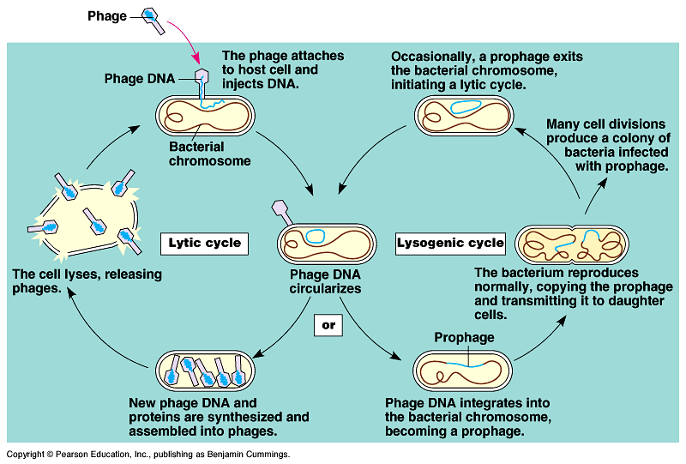
2)- Lysogenic cycle (الدورة غير التحللية)

Slide 19
Video: plays in LMS

Slide 20
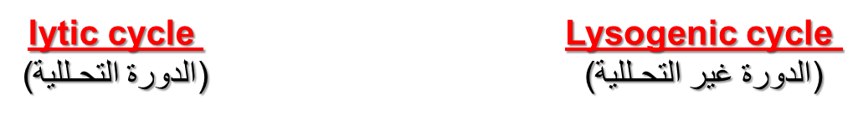
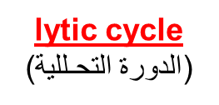
Summary
Phage T4
Phage lambda (ג)
Many tail fibres
Only 1 tail fibre
(virulent virus)
Temperate virus
&

Slide 21
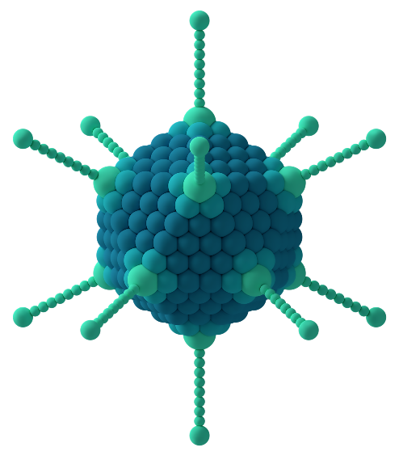
Summary: Characters of viruses
Most viruses of eukaryotes attack specific tissues. eg. Human cold viruses infect only the cells lining the upper respiratory tract, and AIDS virus binds only to certain white blood cells (Immune system).
- DNA enclosed in a protein coat (sometimes, membranous envelope also)
- Can be crystallised يتبلور
- They lack يفتقد enzymes for metabolism
- Have no ribosomes for making their own proteins
- Reproduce only within a living host cell (obligate parasitism تطفل إجباري).
- Each type of a virus infects a limited range of host cells (host range مدى الإصابة)
Viruses are host specific
a protein on the surface of the virus has a shape that matches a molecule in the plasma membrane of its host, allowing the virus recognize the host cell.

Slide 22

College of Science,
Zoology Department
General Animal Biology
(Zoo-109)
Zoology Department

