Slide 1
Lecture 3
Nutrients and their classification
Food Functions and Nutritional Assessment Methods
Types of Nutritional Deficiencies and stages of its development

Slide 2
Food is anything that you can eat. It's a very general term.
Diet: When foods made into deferent forms/formulations..
A meal is when you sit down at a table and eat things. If you sit down to eat a meal in the morning, it's breakfast. If you sit down to eat a meal at night, it's dinner.
Nutrient: Components of food/diet that are known on the basis of their unique chemical composition
Nourishment: indicates benefit we get from food
Nutrition: Theoretical understanding of foods/diet for health.
Dietetics: Practical Application of Nutrition
Food
Diet
Meal
Nutrient
Nourishment
Nutrition
Dietetics
Notes:
A diet is a particular way of eating. Someone who is on a diet will avoid certain foods, such as potato chips or cake. A diet is also a way of life. If someone eats a vegetarian diet, they do not eat meat at all.

Slide 3
Nutrients and their classification
Carbohydrates
Proteins
Fats
Vitamins
Minerals
Water
Energy………….?
Macronutrients: needed in large amounts
by the body i.e. protein, fat and carbohydrate.
Micronutrients: Needed in small amounts
by the body i.e. vitamins, minerals
WATER…………Macro-or Micro?

Slide 4
Macronutrients
FUNTIONS
provide energy to the body
provide structure to tissues
regulate hormonal processes within the body
protect the internal organs

Slide 5
Micronutrients
FUNCTIONS
Regulation of the functions of Macronutirients
Energy
Growth/development
Hormones regulations
Immunity & Defense
Magnesium helps prevent heart disease by regulating the rhythm of heartbeats and muscular activity in the heart.
Zinc, selenium and phosphorus play an important role in the regulation and activation of other micronutrients.
B-complex vitamins are better absorbed and assimilated by the body when combined with adequate levels of zinc.

Slide 6
Nutritional Status
Functions of Macro- and Micronutrients promote health
If nutrients are doing their functions → is reflected by healthy/positive Nutritional status.
Nutritional Status: “The condition of the body in those respects influenced by the diet; the levels of nutrients in the body and the ability of those levels to maintain normal metabolic integrity”.
Growth
Development
Fight Against Diseases
Recovery
Scholastic capabilities
Cognition

Slide 7
Measurement of Nutritional Status or Nutritional Status Assessment
Nutritional Status Assessment: “Measurement in quantitative terms whether the functions of nutrients are reflected by the body”
Methods
Anthropometric
Biochemical
Clinical
Dietary
ABCD……?

Slide 8
Provide structure to tissues Growth/Development/Maintainace/Recovery
Monitoring whether body is having a normal growth or not
Measuring Weight, height, Fat tissues, Musceles, bones elongation etc
Measurement of growth is called “Anthropometry”
Weight & Height
Triceps/Bicep measurement
Skull Circumference
MUAC (Mid-upper Arm Circumferance)

Slide 9
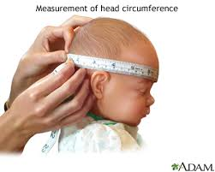
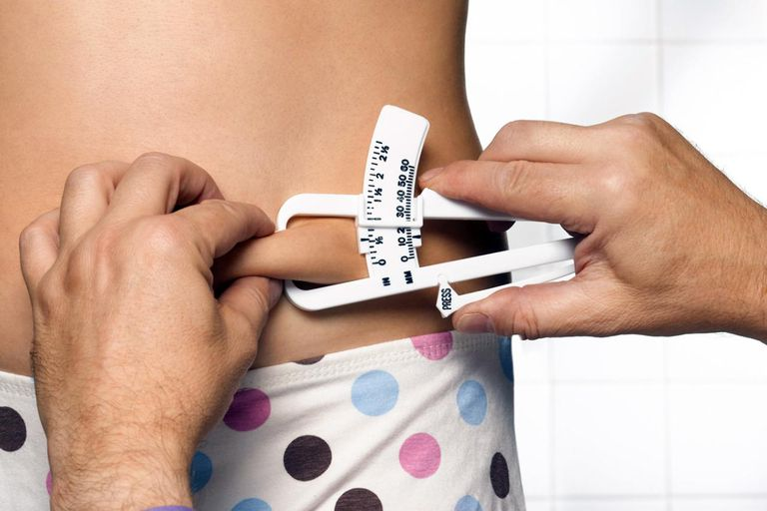
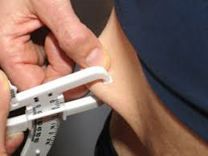
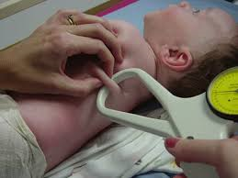
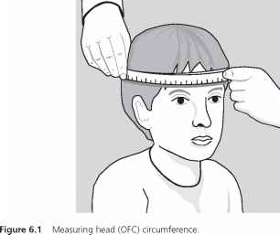
Anthropometry

Slide 10
What information we get from Nutritional status Assessment
For example: from weight and height, we may know whther the person is growing well or not
Problem in physical growth:
Stunting
Underweight
Wasted

Slide 11
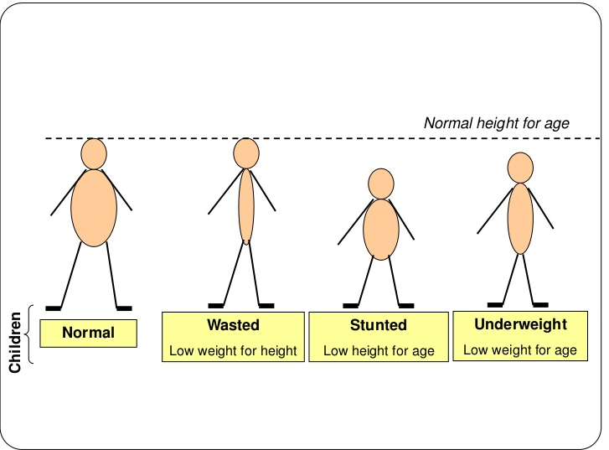

Slide 12
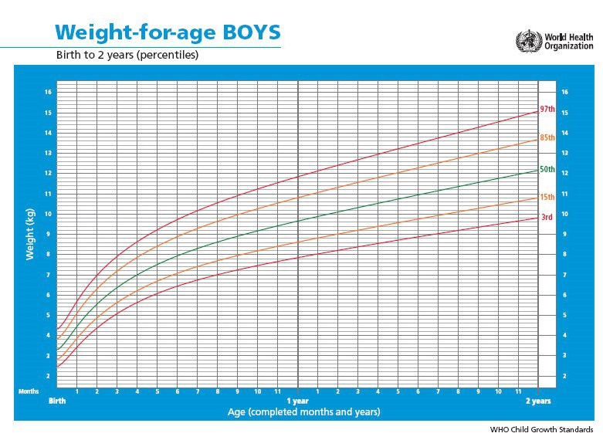

Slide 13
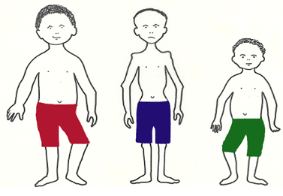

Slide 14
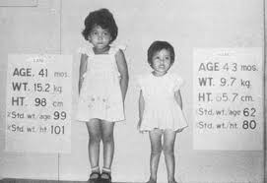
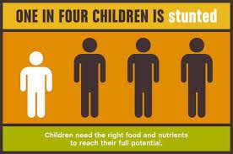
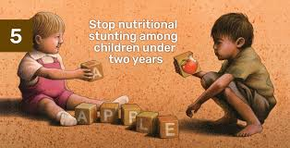
Stunting: Stunted growth, also known as stunting and nutritional stunting, is a reduced growth rate in human development.
It is a primary manifestation of malnutrition (or more precisely undernutrition) and recurrent infections, such as diarrhea and helminthiasis, in early childhood and even before birth, due to malnutrition during fetal development brought on by a malnourished mother.
The definition of stunting according to the WHO is for the "height for age" value to be less than two standard deviations of the WHO Child Growth Standards median.
Chronic Malnutrition

Slide 15
Wasted: Wasted refers to low weight-for-height where a child is thin for his/her height but not necessarily short.
Also known as acute malnutrition, this carries an immediate increased risk of morbidity and mortality.
Wasted children have a 5-20 times higher risk of dying from common diseases like diarrhoea or pneumonia than normally nourished children.

Slide 16
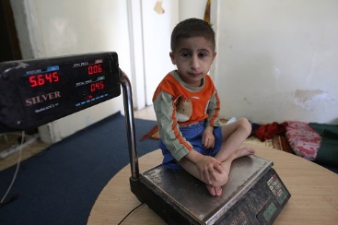
Under-weight: Under-weight refers to low weight-for-age, when a child can be either thin or short for his/her age.
WHO: “weight for age” to be less than two standard deviations of the WHO Child Growth Standards median.
This reflects a combination of chronic and acute malnutrition.

Slide 17
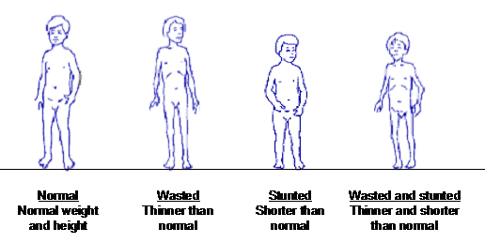

Slide 18
Summary for today
If children are not getting enough food in their first 5 years of life, they may become: Stunted, Underweight,or wasted
All the three conditions can occur simultaneously
Causes:
Primary Malnutrition
Secondary Malnutrition
Acute Malnutrition
Chronic Malnutrition
Other Nutrition related negative conditions

