Slide 1
Ch 7 A word and its Structure
ENGT 243
Morphology & Syntax

Slide 2
The nature of word formation rules
It is generally agreed that word-formation are like phrase-structure (sentence formation) rules used in syntax.

Slide 3
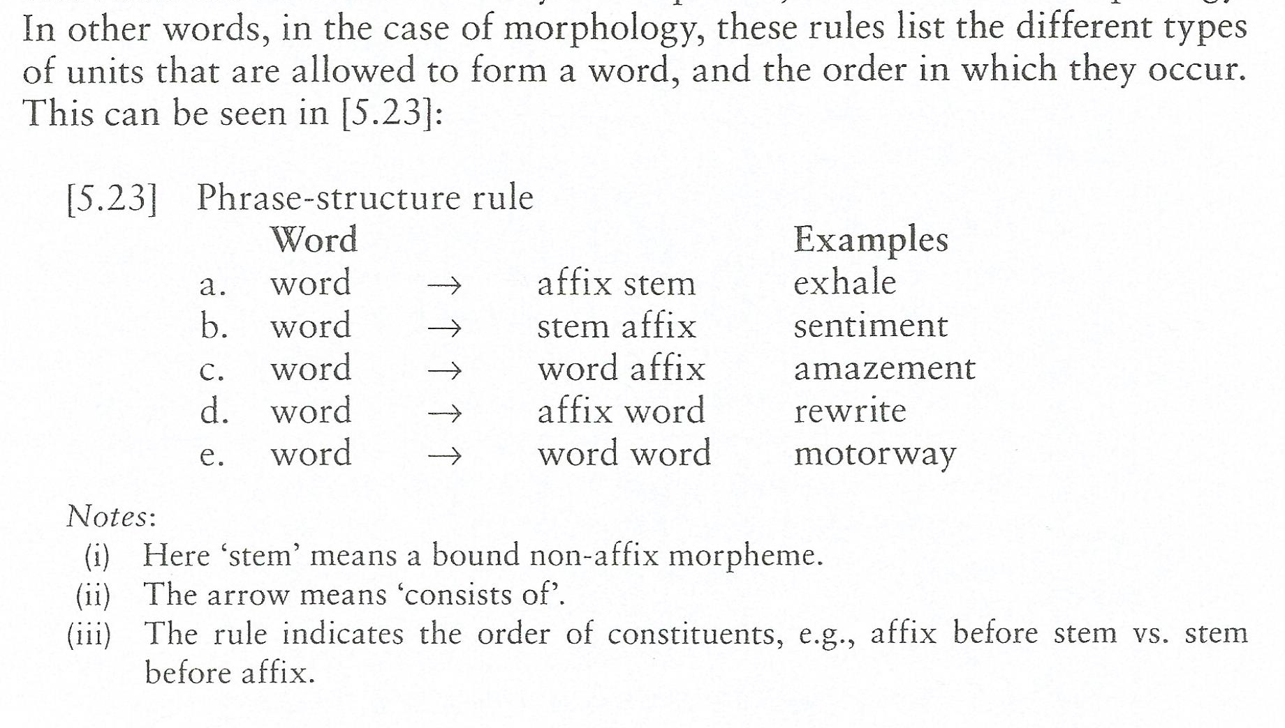
Word-structure rule

Slide 4
Word-structure rule
A phrase structure rule is usually translated into a phrase structure tree diagram.
Words have internal structure, affixes and roots are not put together higgledy-piggledy.

Slide 5
Word-structure rule
There must be a head element that dominates everything and determines the word class, and the slots that it can occupy in a sentence.
Normally, In English word, the head is the right-hand-most element, be it a root or a suffix. This principle is known as right-hand-head-rule.
E.g. disagree, unfair.

Slide 6
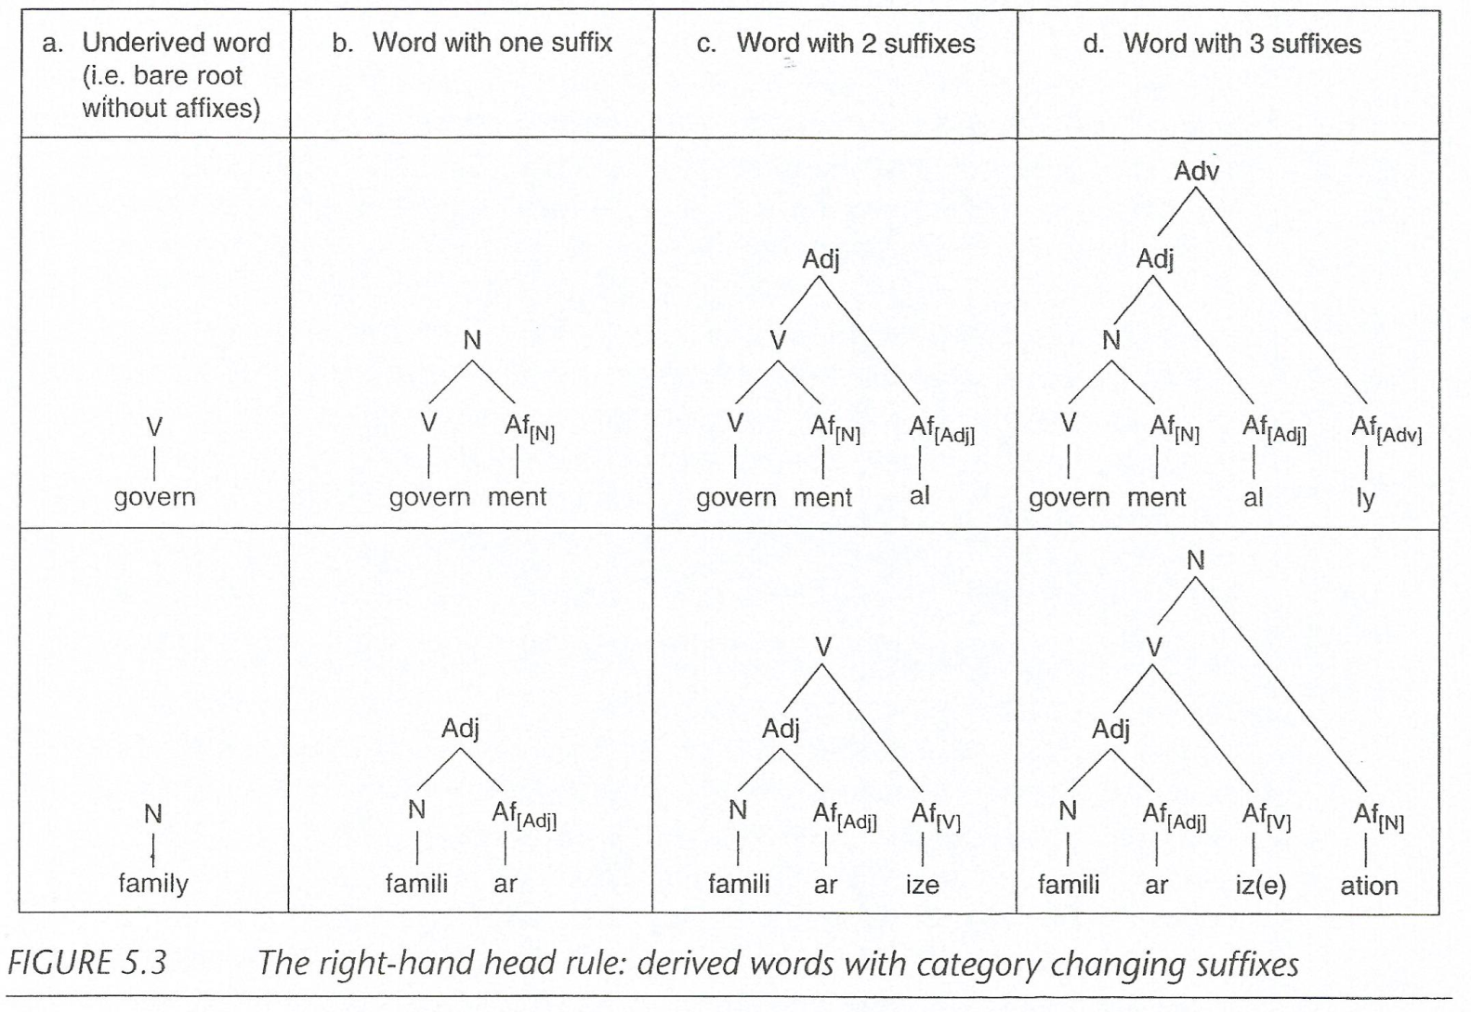

Slide 7
Compositionality
Consider the following:
He Kicked the bucket
to die
He spilled the beans
to spread the secret

Slide 8
Compositionality
Definition of compositionality: If a linguistic structure is compositional, then the meaning of the whole can be inferred from the parts, taking into account the grammatical relations between them.
Compositionality (in morphology )
Affixed words are composed of building blocks, each contributing its syntax and meaning.

Slide 9
Compositionality
Complex Words
Often the meaning of a complex word containing affixes can be computed from the meaning of its parts.
You can usually work out the meaning of a word that you may not have encountered before, if you know the meaning of its constituents parts. E.g. retraditionalization.

Slide 10
Limits of compositionality
Consider the following:
Seeker, writer, looker.
Agentive nominalizing suffix -er

Slide 11
Compositional Vs. Non-compositional
seeker and writer derive a noun meaning 'somebody who does whatever'
However, if we applied the same interpretation to looker, we would be wrong.
A looker is not someone who looks, it is a handsome person.
Hence, the meaning of looker is non-compositional.
So this word has to be listed in the lexicon, and memorized.

Slide 12
Compounding
Consider the Following
Schoolboy
Gundog
Undrsell
Razorsharp
Greenhouse
Taxpayer

Slide 13
Compounding
Compounds are complex words containing at least two bases that are themselves words.
It has always been a highly productive process in English.
Compounds are classified on the basis of the word class of their constituents and the class of the entire resulting word.

Slide 14
Compounding
As is the case with affixes, the concept of head is important in morphology in general, and in compounds too.
Compounds always have a headword which assigns its syntactic properties to the entire word, based on the right-hand head rule, it is normally the right-hand-most word.
But this is not always the case, (phrasal verbs)

Slide 15
Compounding
The right-hand head rule applies and the last word in the compound assigns its class to the entire word as you can see

Slide 16
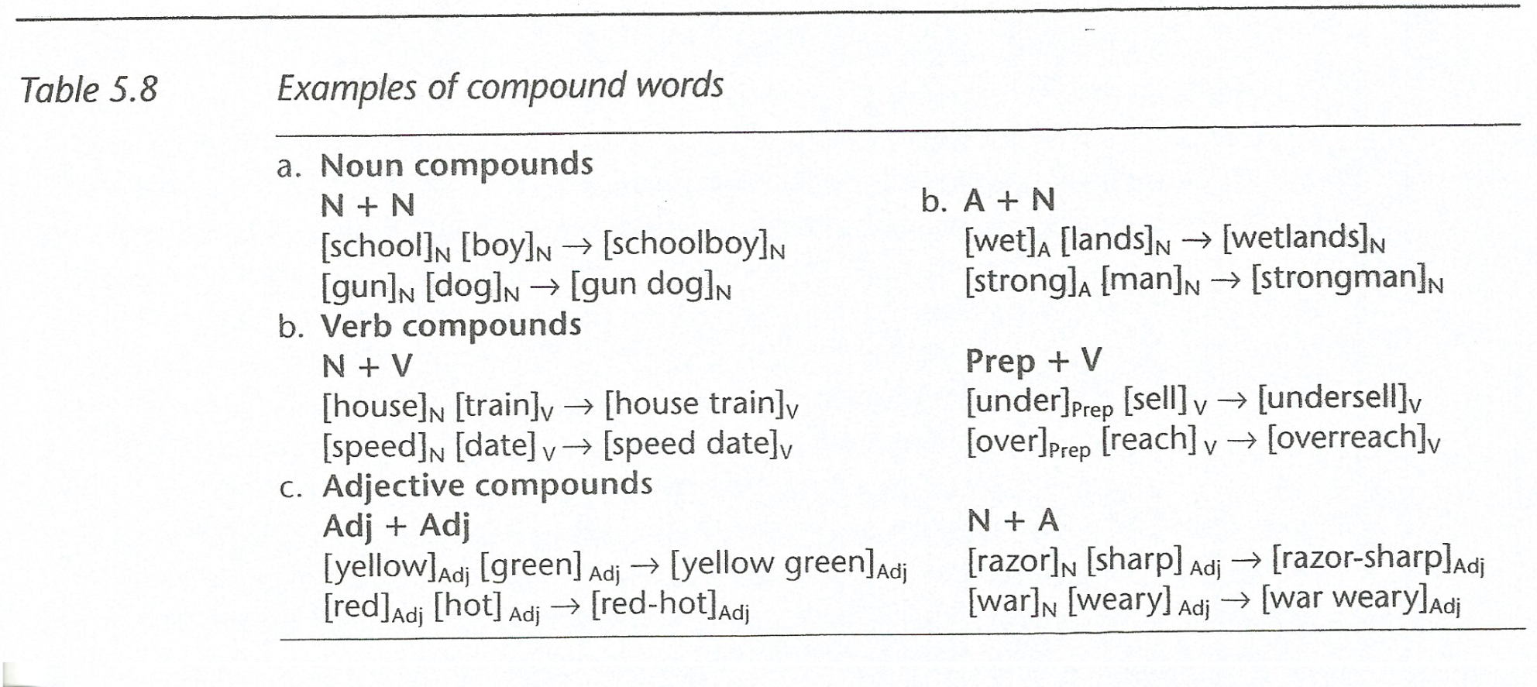
Compounding

Slide 17
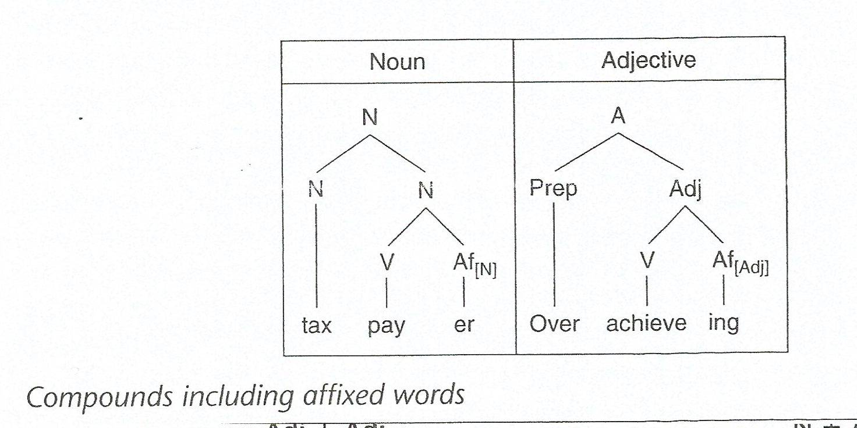
Compounding

Slide 18
Compounding
The right-hand head rule is very important in English word-formation, but it does not apply all the time.
Examples:
an up market pub. (adj.)
Look for, look up to, look into, etc. (Verbal phrases)

