Slide 1
Ciliates and Flagellates
Balantidium coli, Giardia lamblia and Trichomonas vaginalis

Slide 2
Balantidium coli
The only ciliate protozoan parasite of humans.
The largest protozoan parasite in humans.
Prevalence is very low.
Zoonosis, it’s a disease of pigs.

Slide 3
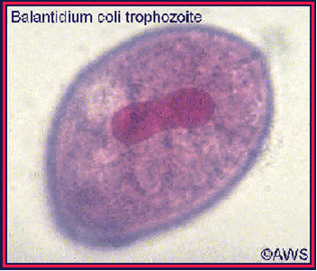
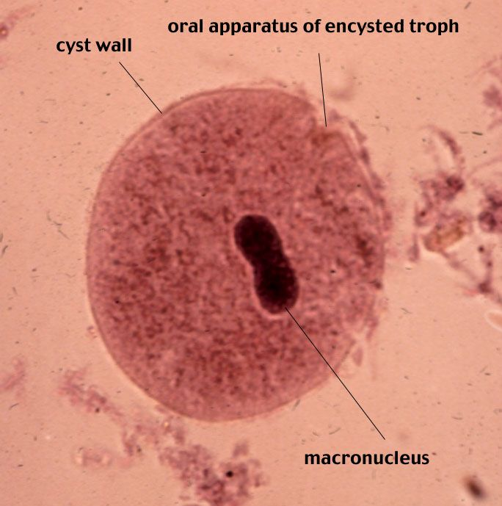
Morphology
Trophozoite Cyst

Slide 4
Habitat, life cycle, pathogenesis and diagnosis
All are the same of E. histolytica.

Slide 5
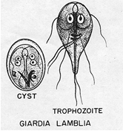
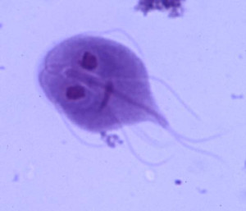
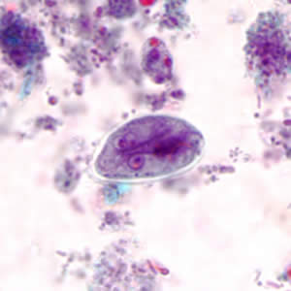
GIT Flagellates: Giardia lamblia Subphylum: Mastigophora
2 morphological forms
Trophozoite Cyst

Slide 6
Life cycle, habitat and epidemiology
Habitat:
small intestine
Epidemiology:
faecal oral spread
By house flies.
- Autoinfection

Slide 7
Pathogenesis and clinical picture
Majority are asymptomatic carriers
Acute giardiasis
Chronic giardiasis (Steatorrhea)
Non invasive

Slide 8
Diagnosis and traetment
Stool examination
Duodenal aspirate
Giardia antigen detection in stool
Treatment: metronidazole and tinidazole are drugs of choice
Furazolidone is slower in action but is preferred in children as it has fewer adverse action

Slide 9
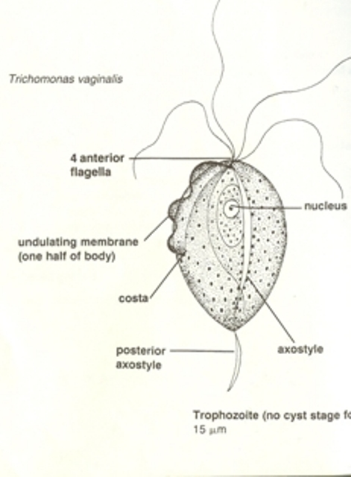
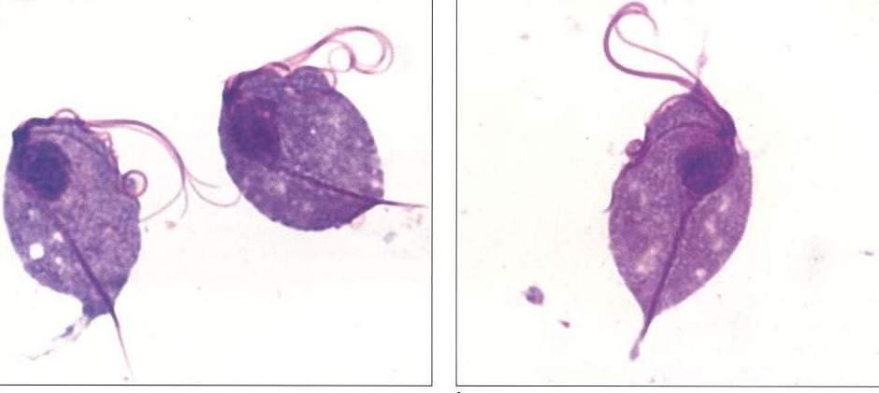
Trichomonas vaginalis Subphylum: Mastigophora
Only trophozoite stage, no Cystic stage

Slide 10
Life cycle and habitat

Slide 11
Pathogenesis, diagnosis and treatment
Causes degeneration of local tissues
Usually asymptomatic in males, can cause urethritis
In females: pruritic vaginitis, cervix may be affected and can cause dysuria
Diagnosed by: urine, vaginal swab (secretion) or prostatic secretion
Treated by: metronidazole for both partners

