Slide 1
Lecture 2
Garlic
(Allium Sativum)
Products description
Doses
Toxicity

Slide 3
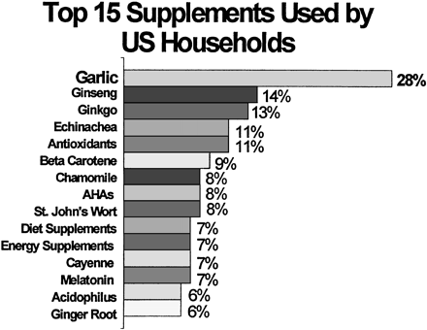
Top Supplements Used by US Households in 1997
Of 91 herbal supplements, garlic was found to be used more than twice as much as other supplements.

Slide 4
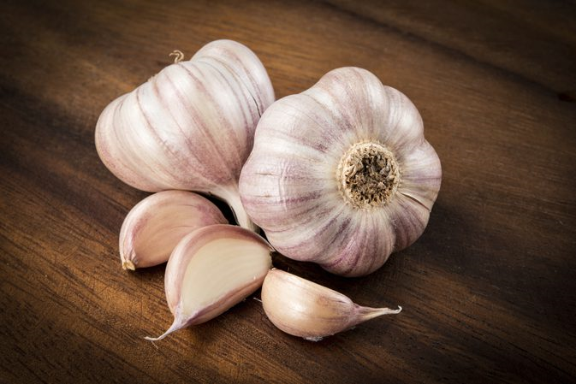
Intake of Garlic?
The appropriate amount is yet to be determined
The German Kommission E monograph (1988) proposed a daily intake of ~1-2 cloves of garlic or ~4 g of intact garlic per day for health benefits
However, there was no scientific evidence to back this recommendation.
Notes:
1. www.allicinnow.com
2. The medicinal effects of garlic happen to be noted for 1000s of years. From Mesopotamia to ancient Egypt to Babylon, the Greeks to Medieval times and to our modern era, its health benefits happen to be observed and scientifically proven. Medical history results of fresh garlic happen to be consistent and in use as medicine and helpful for, digestive aid, antibiotic, anti- contestant, to soothe continuous coughing, clearing arteries, treat asthma, colds, and cancer prevention among other uses for quite a while. Some early Greek and Roman writings listed it as a treatment for dozens of health issues, including hypertension, infections, and tumors. Today we use aged garlic and aged garlic extract for blood pressure, cardiovascular disease, and cholesterol levels. We also combine cinnamon, onion and ginger into our herbal mix to have a greater natural medicinal effect
3.  The medicinal effects of garlic and trying to minimize health issues, it is always best to consult with a physician first. The consumption of large amounts of raw garlic, without the advice of doctors could lead to more severe side effect problems. There is thing called garlic allergy that is rare but can cause nausea, vomiting, headache, low-grade fever, and skin rashes. Although these symptoms may also indicate the medicinal results of garlic, it takes place, and it is the body’s a reaction to it. If the individual taking raw garlic is experiencing this stuff, he then should probably start with small doses in order to assist the body to get used to it and minimize the “allergic reactions” to it. Nothing replaces a recommendation from doctors with particular regard to health.
4.  Orally, garlic supplements are used for the most popular cold, cough, inflammation from the mouth and pharynx, sinusitis, fever, liver and gallbladder complaints. It is also used for nausea, vomiting, morning sickness, painful menstruation, small intestinal bacterial. Garlic can also be used as anti-allergy medication, good treatment of cough along with other throat irritations. Among the studies conducted by experts, it may be deduced conclusively that garlic with allicin is definitely another miracle plant which not just adds flavor and taste to our food, good medicine, but additionally bring about our body. The medicinal effects of garlic, is a wonderful natural herbal plant because of its main compound allicin.

Slide 5
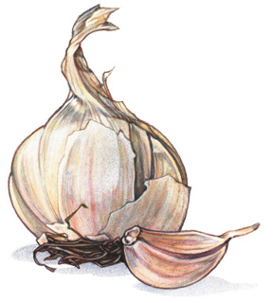
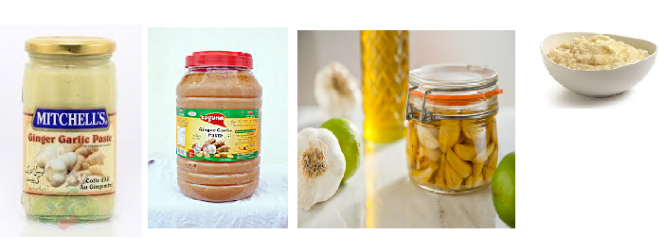
Garlic supplements
Essential oil
Dehydrated powder
Oil macerate
Extract

Slide 6

Essential Oil
Garlic oil is typically prepared using steam distillation, whereby crushed garlic is steamed with the resultant condensation containing the oil
Steam-distilled garlic oil typically has a pungent odor and a yellow-brownish coloration
The essential oil content of garlic cloves is 0.2-0.5% and consists of a variety of sulfides.
Its odor has been attributed to the presence of diallyl disulfide
To produce around 1 g of pure steam-distilled garlic oil, around 500 g garlic is required.
Steam-distilled garlic oil has around 900 times the strength of fresh garlic, and around 200 times the strength of dehydrated garlic
Commercially available garlic oil capsules generally contain vegetable oil and a small amount of garlic essential oil because of pungent odors.
Notes:
heir relatively high sulfur content is the foundation for many of the molecules that help us detoxify our blood, that reduce inflammation, that fight infections, and that can help inhibit angiogenesis. Garlic is also a potent diaphoretic, expectorant, and anti-parasitic plant that was used as often a primary ingredient in many of Hippocrates pulses and treatments.
A type of garlic oil involves soaking diced or crushed garlic in vegetable oil, but this is not pure garlic oil; rather it is a garlic-infused oil
sulfur compounds such as diallyl disulfide, which is the "most abundant constituent" of essential garlic oil

Slide 7
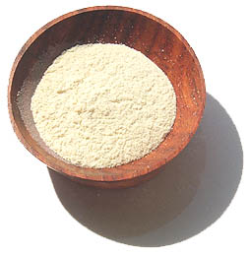
Dehydrated Powder
Garlic powder is mass-produced as a flavoring agent for condiments and processed foods.
Garlic cloves are sliced or crushed, dried and pulverized into powder.
Garlic powder is thought to retain the same ingredients as raw garlic; however, the proportions and amounts of various constituents differ significantly.

Slide 8

Oil Macerate
Oil macerates were originally developed for use as condiments.
Oil macerate products are made of encapsulated mixtures of whole garlic cloves ground into vegetable oil.

Slide 9
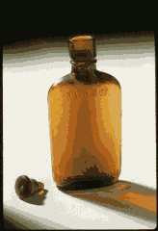
Extract
For garlic extract, whole or sliced garlic cloves are soaked in an extracting solution (purified water and diluted alcohol) for varying amounts of time.
After separation of the solution, the extract is generally concentrated and used.
Powdered forms of the extract are also available.
The extract, especially AGE, contains mainly the water-soluble constituents in garlic and a small amount of the oil-soluble compounds.

Slide 10
Aged Garlic Extract
As the name implies, this extract is aged for up to 20 months.
Over this time, the harsh and irritating compounds in garlic are converted naturally into stable and safe sulfur compounds.
Aged garlic extract contains primarily water-soluble sulfur compounds such as SAC and SAMC (S-allylcysteine (SAC) and S-allyl-mercapto-cysteine), as well as a variety of oil-soluble sulfur compounds.
The safety of AGE has been confirmed by various toxicological studies.
Notes:
S-allylcysteine (SAC) and S-allylmercaptocysteine

Slide 11
Bioavailability of garlic compounds
SAC is one of the water-soluble organosulfur compounds in garlic, whose concentration can be detected in the plasma, liver, and kidney after oral intake.
Its concentration increases during extraction/aging.
The pharmokinetics of SAC are well-established.
Its bioavailability in mice is 100.0%, in rats 98.2%, and in dogs 87.2%.

Slide 12
From several studies, SAC has proven to be a stable, odorless, water-soluble compound with the ability to lower cholesterol, serve as an antioxidant, inhibit the cancer process, and protect the liver from toxins.
AGE has shown cholesterol-lowering effects in several clinical studies
At present, SAC is the only reliable human compliance marker used for studies involving garlic consumption because it is detectable and increases quantitatively in the blood after oral intake of garlic capsules.

Slide 13
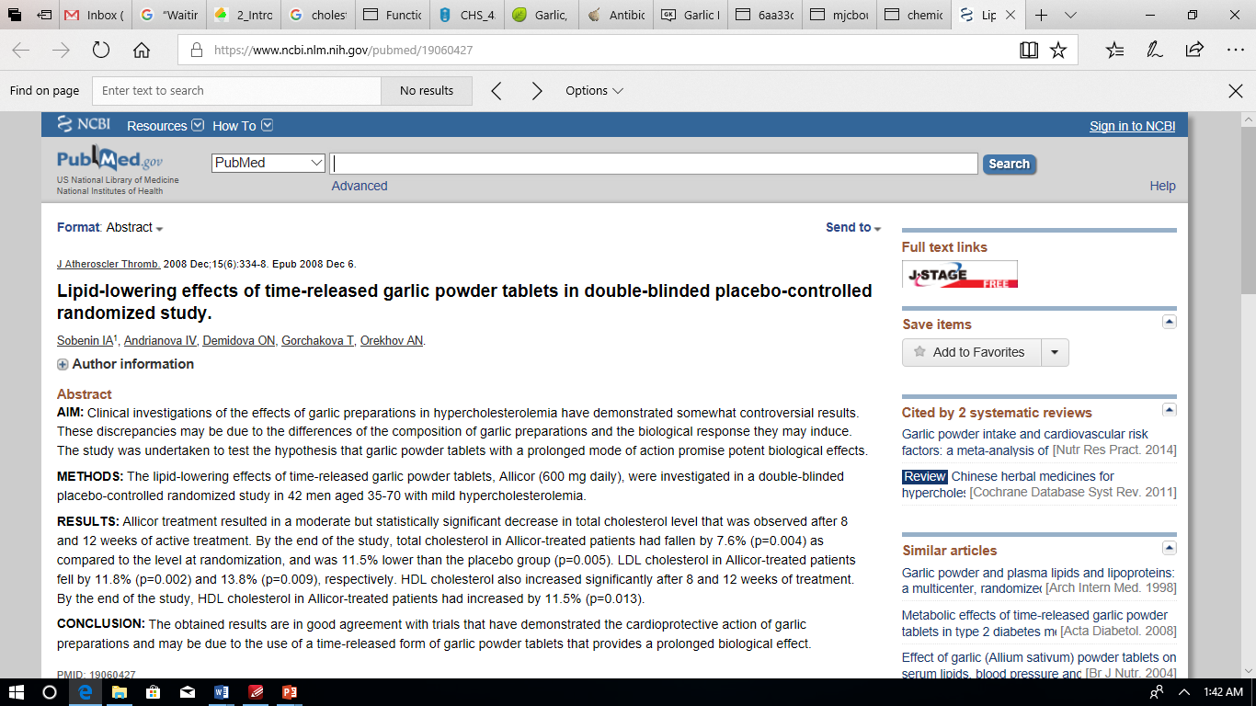

Slide 14
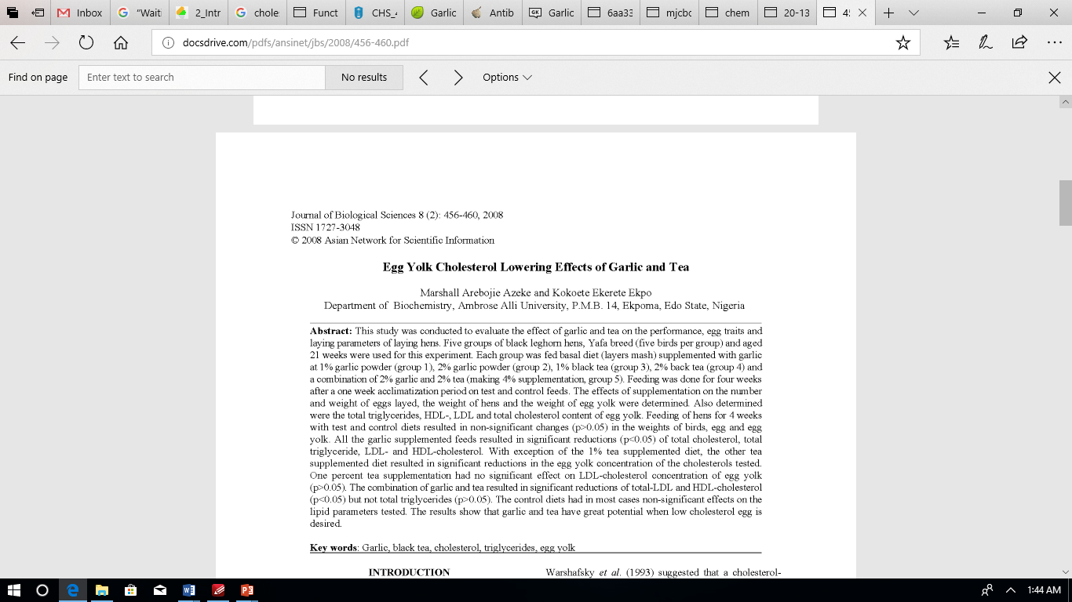

Slide 15
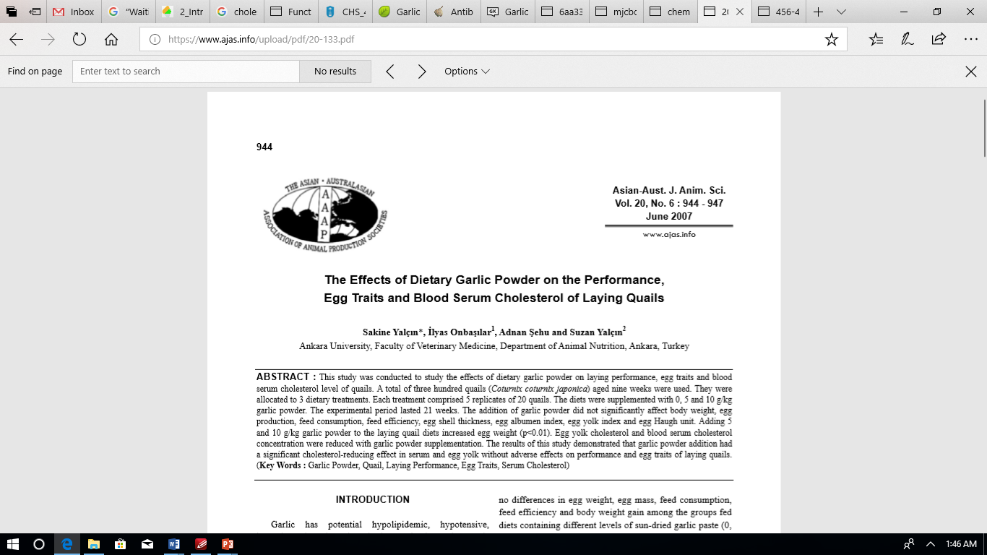

Slide 16
The oil-soluble organosulfur compounds in garlic, including allicin, sulfides, ajoene, and vinyldithiins are not found in the blood or urine after garlic consumption.
They are not likely to be the active compounds.
The instability and/or metabolism of such compounds likely contribute to the inconsistent results found in the clinical cholesterol studies using garlic oil and garlic powder products.

Slide 17

Safety Issues
Prevention, rather than in therapy, is where the effectiveness of garlic probably lies
However, to obtain the preventative benefits of garlic, long-term supplementation may be necessary

Slide 18
Safety Issues
Although garlic has been used safely in cooking as a popular condiment or flavoring and used traditionally for medicinal purposes, it is commonly known that excessive consumption of garlic can cause problems.
Garlic odor on breath and skin and occasional allergic reactions are recognized.

Slide 19

Reports since 1932 have revealed the following adverse effects associated with raw garlic and garlic powder:
    Stomach disorders and diarrhea
    Decrease of serum protein and calcium
    Anemia
    Bronchial asthma
    Contact dermatitis
    Inhibition of spermatogenesis

Slide 20
Oil-soluble sulfur compounds are known irritants and allergens
Topically applied diallyl-sulfide (DAS) is the most allergenic
The following toxicity effects of garlic were reported in 1990:
    Allicin is one of the major irritants in raw garlic
    Oil soluble sulfur compounds are more toxic than water-soluble
    When garlic is extracted in a certain period, its toxicity is greatly reduced

Slide 21
On the other hand, the safety of AGE has been well established by the following studies:
  Acute and subacute toxicity tests
  Chronic toxicity tests
  Mutagenicity tests
  General toxicity tests
  Teratogenicity tests
  Toxicity tests conducted by the USDA
  Clinical studies conducted on >1000 subjects
Notes:
https://www.ncbi.nlm.nih.gov/pmc/articles/PMC3127354/
https://www.ncbi.nlm.nih.gov/pmc/articles/PMC3731019/
Neurotoxicity studies in rodents
Mutagenicity testing
Skin sensitization tests
Subchronic oral toxicity testing (repeated dose 90-day oral toxicity testing)
Carcinogenicity testing
One-generation reproduction toxicity testing
Two-generation reproduction toxicity studies
Repeated dose toxicity testing
Developmental toxicity/embryotoxicity studies
Genetic toxicity testing

Slide 22
SAC versus DADS
The 50% lethal oral dose for each in mg/kg body weight
The United States National Cancer Institute tested the toxicity of SAC vs. other typical garlic compounds and found that it has a 30-fold less toxicity than allicin and diallyl-disulfide (DADS)
 | Allicin | DADS | SAC
Male | 309 | 145 | 8890
Female | 363 | 130 | 9390

Slide 23
The Globally Harmonized System (GHS),defines it as "those adverse effects occurring following oral or dermal administration of a single dose of a substance, or multiple doses given within 24 hours, or an inhalation exposure of 4 hours"
The preferred species for oral and inhalation testing is the rat, and for dermal testing, the rat or rabbit
Oral administration is the most common form of acute systemic toxicity testing.

Slide 24
ALLERGENICITY/HYPERSENSITIVITY TOXICOLOGY STUDIES ➢Guinea Pig Maximization test ➢Local lymph node assay ➢Determination of Maximum non irritant or minimum irritant dose ➢Evaluation of Erythema and oedema ➢Mice of one sex(either male or female) ➢Drug treatment given on ear skin ➢Auricular lymph node dissection after 5 days ➢Increase in 3h-thymidine used for evaluation
GENOTOXICITY STUDIES ➢To detect early tumorigenic effects in cases of chronic illness ➢In vitro tests: ▪Test for gene mutation in Bacteria ▪Cytogenetic evaluation of chromosomal damage in mammalian cells E.g.; Ames’s Salmonella Assay detects increased number of aberrations in metaphase chromosomes ▪DNA strand breaks, DNA repair or recombination, Measurements of DNA adducts

Slide 25
IN VIVO TESTS ▪ In vivo test for chromosomal damage using mammalian hematopoietic cells. ▪ Chromosome damage in rodent hematopoietic cells E.g.; Micronucleus Assay
CARCINOGENICITY/ ONCOGENICITY STUDIES ➢life-time bioassays ➢carcinogenicity studies are performed on: ➢drug used for >6 months or frequent intermittent use for chronic diseases ➢chemical structure of drug indicates carcinogenic potential ➢therapeutic class of drugs which have produced positive carcinogenicity.
NOTE ON STEM CELLS STEM CELLS NOW EMERGING AS AN ALTERNATIVE TO LABORATORY ANIMALS Drug company interest in stem cell drug testing was demonstrated in July 2008, when GlaxoSmithKline entered into a $25 million-plus agreement with the Harvard Stem Cell Institute. By testing drugs on specific cells and tissues created from iPS cells, we can even predict a patients individual response to a treatment realizing the vision of personalized medicine. In the current issue of Stem Cells and Development (2007), Cezar and her colleagues revealed a novel way to test drug toxicity: by monitoring the behaviour of embryonic stem cells exposed to a drug-candidate compound. Studying how potential drugs affect embryonic stem cells could provide a far more accurate prediction of a drug's potential toxicity than conventional animal models can. Currently, the most successful development of stem cells as in vitro models for toxicology testing is in human cardiac tissue.

Slide 26
The Ames test is a widely employed method that uses bacteria to test whether a given chemical can cause mutations in the DNA of the test organism. ... A positive test indicates that the chemical is mutagenic and therefore may act as a carcinogen, because cancer is often linked to mutation.

