Slide 1
EE 201 Fundamentals of Electric Circuits

Slide 2
Course Introduction
Anmar Arif
Lecturer/Assistant Professor
PhD from Iowa State University on August 10, 2019
Office: ??
Office Hours:
Sunday: 9:00 am – 12:00 pm, 1:00 pm – 3:00 pm
Monday: 10:00 am – 12:00 pm, 1:00 pm – 2:00 pm
If my office is open, come in
Textbook
“Introductory Circuit Analysis” By Robert L. Boylestad, 12th (or 11th or 10th) Edition, Published by Prentice Hall, 2001.
Website
https://fac.ksu.edu.sa/anarif

Slide 3
Grades
Quizzes and Homework (20%)
Exams (80%)
Exam 1 (20%): Sunday, 20 October 2019
Exam 2 (20%): Monday, 25 November 2019
Final (40%): Monday, 23 December 2019

Slide 4
Lecture 1 - Summary
The charge (Q , Coulombs (C) ) = No. of electrons $×$ $1.602 ×{10}^{−6}$ = $\frac{No. of electrons}{6.242 ×{10}^{18}}$
Current ( I , Amperes (A) ) = Charges (Q)/ time (t, seconds)
$I=\frac{Q}{t}, i\left(t\right)=\frac{dQ\left(t\right)}{dt}$
Voltage (V, Volts (V)) = Energy (W, Joule (J)) / Charge (Q)
$V=\frac{W}{Q}$

Slide 5
Lecture 2 Chapter 4 - Ohm’s Law, Power and Energy

Slide 6
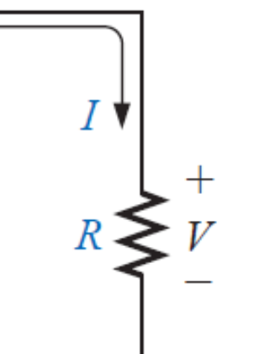
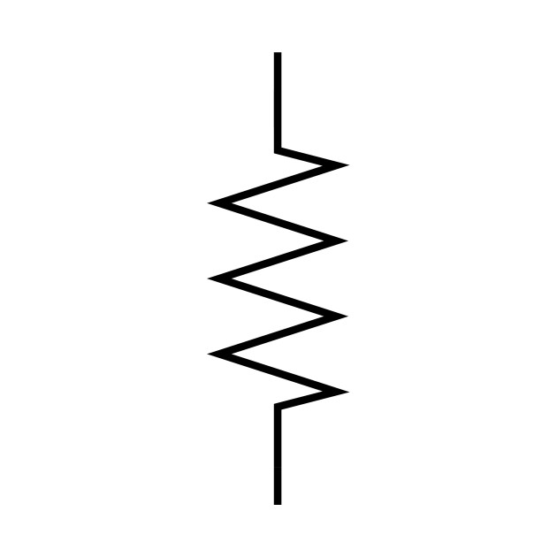
Resistance
The flow of charge through any material encounters an opposing force
This is due to collision between electrons and atoms
These collisions convert electrical energy into heat
This opposition is called resistance, the unit of a resistance is “ohm” $Ω$
Ohm’s law: $I=V/R$
$$+$$
$$R$$
$$−$$
$$+$$
$$R$$
$$−$$
$$I=1A$$
$$I=−1A$$

Slide 7
Examples

Slide 8
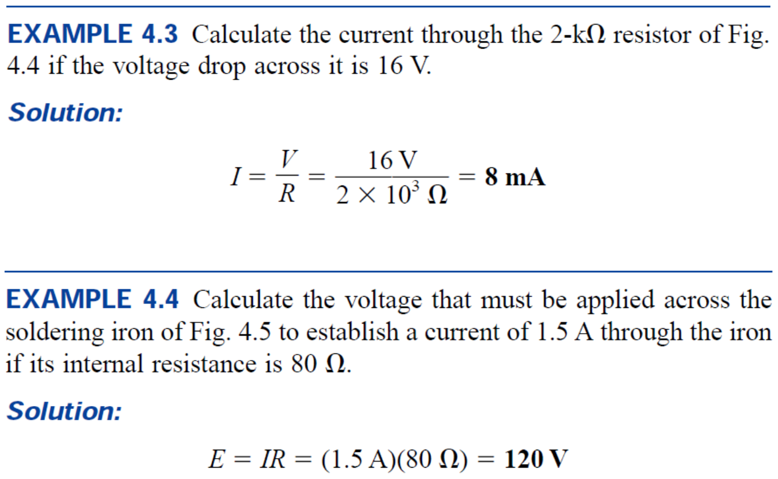
Examples

Slide 9
Power
Electric power is defined as the rate, per unit time, at which electrical energy is consumed/transferred in an electrical circuit.
$P=\frac{W}{t}=\frac{Joule (J)}{seconds (s)}=Watts (W)$
$P=\frac{W}{t}=\frac{Q∙V}{t}=V∙I →P=V∙I$
$P=V∙I=V∙\frac{V}{R}=\frac{V^{2}}{R}$
$P=V∙I=\left(I∙R\right)∙I=I^{2}∙R$

Slide 10
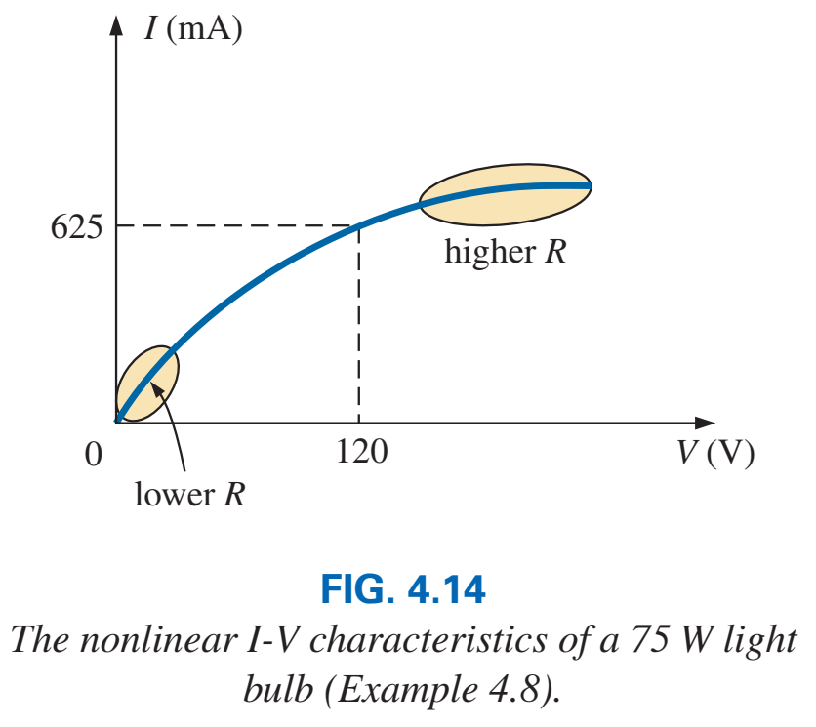
Examples

Slide 11
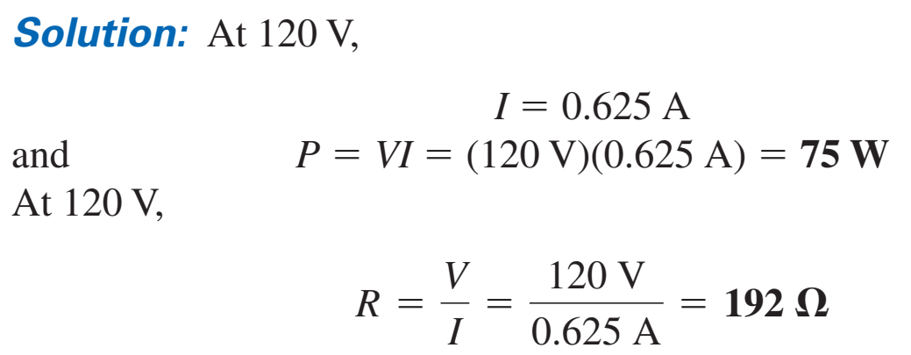
Examples

Slide 12
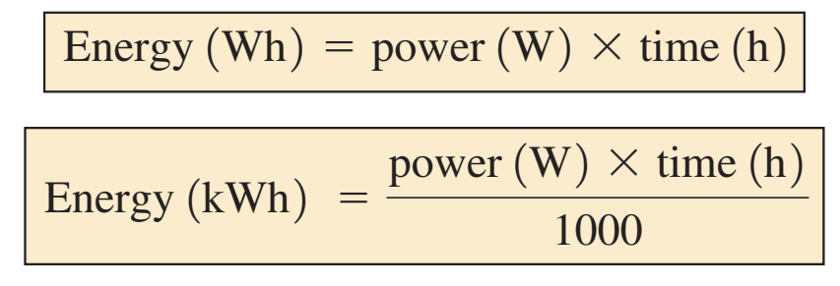
Energy
The energy (W) is equal to the power multiplied by the time
1 hp = 746 W

Slide 13
Energy
The energy (W) is equal to the power multiplied by the time
1 hp = 746 W

Slide 14
Efficiency
Efficiency $η=\frac{P_{output}}{P_{input}}×100$
$P_{output}=P_{input}−P_{lost\left(loss\right)}$

Slide 15
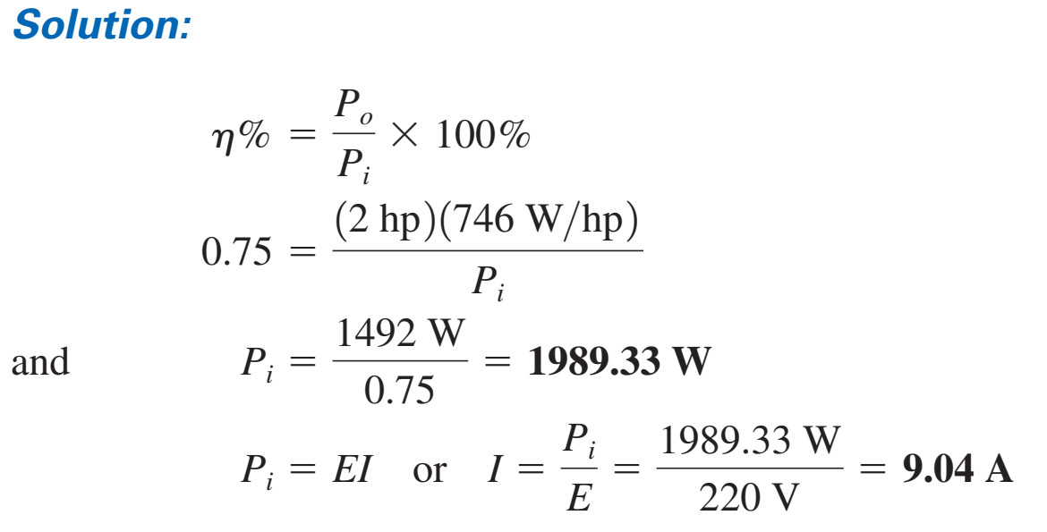
Efficiency

Slide 16
Exercise
If the total cost of an air conditioning after 24 hours is 4 SAR, how much power (in kW) is the AC consuming? (price = 18 halalah/kWh)
The work required to move a 5-C charge from point a to point b is 100 J. What is the voltage between a and b if the distance between a and b is 25 mm?

