Slide 1
Amoeba
Parasitic and free living amoeba

Slide 2
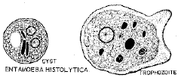
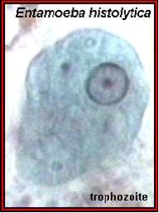
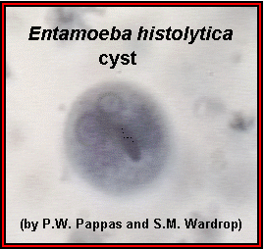
Entamoeba histolytica- Subphylum: Sarcodina

Slide 3
Morphology
Trophozoite - metabolically active invasive stage, moves with pseudopodia, ingests RBC, lives in colon and is found in fresh diarrheal stool; divides by binary fission.
Cyst - "vegetative" inactive form resistant to unfavourable environmental conditions outside human host; survives up to 30 days; excyst to trophozoite on passing through stomach.
(Infective stage).
Habitat: lumen of the large intestine and it can invade its wall.

Slide 4
Epidemiology, Pathogenesis and Clinical picture:
Through contaminated food or drink, contaminated hands, by the flies, use of human excreta as fertilizer.
Lytic enzymes.
Flask-shape ulcer.
Intestinal Complications.
Extra intestinal Complications.

Slide 5
Diagnosis and Treatment
Stool examination.
Amoebic serology.
In case of hepatic affection:
X-ray, U/S, C.T. scan have to be done to detect liver abscess. - abscess aspirate (only indicated in large abscess), trophozoites are present in the edge of the abscess.
Treatment:
Invasive states (Dysentery, Liver abscess): metronidazole Carrier states: diiodoquine.

Slide 6
Commensal amaebae
Harmless amoebae that inhabit the large intestine and transmitted by their cysts except E.gingivalis which inhabits the buccal cavity and transmitted by the trophozoites since it lacks the cystic stage.

Slide 7
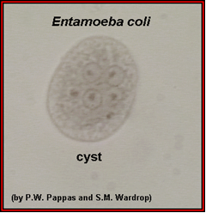
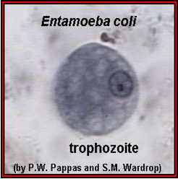
Entamoeba coli

Slide 8
Commensal Amoeba
Endolimax nana and Iodamaeba butschlii.
Entamoeba gingivalis.

Slide 9
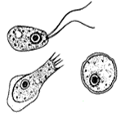
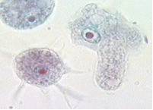
Pathogenic free living amoebae
Habitat: They are free living in water as lakes and swimming pools, They infect the CNS of man. Also, in Acanthamoeba, it can infect the eyes, skin, lung and genitor-urinary tract.
Naeglaria: Acanthamoeba:

