Slide 1
Introduction to the Internet
Lecture 2
HTML
Dr. Abeer Alnuaim

Slide 2
HTML
Is a markup language NOT a programming language (set of Web Programming standardized codes)
Used to create Web pages with Hyperlinks.
Hyperlinks Connect pages together.

Slide 3
What is an HTML document?
It is a Plain-text files (also known as ASCII) that contains the markup tags.
An HTML file is created using any text editor (e.g.: TextEdit on Macintosh, Notepad on a Windows machine).
You do not need an Internet connection to compose and view HTML pages.
The World Wide Web Consortium (http://w3c.org) sets the standards for HTML and its related languages.

Slide 4
What can we do with HTML Document?
we can,
Publish online documents with headings, text, tables, lists, photos, etc.
Retrieve online information via hypertext links, at the click of a button.
Design forms for conducting transactions with remote services, for use in searching for information, making reservations, ordering products, etc.
Include spread-sheets, video clips, sound clips, and other applications directly in their documents.
All computer platforms can understand it. Web pages created on a PC can be viewed, for example, on a Macintosh or a Unix computer.

Slide 5
Basic HTML Editors
There are many ways to write HTML code.
It can be done using an Editor Like:
Notepad in Windows.
TextEdit in MAC.
OR
by using a professional integrated development environment (IDE) like:
Adobe Dreamweaver

Slide 6
Notepad
To start Notepad go to:
Start → All Programs → Accessories → Notepad
Create a shortcut on your desktop for a quick access

Slide 7
Better Editors
That can give you Syntax Highlighting and Syntax Folding are:
Notepad++ in Windows.
TextWrangler in MAC

Slide 8
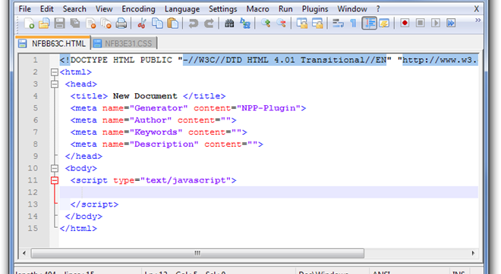
Notepad++

Slide 9
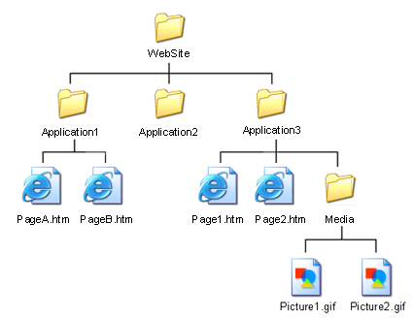
Website Files

Slide 10
HTML 5
Newest draft version of HTML/XHTML
Supported by modern browsers
Safari, Google Chrome, Firefox, Internet Explorer 9
Intended to be backwards compatible
Adds new elements
Adds new functionality
Edit form data
Native video and audio
And more!

Slide 11
Writing HTML Basic Syntax
Elements are defined by tags (markers).
Tags are keywords surrounded by angle brackets.
Tag format:
- Opening tag: <name>
- Closing tag: </name>
Tags normally come in pairs
<b>...</b>
The opening tag and its closing tag together specify a container for the content they enclose

Slide 12
HTML Syntax
HTML syntax:
two-sided tag:
<tag attributes>document content</tag>
Closing tag
Starting tag
Properties of the tag.
Optional!
Actual content appears in webpage. It could be empty
Examples: <p> CGS 2100 </p>

Slide 13
Basic Syntax
Not all tags have content
- If a tag has no content, its form is <name />
The container and its content together are called an element
If a tag has attributes, they appear between its name and the right bracket of the opening tag

Slide 14
HTML Element An HTML element is everything from the start tag to the end tag
Element start tag/ opening tag.
<head>
Element content
</head>
Element
Element end tag/ closing tag.
Some HTML elements have empty content which are closed in the start tag.

Slide 15
Basic Syntax
In XHTML, element and attribute names must be in all lowercase letters
In HTML, they can be any combination of uppercase and lowercase

Slide 16
Commenting Your Files
You might want to include comments in your HTML files. Comments in HTML are like comments in a computer program—the text you enter is not used by the browser in any formatting and is not directly viewable by the reader just as computer program comments are not used and are not viewable.
Comments such as the name of the person creating the file, the software and version used in creating a file, or the date that a minor edit was made are the norm.
To include a comment, enter:
<!-- your comments here -->
You must include the exclamation mark and the hyphens as shown.

Slide 17
HTML Tags
In HTML there are two major types of markup tags:
– Empty tags are used for page formatting. They have no closing tag and so doesn’t enclose any text.
– Container tags are used to manipulate or control the contents placed within them. They have a starting tag and an ending tag (/ slash preceding the tag).

Slide 18
The Minimal HTML Document
Each document consists of head and body text.
The head contains the title, and the body contains the actual text that is made up of paragraphs, lists, and other elements.
<!DOCTYPE html>
<html>
<head>
</head>
<body>
</body>
</html>
This tells your browser that this is an HTML tag
This identifies the first part of your HTML-coded document that contains the title.
This identifies the body part of your HTML-coded document.

Slide 19
HTML file
HTML Files Extensions
Filename.htm
Filename.html

Slide 20
Meta Tags
Used by Browsers and search engine and how your site info is displayed in the search results.
<meta> tags always go inside the <head> element.
Suggested Meta tags to include: charset, description, keywords, author and refresh.
Useful resource:
http://www.youtube.com/watch?v=aTaIMu01_bc

Slide 21
Meta Tags
<head>
<meta charest=“utf-8”>
<meta name=“description” content=“Course Code CT1501”>
<meta name=“keywords” content=“Web development, KSU”>
<meta name=“author” content=“author‘s name”>
<title>web development class web page</title>
</head>

Slide 22
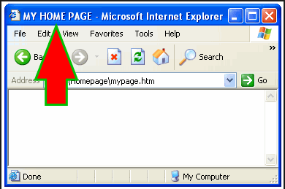
Start with a Title
Every HTML document needs a title.
Here is what you need to type in the header part of your HTML document:
<title>
My Home Page
</title>

Slide 23
A basic HTML5 web page template
<! DOCTYPE html>
<html lang=“en”>
<head>
<title> </title>
<meta charest=“utf-8”>
</head>
<body>
</body>
</html>
The DTD (Document type definition). Always first line, identifies the type of the markup language.
Optional, specifies spoken language of the document
Describes the characteristic of the webpage. Utf-8 is widely supported by the browser

Slide 24
Basic Text Markup
Text is normally placed in paragraph elements
The <p> tag defines a paragraph.
The <p> tag breaks the current line and inserts a blank line.
Browsers automatically add some space (margin) before and after each <p> element.
The new line gets the beginning of the content of the paragraph

Slide 25
HTML Paragraphs
Source Code
<!DOCTYPE html>
<html>
<body>
<p>This is a paragraph.</p>
<p>This is another paragraph.</p>
</body>
</html>
Result

Slide 26
Empty Tags
An empty tag means that it has no end tag (No closing tag!)
The Line break <br> tag
Inserts a single line break.
Causes the next element or text to display on a new line.
XHTML syntax: <br />
HTML syntax: <br>

Slide 27
Empty Tags
Horizontal Rules <hr>
The <hr> tag In HTML5, the <hr> tag defines a thematic break.
A horizontal rule is useful to separate major sections of your document.
XHTML syntax: <hr />
HTML syntax: <hr>
You will format this in CSS in later lectures

Slide 28
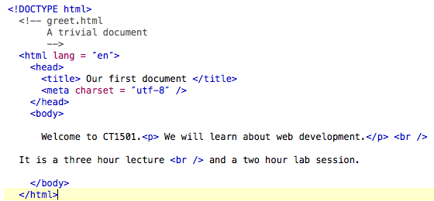
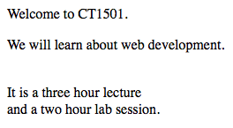
Example
Source Code
Result

Slide 29
HTML Headings
Six sizes, 1 - 6, specified with <h1> to <h6>
1, 2, and 3 use font sizes that are larger than the default font size
4 uses the default size
5 and 6 use smaller font sizes

Slide 30
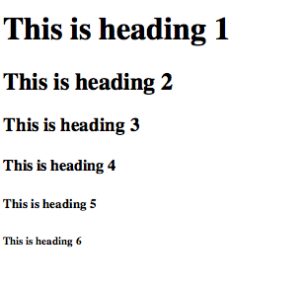
HTML Headings
Source Code
Result
<!DOCTYPE html>
<html>
<body>
<h1>This is heading 1</h1>
<h2>This is heading 2</h2>
<h3>This is heading 3</h3>
<h4>This is heading 4</h4>
<h5>This is heading 5</h5>
<h6>This is heading 6</h6>
</body>
</html>

Slide 31
Font
Font Styles and Sizes (can be nested)
Emphasis - <em> (often set in italics)
Strong - <strong> (often set in boldface)
Monospace - <code> (often set in Courier)
Superscripts and subscripts
Subscripts with <sub>
Superscripts with <sup>
For other styles and fonts use CSS (we’ll get to that later)

Slide 32
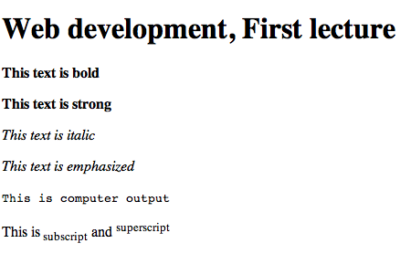
HTML Formatting
Source Code
Result
<!DOCTYPE html>
<html>
<body>
<p><h1> Web development, First lecture </h1></p>
<p><b>This text is bold</b></p>
<p><strong>This text is strong</strong></p>
<p><i>This text is italic</i></p>
<p><em>This text is emphasized</em></p>
<p><code>This is computer output</code></p>
<p>This is<sub> subscript</sub>
and <sup>superscript</sup></p>
</body>
</html>

Slide 33
HTML Attributes
HTML elements can have attributes
Attributes define an element
Attributes are always specified in the start tag
All attributes are made up of two parts: a name and a value
-The name is the property you want to set
- The value is what you want the value of the property to be
Example: <p id= “top”>First Paragraph</p>
*Find more attributes

Slide 34
HTML Links
The HTML <a> tag defines a hyperlink.
href (hyperlink reference) is an attribute to specify a URL for the page
Source Code
<a href="http://www.ksu.edu.sa">King Saud University’s Website</a>
indicates the link’s destination
The URL
The link’s Text
Result
King Saud University’s Website

Slide 35
HTML Links
By default, links will appear as follows in all browsers:
An unvisited link is underlined and blue
A visited link is underlined and purple

Slide 36
HTML Links
Possible values for href:
An absolute URL (remote link)
– link to other websites:
<a href="http://yahoo.com">Yahoo</a>
A relative URL (local link)
- link to pages in your own site
<a href="index.html">Home</a>
An anchor URL
- points to an anchor within a page
(used a lot in back to top links)
href="#top” (local link)

Slide 37
HTML Links
If the target is not at the beginning of the
document, the target spot must be marked
- Target labels can be defined in many different
tags with the id attribute, as in
<h1 id = ”top”> This is the top of the Page </h1>
- The link to an id must be preceded by a pound
sign (#); If the id is in the same document,
this target could be
<a href = ”#top”>Back to top?</a>

Slide 38
HTML Links
If the target is in a different document, the
document reference must be included
<a href = "myAd.html#baskets”> Baskets </a>
If you would like the page to be loaded in a new
Window use target
<a href = Http://Ksu.edu.sa
target="_blank"> KSU </a>
* Find more info on attribute TARGET

Slide 39
HTML Links
Email Hyperlink:
Automatically launch the default mail program configured for the browser
If no mail default is configured, a message is displayed
<a href="mailto:me@ksu.edu.sa"> Email me</a>

Slide 40
Questions !! ☺

