Slide 1
Zoology 109 course
General Animal Biology
For Premedical Student
Zoology Department
Lecture 26 : Endocrine System (Hormones and the Endocrine System)
(Continue)
1438-1439H

Slide 2
Objectives
Thyroid gland.
Parathyroid gland.
Pancreas.
The adrenal gland.
Testes.
Ovaries.
Thymus gland.

Slide 3
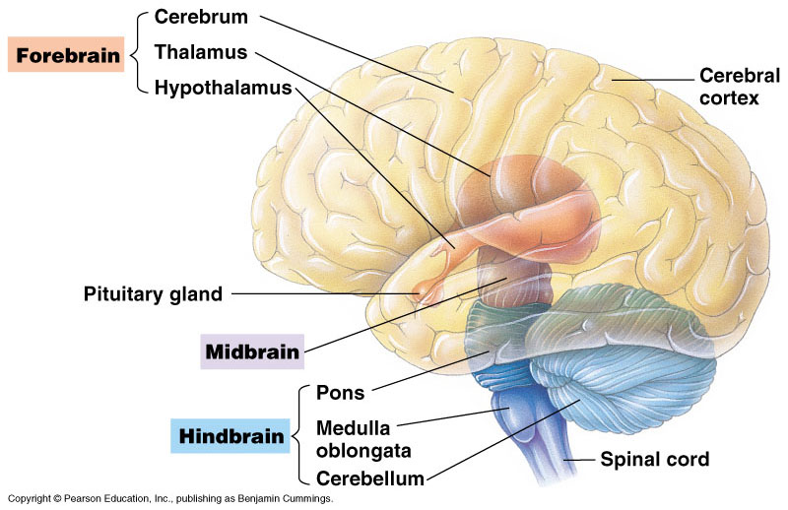
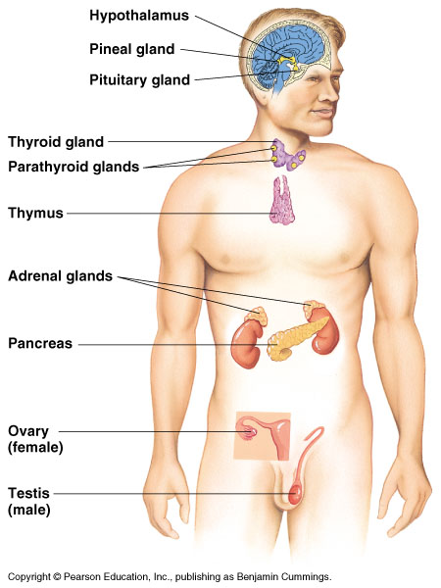
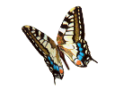
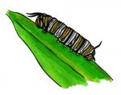
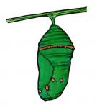
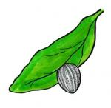
CHEMICAL SIGNALS IN ANIMALS
Egg
Larva
Pupa
Adult

Slide 4
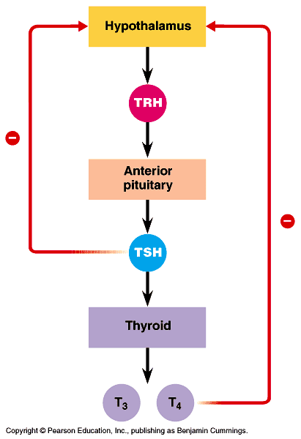
3. Thyroid gland: its hormones help in development, bioenergetics, and homeostasis
The thyroid gland of mammals consists of two lobes located on the ventral surface of the trachea. It contains 4 small Parathyroid glands. It plays role in maintaining normal blood pressure, heart rate and digestion ..etc.
Thyroid glands secretes 3 hormones:
Tri-iodothyronine [(T₃), 3 I atoms]: amino acid derivative.
Thyroxine [(T₄), 4 I atoms]: amino acid derivative.
Stimulates and maintain metabolic processes.
Secretion is regulated by TSH hormones.
Thyroid releasing H.
Thyroid stimulating H.

Slide 5
Calcitonin: a peptide.
Lowers blood Ca²⁺ levels.
Its secretion regulated by calcium in blood.
Hyperthyroidism:
It is the excessive secretion of thyroid hormones causes:
high body temperature, sweating, weight loss, Irritability, high blood pressure.
Hypothyroidism:
It is an insufficient قليل amount of thyroid hormones because deficiency of I in human diet (causes Goiter).
Infants: cretinism.
Adults: weight gain, lethargy الخمول, cold intolerance.
Goiter : often is associated with iodine deficiency.

Slide 6
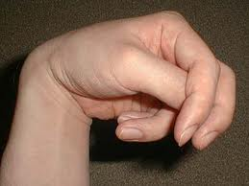
4- Parathyroid gland: Secretes Parathyroid hormone (PTH): it is a peptide
PTH is secreted by The four parathyroid glands which are embedded in the surface of the thyroid gland. It functions as:
Raises blood Ca²⁺ levels.
Secretion is regulated by calcium in the blood.
Causes osteoclasts to break down bone, releasing Ca²⁺ into the blood.
Stimulates the kidneys to reabsorb Ca²⁺.
Stimulates kidneys to convert vitamin D to its active form, which stimulate intestine to absorb Ca²⁺.
PTH and calcitonin are antagonistic hormones. Thus PTH and calcitonin regulate blood calcium level (important role in homeostasis).
Hypoparathyoidism (tetany):
It is a lack of PTH which causes:
Ca²⁺ levels in the blood drop.
Convulsive تشنج contractions of the skeletal muscles.

Slide 7
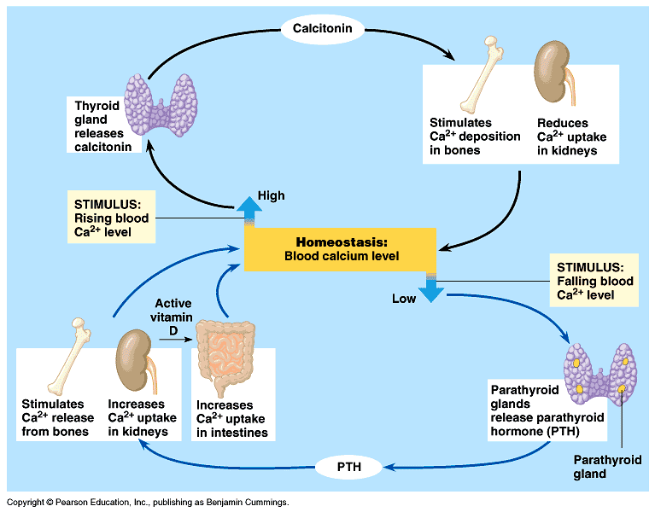
Hormonal control of calcium: homeostasis in mammals blood

Slide 8
5. Pancreas: The endocrine tissues of the pancreas secrete insulin and glucagon, antagonistic hormones that regulate blood glucose
The pancreas has both endocrine and exocrine functions.
Exocrine function: secretion of bicarbonate ions and digestive enzymes.
Endocrine function: insulin and glucagon are secreted by beta and alpha cells of islets of Langerhans.
Insulin: a protein secreted by beta cells.
Lowers blood glucose levels.
Stimulates all body cells (except brain cells) to take up glucose.
Slows glycogenolysis (a source of glucose).
Inhibits gluconeogenesis.
Secretion is regulated by glucose in blood (negative feedback).
Hypo-insulinism: diabetes mellitus.
Hereditary factors and play a role in its development.
High blood sugar levels – sugar is excreted in the urine.
Symptoms: excessive urination and excessive thirst.

Slide 9
Type I diabetes mellitus (insulin-dependent diabetes).
Autoimmune disorder.
Usually appears in childhood الطفولة.
Treatment: insulin injections.
Type II diabetes mellitus (non-insulin-dependent diabetes).
Usually due to target cells having a decreased responsiveness to insulin.
Usually occurs after age 40 – risk increases with age.
Accounts for over 90% of diabetes cases.
Glucagon: a protein secreted by alpha cells.
Raises blood glucose levels.
Stimulates glycogenolysis in the liver and skeletal muscle to produce glucose.
Secretion is regulated by glucose in blood (negative feedback).

Slide 10
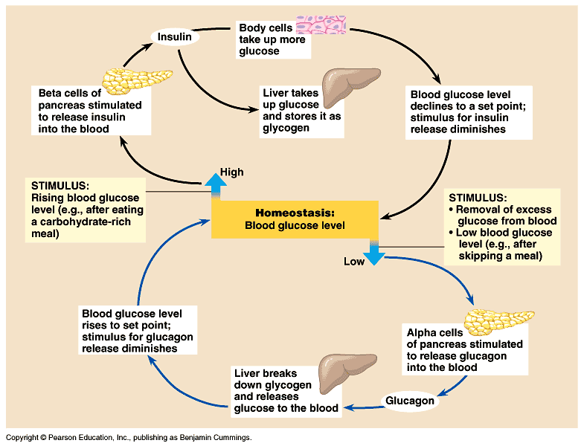
Hormonal control of glucose: homeostasis in mammals blood

Slide 11
6. The adrenal gland: adrenal medulla and adrenal cortex help the body manage stress
The adrenal glands are located adjacent to the kidneys.
The adrenal cortex القشرة is the outer portion.
The adrenal medulla is the inner portion.
I- Adrenal medulla.
Developmentally and functionally related to the nervous system.
It produces the following hormones (in response to stress):
Epinephrine (adrenaline).
Norepinephrine (noradrenaline).
They are amino acid derivatives (synthesized from tyrosine) and function as:
Raises blood glucose level and blood fatty acid level.
Increases heart rate and stroke volume and dilates bronchioles.
Shunts blood away from skin, digestive organs, and kidneys, and increases blood flow to heart, brain, and skeletal muscle.

Slide 12
II- Adrenal cortex: reacts to stress.
Secretion of corticosteroids (a family of steroid hormones) is regulated by the nervous system in response to stress for example:
Glucocorticoids.
Raises blood glucose level.
Secretion is regulated by ACTH (Adrenocorticotropic hormone) from the anterior pituitary.
Abnormally high doses are administered as medication to suppress the inflammation response.
Mineralocorticoids (example: aldosterone, which affects salt and water balance).
Promotes re-absorption of Na⁺ and excretion of K⁺ in kidneys.
Their secretion regulated by K⁺ in blood.
Sex hormones.
Androgens are secreted by the adrenal cortex may account for the female sex drive.
The adrenal cortex also secretes small amounts of estrogens and progesterone.
Although the adrenal cortex produces small amounts of these hormones, the gonads (testes and ovaries) serve as the major source.

Slide 13
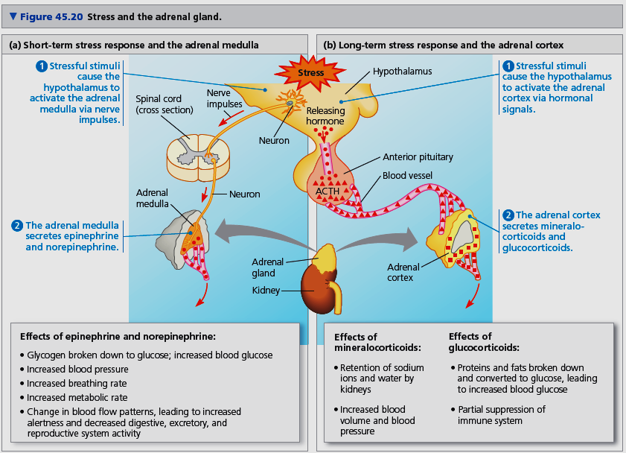

Slide 14
7. Testes & 8. ovaries: Gonadal steroids regulate growth, development, reproductive cycles, and sexual behavior
Testes hormones:
Testosterone): steroids.
Supports sperm formation.
Promote development and maintenance of male sex characteristics.
Secretion is regulated by FSH and LH.
Ovaries hormones:
Estrogens: steroids.
Stimulate uterine lining growth.
Promote development and maintenance of female sex characteristics.
Secretion is regulated by FSH and LH.
Progesterone: steroids.
Promotes uterine lining growth.
Secretion is regulated by FSH and LH.

Slide 15
9- Thymus gland:
Secretes Thymosin: a peptide. It stimulates T lymphocytes.
Protein hormones affect target cells via receptors on the membrane protein
Steroid hormones enter the target cells and trigger protein synthesis via receptors in the nucleus.

Slide 16
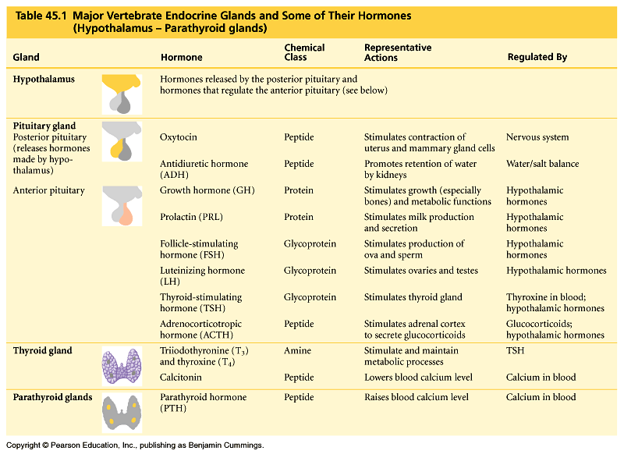
Page 961

Slide 17
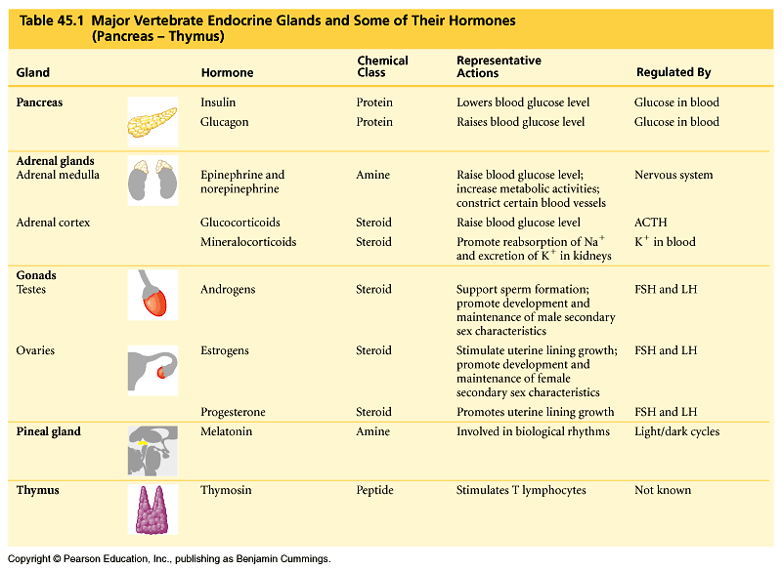
Table 45.1 (continued)

Slide 18
Reference

Slide 19
Thank you

