Slide 1


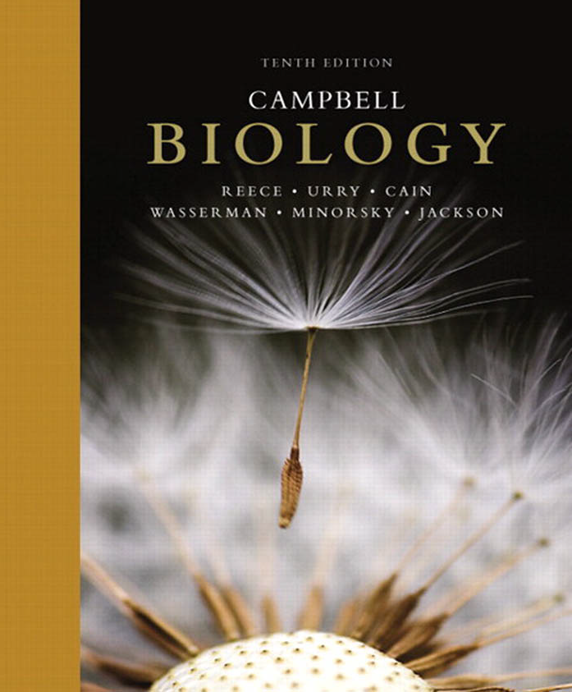
Zoology 109 course
General Animal Biology
For Premedical Student
Zoology Department
Lecture 25 : Endocrine System (Hormones and
the Endocrine System)
1438-1439H

Slide 2
Objectives
CHEMICAL SIGNALS IN ANIMALS
Function and Secretion.
Classes of Hormones and Mechanism of chemical signaling
Pituitary gland:
  Follicle-stimulating hormone (FSH) and luteinizing hormone (LH)
  Thyroid-stimulating hormone (TSH)
  Adrenocorticotropic hormone (ACTH
  Prolactin
  Growth hormone (GH)
  Melanocyte-stimulating hormone (MSH).
  Endorphins.
  Oxytocin
  Vasopressin (antidiuretic hormone, ADH)
Pineal gland

Slide 3
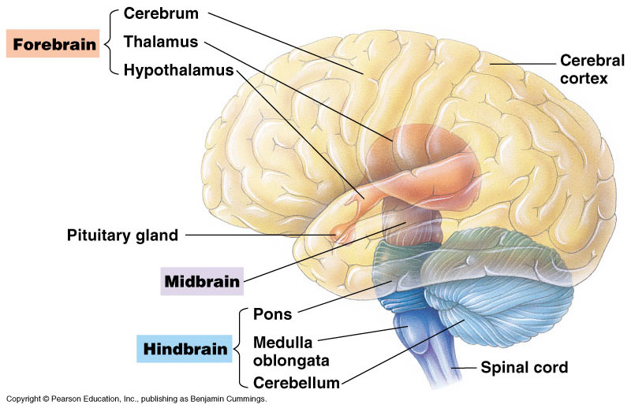
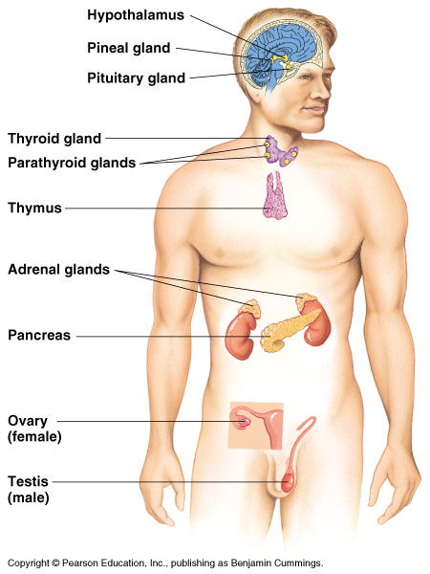
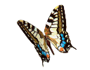
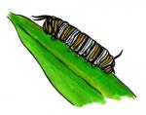
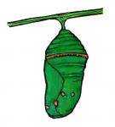
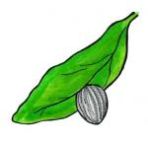
CHEMICAL SIGNALS IN ANIMALS
Egg
Larva
Pupa
Adult

Slide 4
Function and Secretion
Hormones: are substances secreted by cells into the blood that act to regulate the activity of other cells in the body.
  Hormones affect all cells in the body and are made and secreted by endocrine glands.
Endocrine glands: are ductless organs that secret hormones either into the bloodstream or the fluid around cells.
The endocrine glands can be found through out the body and are collectively known as the endocrine system.
Endocrine glands, such as the pancreas, can also be exocrine glands.
  Exocrine glands: secrete substances through ducts to specific locations inside and outside the body.

Slide 5
Nervous and endocrine systems are the main internal communication and regulation systems.
The animal hormone-secreting cells constitute the endocrine system.
Hormone secreting organs are called Endocrine Glands (ductless glands الغدد الصماء ). While Exocrine Glands secrete substances through ducts to specific locations inside and outside the body.
Hormone is a chemical signal secreted into blood stream and regulates communicating messages within the body.
Target cell is the site that is reached by the hormone to which it responds.
Complete changes in the body is regulated by hormones (e.g. metamorphosis in insects).
Types of hormones are [Polypeptide H., Amino acid derivatives H or Steroid H.].

Slide 6
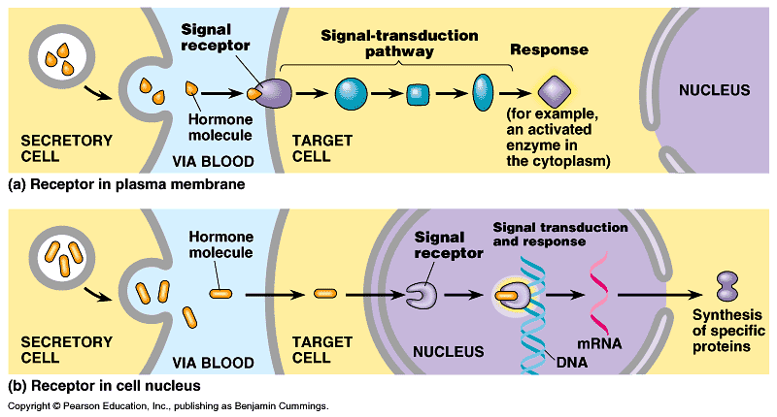
Classes of Hormones and Mechanism of chemical signaling:
Hormones fall into three major chemical classes: polypeptides, steroids, and amines.
The hormone insulin, for example, is a polypeptide that contains two chains in its active form.
Steroid hormones, such as cortisol, are lipids that contain four fused carbon rings. All are derived from the steroid cholesterol.
Epinephrine and thyroxine are amine hormones, each synthesized from a single amino acid, either tyrosine or tryptophan.
Polypeptides and most amine hormones are water-soluble, whereas steroid hormones and other largely nonpolar (hydrophobic) hormones, such as thyroxine, are lipid-soluble.
I): Protein hormones: Bind to a receptor protein on the surface of the target cell which will trigger signal transduction pathway.

Slide 7
II) Steroid hormones:
Penetrate the cell and bind to a receptor protein inside the target cell. This also will trigger signal transduction pathway (for triggering mRNA transcription for synthesizing a specific protein).
Estrogen, progesterone, vitamin D and Nitric oxide (NO).
  Usually, the intracellular receptor activated by a hormone is a transcription factor.

Slide 8
Tropic hormones: الهرمونات المحفزة (المنبهة) Target other endocrine glands and are important to understanding chemical coordination.
لأنها لا تتبع التصنيف السابق tropic hormones تم تغيير فورمات
Many endocrine organs contain specialized nerve cells called neurosecretory cells that secret hormones.
The hormone epinephrine has two functions:
  As a hormone of the endocrine system.
  As a signal in the nervous system.
Feedback is common in regulation of the activity of both endocrine and nervous systems (homeostasis):
  Calcitonin and parathyroid hormones play an important role in maintaining the concentration of the blood calcium constant.
  They are secreted from thyroid and parathyroid glands respectively.
Hormones regulate the development of invertebrates (e.g. insects)

Slide 9
The Vertebrate Endocrine System
Tropic hormones
(الهرمون المنبه للغدد)
Target other endocrine
glands and are
important to understanding
chemical coordination.
Human has 9 endocrine glands.
Fig. 45.5, Page 960

Slide 10
The hypothalamus and pituitary integrate many functions of the vertebrate endocrine system
The hypothalamus and the pituitary gland, control the initial release of many hormones for the endocrine system.
  The hypothalamus is the area of the brain that coordinates many activities of the nervous and endocrine systems.
  The pituitary gland has two parts, anterior and posterior. The posterior part stores and releases hormones produced by the hypothalamus.
  Neurosecretory cells of the hypothalamus produce hormones:
    Releasing hormones stimulate the anterior pituitary (adenohypophysis) to secrete hormones.
    Inhibiting hormones prevent the anterior pituitary from secreting hormones.
Hypothalamus
Anterior
pituitary
Posterior
pituitary

Slide 11
1)- Pituitary gland: Secrets 9 hormones ( 7 hormones by the anterior part and 2 hormones by the posterior part).
A)- Anterior pituitary hormones.
  Growth hormone (GH): a protein.
    Stimulates growth and metabolism.
    Secretion is regulated by hypothalamic hormones.
    Acts directly on tissues or acts via growth factors.
    Gigantism: العملقة excessive GH during development.
    Acromegaly: excessive GH production during adulthood.
    Hypopituitary dwarfism القزمية: childhood GH deficiency.
  Prolactin (PRL): a protein.
    Stimulates milk production and secretion from mammary gland الغدد اللبنية. This secretion is regulated by hypothalamic hormones.
  Gonadotropins : glyocoproteins.
    Follicle-stimulating hormone (FSH).
      Stimulates production of sperms and ova.
      Secretion is regulated by hypothalamic hormones.
    Luteinizing hormone (LH) المُحفز لتكوين الجسم الأصفر.
      Stimulates ovaries and testes.
      Secretion is regulated by hypothalamic hormones.

Slide 12
  Thyroid-stimulating hormone (TSH): a glycoprotein.
    Stimulates thyroid gland.
    Secretion is regulated by thyroxine in blood.
    Secretion is also regulated by hypothalamic hormones.
  Adrenocorticotropic hormone (ACTH): a peptide
    Stimulates adrenal cortex secretion of glucocorticoids
    Secretion is regulated by glucocorticoids and hypothalamic hormones.
  Melanocyte-stimulating hormone (MSH): a peptide.
    May play a role in fat metabolism.
    In amphibians, fishes, and reptiles, MSH regulates skin color by controlling pigment distribution in skin cells called melanocytes.
  Endorphins: peptides.
    Inhibit pain perception.
    Effects mimicked by heroin and other opiate drugs.

Slide 13
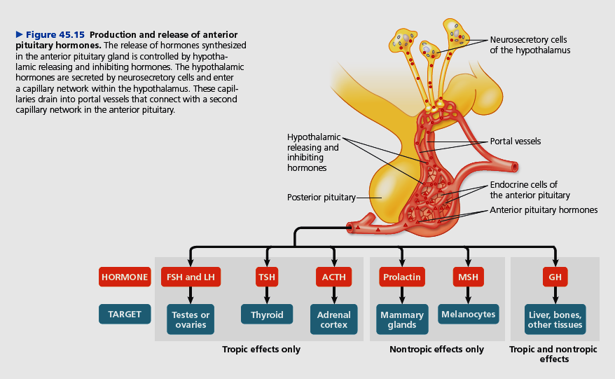

Slide 14
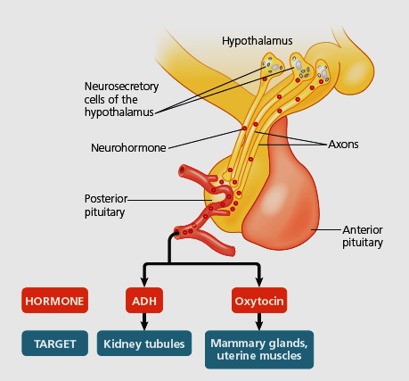
B)- Posterior pituitary hormones.
Neurosecretory cells of the hypothalamus synthesize the two posterior pituitary hormones: antidiuretic hormone and oxytocin.
  Oxytocin: a peptide.
    Stimulates contraction of the uterus and mammary glands.
    Secretion is regulated by the nervous system.
  Antidiuretic hormone (ADH): a peptide.
    Promotes retention of water by the kidneys (in Kidney tubules).
    High level decreases urination and vice versa.
    Secretion regulated by water/salt balance.
Figure 45.14 Production and release of posterior pituitary hormones

Slide 15
2- Pineal gland: الغدة الصنوبرية
It is a small mass of tissue near the center of the mammalian brain and is involved in biorhythms.
  The pineal gland secretes the hormone, melatonin, an amine.
    Involved in biological rhythms associated with reproduction.
    Secretion is regulated by light/dark cycles.
Pineal gland
Pituitary hormones

Slide 16
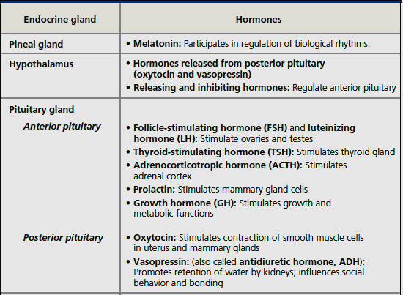
Figure 45.9 Human endocrine glands and their hormones

Slide 17
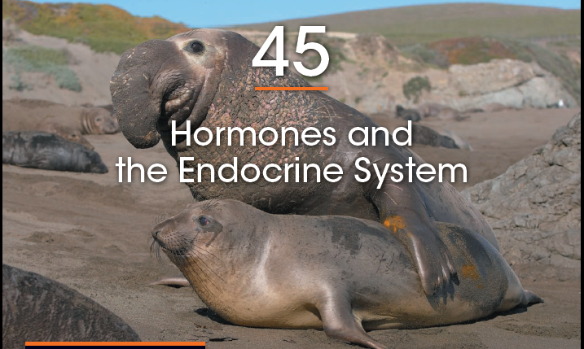
Reference

Slide 18
Thank you

