Slide 1



Zoology 109 course
General Animal Biology
For Premedical Student
Zoology Department
Lecture 24 : Genetics
(The Chromosomal Basis
of Inheritance)
1438-1439H

Slide 2
Objectives
Section B: Sex Chromosomes.
  Some chromosomal systems of sex determination.
  Sex-linked genes exhibit unique patterns of inheritance.
    Inheritance of X-Linked Genes.
    human X-linked disorders.
      Duchenne muscular dystrophy.
      Hemophilia (X-linked recessive disorder).
      Color blindness.
  Alterations of chromosome number or structure cause some genetic disorders:
    Abnormal Chromosome Number.
    Alterations of Chromosome Structure.

Slide 3
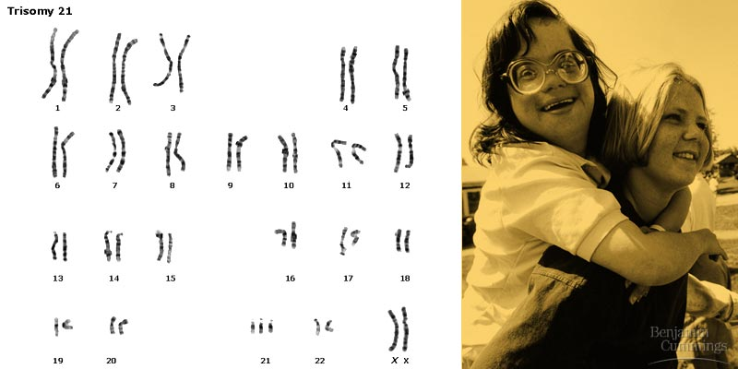
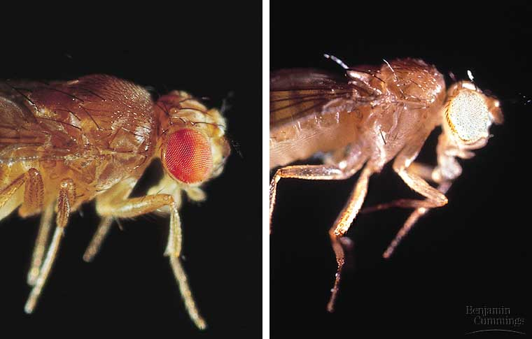
THE CHROMOSOMAL BASIS OF INHERITANCE
Section B: Sex Chromosomes
The chromosomal basis of sex varies with the organism
Sex-linked genes have unique patterns of inheritance

Slide 4
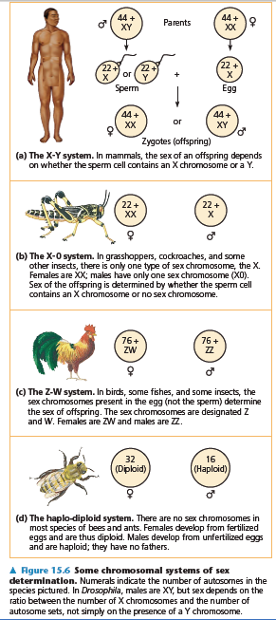
1. The chromosomal basis of sex varies with the organism
In human and other mammals, there are two varieties of sex chromosomes, X & Y.
  An individual who inherits two X chromosomes usually develops as a female.
  An individual who inherits an X and a Y chromosome usually develops as a male.
This X-Y system of mammals is not the only chromosomal mechanism of determining sex.
Other options include the X-0 (in locust) system, the Z-W system (in birds), and the haplo-diploid system (in bees).
In Human, the SRY gene (Sex-determining Region of the Y chromosome) modifies embryonic gonads into testes.
Females lack the SRY gene, thus, the embryonic gonads develop into ovaries.

Slide 5
1. The chromosomal basis of sex varies with the organism
In the X-Y system, Y and X chromosomes behave as homologous chromosomes during meiosis.
  In reality, they are only partially homologous and rarely undergo crossing over
In both testes (XY) and ovaries (XX), the two sex chromosomes segregate during meiosis and each gamete receives one.
  Each egg receives an X chromosome.
  Half the sperm receive an X chromosome and half receive a Y chromosome.
Because of this, each conception has about a fifty-fifty chance of producing a particular sex.

Slide 6
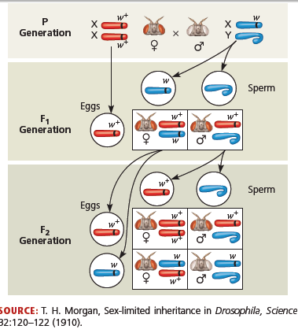
2. Sex-linked genes have unique patterns of inheritance
The sex chromosomes, especially the X chromosome, have genes for many characters unrelated to sex.
These sex-linked genes follow the same pattern of inheritance as the white-eye locus in Drosophila.
If a sex-linked trait is due to a recessive allele, a female have this phenotype only if homozygous.
  Heterozygous females will be carriers.

Slide 7
Sex-linked genes
Because males have only one X chromosome (hemizygous), any male receiving the recessive allele from his mother will express the trait.
Therefore, males are far more likely to inherit sex-linked recessive disorders than are females.

Slide 8
Sex-linked disorders in human.
Duchenne muscular dystrophy: وَهَن العضلات affects one in 3,500 males born in the United States.
  Affected individuals rarely live past their early 20s.
  This disorder is due to the absence of an X-linked gene for a key muscle protein, called dystrophin.
  The disease is characterized by a weakening ضعف of the muscles and loss of coordination فـقـْد التوازن.
Hemophilia: النزيف الدمويis a sex-linked recessive trait defined by the absence of one or more clotting factors عوامل تجلط.
  These proteins normally slow and then stop bleeding.
  Individuals with hemophilia have prolonged bleeding نزيف مستمر because a firm clot تجلط forms slowly.
  Individuals can be treated with intravenous injections of the missing protein.
  This gene is transmitted to offspring via the mothers.
  Thus, Sons borne from hemophilic woman should be exempted يُستثنى from circumcision الختان.

Slide 9
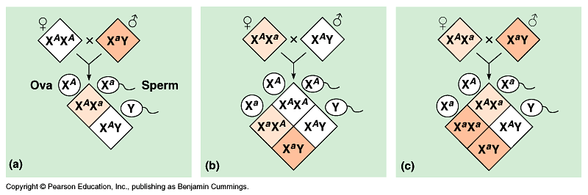
Color blindness: عمى الألوان is a disorder inherited as a recessive sex-linked character and affect both males and females.
  A color blind female (XªXª) may be born to a color blind father (XªY) and a carrier mother (X^{A}Xª)

Slide 10
Alterations of chromosome number or
structure cause some genetic disorders
Physical and chemical disturbances, as well as errors during meiosis, can damage chromosomes in major ways or alter their number in a cell.
Chromosomal deletions/translocations
Homologous chromatids may break and rejoin at incorrect places, thus, one chromatid will loose more genes than it receives.
Abnormal Chromosome Number.
result from non-disjunction during gametes production in one parent.
an abnormal number of a particular chromosome, a condition known as aneuploidy.

Slide 11
Alterations of chromosome number or
structure cause some genetic disorders
Some organisms have more than two complete chromosome sets in all somatic cells.
The general term for this chromosomal alteration is polyploidy
the specific terms triploidy (3n) and tetraploidy (4n) indicate three or four chromosomal sets, respectively.
Polyploidy is fairly common in the plant kingdom

Slide 12
Alterations of chromosome number or
structure cause some genetic disorders
A diploid embryo that is homozygous for a large deletion or male with a large deletion to its single X chromosome is usually missing many essential genes and this leads to a lethal outcome.
  Duplications and translocations are very harmful.
Translocation or inversion can alter phenotype because a gene’s expression is influenced by its location.

Slide 13

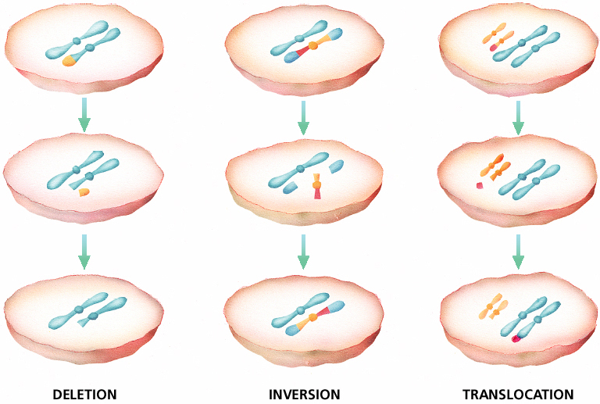
Chromosomal Mutations
Chapter 12

Slide 14
A)- Abnormal Chromosome Number (Aneuploidy)
Down syndrome
Klinefelter’s syndrome (XXY)
Turner’s syndrome
Autosomes
Sex Chromosomes
47,XYY syndrome
triple X syndrome

Slide 15
A)- Abnormal Chromosome Number
1- Down syndrome [aneuploid condition (2n + 1), trisomy in autosomes]:
Is due to three copies of chromosome 21 (Trisomies). Although chromosome 21 is the smallest human chromosome, it severely alters an individual’s phenotype in specific ways.

Slide 16
Symptoms of Down Syndrome
Upward slant to eyes.
Small ears that fold over at the top.
Small, flattened nose.
Small mouth, making tongue appear large.
Short neck.
Small hands with short fingers.
In addition, down syndrome always involves some degree of mental retardation, from mild to severe. In most cases, the mental retardation is mild to moderate.

Slide 17
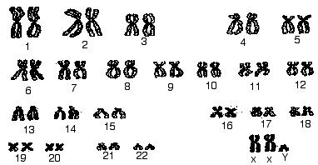
Aneuploidy of Sex Chromosomes
a- Klinefelter’s syndrome [trisomy in sex chromosomes ], (XXY)
Disorder occurring due to nondisjunction of the X chromosome.
The Sperm containing both X and Y combines with an egg containing the X, results in a male child. The egg may contribute the extra X chromosome.
An XXY male, occurs once in every 2000 live births.
These individuals have male sex organs, but are sterile.
There may be feminine characteristics, but their intelligence is normal.
Males with some development of breast tissue normally seen in females.
Little body hair is present, and such person are typically tall, have small testes.
Infertility results from absent sperm.
Evidence of mental retardation may or may not be present.

Slide 18
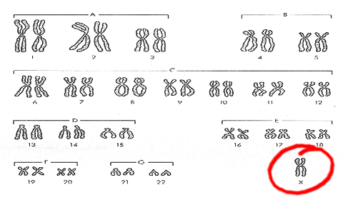
Aneuploidy of Sex Chromosomes
An XYY male, tend to somewhat taller than average
A trisomy female (XXX), which occurs once in every 2000 live births, produces healthy females.
Turner’s syndrome, a monosomy female (X0),
  Occurs once in every 5000 births, produces phenotypic, but immature females غير ناضجة جنسيا.
Turner syndrome is associated with underdeveloped ovaries, short stature.
Bull neck, and broad chest. Individuals are sterile, and lack expected secondary sexual characteristics.
Mental retardation typically not evident.
Chromosomal or monogenic?

Slide 19
B)- Disorders Caused by Structurally Altered Chromosomes:
It can also cause human disorders.
Deletions حزف, even in a heterozygous state, cause severe physical and mental problems.
Cri-du-chat عارض مواء القط, results from a specific deletion in chromosome 5.
-- Is a rare genetic disorder due to a missing part of chromosome 5
  These individuals are mentally retarded, have a small head with unusual facial features, and a cry like the mewing of a distressed cat.
  This syndrome is fatal in infancy الطفوية or early childhood.

Slide 20
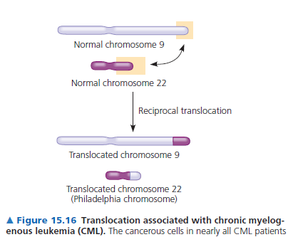
Chronic Myelogenous Leukemia, (CML). Caused by chromosomal translocations since a fragment of chromosome 22 switches places with a small fragment from the tip of chromosome 9.

Slide 21
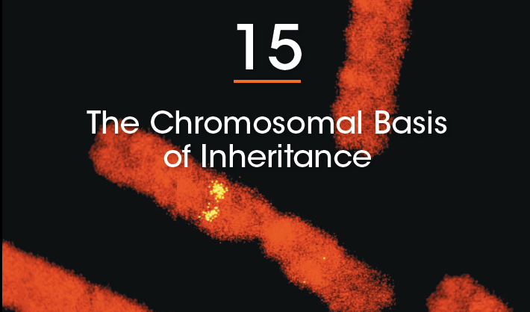
Reference

Slide 22
Thank you

