Slide 1



Zoology 109 course
General Animal Biology
For Premedical Student
Zoology Department
Lecture 22 : Genetics
(Mendel and the Gene Idea)
1438-1439H

Slide 2
Objectives
  The Law of Independent Assortment.
  Recessively Inherited Disorders.
    Cystic Fibrosis.
    Tay-Sachs disease.
    Sickle-Cell Disease.
  Dominantly Inherited Disorders.
    Achondroplasia.
    Huntington’s disease.
  Multifactorial Disorders.

Slide 3
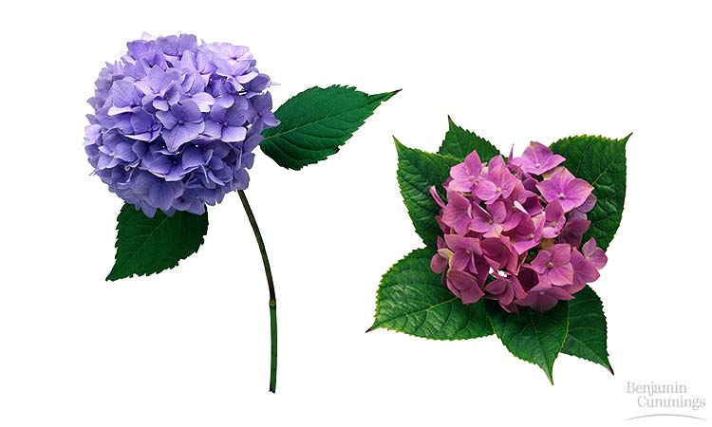
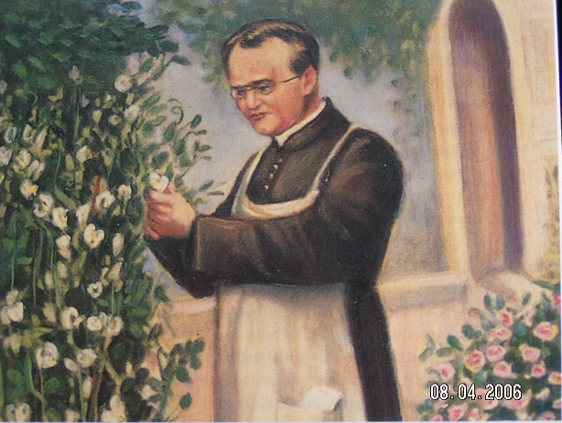
MENDEL AND THE GENE IDEA
Mendelian Inheritance in Humans

Slide 4
2- The law of Independent Assortment: each pair of alleles segregates into gametes independently
Mendel’s experiments that followed the inheritance of flower color or other characters focused on only a single character via monohybrid crosses التزاوج أحادي الصفة.
He conducted other experiments in which he followed the inheritance of two different characters (a dihybrid cross التزاوج ثنائي الصفة).
In one dihybrid cross experiment, Mendel studied the inheritance of seed color and seed shape.
  The allele for yellow seeds (Y) is dominant compared to the allele for green seeds (y).
  The allele for round seeds (R) is dominant compared to the allele for wrinkled seeds (r)
Mendel crossed true-breeding plants that had yellow & round seeds (YYRR) with true-breeding plants that has green & wrinkled seeds (yyrr).

Slide 5
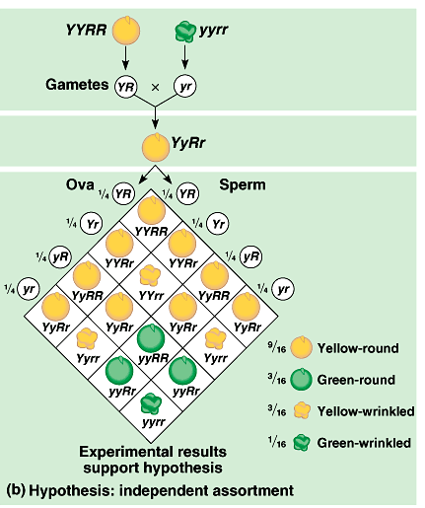
The two pairs of alleles segregate independently of each other.
  The presence of one specific allele for one trait has no impact تأثير on the presence of a specific allele for the second trait.
When a sperm and an ova each with four classes of alleles combine, there would be 16 equally probable ways in which the alleles can combine
in the F₂ generation.
These combinations produce four distinct phenotypes in a
9:3:3:1 ratio.
This was consistent with Mendel’s results.
Each character appeared to be inherited independently.

Slide 6
The Law of Independent Assortment
The law of independent assortment, which states that two or more genes assort independently—that is, each pair of alleles segregates independently of each other pair of alleles—during gamete formation.

Slide 7
Mendel’s law of Independent assortment (Dihybrid cross)
It is a mating between two parent plants different in two characters.
X
Y
Y
R
R
yy
r
r
Y
R
Y
R
y
r
y
Y
y
r
R
r
F₁ Yellow Round

Slide 8
y
X
Y
R
r
y
Y
R
r
YR
Yr
yR
yr
YYRR
YR
Yellow Round
YYrr
Yr
Yellow Wrinkled
yR
yyRR
Green Round
yyrr
yr
Green Wrinkled
F_{2:} % of Phenotype ?

Slide 9
Many human disorders follow Mendelian patterns of inheritance
Thousands of genetic disorders, including disabling الإعاقة or deadly hereditary diseases, are inherited as simple recessive traits.
These range from the relatively mild (albinism) to life-threatening (cystic fibrosis).
Heterozygotes have a normal phenotype because one “normal” allele produces enough of the required factors (for normal trait).
A recessively inherited disorder shows up only in the individuals who inherit homozygous recessive allele from parents.
Thus, individuals who lack the disorder are either homozgyous dominant or heterozygous.
Heterozygous member may have no clear phenotypic effects, but is a carrier who may transmit a recessive allele to their offspring.
Most people with recessive disorders are born from carrier parents with normal phenotypes.
  Two carriers have a 1/4 chance of having a child with the disorder, 1/2 chance of a carrier, and 1/4 free.
Albinism

Slide 10
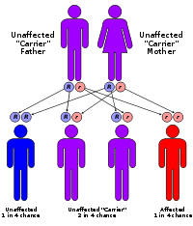
A- Recessively inherited disorders
Cystic fibrosis (التليف الكيسي ): a lethal recessive disorder
  One in 25 people is a carrier.
  The normal allele codes for a membrane protein that transports Cl⁻ between cells and the environment.
  If these channels are absent, there are abnormally high extracellular levels of chloride that causes the mucus coats of certain cells to become thicker سميكة and stickier لزجة than normal.
  This mucus build-up in the pancreas, lungs, digestive tract, and elsewhere favoring bacterial infections.
  Without treatment, affected children die before five, but with treatment can live past their late 20’s.

Slide 11
Tay-Sachs disease : a lethal recessive disorder.
  It is caused by a dysfunctional enzyme that fails to break down specific brain lipids.
  The symptoms begin with seizures حول, blindness, and degeneration of motor and mental performance a few months after birth.
  Inevitably, the child dies after a few years.

Slide 12
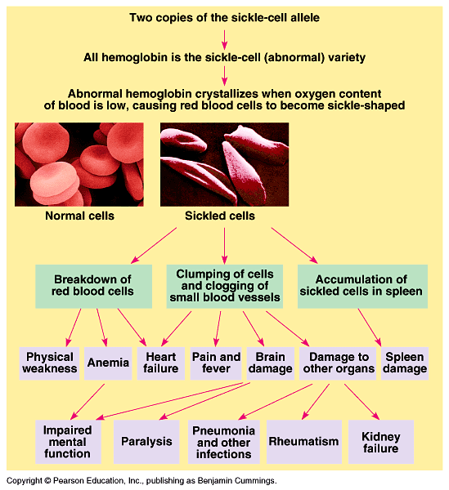
Sickle-cell disease.
  It is caused by the substitution of a single amino acid in hemoglobin.
  When oxygen levels in the blood of an affected individual are low, sickle-cell hemoglobin crystallizes into long rods.
  This deforms red blood cells into a sickle shape.
  Doctors can use regular blood transfusions to prevent brain damage and new drugs to prevent or treat other problems.
At the molecular level, the two alleles are codominant; both normal and abnormal (sickle-cell) hemoglobins are made in heterozygotes (carriers), who are said to have sickle-cell trait.

Slide 13
B- Dominantly inherited disorders
Although most harmful alleles are recessive, many human disorders are due to dominant alleles.
Achondroplasia, a form of dwarfism القِزمية, has an incidence of one case in 10,000 people.
  Heterozygous individuals have the dwarf phenotype.
  Those who are not achodroplastic dwarfs are homozygous recessive for this trait.
Lethal dominant alleles are much less common than lethal recessives because if a lethal dominant kills an offspring before it can mature and reproduce, the allele will not be passed on to future generations.

Slide 14
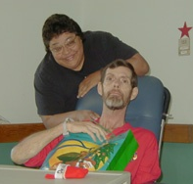
2- Huntington’s disease: a degenerative ضُمور disease of the nervous system.
The dominant lethal allele has no obvious phenotypic effect until an individual is about 35 to 45 years old.
The deterioration of the nervous system is irreversible and inevitably fatal مُميت.
Huntington's disease results in an eventual loss of both mental and physical control.
The disease is also known as Huntington's chorea (means "dance-like movements“) refers to the uncontrolled motions.

Slide 15
Many other disorders have a multifactorial basis.
These have a genetic component plus a significant environmental influence.
Multifactorial disorders include:
  heart disease, diabetes, cancer, alcoholism, and certain mental illnesses, such a schizophrenia and manic-depressive disorder.
  In these cases, the hereditary component is polygenic. For example, many genes affect cardiovascular health, making some of us more likely to than others to heart attacks and strokes.
At present, little is understood about the genetic contribution to most multifactorial diseases

Slide 16
Summary of the Human Genetic Disorders
Autosome - Any chromosome other than a sex chromosome
Genetic disorders caused by genes on autosomes are called autosomal disorders
  Some genetic disorders are autosomal dominant
    An individual with AA has the disorder
    An individual with Aa has the disorder
    An individual with aa does NOT have disorder
  Other genetic disorders are autosomal recessive
    An individual with AA does NOT have disorder
    An individual with Aa does NOT have disorder, but is a carrier
    An individual with aa DOES have the disorder

Slide 17
Reference

Slide 18
Thank you

