Slide 1




College of Science,
Zoology Department

Slide 2



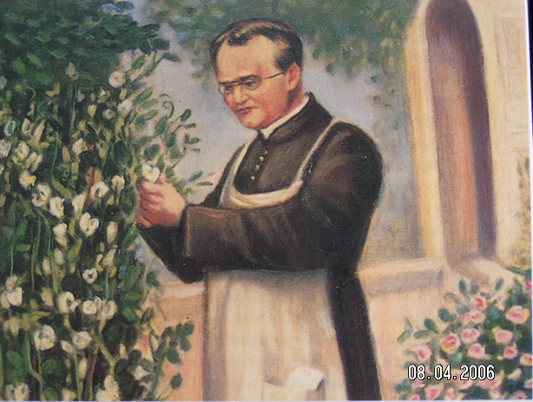
Mendelian Inheritance in Humans
Albinism
Copyright © 2002 Pearson Education, Inc., publishing as Benjamin Cummings

Slide 3


Objectives
  The Law of Independent Assortment.
  Recessively Inherited Disorders.
    Cystic Fibrosis.
    Tay-Sachs disease.
    Sickle-Cell Disease.
  Dominantly Inherited Disorders.
    Achondroplasia.
    Huntington’s disease.
  Multifactorial Disorders.

Slide 4
2- The law of Independent Assortment: قانون التوزيع الحر للـﭽـينات
Each pair of alleles of a character segregates independently of each other during gamete formation
Mendel’s experiments that followed the inheritance of flower color or other characters focused on only a single character via monohybrid crosses التزاوج أحادي الصفة.
He conducted other experiments in which he followed the inheritance of two different characters (a dihybrid cross التزاوج ثنائي الصفة).
In one dihybrid cross experiment, Mendel studied the inheritance of seed color and seed shape.
  The allele for yellow seeds (Y) is dominant compared to the allele for green seeds (y).
  The allele for round seeds (R) is dominant compared to the allele for wrinkled seeds (r)
Mendel crossed true-breeding plants that had yellow & round seeds (YYRR) with true-breeding plants that has green & wrinkled seeds (yyrr).
Copyright © 2002 Pearson Education, Inc., publishing as Benjamin Cummings

Slide 5
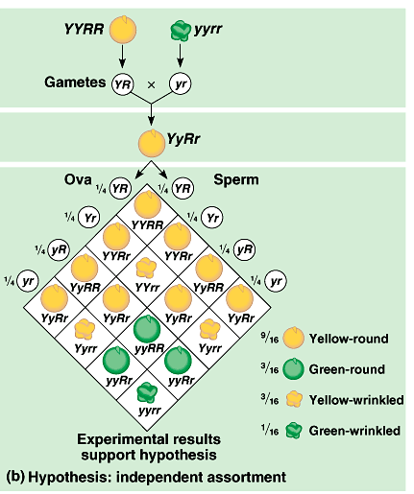
The two pairs of alleles segregate independently of each other.
  The presence of one specific allele for one trait has no impact تأثير on the presence of a specific allele for the second trait.
When a sperm and ova (each with four classes of alleles) combine, there would be 16 equally probable ways in which the alleles can combine
in the F₂ generation.
These combinations produce four distinct phenotypes in a
9:3:3:1 ratio.
This was consistent with Mendel’s results.
Each character appeared to be inherited independently.

Slide 6
Mendel’s law of Independent assortment (Dihybrid cross)
It is a mating between two parent plants different in two characters.
X
Y
Y
R
R
yy
r
r
Y
R
Y
R
y
r
y
Y
y
r
R
r
F₁ Yellow Round

Slide 7
y
X
Y
R
r
y
Y
R
r
YR
Yr
yR
yr
YYRR
YR
Yellow Round
YYrr
Yr
Yellow Wrinkled
yR
yyRR
Green Round
yyrr
yr
Green Wrinkled
F_{2:} % of Phenotype ?

Slide 8
Many human disorders أمراض follow Mendelian patterns of inheritance
Thousands of genetic disorders أمراض وراثية, including disabling الإعاقة or deadly hereditary diseases الأمراض الوراثية المُميتة, are inherited as simple recessive traits صفات وراثية مُتنحية.
These range from the relatively mild (albinism الألبينو، المهقة) to life-threatening (cystic fibrosis).
Heterozygotes have a normal phenotype because one “normal” allele produces enough of the required factors (for the normal trait).
A recessively inherited disorder shows up يظهر only in the individuals who inherit homozygous recessive allele from parents.
Thus, individuals who lack the disorder are either homozgyous dominant or heterozygous.
Heterozygous member may have no clear phenotypic effects, but is a carrier who may transmit a recessive allele to their offspring.
Most people with recessive disorders are born from carrier parents with normal phenotypes.
  Two carriers have a 1/4 chance of having a child with the disorder, 1/2 chance of a carrier, and 1/4 free.
Albinism

Slide 9
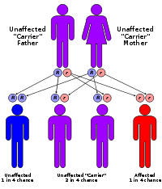
A- Recessively inherited disorders الصفات المرضية المتنحية
Cystic fibrosis (التليف الكيسي ): a lethal recessive disorder
  One in 25 people is a carrier.
  The normal allele codes for a membrane protein that transports Cl⁻ between cells and the environment.
  If these proteins are absent, there are abnormally high extracellular levels of chloride that causes the mucus coats of certain cells to become thicker سميكة and stickier لزجة than normal.
  This mucus build-up in the pancreas, lungs, digestive tract, and elsewhere favoring bacterial infections.
  Without treatment, affected children die before five, but with treatment can live past their late 20’s.
التليف الكيسي (Cystic Fibrosis) هو مرض وراثي متنحّ يحدث فيه عجز مترقّي في عمل الغدد خارجية الإفراز مما يؤثر بصورة كبيرة على وظائف كثيرة في الجسم.
أعراض الافراد المصابين بالتليف الكيسي تعتمد على سن الفرد، ومدى هذا المرض يؤثر على أجهزة محددة، قبل العلاج، تطاول اثار التليف الكيسي أجهزة التنفس، والهضم، والتكاثر الجنسي
الاعراض الأخرى وتشمل امراض الرئة، والصعوبات المتزايدة مع سوء امتصاص الفيتامينات والمواد المغذيه من قبل الجهاز الهضمي وبالإضافة إلى ذلك، صعوبات مع الخصوبه.
لا يوجد علاج للتليف الكيسي، ويموت كثير من المصابين بالتليف الكيسي في الثلاثينات من العمرمن فشل الرئة، وكثيرا ما يكون لازما زرع الرئة

Slide 10
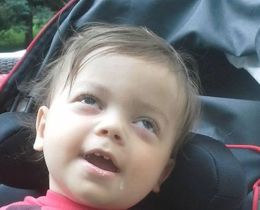
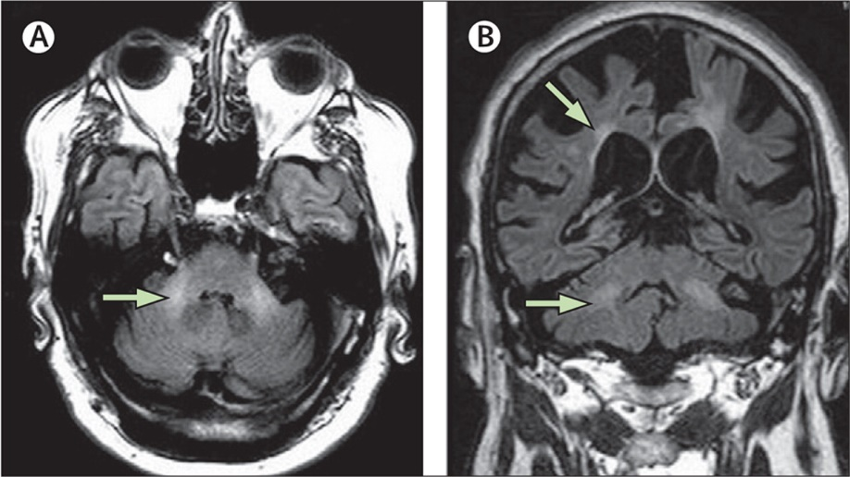
Recessively inherited disorders
Tay-Sachs disease (البله المميت ): a lethal recessive disorder.
  It is caused by a dysfunctional enzyme إنزيم غير عامل that fails to break down specific brain lipids.
  The symptoms begin with seizures حول, blindness, and degeneration of motor and mental performance a few months after birth.
  Inevitably, the child dies after a few years.
البَلَه المُميت (Tay-Sachs) مرض وراثي نادر يسببه ﭽين متنحي يؤدي إلى نقص نشاط إنزيم هيكسورامينيديز (Hexooraminidase) ذو العلاقة بتكسير دهون المخ (brain lipids) gangliosides (المهم في التواصل الخلوي) وعدم تكسيره يقود إلى تراكمه بالخلايا العصبية والاضرار بها.
تطور المرض يؤدي إلى فقدان السمع، والبصر، وضعف عضلي، وضعف عقلي.
عادة ما يبدأ ظهور الاعراض في سن الـ 6 شهور ويؤدي غالباً إلى الوفاة في سن الخامسة لعدم توافر علاج لهذا المرض

Slide 11
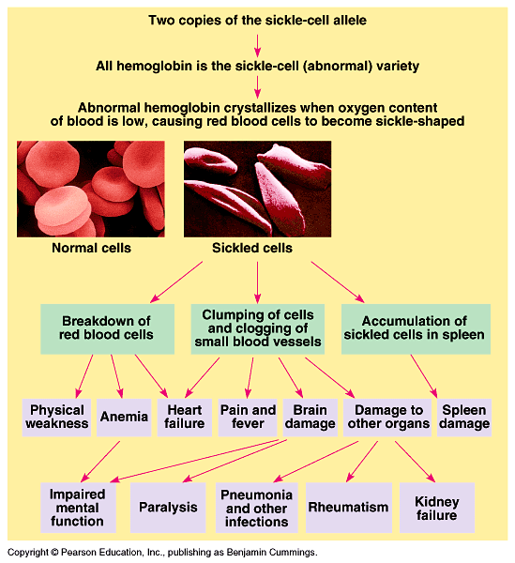
Sickle-cell disease مرض خلايا الدم المنجلية.
  It is caused by the substitution of a single amino acid in hemoglobin.
  When oxygen levels in the blood of an affected individual are low, sickle-cell hemoglobin crystallizes into long rods.
  This deforms red blood cells into a sickle shape.
  Doctors can use regular blood transfusions to
  prevent brain damage and new drugs to prevent or treat other problems.
The two alleles are codominant as both normal and abnormal hemoglobins are synthesized.

Slide 12
مرض خلايا الدم الهلالية.
وتكمن مشكلة المرض في إنتاج نخاع العظم لكريات دم حمراء - التي تنقل الغذاء والأكسجين إلى مختلف أنحاء الجسم – غير طبيعية. وتكون غير طبيعية نتيجة لخلل في تكوين الهيموجلوبين (خضاب الدم)وفي كميته أيضا. وهذه الخلايا غير الطبيعية تأخذ شكل المنجل (الهلال) وهي قابلة إلى التكسر وتتحلل بعد فترة قصيرة من إنتاجها وقد تعيق مرور الدم خلال الشعيرات الدموية، وقد تسد عروق الدم فتسبب الام مبرحه في اجزاء مختلفة من الجسم خاصة في العظام خاصة عظام الاطرف والظهر.
و قد تسد كريات الدم الحمراء المنجلية اي عرق من العروق الدموية في الرئتين أو في البطن أو حتى في المخ وقد تسبب مضاعفات خطيرة إضافة إلى الألام المبرحه التي يعاني منها الشخص المصاب.
ويعتبر فقر الدم المنجلي من الامراض المزمنة. لما يسببة من الام مبرحة وقاسية جدا. وعند حدوث نوبات الالم الشديدة لابد من استخدام العقاقير الطبية والمسكنات القوية.

Slide 13
B- Dominantly inherited disorders الصفات المَرضية السائدة
Although most harmful alleles are recessive, many human disorders are due to dominant alleles.
Achondroplasia, a form of dwarfism القِزمية, has an incidence of one case in 10,000 people.
  Heterozygous individuals have the dwarf phenotype.
  Those who are not achodroplastic dwarfs are homozygous recessive for this trait.
Lethal dominant alleles are much less common than lethal recessives because if a lethal dominant kills an offspring before it can mature and reproduce, the allele will not be passed on to future generations.

Slide 14
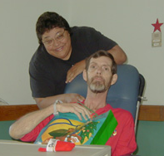
Dominantly inherited disorders الصفات المَرضية السائدة
2- Huntington’s disease: a degenerative ضُمور disease of the nervous system.
The dominant lethal allele has
no obvious phenotypic effect
until an individual is about 35
to 45 years old.
The deterioration of the nervous system is irreversible and inevitably fatal مُميت.
Huntington's disease results in an eventual loss of both mental and physical control.
The disease is also known as Huntington's chorea (means "dance-like movements“) refers to the uncontrolled motions.

Slide 15
Many other disorders have a
multifactorial متعدد العوامل basis.
  These have a genetic component plus a significant environmental influence.
  Multifactorial disorders include:
  heart disease, diabetes, cancer, alcoholism, and certain mental illnesses, such a schizophrenia and manic-depressive disorder.
  The genetic component is typically polygenic متعدد الجينات. For example, many genes affect cardiovascular health, making some of us more likely to than others to heart attacks and strokes
At present, little is understood about the genetic contribution to most multifactorial diseases

Slide 16
Summary of the Human Genetic Disorders
Autosome - Any chromosome other than a sex chromosome
Genetic disorders caused by genes on autosomes are called autosomal disorders
  Some genetic disorders are autosomal dominant
    An individual with AA has the disorder
    An individual with Aa has the disorder
    An individual with aa does NOT have disorder
  Other genetic disorders are autosomal recessive
    An individual with AA does NOT have disorder
    An individual with Aa does NOT have disorder, but is a carrier
    An individual with aa DOES have the disorder

Slide 17

College of Science,
Zoology Department
General Animal Biology
(Zoo-109)
Zoology Department

