Slide 1


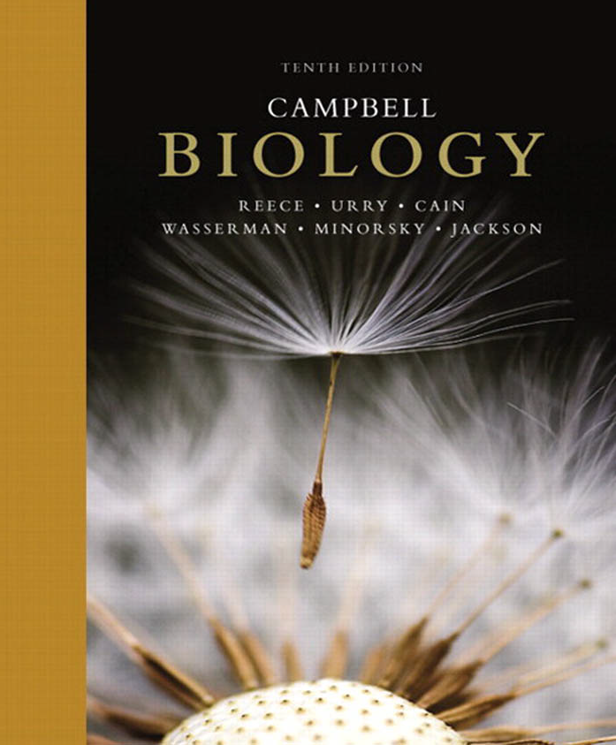
Zoology 109 course
General Animal Biology
For Premedical Student
Zoology Department
Lecture 22 : Genetics
(Mendel and the Gene Idea)
1438-1439H

Slide 2
Objectives
Section A: Gregor Mendel’s Discoveries.
Mendel used the scientific approach to identify two laws of inheritance:
  Mendel’s Experimental, Quantitative Approach.
  The Law of Segregation.
  Useful Genetic Vocabulary.
  The Testcross.

Slide 3
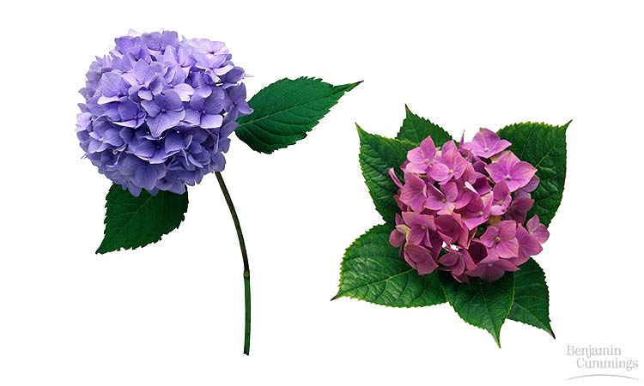
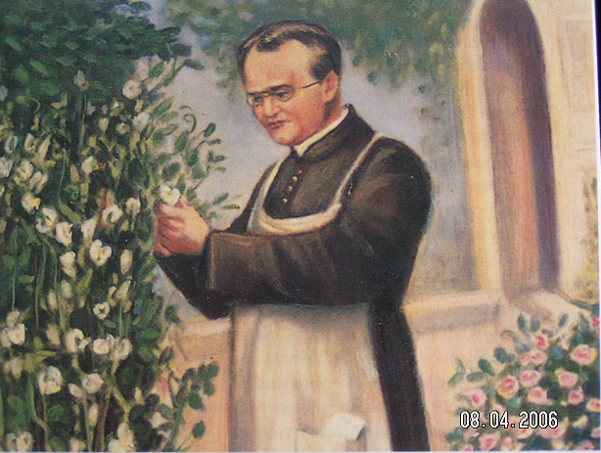
MENDEL AND THE GENE IDEA
Section A: Gregor Mendel’s Discoveries

Slide 4
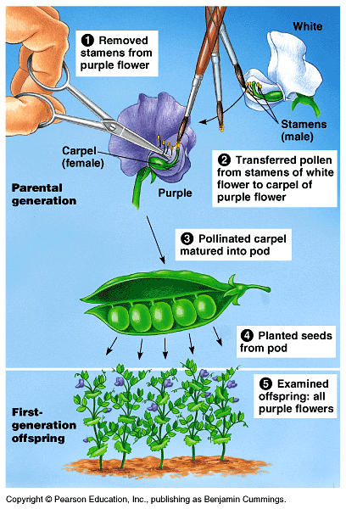
Mendel brought an experimental and quantitative approach to genetics
Around 1857, Mendel began breeding garden peas to study inheritance وراثة. Because they are available in many varieties with distinct heritable مُتوارث characters صفات with different traits (genes).
Each pea plant has male (stamens) and female (carpel) sexual organs.
In nature, pea plants typically
self-fertilize تلقيح ذاتي, fertilizing ova with their own pollens.
However, Mendel could also move pollens حبوب اللقاح from one plant to another to cross-pollinate يُـلقح plants.

Slide 5
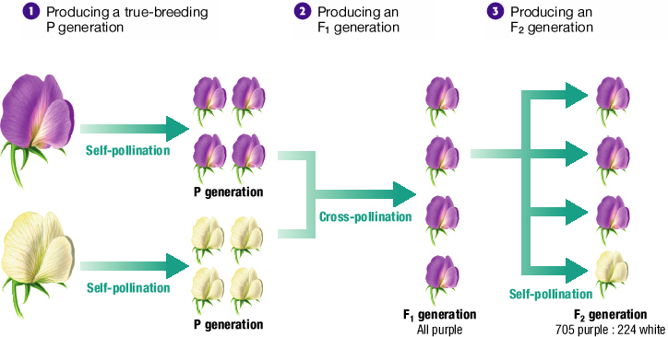
Three Steps of Mendel’s Experiments

Slide 6
Mendel’s Results and Conclusions
Recessive and Dominant Traits
  Mendel concluded that inherited characteristics are controlled by factors that occur in pairs.
  In his experiments on pea plants, one factor in a pair masked the other. The trait that masked the other was called the dominant trait. The trait that was masked was called the recessive trait.

Slide 7
In a breeding experiment, Mendel would cross-pollinate تلقيح خلطي (hybridize هَجن) two contrasting متباينين, true-breeding pea varieties أنواع.
  The true-breeding parents are the P (Parental generation) and their hybrid offspring النسل المُهجن are the F₁ (1st Filial generation) .
Mendel would then allow the F₁ (1st Filial generation) hybrids to self-pollinate to produce an F₂ generation.
It was mainly Mendel’s quantitative analysis تحليل كمي of F₂ plants that revealed the two fundamental laws of heredity:
A)- The law of segregation. B)- The law of independent assortment.

Slide 8
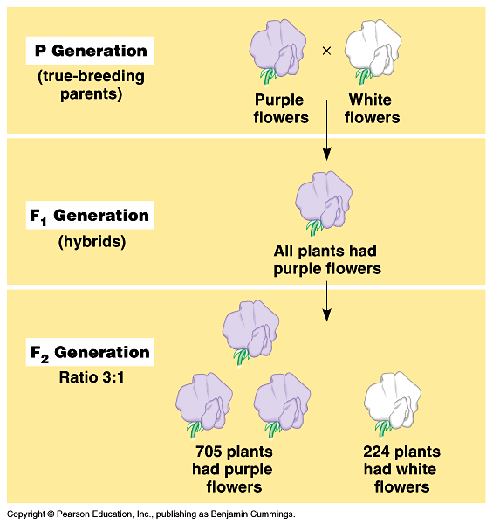
A)- Law of segregation: قانون الإنعزال)) the two alleles ﭽـينات for a character are isolated into separate gametes
Mendel expected that the F₁ hybrids from a cross تلقيح between purple-flowered and white-flowered pea plants would have pale purple flowers بنفسجي باهت.
Instead, ولكن the F₁ hybrids all have purple flowers, just a purple like their parents.
This cross produced a 3 purple to 1 white ratio of traits in the F₂ offspring,
Mendel reasoned that the heritable factor for white flowers was present in the F₁ plants, but it did not affect flower color.
Thus, purple flower is a dominant color (صفة سائدة) and white flower is a recessive color(صفة مُتنحية) .

Slide 9
Mendel found similar 3 : 1 ratios of two traits among F₂ offspring when he conducted crosses for six other characters, each represented by two different varieties صفتين مختلفتين.
For example, when Mendel crossed two true-breeding varieties, one of which produced round seeds بذور مُستديرة, the other of which produced wrinkled seeds بذور مُجَعدة, all the F₁ offspring had round seeds, but among the F₂ plants, 75% of the seeds were round and 25% were wrinkled (see second law in the next lecture).

Slide 10
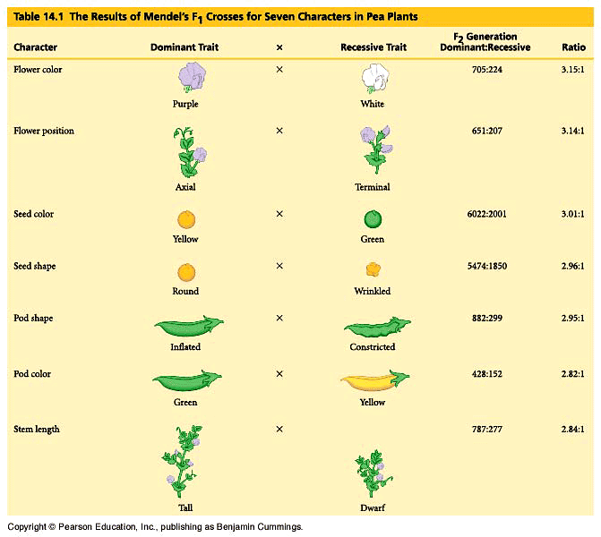

Slide 11
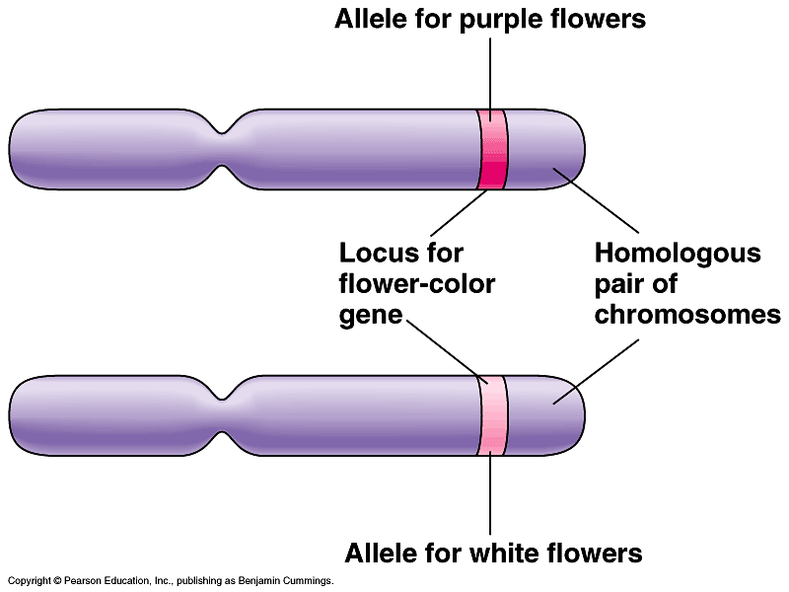
Mendel developed a hypothesis إفتراض to explain these results that consisted of four related ideas.
1. Alternative version of genes (different alleles الـﭽينين المتقابلين) account
for variations in inherited characters.
  Different alleles vary somewhat in the sequence of nucleotides at the specific locus موضع of a gene.
2. For each character, an organism
inherits يرث two alleles, one from
each parent.
  These homologous loci مَوقِعُه على الكروموسوم may differ
  In the flower-color example, the F₁ plants inherited a purple-flower allele from one parent and a white-flower allele from the other.

Slide 12
Mendelian inheritance reflects rules of probability for the behaviour of genes (alleles).
  Alleles segregate تنفصل because of the distribution of homologous chromosomes to different gametes in meiosis.
For each character, an organism inherit two alleles (one from each parent).
Red colour gene (allele)
Homologous chromosomes
White colour gene (allele)
If the two alleles differ, one of them will be Dominant, and the other is Recessive.
The two alleles (genes) for a character are separated (segregated) into separate gametes (summarized as Mendel’s law of segregation) and aggregated again by fertilization.

Slide 13
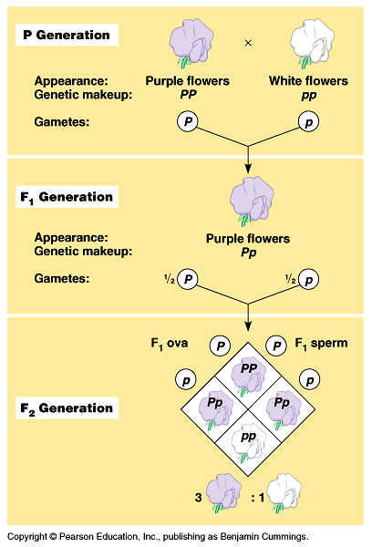
Mendel’s law of segregation accounts for the 3:1 ratio in the F₂ generation.
The F₁ hybrids will produce two classes of gametes, half with the purple-flower allele and half with the white-flower allele.
During self-pollination, the gametes of these two classes unite randomly.
This can produce four equally likely combinations of sperm and ovum.
A Punnett square predicts the results of a genetic cross between individuals of known genotype الطرز الـﭽيني.
A Punnett square analysis of the flower-color example demonstrates Mendel’s model.
Mendel’s model accounts for the 3:1 ratio in the F₂ generation

Slide 14
Pea plant
Pp
Pp
PP
pp
X
X
Heterozygous
Homozygous
P
p
P
p
P
p
Pp
PP
Pp
Pp
pp
Dominant allele
Recessive allele
100% Purple
3 Purple : 1 White
F₁ generation
F₂ generation

Slide 15
Phenotype: Is the organism’s appearance الطرز المظهري.
Phenotype
(Colour)
Genotype: Is the organism’s genetic makeup الطرز الـﭽيني.
PP
متماثل الجينات
PP
Homozygous
pp
An organism having a pair of identical alleles
Genotype
Pp
متباين الجينات
Heterozygous
(Genetic make up)
An organism having a pair of two different alleles

Slide 16
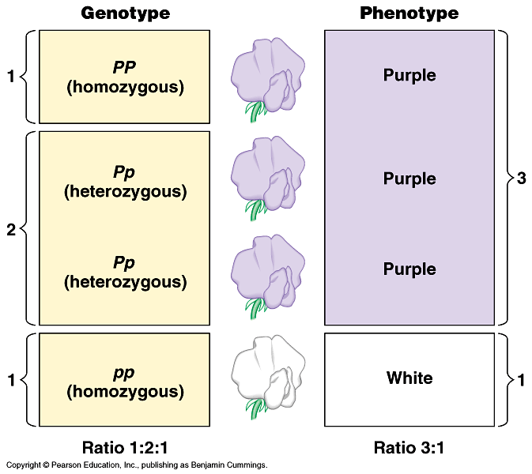
For flower color in peas, both PP and Pp plants have the same phenotype (purple) but different genotypes (homozygous and heterozygous).
The only way to
produce a white
phenotype is to
be homozygous
recessive (pp)
for the flower-
color gene.

Slide 17
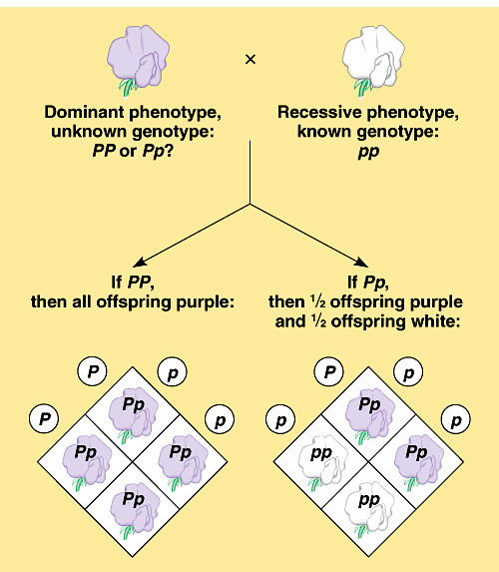
It is not possible to predict the genotype of an organism with a dominant phenotype.
  The organism must have one dominant allele, but it could be homozygous dominant or heterozygous.
Test cross,
is breeding a
homozygous recessive
with dominant phenotype,
but unknown genotype,
can determine the identity
of the unknown allele.
Q: What is the result of Cross hybridization of purple X white colored flowers ?

Slide 18
Definitions
The Law of Segregation: states that the two alleles for a heritable character segregate (separate from each other) during gamete formation and end up in different gametes.
Dominant allele An allele that is fully expressed in the phenotype of a heterozygote.
Recessive allele An allele whose phenotypic effect is not observed in a heterozygote.
Homozygous: Having two identical alleles for a given gene.
Heterozygous: Having two different alleles for a given gene.
Phenotype: The observable physical and physiological traits of an organism, which are determined by its genetic makeup.
Genotype: The genetic makeup, or set of alleles, of an organism..

Slide 19
Reference

Slide 20
Thank you

