Slide 1
Saturated Hydrocarbons Alkanes
Dr. Shatha I Alaqeel
108 Chem

Slide 2
Learning Objectives
Chapter one discusses the following topics and the student by the end of this chapter will:
Know the classification of hydrocarbon
Know general formula of simple alkanes and their names from methane to decane.
Know the different methods of representing molecular formulas
Know the different classes of carbon and hydrogen atoms
know the hybridization and geometry of alkanes
Know the rules for naming branched chain alkanes and how to use them.
Know the physical properties of alkanes and factors affecting them.
Know the different methods used for preparing alkanes
Know the different reaction of alkanes.
Know why are cycloalkanes are special class of hydrocarbons
Know the cis/trans isomerism in cycloalkanes
Know the rules for naming cycloalkanes and how to use them.
know the halogenation reactions of different cycloalkanes.
108 Chem

Slide 3
Hydrocarbons ( C,H)
Saturated
i.e. contain only single bonds
Unsaturated
i.e. contain multiple bonds
(double or triple)
Opened chain
e.g.
Alkanes
Cyclic
e.g. Cycloalkanes
Opened chain
e.g. Alkenes and Alkynes
Cyclic
e.g. Cycloalkenes and Aromatic compouds
108 Chem

Slide 4
Alkanes : C_{n}H_{2n+2}
Carbon | Name | Molecular Formula | Structural Formula
1 | Methane | CH₄ | CH₄
2 | Ethane | C₂H₆ | CH₃CH₃
3 | Propane | C₃H₈ | CH₃CH₂CH₃
4 | Butane | C₄H₁₀ | CH₃CH₂CH₂CH₃
5 | Pentane | C₅H₁₂ | CH₃CH₂CH₂CH₂CH
6 | Hexane | C₆H₁₄ | CH₃(CH₂)₄CH₃
7 | Heptane | C₇H₁₆ | CH₃(CH₂)₅CH₃
8 | Octane | C₈H₁₈ | CH₃(CH₂)₆CH₃
9 | Nonane | C₉H₂₀ | CH₃(CH₂)₇CH₃
10 | Decane | C₁₀H₂₂ | CH₃(CH₂)₈CH₃
108 Chem

Slide 5
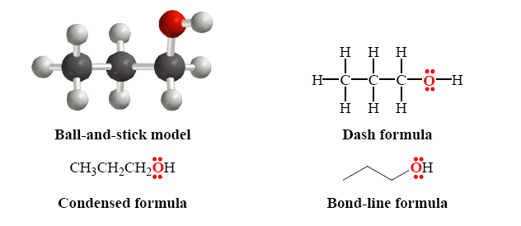
Representation Of Molecular Formulae
108 Chem

Slide 6
Classes Of Carbons and Hydrogens
Primary carbon 1º: CH₃-CH₂-CH₃
Carbon bonded to only one other carbon
Secondary carbon 2º: CH₃-CH₂-CH₃
Carbon bonded to two other carbon
Tertiary carbon 3º : (CH₃)₂-CH-CH₃
Carbon bonded to three other carbon
Hydrogens are also referred to as 1º, 2º or 3º according to the type of carbon they are bonded to.
108 Chem

Slide 7
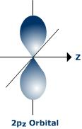
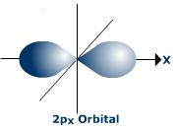
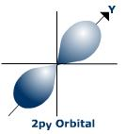
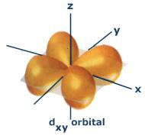
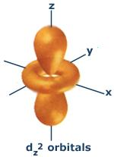
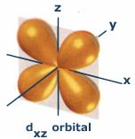
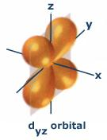
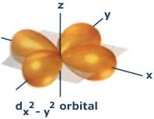
ATOMIC ORBITALS is a specific region in space in which an electron is most like to be found
S-Orbital
P-Orbital
d-Orbital
108 Chem

Slide 8
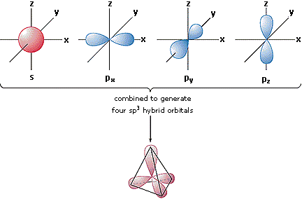
hybridization of carbon in alkane:
In the case of a carbon that has 4 single bonds, all of the orbitals are hybrids
4 Molecular orbital (Sp³)
Each orbital has
25% s, 75% p Character

Slide 9
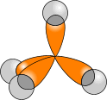
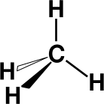
In ALKANES, the four sp³ orbitals of carbon repel each other into a TETRAHEDRAL arrangement with bond angles of 109.5º.
C
Each sp³ orbital in carbon overlaps with the 1s orbital of a hydrogen atom to form a C-H bond.
109.5º

Slide 10
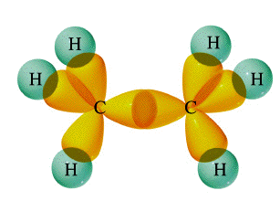
s orbital (hydrogen)
Ethane:
σ bond
109.5º
sp3 hybrids orbital
(carbon)
The length of the band: 1.54 Aº
Angle: 109.5º
108 Chem

Slide 11
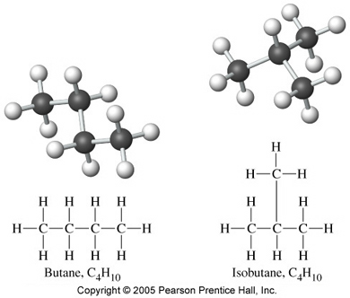
Isomerism
Isomers are different compounds with the same molecular formula
Structural Isomers (Constitutional isomers) are Isomers that differ in their structures .
108 Chem

Slide 12
Geometrical Isomers (Stereoisomers) are compounds with the same covalent arrangement but different arrangement around a carbon-carbon double bond
108 Chem

Slide 13
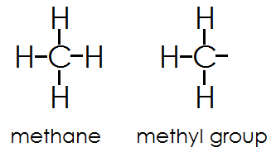
Alkyl groups
Alkyl groups are formed by loss of a hydrogen atom from the corresponding alkane
( e.g. CH₄ Methane – 1 H = -CH₃ Methyl group )
Alkyl groups are named by dropping the -ane suffix of the alkanes and adding the suffix -yl. Methane becomes a methyl group, ethane an ethyl group, etc.
108 Chem

Slide 14
Propyl group C₃H₇ (can give two isomeric alky groups)
Butyl Group C₄H₉
(can give four isomeric alky groups)
108 Chem

Slide 15
IUPAC Nomenclature Of Branched-Chain Alkanes
1- Locate the longest continuous chain of carbon atoms; this chain determines the root name for the alkane.
Sometimes, you may need to go around corners and zigzag to find the longest (parent) chain. (the parent chain is in blue):
If the parent chain for example has 6 carbon atoms, therefore, it is a derivative of hexane and if it has 4 carbon atoms it is derivative of butane and so on .
108 Chem

Slide 16
2- Number the longest chain beginning with the end of the chain nearer to the substituent.
108 Chem

Slide 17
3- Use the numbers obtained by application of rule 2 to designate the location of the substituent group.
In writing the full name the root name is placed last; the substituent group, preceded by the number indicating its location on the chain, is placed first.
108 Chem

Slide 18
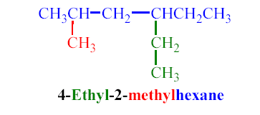
When two or more substituents are present, give each substituent a number corresponding to its location on the longest chain.
The substituent groups are listed alphabetically regardless of their order of occurrence in the molecule. Cl is called chloro, Br called bromo, I called iodo, F called fluoro, NO₂ called nitro, CN called cyano
108 Chem

Slide 19
5- When two or more substituents are identical, indicate this by the use of the prefixes di-, tri-, tetra-, and so on.
In case of deciding alphabetical order of many substituent disregard multiplying prefixes such as “di”and “tri”, “tetra”, “penta”, ….
108 Chem

Slide 20
6- When two substituents are present on the same carbon, use the number twice.
108 Chem

Slide 21
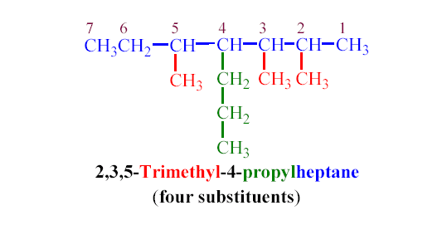
When two chains of equal length compete for selection as the parent chain, choose the chain with the greater number of substituents.
108 Chem

Slide 22
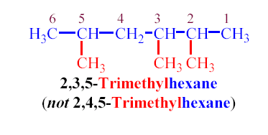
8- When branching occurs at an equal distance from both ends of the longest chain, choose the name that gives the lower number at the first point of difference.
108 Chem

Slide 23
Important Notes
The common names isopropyl, isobutyl, sec-butyl, tert-butyl are approved by the IUPAC for the substituted groups.
Substituent groups are cited in the name in alphabetical order, regardless of their order of occurrence in the molecule. Multiplication prefixes di, tri, ect. and structural prefixes sec., tert. written in italics and separated from the name by a hyphen) are ignored, but prefixes iso and cyclo are not!
Thus “tert-butyl” precedes “ethyl”, but ethyl preceeds “isopropyl”
3-ethyl comes before 2,2-dimethyl
4-hexyl comes before 2,3-diisopropyl
3-Tert-butyl comes before 3-isopropyl
108 Chem

Slide 24
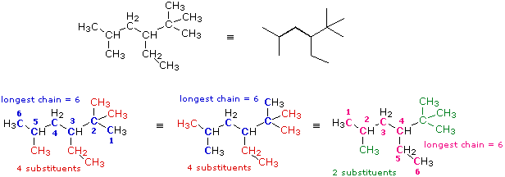
Examples of The IUPAC Rules
Thus the parent chain will be the one with 4 substituents and the correct IUPAc name of this compound is : 3-Ethyl-2,2,5-trimethylhexane
108 Chem

Slide 25
Physical Properties
C1-C4 unbranched alkanes are gases; the C5-C17 unbranched alkanes are liquids; the unbranched alkanes with 18 or more carbon atoms are solids.
Alkanes are non- polar so are immiscible with water , they are soluble in most organic solvents.
Boiling points and Melting points
The boiling points and melting points of alkanes increase with increasing the numbers of carbon atoms and increasing molecular weights.
Branching reduces the boiling point, the more branching leads to lower the boiling point.
108 Chem

Slide 26
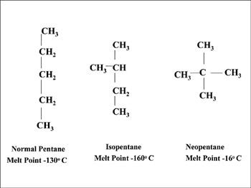
Example
108 Chem

Slide 27
Preparation Of Alkanes
1- Hydrogenation of unsaturated hydrocarbon
2- Hydrolysis of Grignard reagent
108 Chem

Slide 28
3- Reduction of alkyl halides
a) By metal and acid or by metal hydrides
b) By sodium metal (Coupling reaction)(Wurtz reaction)
Symmetrical alkane
c) By lithium dialkyl cuprate (Corey-House (Gilman reagent))
108 Chem

Slide 29
Reactions Of Alkanes
Chemically alkanes are very unreactive and stable at room temperature towards acids , bases and most reactive metals.
Despite their relative inertness ( thus they known as paraffines i.e lacking affinity) , alkanes undergo halogenation reactions.
1. Halogenation:
Halogenation is the replacement of one or more hydrogen atoms in an organic compound by a halogen (fluorine, chlorine, bromine or iodine).
The halogenation of an alkane appears to be a simple free radical substitution reaction in which a C-H bond is broken and a new C-X bond is formed; the reaction takes place in presence of heat or UV light ( no reaction in the dark to form the attacking radicals)
108 Chem

Slide 30
108 Chem

Slide 31
If there is one type of the carbon atoms in the molecule (e.g. methane and ethane)
If there are different types of carbon
In the higher alkanes, replacment of different hydrogn atoms may lead to isomeric products.
The preferred order for the hydrogens to be substituted is 3° then 2° then 1° .
108 Chem

Slide 32
2. combustion of alkanes
Alkanes are oxidized to carbon dioxide and water.
108 Chem

Slide 33
Cycloalkanes
Cycloalkanes are alkanes that have carbon atoms forming rings (called alicyclic compounds).
Simple cycloalkanes have the formula (CH₂)_{n}, or C_{n}H_{2n}
Nomenclature of Unsubstituted Cycloalkanes
1. Cycloalkanes with only one ring:
108 Chem

Slide 34
Naming Substituted Cycloalkanes
Count the number of carbon atoms in the ring and the number in the largest substituent chain. If the number of carbon atoms in the ring is equal to or greater than the number in the substituent, the compound is named as an alkyl-substituted cycloalkane i.e. use the prefix cyclo followed by the suffix indicate the number of carbon atoms.
For an alkyl- or halo-substituted cycloalkane, start at a point of attachment as C₁ and number the substituents on the ring so that the second substituent has as low a number as possible.
Number the substituents and write the name with the substituents in alphabetical order.
108 Chem

Slide 35
If the alkyl substituent is larger and/or complex, the ring is considered as a substituent on alkane chain.
If a functional group (OH. CHO, COOH, CO , NH₂) is attached to the ring a suitable suffix is used to indicate their presence as appear in the following examples.
108 Chem

Slide 36
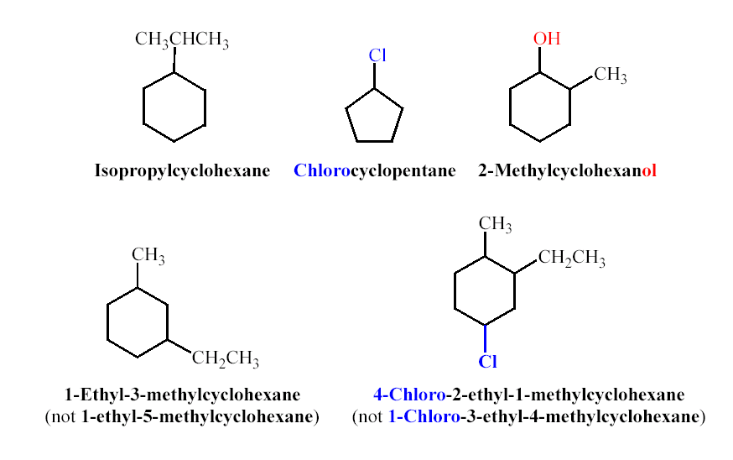
108 Chem

Slide 37
Cis-Trans Isomerism In Cycloalkanes
Rotation about C-C bonds in cycloalkanes is limited by the ring structure.
There are two different 1,2-dimethylcyclopropane isomers, one with the two methyls on the same side (cis) of the ring and one with the methyls on opposite sides (trans).
108 Chem

Slide 38
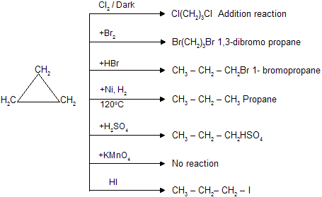
Reactions Of Cycloalkanes
Less stable rings
More stable 5 and 6 rings
108 Chem

Slide 39
Thank You for your kind attention !
Questions
108 Chem

