Slide 1
Lecture Isoflavones

Slide 2
introduction

Slide 3
Sources

Slide 4
Mechanism of Action
Notes:
How do isoflavones work?
In the eighties, scientists discovered the alpha- and beta-receptors for estrogens. Estrogens, like all hormones, act by using receptors located on the cell, which provokes some reaction. The alpha-receptors are linked with a risk of estrogen related cancers. On the other hand, the beta-receptors initiate only favourable effects. The repartition of these two types of receptors in the cells and organs is different. Different tissues appear to have different ratios of each receptor type. This discovery allowed us to understand why isoflavones can act differently than estrogens even though the structure of isoflavones is similar to estrogens.
The isoflavones mechanism
How can we explain that isoflavones have an estrogenic effect and an anti-estrogenic effect? When the natural levels of estrogens are low, isoflavones can help the estrogens by activating the beta-receptors. When the natural levels of estrogen are high, for example during Adolescence , the isoflavones bind with the alpha-receptors and prevent the natural estrogens from binding with these receptors.

Slide 5
Estrogenic and Antiestrogenic Activity

Slide 6
Estrogenic and Antiestrogenic Activity

Slide 7
Breast Cancer

Slide 8
Breast Cancer

Slide 9
Breast Cancer

Slide 10
Prostate Cancer

Slide 12
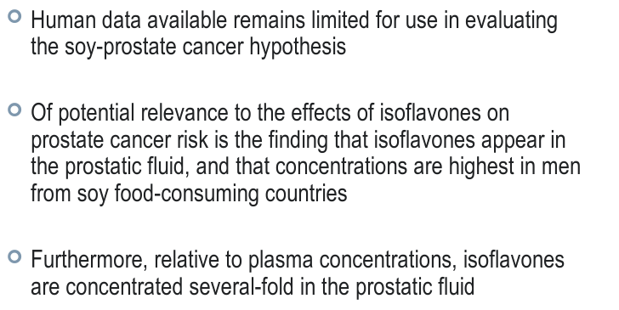

Slide 13
Bone Health

Slide 14
Bone Health

Slide 15
Bone Health

Slide 16
Menupause Symptoms
The benefits of soy go beyond reducing long-term cancer risk.
Recent studies have found that soy isoflavones can reduce menopause symptoms such as hot flushes and increase bone density in women., many
menopausal and post-menopausal health problems may resulIndeedt from a lack of isoflavones in the typical Western diet.
Although study results are not entirely consistent, isoflavones from soy or red clover may be helpful for symptoms of menopause. A study carried out by "Health Test" in 2004 investigated the prescription behaviour of 27 doctors for women with menopause symptoms. It showed that isoflavones were recommended twice (44%) as often as hormonal treatment (22%). The prescribed supplements were mainly based on the following plants: soy, black cohosh and hops.

Slide 17
Reduce heart disease risk
Soy isoflavones also appear to reduce cardiovascular disease risk via several distinct mechanisms.
Isoflavones inhibit the growth of cells that form artery clogging plaque. These arteries usually form blood clots which can lead to a heart attack.
A review of 38 controlled studies on soy and heart disease concluded that soy is definitely effective for improving cholesterol profile. There is some evidence that isoflavones are the active ingredients in soy responsible for improving cholesterol profile.

Slide 18
Isoflavones are natural antioxidants
A recent study has demonstrated that isoflavones have potent antioxidant properties, comparable to that of the well known antioxidant vitamin E.
The antioxidant powers of isoflavones can reduce the long-term risk of cancer by preventing free radical damage to DNA. Genistein is the most potent antioxidant among the soy isoflavones, followed by daidzein.

Slide 19
Issues of Metabolism

Slide 20
Influence of diet on isoflavones metabolism
Your intestinal flora has an effect on the metabolism of isoflavones. When your intestinal flora is low, for example when you take antibiotics, metabolism falls down.
Transformation of daidzein into equol is also strongly influenced by your diet. A high carbohydrate environment, which causes increased intestinal fermentation, results in more equol production.
When dietary intake of fat is high, intestinal flora has difficulty in synthesizing equol from isoflavones.

Slide 21
Issues of Metabolism
Metabolism of isoflavones
Isoflavones occur in foods in the form of water soluble glucosides (daidzein, genistin and glicitin), which means that they are bound to sugar. These glucosides have to undergo further changes before they can become biologically active. They must first undergo hydrolysis by bacterial beta-glucosidases in our intestine, releasing the corresponding bioactive aglycones (daidzein, genistein and glycitein). Aglycones are rapidly and efficiently absorbed by our body, reaching a peak plasma level about 5 hours after consumption. They can be further metabolized to other bioactive metabolites such as equol. This is relevant because the potency of equol is higher than that of daidzein. Only 30�% of the population can convert daidzein into equol and are called equol producers.

