Slide 1
GE105
Introduction to Engineering Design College of Engineering
King Saud University
Lecture 11.
Intellectual Property
Spring 2016

Slide 2
Kinds of Property
Movable Property
Car, Pen, Furniture
Immovable Property
Land, Building
Intellectual Property
Literary works, inventions
Intellectual Property is defined as products of the human intellect that have economic value

Slide 3
Topics of Discussion
Patents
Copyrights
Trademarks
Trade secrets

Slide 4
What is a PATENT?
It is a right granted for an invention (a product or a process) providing a new way of doing something
It enables an inventor to prohibit another person from manufacturing, using or selling the patented product without permission.
Period of Patents span 20 years

Slide 5
What can be patented:
Inventions in all fields of technology, whether products or processes, if they meet the following criteria:
Novelty (originality)
Non-obviousness (inventiveness)
Industrial application (utility)

Slide 6
Who Grants Patents
Patents are granted by national patent offices after publication and substantial examination of the applications
They are valid within the country in which they are granted

Slide 7
What Cannot be Patented
An Invention Which is useless
An Invention contradicting established Natural Laws (e.g., more than 100% performance)*
Scientific Principles, abstract theory, algorithms, or computer programs (outcomes of mental process only)
Discovery of any living thing or non–living substance occurring in nature
Notes:
* Another example: perpetual motion machines

Slide 8
What Cannot be Patented
An invention contrary to public order or morality or which causes risk to human, animal, or the environment
Examples:
Gambling machine
Invention for house-breaking
Biological warfare material
Terminator gene technology

Slide 9
Filing a Patent
Do it invent it build it
Prove it! (Patent search)
Generate documents, file, pay, wait, negotiate
Protect it use it

Slide 10
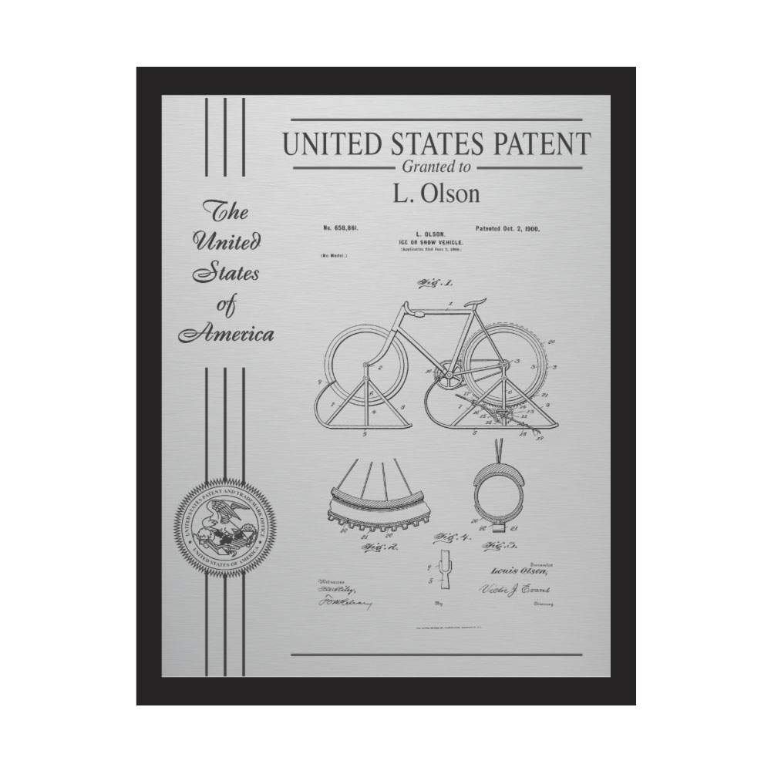
Patent Document
Title
Abstract
Drawings
Background of invention
Summary of invention
Description of drawings
Claims

Slide 11
Copyright
Original Literary, Dramatic, Musical and Artistic Works (Work: Ideas expressed in material form)
Cinematograph Films
Sound Recordings
No copyright in ideas or facts
Duration of Copyright is lifetime of author + 60 years

Slide 12
Copyrights Must:
Have some originality
Have some creativity
Be an expression, not an idea or formula
Be visibly indicated by: “© date, name of owner”

Slide 13
Trade Mark
A name capable of being represented graphically, distinguishing the goods or services of one person from those of others
A Trademark can be:
Sign, words, letters, numbers
Drawings and pictures
Colors or combination of colors
Shape of goods
Graphic representation or packaging

Slide 14
Trade Mark Examples
Coca Cola (soft drink)
Twix (Chocolate)
Facebook (social media)
Apple (computer)

Slide 15
Registration of Trade Mark
Trademarks are registered by national trademark registries and are valid in that country
Registration is made after examination and publication
Period of registration is for 10 years but can be renewed indefinitely

Slide 16
Trade Secrets
Some important information cannot be protected by any of the available means of IP; it is held confidential as a trade secret.
A Trade secret can be an invention, idea, survey method, manufacturing process, experiment results, chemical formula, recipe, financial strategy, client database etc.

Slide 17
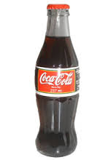
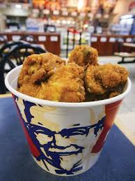
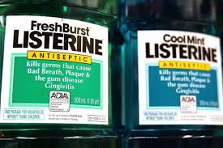
Trade Secret
Anything that gives an advantage and if “stolen” will immediately help the competition (example: COKE®)
It involves non-disclosure agreements
Cannot prevent invention by others
Cannot prevent reverse engineering

Slide 18
When Trade Secrets are preferred?
When the invention is not patentable
Patent protection is limited to 20 years, when a secret can be kept beyond that period
When it is difficult to reverse engineer

Slide 19
How to guard Trade Secret?
Restricting number of people having access to secret information
Signing confidentiality agreements with business partners and employees
Using protective techniques like digital data security tools and restricting entry into area where trade secret is worked or held.

Slide 20
Final Thoughts
Intellectual property is to be respected
Violating the IP is punishable by very strict laws
KSU resources used inside/outside of classwork give KSU IP claim
KSU employees and students agree to IP policy by virtue of employment and enrollment
http://iptl.ksu.edu.sa/

