Slide 1
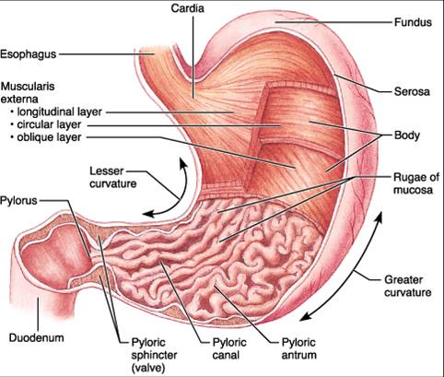
Functions of stomach

Slide 2
Secretions
Production of stomach juice per day – near 2,5 L of juice.
Their main components – enzymes, HCl and mucin.
pH of morning saliva is neutral, after eating – sour – 0,8-1,5.
Optimum pH of its activity is 1,5-2,0.
Pepsinogens whose activity the most in the condition of pH 3,2-3,5 is gastrecsin.
In the stomach, juice produces lipase and gelatinize.
HCl produce in parietal or oxyntic cells. pH of its secrete is near 0,8.
These processes need energy.

Slide 3
Composition of stomach juice and their properties
There are 2 types of glands –
the oxyntic (or gastric)
and the pyloric glands.
The oxyntic glands secrete hydrochloric acid, pepsinogen, intrinsic factor, and mucus.
The pyloric glands secrete mainly mucus. The main cells (peptic or chief cells) produce non active enzymes (pepsinogens).
There are 7 pepsinogens. They hydrolyzed proteins.

Slide 4
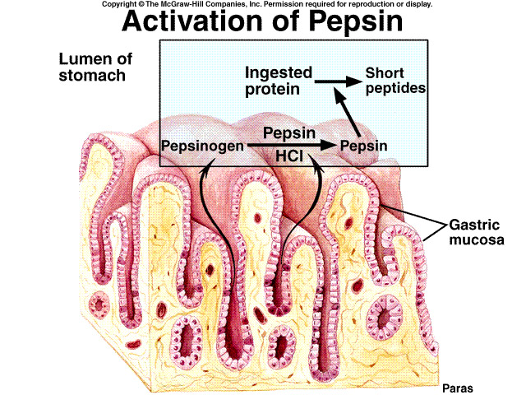

Slide 5
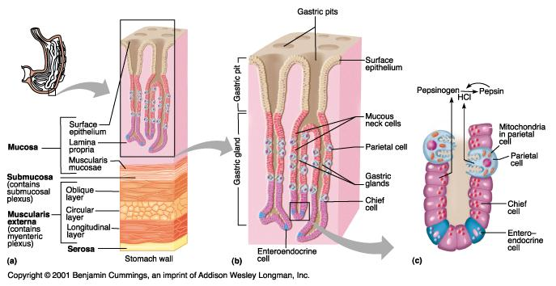

Slide 6
Formation of hydrochloric acid
Mechanism of its production: Cl⁻ actively transported in the canaliculi, Na⁺ – from the canal into cytoplasm. H₂O dissociated to H⁺ and OH⁻. H⁺ actively go into canaliculi in change of K⁺. In these processes take place Na⁺,K⁺-ATPase. CO₂, which produce in cells act with H+ and syntheses HCO⁻. This anion go into the cell in change by Cl⁻.
stomach
Parietal cell
blood
metabolism
carboanhydrase
se

Slide 7
Role of the hydrochloric acid in the digestion
1. To promote the swell of protein;
2. To promote the change of pepsinogen in pepsins;
3. To make optimal conditions for actions of pepsins;
4. To fulfill protective role from bacteria;
5. To promote motor and evacuated functions of stomach;
6. To stimulate production of duodinum gormon – secretin.

Slide 8
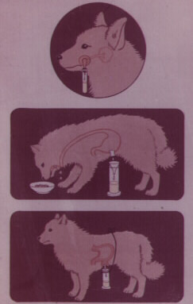
Phases of stomach secretion
Cephalic Phase Smell, See, Thinking
Stomach phase is depends on the quantity of food, which are present in stomach. It has vago-vagal reflexes (by mean of central nerves system) and local – peripheral reflexes, which are closed in stomach walls. Duration of these phase is longer and quantity of juice is much. It has humoral mechanisms too (production of gastrin and histamin.
Intestine phase: presence of food in the upper portion of small intestine can cause the stomach to secrete small amount of gastric juice. This probably results of gastrin are also released by the duodenal mucosa in response to distension or chemical stimuli of the same type as those that stimulate the stomach gastrin mechanism.

