Slide 1



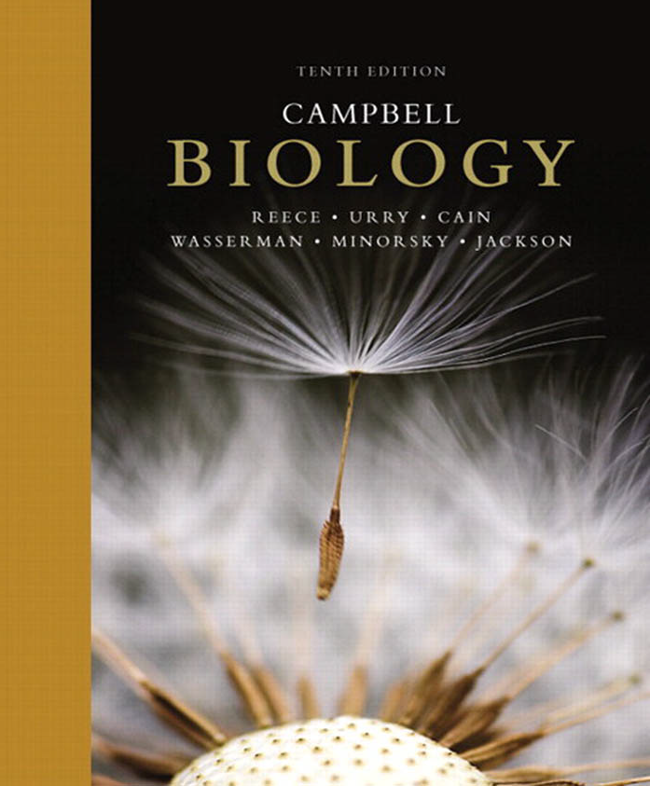
College of Science,
Zoology Department

Slide 2
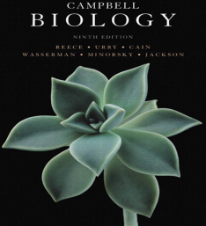


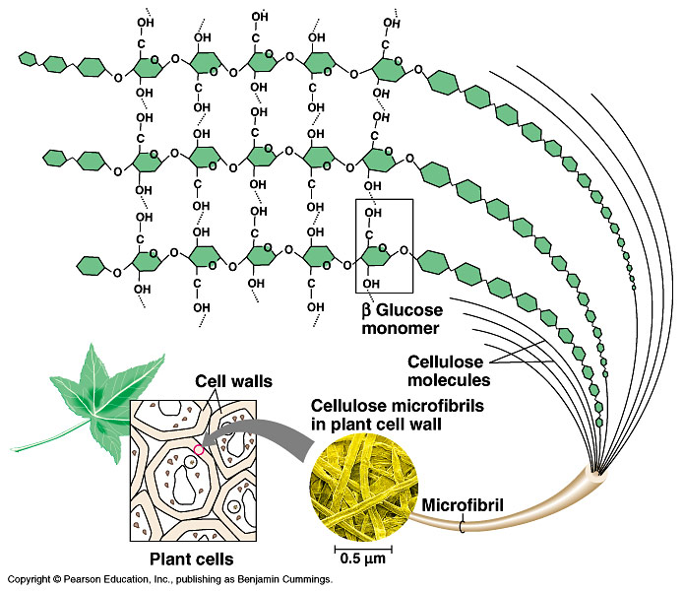
THE STRUCTURE AND FUNCTION OF MACROMOLECULES
Polymer principles
And
Macromolecules
Copyright © 2002 Pearson Education, Inc., publishing as Benjamin Cummings

Slide 3
Objectives
Polymers principles: The synthesis and breakdown of polymers.
A)- Carbohydrates
  Monosaccharides
    (Classifications of Monosaccharides: Types and examples).
  Disaccharides
  Polysaccharides: Types and examples
    A)- Storage Polysaccharides.
    B)- Structural Polysaccharides

Slide 4
Polymers principles
Cells join تربط smaller organic molecules (Monomers) together to form larger molecules (macromolecules) (Polymers), which may be composed of thousands of molecules.
Macromolecules are organic molecules that weigh more than 100,000 daltons (ATOMIC MASS UNIT).
The four major classes of macromolecules are:
- Carbohydrates,
- Lipids,
- Proteins,
- Nucleic acids (will be studied later: lectures 19 & 20 and 21)

Slide 5
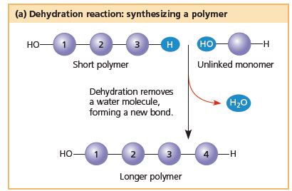
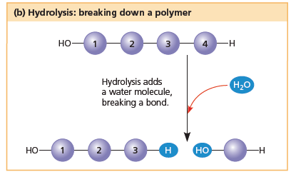
Polymers principles
Monomers are connected by covalent bonds through a dehydration reaction تفاعل نزع الماء.
  One monomer provides a hydroxyl group and the other provides a hydrogen to form water.
  This process requires energy and is aided by enzymes.
The covalent bonds connecting monomers in a polymer can be disassembled
تـُكسَــر by hydration (hydrolysis) reaction تفاعل إضافة الماء.
  In hydrolysis as the covalent bond is broken, a hydrogen atom and a hydroxyl group from a split water molecule attaches where the covalent bond used to be.
  Hydrolysis reactions dominate the digestive process, guided by specific enzymes.
5

Slide 6
Polymers principles
(Carbohydrates, Lipids, Proteins and nucleic acids)
Mono-mer
Di-mer
Poly-mer
أحادي
ثنائي
عديد
A Polymer: is a long molecule consists of a chain of similar building molecules (monomers) covalently bonded together.

Slide 7
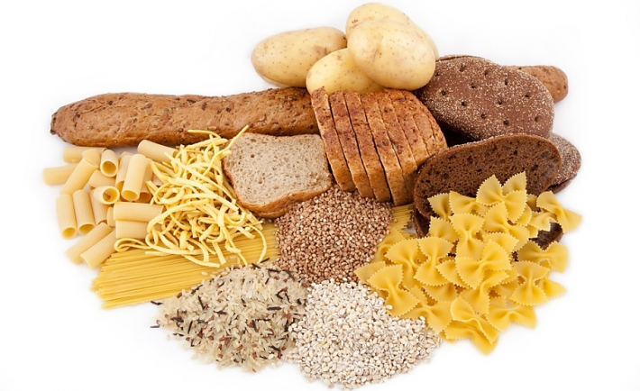
A. Carbohydrates
Notes:
7

Slide 8
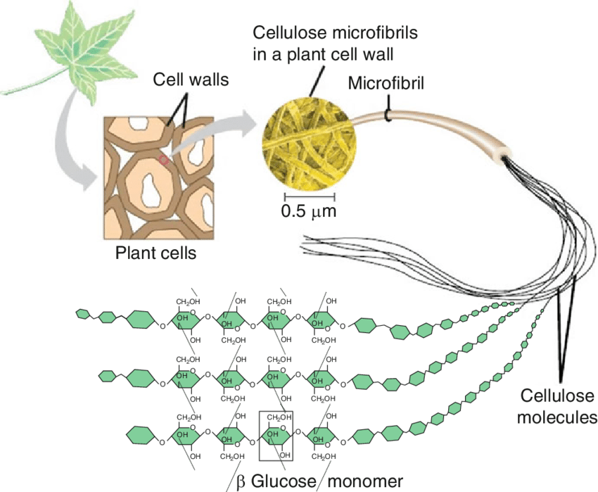
A. Carbohydrates
Notes:
8

Slide 9
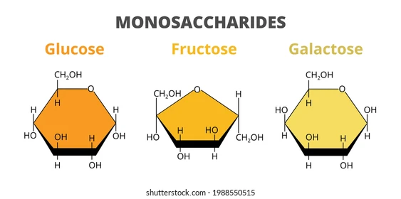
A. Carbohydrates
Sugars, Carbo = carbon, hydrate = water; Used as an immediate energy source.
  The molecular formula is C_{n}H_{2n}O_{n} means that, carbon, hydrogen and oxygen are found in the ratio = 1:2:1
  Monosaccharides:
  are the simplest form of carbohydrates (simple sugars). contain a single sugar molecule.
Notes:
9

Slide 10
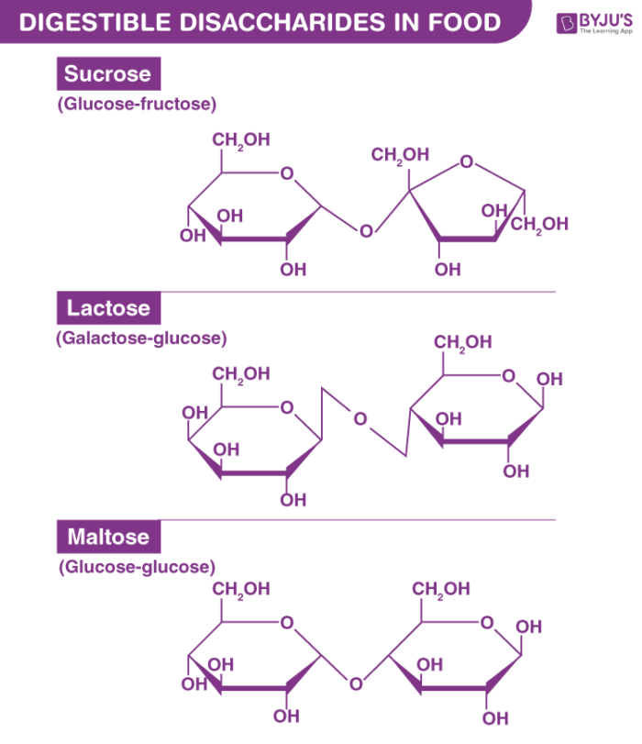
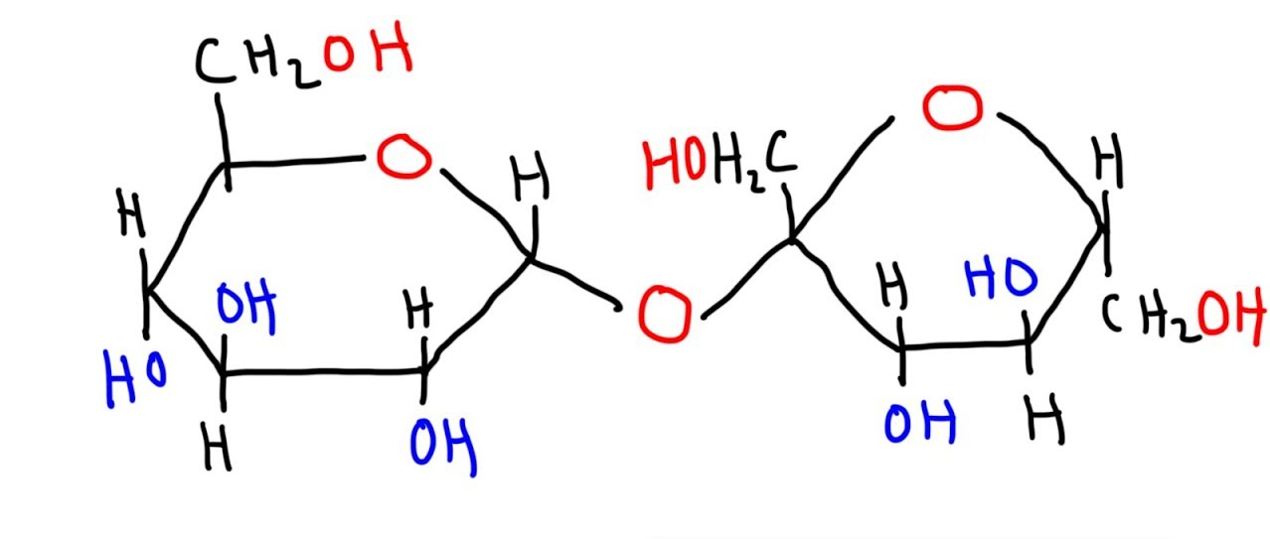
A. Carbohydrates
  Disaccharides:
  contain two (2) monosaccharides joined via dehydration synthesis
Notes:
10

Slide 11

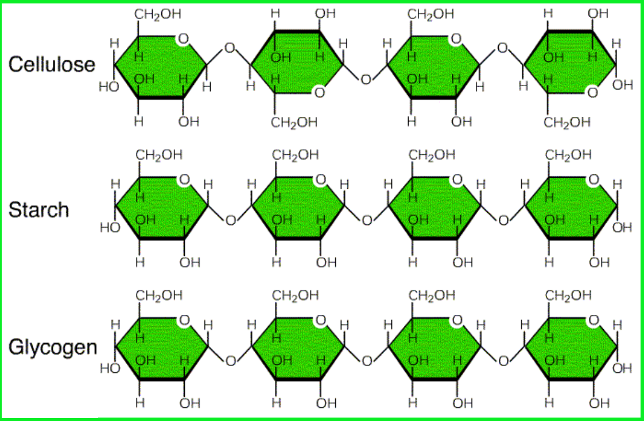
A. Carbohydrates
  Polysaccharides:
  are polymers of many monosaccharides.
Notes:
11

Slide 12

1- Monosaccharides السكر الأحادي
Aldehyde sugars
Aldose
Aldose
H
O
H
O
C
C
Glucose
Galactose
C₆H₁₂O₆
H
C
OH
H
C
OH
C₆H₁₂O₆
OH
C
H
OH
C
H
H
C
OH
OH
C
H
Asymmetric C
Asymmetric C
H
C
OH
H
C
OH
H
C
OH
H
C
OH
H
H
An OH group is attached to each carbon except one, which is double bonded to an oxygen (carbonyl).

Slide 13
Fructose
Triose Sugar
Pentose Sugar
Hexose Sugar
C₆H₁₂O₆
H
H
OH
C
H
O
Ketone sugar
H
O
C
Ketose
C
C
O
H
C
OH
C
C
OH
H
H
OH
H
C
OH
H
C
OH
H
C
OH
H
C
OH
H
H
C
OH
Glyceraldehyde
H
C
OH
H
C
OH
H
Ribose
H

Slide 14
Classification of monosaccharides
A- Based on the location of the carbonyl group, C=O
Aldoses: are the monosaccharides with the carbonyl group (C=O) at the end of Carbon chain (e.g. Glucose).
Ketoses: are the monosaccharides with the C=O carbonyl group within داخل the Carbon chain (e.g. Fructose).
B- Based on the number of C in the skeleton
Triose (3C): e.g.Glyceraldehyde.
Pentose (5C): e.g. Ribose.
Hexose (6C): e.g. Glucose, Fructose and Galactose.

Slide 15
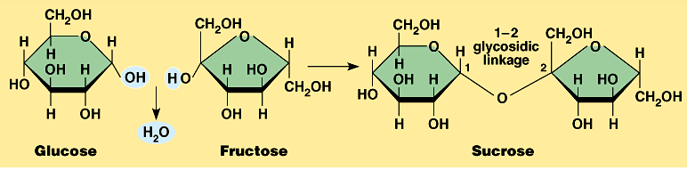
2- Disaccharides السكر الثنائي
Consist of 2 monosaccharide molecules joined during a dehydration reaction تفاعل نزع الماء.
Sucrose (table sugar): consists of Glucose + Fructose.
The covalent bond formed between Glucose & Fructose is called “glycosidic linkage”.

Slide 16
3- Polysaccharides السكر العديد
They consist of few hundreds to few thousands of monosaccharides joined by a dehydration reaction.
These are of two types:
1- Storage تخزينية. Provide sugar for cell by hydrolysis إضافة ماء.
2- Structural تركيبية. Serve as building materials for the organism.

Slide 17
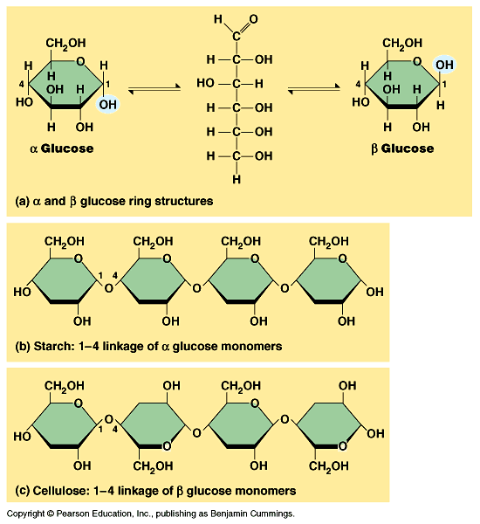
I- Starch (Source is plants) النشا
A)- Storage تخزينية Polysaccharides
A storage polysaccharide of plants (within plastids).
It consists of thousands of α glucose molecules.
Thus, it gives glucose when hydrolysed بإضافة الماء by special enzymes in humans. .
Potatoes and grains are the major sources of starch.

Slide 18
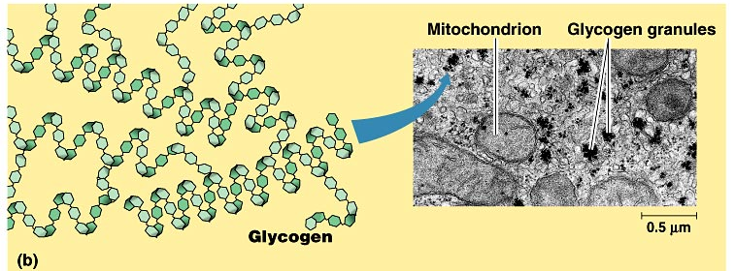
II- Glycogen (in animals) الجليكوﭽـين
Storage Polysaccharides
Stored in animal cells (e.g. liver and muscle cells in Human).
It is consisted of thousands of glucose molecules.
Thus, it gives glucose when hydrolysed.

Slide 19
I- Cellulose
B)- Structural تركيبية Polysaccharides
It is the building material of plant cell wall.
Forms the micro-fibrils and cell wall in plants.
It is consisted of thousands of β glucose molecules.
Humans cannot digest it, but some bacteria and protozoa can (e.g. in Termites and Cows stomach).

Slide 20
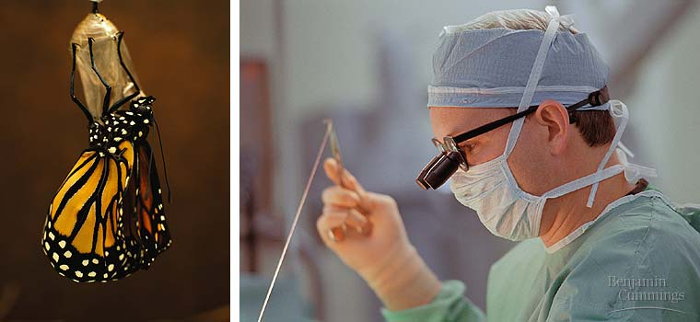
Structural Polysaccharides
II- Chitin الكيتين
It is the building material of the cuticle الجُـلَيد in insects.
It is consisted of thousands of glucose molecules with a N atom at one end.
It is used to manufacture the surgical threads.

Slide 21
Carbohydrates
No. of sugar molecules
Monosaccharides
Disaccharides
Polysaccharides
(Glucose)
(Sucrose)
Storage
Structural
Starch (in plants) & Glycogen (in animals)
Cellulose (in plants)
& Chitin (in insects)
No. of C atoms
Location of Carbonyl Group
Triose (3C)
Glyceraldehyde
Pentose (5C)
Ribose
Hexose (6C)
Glucose
Aldose
Ketose
C=O on top
C=O within chain

Slide 22

College of Science,
Zoology Department
General Animal Biology
(Zoo-109)
Zoology Department

