Slide 1
GE105
Introduction to Engineering Design College of Engineering
King Saud University
Lecture 3.
The Engineering Profession
FALL 2016

Slide 2
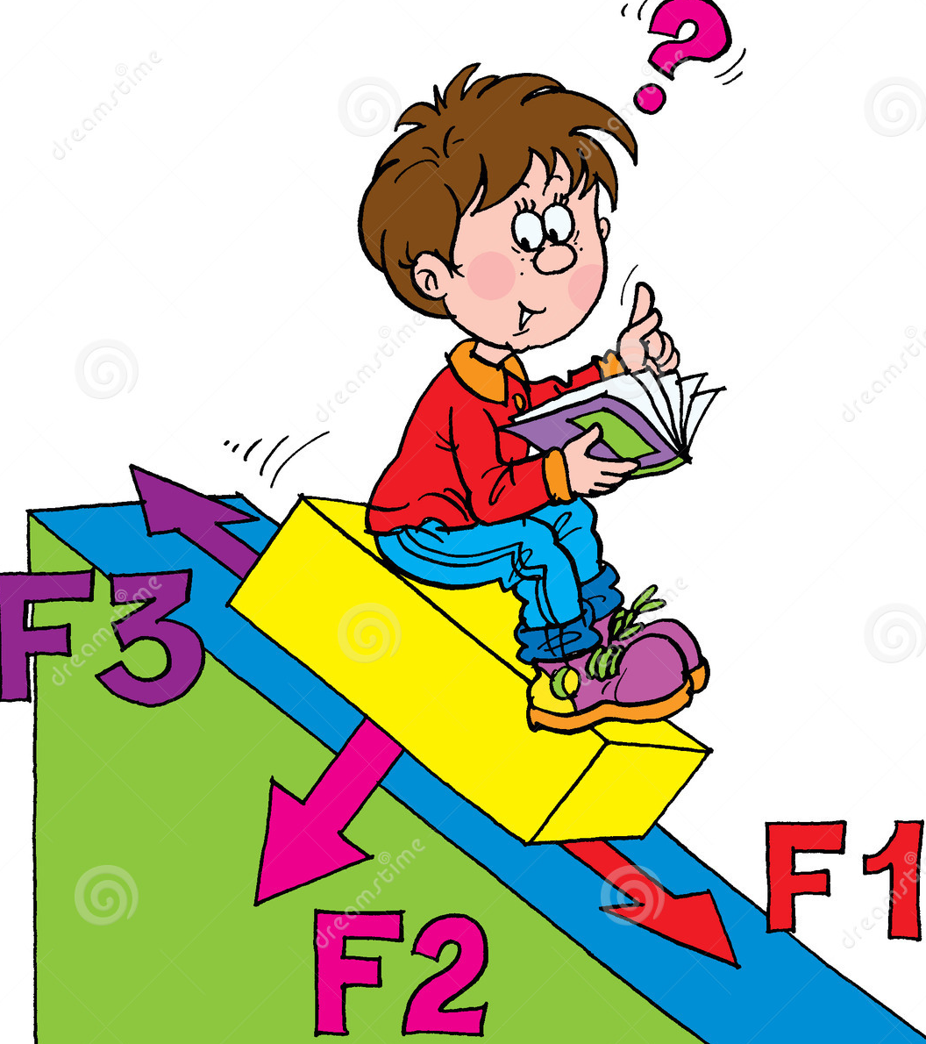
Scientists Versus Engineers
Scientist
Engineer
Applies knowledge of math and the physical sciences to the efficient design and construction of usable devices, structures and processes.
The primary goal is the expansion of knowledge and understanding physical processes.

Slide 3
What is a Profession?
Requires specialized and highly skilled knowledge
Requires an academic training
Regulated by professional bodies
Examination of competence
Vital to society
Compensation is higher than other occupations
Enforces high standard of legal and ethical conduct

Slide 4
Is Engineering a Profession?
Engineering possesses those attributes that typically characterize a profession
Satisfies an indispensable and beneficial need
Requires the exercise of carefulness and judgment
Involves activities that require knowledge and skill not commonly possessed by the general public
Has group consciousness for the promotion of knowledge and professional ideas and for rendering social services
Has a legal status and requires well-formulated standards of admission

Slide 5
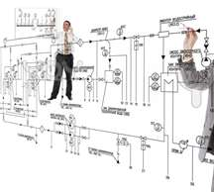
The Engineering Profession
Engineering is a career based on logical, systematic problem solving, generally in high-tech, industrial, or scientific fields.
Whether the end result is a product, a process, a system or service, engineers need to consider safety, reliability, and cost-effectiveness.

Slide 6
What Engineers Do?
Design products
Design machinery to build and test these products
Design Plants in which those products are made
Design the systems that ensure the quality and efficiency of the manufacturing process
Design, plan and supervise the construction of buildings, highways, transit systems.
Develop and implement ways to extract, process and use raw materials such as petroleum and natural gas
Exploit resources to satisfy the nations needs

Slide 7
Elements of Professionalism
Competence
Integrity
Responsibility and Accountability
Public Obligation

Slide 8
Elements of Professionalism (contn’d)
1 Competence
Relevant, up-to-date knowledge and capabilities in a given area
Appropriate non-technical competences: communication, business, leadership and management skills
A broader foundation of relevant experience and understanding
Relevant qualifications
Continuing Professional Development

Slide 9
Elements of Professionalism (contn’d)
2 Integrity
A clear commitment to abide by a code of ethics which is recognized and administered by the professional community.
Notes:
قواعد للسلوكيات / قواعد أخلاقية

Slide 10
Elements of Professionalism (contn’d)
3 Responsibility and Accountability
A set of personal obligations and responsibilities which sit alongside the contractual obligation to an employer or client.
A matching accountability which is also separate from that of an employer.

Slide 11
Elements of Professionalism (contn’d)
4 Public Obligation
Regard for and contribution to the public good
Protect the public interests
Social responsibility
Commitment and contribution to the professional community

Slide 12
Engineering Departments
CE
Construction
Structural
Transportation
Geotech.
Environmental
ME
Fluid
Dynamics
Thermo-
dynamics
Mechanical
Design
Mechatronics
Industrial
Petroleum
Aerospace
Nuclear
Mechatronics
Bio-Engineering
Ch. E
Biochemical
Polymers
Plastics
Food
Processing
EE
Power
Generation
Communication
Control
Electronics

