Slide 1
net301
lecture9

Slide 2
Dynamic mac protocol: contention protocol
Carrier Sense Multiple Access (CSMA):
A protocol in which a node verifies the absence of other traffic before transmitting on a shared transmission medium.
Transmitter uses feedback from a receiver to determine whether another transmission is in progress before initiating a transmission. That is, it tries to detect the presence of a carrier wave from another station before attempting to transmit.

Slide 3
Dynamic mac protocol: contention protocol
Carrier sense, if busy wait for a random period.
When carrier is idle, encapsulate data into a packets, then send it through the transmission channel.
Reads what in channel.
Check integrity of packet, if packet sent similar to received, transmission successes.
Otherwise, collision occurs, wait for random period then repeat the transmission again.
Less collisions occur than ALOHA, due to carrier sense before transmitting data

Slide 4
Dynamic mac protocol: contention protocol
Better use of CSMA achieved with better carrier sense.
Carrier sense may be difficult when network channel is long.
CSMA is not effective with long network channel .
Slotted CSMA: dividing time to slots, sense only when starting time of the slot.

Slide 6
Dynamic mac protocol: contention protocol
Non CSMA persistent:
In this protocol, before sending the data, the station senses the channel and if the channel is idle it starts transmitting the data. But if the channel is busy, the station does not continuously sense it but instead of that it waits for random amount of time and repeats the algorithm.
Persistent CSMA
When the sender (station) is ready to transmit data, it checks if the transmission medium is busy. If so, it then senses the medium continually until it becomes idle, and then it transmits the message (packet).

Slide 7
Dynamic mac protocol: contention protocol
P-persistent CSMA:
When the sender is ready to send data, it checks continually if the medium is busy. If the medium becomes idle, the sender transmits a frame with a probability p. If the station chooses not to transmit (the probability of this event is 1-p), the sender waits until the next available time slot and transmits again with the same probability p.

Slide 8
Dynamic mac protocol: contention protocol
Advantages:
Less collisions probabilities compared to ALOHA.
Transmission on demand only.
Disadvantages:
Unknown delay when more nodes are connected.
Collisions still occur.
Network with heavy traffic may not benefit with CSMA.

Slide 9
Dynamic mac protocol: contention protocol

Slide 10
Dynamic mac protocol: contention protocol
Carrier Sense Multiple Access\collision Detection (CSMA\CD):
It uses a carrier sensing scheme in which a transmitting data station detects other signals while transmitting a frame, and stops transmitting that frame, transmits a jam signal, and then waits for a random time interval before trying to resend the frame.
When collision detection: it sends Jamming Signal to tell other stations that collision has occurred.
CSMA/CD is used to improve CSMA performance by terminating transmission as soon as a collision is detected

Slide 11
Dynamic mac protocol: contention protocol
Main procedure:
Is my frame ready for transmission? If yes, it goes on to the next point.
Is medium idle? If not, wait until it becomes ready
Start transmitting.
Did a collision occur? If so, go to collision detected procedure.
Reset retransmission counters and end frame transmission.

Slide 12
Dynamic mac protocol: contention protocol
Collision detected procedure:
Continue transmission (with a jam signal instead of frame header/data/CRC) until minimum packet time is reached to ensure that all receivers detect the collision.
Increment retransmission counter.
Was the maximum number of transmission attempts reached? If so, abort transmission.
Calculate and wait random back off period based on number of collisions.
Re-enter main procedure at stage 1.

Slide 13
Dynamic mac protocol: contention protocol
Advantages:
Less collision occurred compared to CSMA.
Transmission on demand.
Disadvantages:
Unknown delay when more nodes are connected.
Wasted time exits due to collisions, but better performance and wasted time compare to CSMA.
Used mostly in IEEE LANs, and called Ethernet Protocol; developed by Xerox.

Slide 15
Dynamic mac protocol: contention protocol CSMA\CA
Carrier Sense Multiple Access\Collision Avoidance CSMA\CA
Each station will sense the channel and inform all the rest station in the network that it will start transmitting data over the channel.
In this protocol the collision may occur between Request To Send RTS frames or Confirm to Send CTS frames. Collisions don’t occur between data frames.

Slide 18
Dynamic mac protocol: contention protocol CSMA\CA
Advantages:
Collisions do NOT occur between data frames.
Transmission on demand only.
Channel utilization is efficient when request and confirm to send done successfully.
Used mostly and better for Wireless networks.
Disadvantages:
Unlimited waste of time (waiting) if nodes connected are large.
Used in Wireless LANs and Apple Talk for apple devices.

Slide 19
Contention protocol advantages and disadvantages:
Contention protocol advantages and disadvantages:
Advantages:
Transmission on demand.
Better used for discontinuous transmission of signal and data (computer networks in general)
Better used in networks with light traffic.
Disadvantages:
Large number of connected nodes results in not utilizing the channel effectively.
Wasted time (waiting)
Sensing channels becomes difficult in large and long network channels

Slide 20
Dynamic mac protocol: Reservation protocols:
To better channel utilizing and eliminate attenuation may occur in network channels due to collisions;
Distributed Queue Dual Bus (DQDB):
This protocol is intended to be used on a dual-bus configuration (unidirectional) fiber optic networks.
Two buses , each one in one direction, and each node is connected to the two buses.
Centralized unit for each bus to control transmission.

Slide 21
Dynamic mac protocol: Reservation protocols: DQDB

Slide 22
Dynamic mac protocol: Reservation protocols: DQDB
Each centralized unit will send empty frames to the channel, which can be used by connected nodes to transmit data.
Each frame has 2 flags; one to identify whether the frame is empty and ready for used or has been reserved by another node.
The other flag identifies if there is a Reservation request of frames on the other channel (bus).
This protocol needed 2 counters in each connected node, that determine the number previous reservations for each channel, the counters will be incremented each time a frame with reservation flag on passes the connected node.

Slide 23
Dynamic mac protocol: Reservation protocols: DQDB
When a node wants to send data to another node:
Chooses which channel will be used.
Turn on the reservation flag on a frame on the other channel.
The node will then use one of the empty frames with its data.
This protocol is used in Ring networks, LAN and MAN networks.

Slide 25
Dynamic mac protocol: Reservation protocols: DQDB
Advantages:
Transmission guaranteed.
Limit delay time.
Channel utilization %100
Disadvantages:
Number of software needed for each connected node to control and determine the location of the node in the network.
The need for centralized unit to control frames.
If the centralized unit stopped, the protocol is stopped.

Slide 26
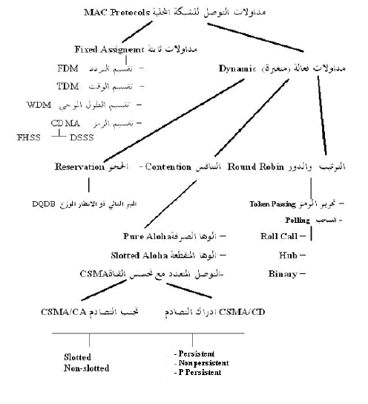

Slide 27
LAN MAC protocols
Dynamic MAC protocols
Round robin protocols:
Token pass
Polling
Roll-call Polling
Hub-polling
Binary Tree Polling
Contention protocols
Pure Aloha Multiple Access
Slotted Aloha Multiple Access
Carrier Sense Multiple Access (CSMA)
Carrier Sense Multiple Access/ Collision Detection (CSMA/CD)
Carrier Sense Multiple Access/ Collision Avoidance (CSMA/CA)
Reservation protocols
Non CSMA persistent
Persistent CSMA
P_Persistent CSMA
Distributed Queue Dual Bus (DQDB

