Slide 1

Introduction to GUI in
Graphical User Interface
2

Slide 2
Creating a JFrame
a JFrame class have the following component:
JFrame(); JFrame(string Title);
setTitle(String title );
setSize(int Wedth , int length);
setVisible(boolean var);
setLocation (FRAME_X_ORIGIN, FRAME_Y_ORIGIN)

Slide 3
Creating a JFrame
a JFrame class have the following component:
setResizable(boolean var);
setDefaultCloseOperation(JFrame. ????????);
  EXIT_ON_CLOSE
  DO_NOTHING_ON_CLOSE

Slide 4

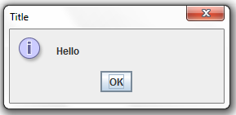
  showMessageeDialog
General syntax
JOptionPane.showMessageDialog(ParentComponent, message string, box title , msseg type);
Example:
JOptionPane.showMessageDialog(null,"Hello","Title", JOptionPane.INFORMATION_MESSAGE);
Example:
JOptionPane.showMessageDialog(null,"Hello");

Slide 5
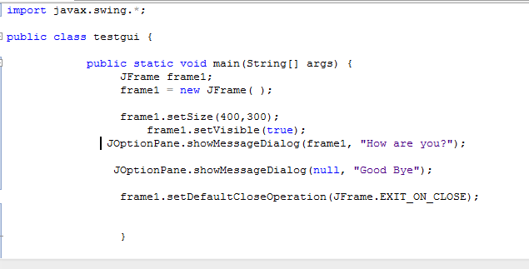
  Example

Slide 6
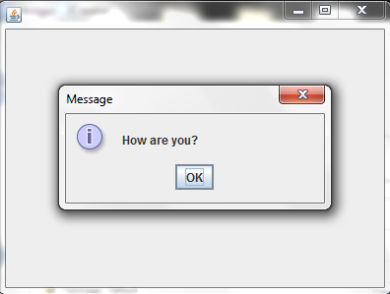
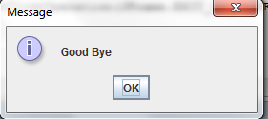
  Example
After Pressing OK or closing the “How are you?” dialog, the “Good Bye” dialog appears

Slide 7
Subclassing JFrame
To create a customized frame window, we define a subclass of the JFrame class.
class TESTGUI extends JFrame {
Public TESTGUI () // constructor
{// necessary code
//set the frame default properties} }
WRITE A CODE TO DO THE FOLLOWING :
An instance of TESTGUI will have the following default characteristics:
  The title is set to My First Subclass.
  The program terminates when the close box is clicked.
  The size of the frame is 300 pixels wide by 200 pixels high.
  The frame is positioned at screen coordinate (150, 250).

Slide 8
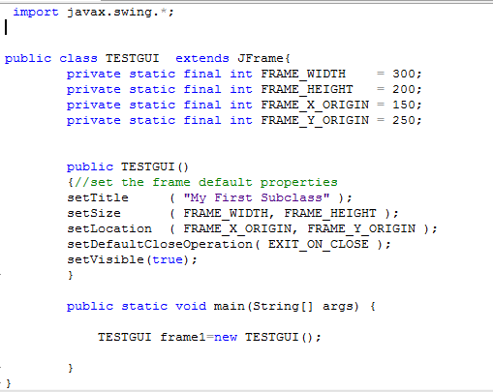

Slide 9
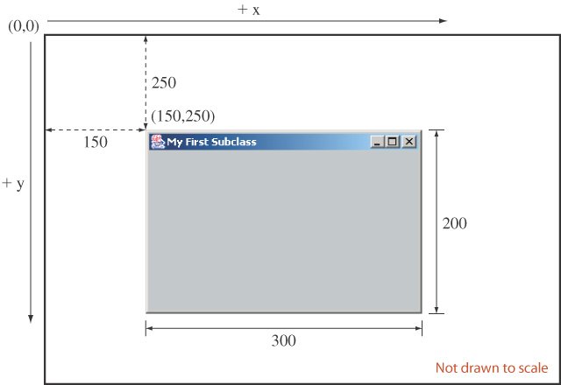
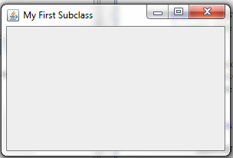
This gray area is the content pane of this frame.
The content pane is where we put GUI objects such as buttons, labels, scroll bars, and others.
We access the content pane by calling the frame’s getContentPane method in class Container.

Slide 10
Frame’s content pane
The Class Container is contained in the package
Java.awt.
import java.awt.*;
//IN CONSTRUCTOR
Container contentPane = getContentPane();
contentPane methods:
setBackground(Color.BLUE);
add(Object_name);
setLayout( layout_type);

Slide 11
Placing GUI Objects on a Frame
There are two ways to put GUI objects on the content pane of a frame:
  Use a layout manager (using setLayout()method)
    FlowLayout
    BorderLayout
    GridLayout
  Use absolute positioning
    null layout manager

Slide 12
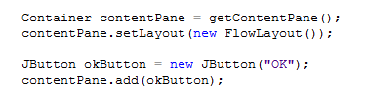
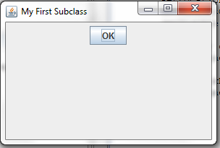
Buttons
Example of Using FlowLayout to places button on the frame (in the top-to-bottom, left-to right order)
Methods :
addActioLesitener(actioLesitener obj);

Slide 13
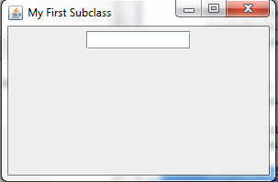

Text Field
A JTextField object allows the user to enter a single line of text.
JTextField(int columns ); JTextField();
setColumns(int col);
getText(); //return the text contained in text field
setEditable(boolen var); // if the value of var is false
the user can’t type in the text field
addActioLesitener(actioLesitener obj); // register
a listener object to the text field

Slide 14
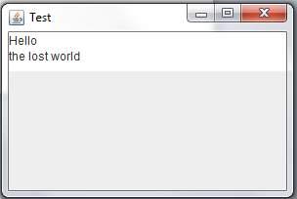
JTextArea
JTextArea textArea = new JTextArea( );
. . .
textArea.setText("Hello\n");
textArea.append("the lost ");
textArea.append("world");
textArea.setColumns(int col);
textArea.setRows(int row);
textArea. setEditable(boolen var);

Slide 15
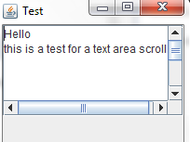
JTextArea
By default a JTextArea does not have any scroll bars. To add scroll bars, we place a JTextArea in a JScrollPane object

Slide 16

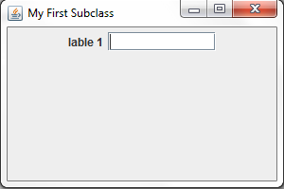
Lable
A JLabel object displays uneditable text (or image).
JLabel imgLabel = new JLabel(new ImageIcon("cat.gif"));

Slide 17
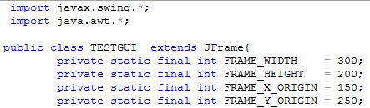
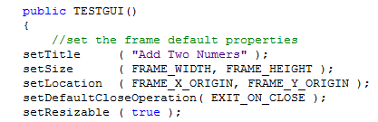
Example: adding two numbers program

Slide 18
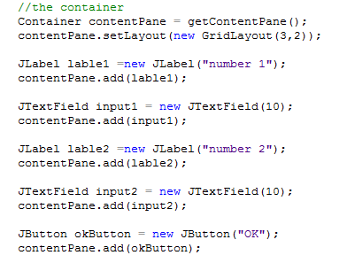

Slide 19
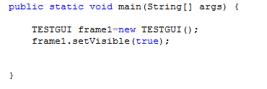
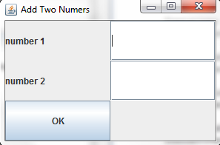
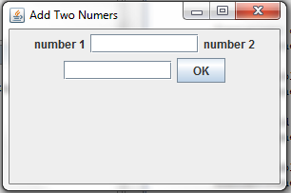
Example: adding two numbers program
FlowLayout()
GridLayout(3,2)

Slide 20
event handling
We have learned how to create a window ,container ,label, buttons and text fields
Now we should specify
In button how such a button behave when we click it?
In text field An action event is generated when the user presses the ENTER key.

Slide 21
event handling
clicking a button create an event known as action event, which sends a message to another object known as action listener , when he receives the message he perform soma actions( execute a method).
The mechanism to process events is called event handling.

Slide 22
event handling
you must do two things :
You must define the method that will be invoked when the event is sent to the listener
for each object (button or text field )you must specify the corresponding listener object (this known as registration).

Slide 23
action event
The action event is handled by the class ActionListener witch contain only one codless method actionPerformed.
The class ActionListener is a spiceal ype of a class called interface
Public interface ActionListener{
Public void actionPerformed(ActionEvent e );
}

Slide 24
action event
We can’t instantiate an object from interface so we build a class on top of it
Private class Buttonhandler implement ActionListener {
Public void actionPerformed(ActionEvent e ){
// write what should button do
}
}

Slide 25

2. specify the corresponding listener object

Slide 26
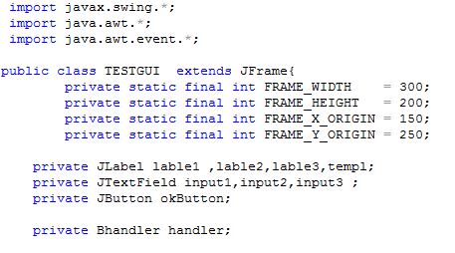
Example: adding two numbers program cont.

Slide 27
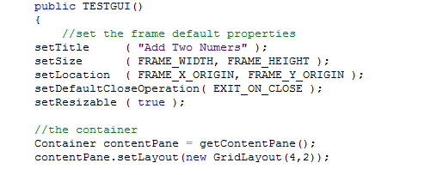

Slide 28
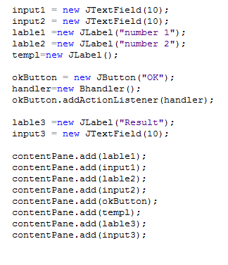

Slide 29
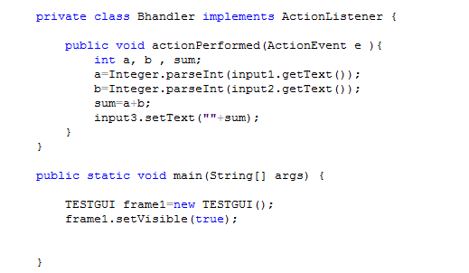

Slide 30
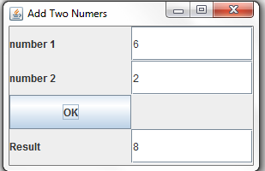

Slide 31
Container as Event Listener
Instead of defining a separate event listener such as ButtonHandler, it is much more common to have an object that contains the event sources be a listener.
  Example: We make the frame a listener of the action events of the buttons it contains.

Slide 32

The changes to the previous program are
Remove class Bhandler and all its objects and
just keep the actionPerformed method

Slide 33

JTextField events
If we want to respond to both button clicking and pressing ENTER event in TextField
1- We should register a listener to both of them

Slide 34
public void actionPerformed(ActionEvent event) {
if (event.getSource() instanceof JButton) {
//button code
}
else {
//TextFiled code
}
}

Slide 35
What if there is two buttons?
public void actionPerformed(ActionEvent event) {
JButton clickedButton = (JButton) event.getSource();
if (clickedButton == button1) {}
Else {}

