Slide 1

Introduction to GUI in
Graphical User Interface

Slide 2
Graphical User Interface
Java is equipped with many powerful ,easy to use GUI component such as input and output dialog boxes that you can use them to make your program attractive and user friendly
GUI-based programs are implemented by using classes from the javax.swing and java.awt packages.

Slide 3
Using Dialog Boxes for Input/Output
JOptionPane this class is contained in the package javax.swing
We will use two methods of this class :
  showInputDialog
  showMessageeDialog

Slide 4

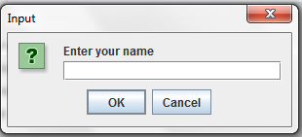
  ShowInputDialog
General syntax
Str= JOptionPane.showInputDialog(stringexpression);
This method returns the input as a String value
Example:
str=JOptionPane.showInputDialog("Enter your name ");

Slide 5
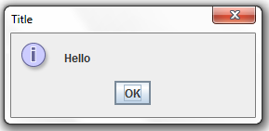
  showMessageeDialog
General syntax
JOptionPane.showMessageDialog(ParentComponent, message string, box title , msseg type);
Example:
JOptionPane.showMessageDialog(null,"Hello","Title", JOptionPane.INFORMATION_MESSAGE);

Slide 6
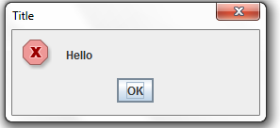
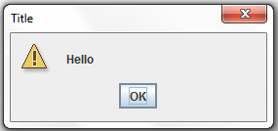
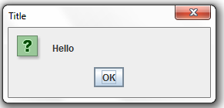
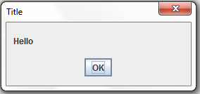
  Messagee Type
JOptionPane.showMessageDialog(null,"Hello","Title", JOptionPane. ????????????);
INFORMATION_MESSAGE
ERROR_MESSAGE
WARNING_MESSAGE
QUESTION_MESSAGE
PLAIN_MESSAGE

Slide 7
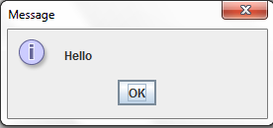
  Short form showMessageeDialog
General syntax
JOptionPane.showMessageDialog
(ParentComponent, message string);
Example:
JOptionPane.showMessageDialog(null,"Hello");

Slide 8
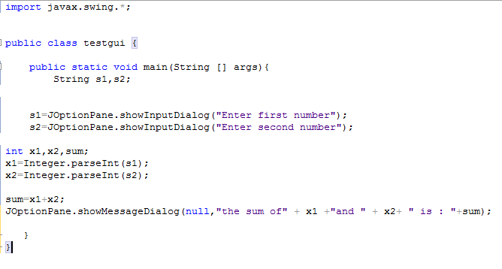
Example for adding two numbers

Slide 9
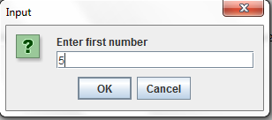
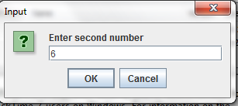
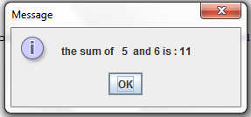

Slide 10
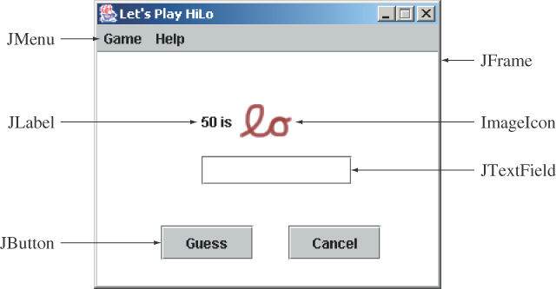
Sample GUI Object Window

Slide 11
Creating a JFrame
a JFrame class have the following component:
JFrame(); JFrame(string Title);
setTitle(String title );
setSize(int Wedth , int length);
setVisible(boolean var);
setLocation (FRAME_X_ORIGIN, FRAME_Y_ORIGIN)

Slide 12
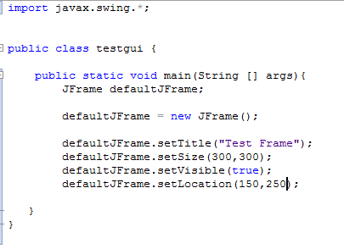
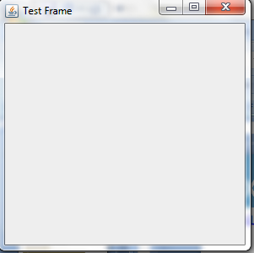
Example

