Slide 1
Polymorphism
CT1513

Slide 2
Introduction to polymorphism

Slide 3
Static Binding Vs. Dynamic Binding
Binding means associating a method definition with its invocation
Polymorphism that is resolved during compiler time is known as static polymorphism. Method overloading is an example of compile time polymorphism. Method Overloading: This allows us to have more than one method having the same name, if the parameters of methods are different in number, sequence and data types of parameters.
It can be also called early binding
Dynamic polymorphism is a process in which a call to an overridden method is resolved at runtime, thats why it is called runtime polymorphism.
It can be also late binding .

Slide 4
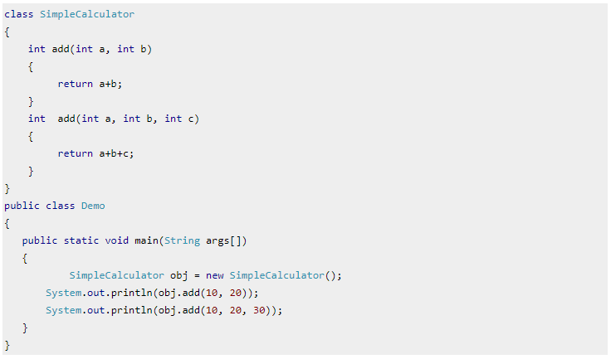
Example of static binding

Slide 5
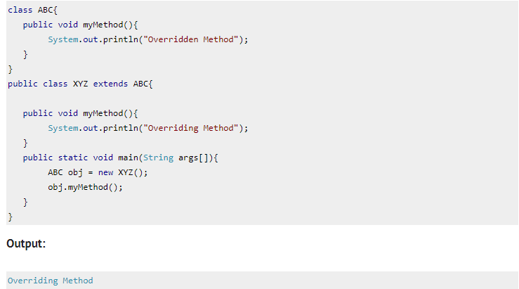
Example of dynamic binding

Slide 8
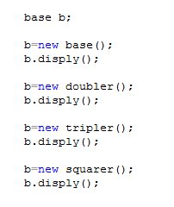
100
200
300
1000

Slide 9
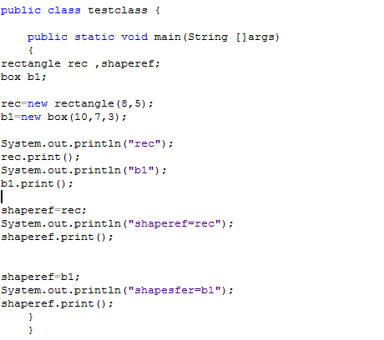
In same rectangle – box example

Slide 10
