Slide 1
Inheritance
CT1513

Slide 2
Introduction
Inheritance
  Software reusability
  Create new class from existing class
    Absorb existing class’s data and behaviors
    Enhance with new capabilities
  Subclass extends superclass
    Subclass
      More specialized group of objects
      Behaviors inherited from superclass
        Can customize
      Additional behaviors

Slide 3
Introduction (Cont.)
Class hierarchy
  Direct superclass
    Inherited explicitly (one level up hierarchy)
  Indirect superclass
    Inherited two or more levels up hierarchy
  Single inheritance
    Inherits from one superclass
  Multiple inheritance
    Inherits from multiple superclasses
      Java does not support multiple inheritance

Slide 4
Superclasses and subclasses
Superclasses and subclasses
  Object of one class “is an” object of another class
    Example: mustang is car.
      Class mustang inherits from class car
      car: superclass
      mustang : subclass
  Superclass typically represents larger set of objects than subclasses
    Example:
      superclass: Vehicle
        Cars, trucks, boats, bicycles, …
      subclass: Car
        Smaller, more-specific subset of vehicles

Slide 5
Examples

Slide 6
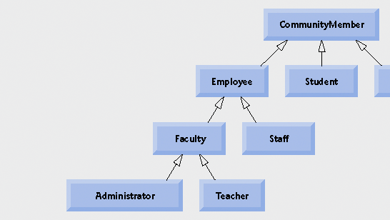
Fig. 9.2 | Inheritance hierarchy for university CommunityMembers

Slide 7
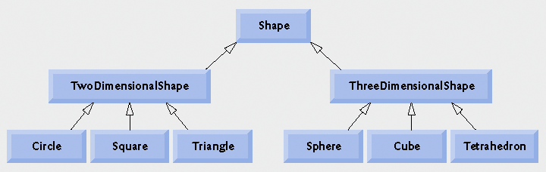
Fig. 9.3 | Inheritance hierarchy for Shapes.

Slide 8
Modifiers in inheritance
Protected (#) makes a data member or method visible and accessible to the instances of the class and the descendant classes (subclasses).
Public (+) data members and methods are accessible to everyone.
Private(-) data members and methods are accessible only to instances of the class.

Slide 9
The derived class inherits all the members and methods that are declared as public or protected. If the members or methods of super class are declared as private then the derived class cannot use them directly. The private members can be accessed only in its own class. Such private members can only be accessed using public or protected getter and setter methods of super class as shown in the example below.

Slide 10
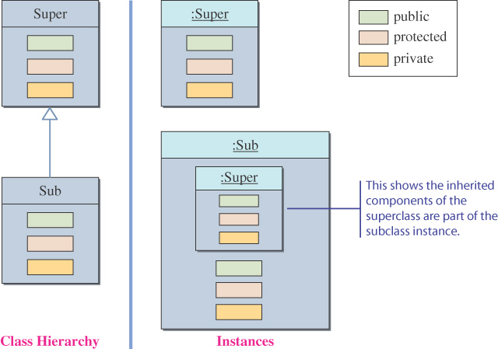
Inheritance and Member Accessibility
We use the following visual representation of inheritance to illustrate data member accessibility.

Slide 11
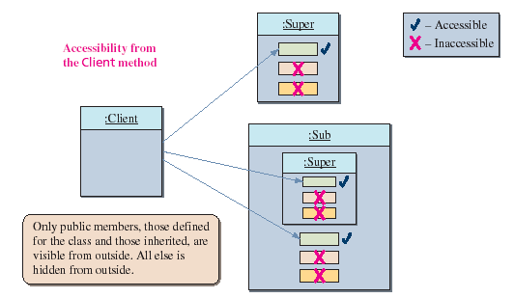

The Effect of Three Visibility Modifiers

Slide 12
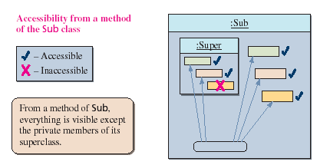
Accessibility of Super from Sub
Everything except the private members of the Super class is visible from a method of the Sub class.

Slide 13
Accessibility from Unrelated Class
class Super {
public int pub_Super_Field;
protected int pro_Super_Field;
private int pri_Super_Field;
public Super () {
pub_Super_Field = 10;
pro_Super_Field = 20;
pri_Super_Field = 30;
}
}
class Sub extends Super {
public int pub_Sub_Field;
protected int pro_Sub_Field;
private int pri_Sub_Field;
public Sub () {
pub_Sub_Field = 100;
pro_Sub_Field = 200;
pri_Sub_Field = 300;
}
}
class Client {
public void main (String [] args) {
Super mySuper = new Super();
Sub mySub = new Sub();
int i = mySuper.pub_Super_Field;
int j = mySub.pub_Super_Field; // inherited
int k = mySub.pub_Sub_Field;
}
}
:Super

VALID
:Sub
:Client

Slide 14
Accessibility from Unrelated Class
class Super {
public int pub_Super_Field;
protected int pro_Super_Field;
private int pri_Super_Field;
public Super() {
pub_Super_Field = 10;
pro_Super_Field = 20;
pri_Super_Field = 30;
}
}
class Sub extends Super {
public int pub_Sub_Field;
protected int pro_Sub_Field;
private int pri_Sub_Field;
public Sub() {
pub_Sub_Field = 100;
pro_Sub_Field = 200;
pri_Sub_Field = 300;
}
}
class Client {
public void main (String [] args) {
Super mySuper = new Super();
Sub mySub = new Sub();
int l = mySuper.pri_Super_Field;
int m = mySub.pri_Sub_Field;
int n = mySub.pri_Super_Field;
}
}
:Super

NOT VALID
:Sub
:Client

Slide 15
Accessibility from Unrelated Class
class Super {
public int pub_Super_Field;
protected int pro_Super_Field;
private int pri_Super_Field;
public Super() {
pub_Super_Field = 10;
pro_Super_Field = 20;
pri_Super_Field = 30;
}
}
class Sub extends Super {
public int pub_Sub_Field;
protected int pro_Sub_Field;
private int pri_Sub_Field;
public Sub() {
pub_Sub_Field = 100;
pro_Sub_Field = 200;
pri_Sub_Field = 300;
}
}
class Client {
public void main (String [] args) {
Super mySuper = new Super();
Sub mySub = new Sub();
int o = mySuper.pro_Super_Field;
int p = mySub.pro_Sub_Field;
int q = mySub.pro_Super_Field;
}
}
:Super

NOT VALID
:Sub
:Client

Slide 16
Accessibility of Super from Super
class Super {
public void superToSuper(Super anotherSuper) {
int i = anotherSuper.pub_Super_Field;
int j = anotherSuper.pro_Super_Field;
int k = anotherSuper.pri_Super_Field;
}
}

VALID
anotherSuper
:Super
:Super

Slide 17
Accessibility of Sub from Sub
class Sub extends Super {
public void subToSub(Sub anotherSub) {
int i = anotherSub.pub_Sub_Field;
int j = anotherSub.pro_Sub_Field;
int k = anotherSub.pri_Sub_Field;
int l = anotherSub.pub_Super_Field; //inherited
int m = anotherSub.pro_Super_Field;
int n = anotherSub.pri_Super_Field;
}
}

VALID

VALID

NOT VALID
anotherSub
:Sub
:Sub

Slide 18
Accessibility of Sub from Super
class Super {
public void superToSub(Sub sub) {
int i = sub.pub_Sub_Field;
int j = sub.pro_Sub_Field;
int k = sub.pri_Sub_Field;
}
}

VALID

NOT VALID
sub
:Super
:Sub

Slide 19
Accessibility of Super from Sub
class Sub extends Super {
public void subToSuper(Super mySuper) {
int i = mySuper.pub_Super_Field;
int j = mySuper.pro_Super_Field;
int k = mySuper.pri_Super_Field;
}
}

VALID

NOT VALID
mySuper
:Sub
:Super

Slide 20
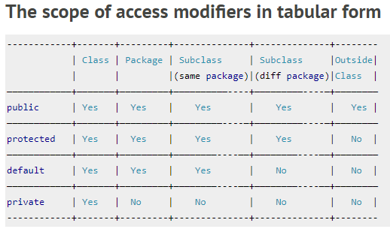

Slide 21
Inheritance and Constructors
Unlike members of a superclass, constructors of a superclass are not inherited by its subclasses!!
You must define a constructor for a class or use the default constructor added by the compiler.
A subclass uses a constructor from the base class to initialize all the data inherited from the base class

Slide 22
Inheritance and Constructors
In order to invoke a constructor from the base class, it uses a special syntax:
public class SubClass extends SuperClass
{
public SubClass(………….)
{
super (………);
}
**the call of the super constructor must be the first statement.
Note : if you do not include statement super().
The default constructor of super will be called if any or there will be an error

Slide 23
Inheritance and Method Overriding
When we declare the same method in child class which is already present in the parent class the this is called method overriding. In this case when we call the method from child class object, the child class version of the method is called. However we can call the parent class method using super keyword as I have shown in the example below:

Slide 24
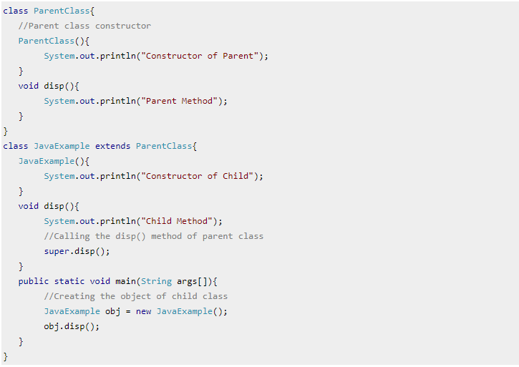
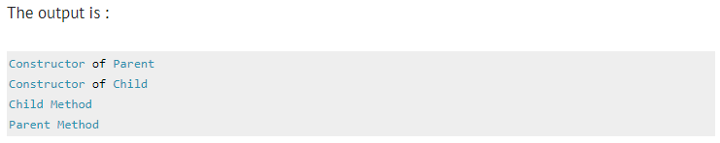

Slide 25
Using super methods
In subclass you can override (or redefine) a method That is already existed in super class.
If there is no override you can call a public method of a superclass by its name and appropriate parameter list.
If the sub override the super method you should call it by using the reserved key word super.methodsName()

Slide 26
Defining Classes with Inheritance
Case Study 1:
  Suppose we want implement a class Employee which has two attributes, id and name, and some basic get- and set- methods for the attributes.
  We want now define a PartTimeEmployee class; this class will inherit these attributes and methods, but can also have attributes (hourlyPay) and methods of its own (calculateWeeklyPay).

Slide 27
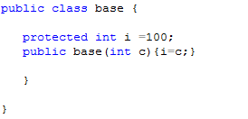
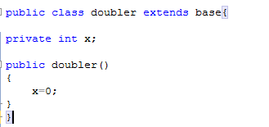
Not valid
No call | super();

Slide 28
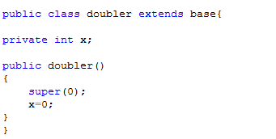
valid

Slide 29
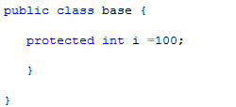
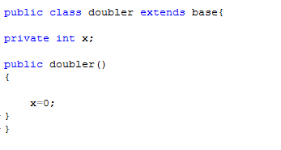
valid

Slide 30
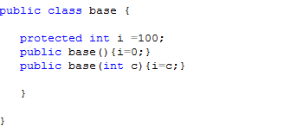
valid

Slide 31
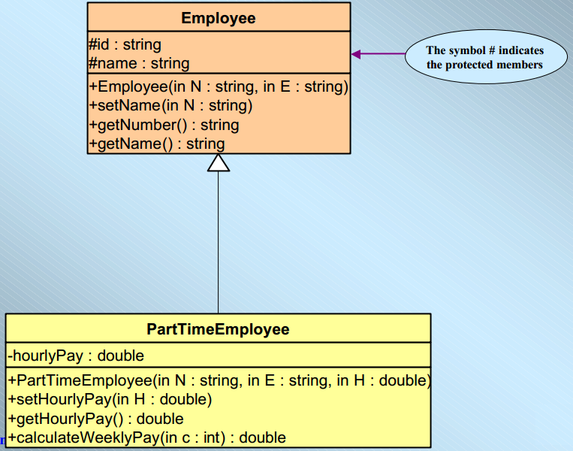
Defining Classes with Inheritance-Protected Modifier

Slide 32
Implementation of the case study
public class Employee
{
protected String number;
protected String name;
public Employee (String N, String E)
{
number = N;
name = E;
}
public String getNumber() { return number;}
public String getName(){return Name;}
public void setName(String N)
{name=new String(N);}
public void setNumber(String N)
{number=new String(N);}
}//end class

Slide 33
Implementation of the case study
public double calculateWeeklyPay(int c)
{
return hourlyPay * c;
}
} // end class
public class PartTimeEmployee extends Employee
{
private double hourlyPay;
public PartTimeEmployee(String N,String E,double H)
{
super(N,E);
hourlyPay=H;
}
public void setHourlyPay(double H)
{hourlyPay=H;}
public double getHourlyPay(){return hourlyPay;}
}

Slide 34
Implementation of the case study
import java.util.Scanner;
public class PartTimeEmployeeTest {
public static void main(String[] args)
{
Scanner input = new Scanner(System.in);
String number, name;
double pay;
int hours;
PartTimeEmployee emp;
// get the details from the user
System.out.print (“Employee Number?”);
number = input.next();
System.out.print (“Employee Name?”);
name = input.next();
}
i
System.out.print ( “Hourly pay?” );
pay = input.nextDouble();
System.out.print ( “Hours worked this week?”);
hours = input.nextInt();
// create a new part-time employee
emp = new PartTimeEmployee (number, name, pay);
//display employee’s details, including the weekly pay
System.out.println();
System.out.println(emp.getName());
System.out.println(emp.getNumber());
System.out.println(emp.calculateWeeklyPay(hours));
}

Slide 35
public class rectangle {
private double length;
private double width;
//defoult constructor
public rectangle() {length=width=0; }
public rectangle( double w , double l){ setdimension(w,l); }
public void setdimension( double w, double l){width=w; length=l; }
public double getw(){return width;}
public double getl(){return length;}
public double area(){ return width*length;}
public void print()
{System.out.println("length =" + length+"width = " + width );}
}

Slide 36
Create class called box inherits from rectangle having the following:
Private height ,, ge_height()
Default constructor and copy constructor to set
Setdimension();
Area();//2*L*W + L * H +W* H
Print();

Slide 37
