Slide 1
Classes and Objects

Slide 2
Object vs. Class
A class could be considered as a set of objects having the same characteristics and behavior.
An object is an instance of a class.

Slide 3
Declaring a Class with Java
ClassName
att₁: dataType₁
…
att_{i}: dataType_{i}
Attributes
+ m₁(…): dataType₁
+ ...
+ m_{j}(…): dataType_{j}
Methods (Services)
public class ClassName {
// Attributes
// Methods (services)
}

Slide 4
Declaring Attributes With Java
  <modifiers> <data type> <attribute name> ;
Modifiers
Data Type
Name
  public String studentName ;

Slide 5
Example of a Class Declaration with Java
public class Course {
// Attributes
public String studentName;
public String courseCode ;
// No method Members
}

Slide 6
Object Creation
A. The instance variable is allocated in memory.
crs
B. The object is created
Object: Course
A
studentName
courseCode
Course crs;
B
crs = ;
new Course ( )
C. The reference of the object created in B is assigned to the variable.
crs
crs
C
Object: Course
studentName
courseCode
Code
State of Memory
Notes:
If the variable refers to an object, then the assignment and the corresponding effect to the memory allocation are different. Notice the content of the variable is not the value itself, as is the case with primitive data, but the address of, or reference to, the memory location where the object data is stored. We use arrows to indicate this memory reference.

Slide 7
Object Creation
A. The instance variable is allocated in memory.
crs
B. The object is created
Object: Course
A
studentName
courseCode
Course crs;
B
crs = ;
new Course ( )
C. The reference of the object created in B is assigned to the variable.
crs
crs
C
Object: Course
studentName
courseCode
Code
State of Memory
Notes:
If the variable refers to an object, then the assignment and the corresponding effect to the memory allocation are different. Notice the content of the variable is not the value itself, as is the case with primitive data, but the address of, or reference to, the memory location where the object data is stored. We use arrows to indicate this memory reference.

Slide 8
Instance VS. Primitive Variables
Primitive variables hold values of primitive data types.
Instance variables hold references of objects: the location (memory address) of objects in memory.

Slide 9
Assigning Objects’ References to the same Instance Variable
crs
Course
Course
A
Course crs;
crs = new Course ( );
crs = new Course ( );
B
A. The variable is allocated in memory.
B. The reference to the new object is assigned to crs.
C
C. The reference to another object overwrites the reference in crs.
Code
State of Memory
Notes:
If the variable refers to an object, then the assignment and the corresponding effect to the memory allocation are different. Notice the content of the variable is not the value itself, as is the case with primitive data, but the address of, or reference to, the memory location where the object data is stored. We use arrows to indicate this memory reference.

Slide 10
Assigning an Object Reference From One Variable to Another
crs1
crs2
Course
A
Course crs1, crs2,
crs1 = new Course( );
crs2 = crs1;
B
A. Variables are allocated in memory.
B. The reference to the new object is assigned to crs1 .
C
C. The reference in crs1 is assigned to crs2.
Code
State of Memory
Notes:
This sample code shows the effect of two reference variables pointing to the same object, which is perfectly legal. This slide highlights the critical fact that the name (variable) and object are two distinct and separate entities. It is no problem to have multiple variables referring to a single object, much as a single person can be referred by many different names.

Slide 11
Assigning an Object Reference From One Variable to Another
A. Variables are allocated in memory.
crs1
crs2
A. Variables are assigned references of objects.
crs1
A
Course
Course
Course crs1, crs2,
crs1 = crs2;
B
crs2
crs1 = new Course( );
crs2 = new Course( );
C. The reference in crs2 is assigned to crs1.
crs1
Course
Course
crs2
C

Slide 12
Accessing Instance Attributes
In order to access attributes of a given object:
    use the dot (.) operator with the object reference (instance variable) to have access to attributes’ values of a specific object.
        instanceVariableName.attributeName
course1.StudentName= “Sara AlKebir“;
course2.StudentName= “Maha AlSaad“;
course2
course1
Object: Course
Object: Course
studentName
Fahd AlAmri
studentName
Majed AlKebir
courseCode
courseCode

Slide 13
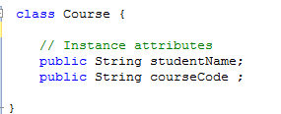
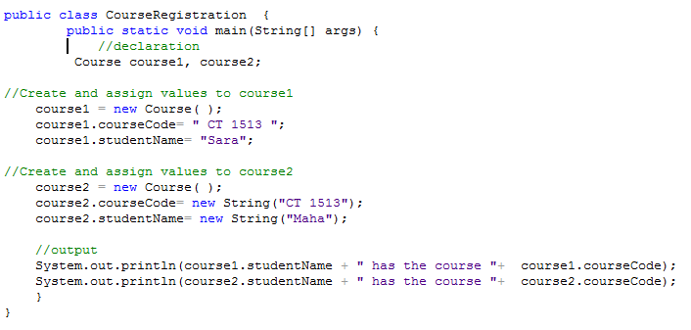
class Course {
// Instance attributes
public String studentName;
public String courseCode ;
}
public class CourseRegistration {
public static void main(String[] args) {
Course course1, course2;
//Create and assign values to course1
course1 = new Course( );
course1.courseCode= new String(“CSC112“);
course1.studentName= new String(“Sara AlKebir“);
//Create and assign values to course2
course2 = new Course( );
course2.courseCode= new String(“CSC107“);
course2.studentName= new String(“Maha AlSaad“);
System.out.println(course1.studentName + " has the course “+
course1.courseCode);
System.out.println(course2.studentName + " has the course “+
course2.courseCode);
}
}

Slide 14
Practical hint
Class Course will not execute by itself
  It does not have method main
CourseRegistration uses the class Course.
  CourseRegistration, which has method main, creates instances of the class Course and uses them.

Slide 15
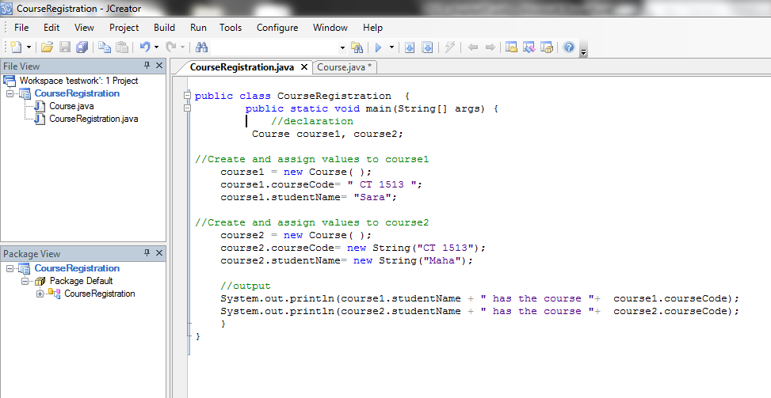

Slide 16
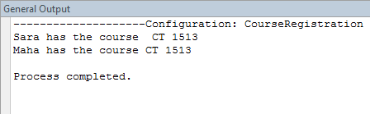
output

Slide 17
Modifiers
Static Public+ Private - Protected #

Slide 18
Static
It used to define class attributes and methods.
Class attributes (and methods):
    live in the class
    can also be manipulated without creating an instance of the class.
    are shared by all objects of the class.
    do not belong to objects’ states.
  <modifiers> <data type> <attribute name> ;
Modifiers
Data Type
Name
  public static int studentNumber ;

Slide 19
Class Attributes Access
Class attributes (and methods) can also be manipulated without creating an instance of the class.
  <class name>.<attribute name>
Class Name
Attribute Name
  Course.studentNumber = 0 ;

Slide 20
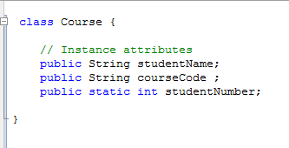
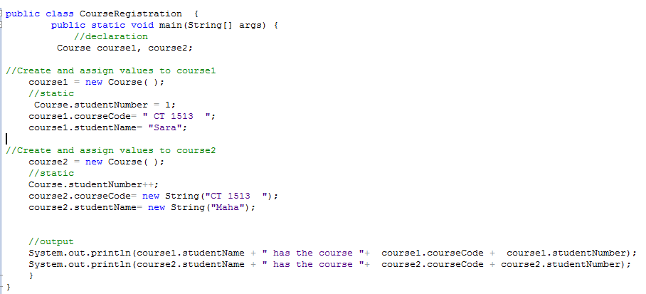
class Course {
// attributes
public String studentName;
public String courseCode ;
public static int studentNumber;
}
public class CourseRegistration {
public static void main(String[] args) {
Course course1, course2;
//Create and assign values to course1
course1 = new Course( ); Course.studentNumber = 1;
course1.courseCode= new String(“CT1513“);
course1.studentName= new String(“Sara AlKebir“);
//Create and assign values to course2
course2 = new Course( ); Course.studentNumber ++;
course2.courseCode= new String(“CSC107“);
course2.studentName= new String(“Maha AlSaad “);
System.out.println(course1.studentName + " has the course “+
course1.courseCode + “ ” + course1.studentNumber);
System.out.println(course2.studentName + " has the course “+
course2.courseCode + “ ” + course2.studentNumber);
}
}

Slide 21
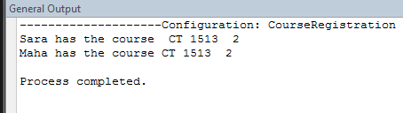
output

Slide 22
public and private modifiers
Let’s consider a class X.
Let’s consider Y a client class of X.
    Y is a class that uses X.
Attributes (and methods) of X declared with the public modifier are accessible from instances of Y.
    The public modifier does not guarantee the information hiding.
Attributes (and methods) of X declared with the private modifier are not accessible from instances of Y.
    The private modifier guarantee the information hiding.

Slide 23
Accessibility from Inside
(the Instance itself)
object:X
Accessible
Inaccessible
public
private
All members of an instance
are accessible from the
instance itself.

Slide 24
Accessibility from
an Instance of another Class
object:X
Accessibility from
The Client class.
Accessible
Inaccessible
public
private
:Y(client)
Only public members
Are visible from outside.
All else is hidden from
Outside.

Slide 25
Accessibility from
an Instance of the same Class
one:X
Accessibility from
The Client class.
Accessible
Inaccessible
public
two:X
private
If a member is accessible
from an instance, it is also
accessible from other
instances of the same
class.

Slide 26
UML Representation of a Class
(UML Class Diagram)
UML uses three symbols to represent the visibility of the class’ members.
    + : mentions that the member is public.
    - : mentions that the member is private.
ClassName
att₁: dataType₁
…
att_{i}: dataType_{i}
Attributes
+ m₁(…): dataType₁
+ ...
+ m_{j}(…): dataType_{j}
Methods (Services)

Slide 27
Declaring Private Attributes
  <modifiers> <data type> <attribute name> ;
Modifiers
Data Type
Name
  private String studentName ;

Slide 28
Example of a Class with
Private attributes
ClassName
studentName: String
courseCode: String
public class Course {
// Attributes
private String studentName;
private String courseCode ;
// No method Members
}

Slide 29
class Course {
// Data Member
private String studentName;
private String courseCode ;
}
public class CourseRegistration {
public static void main(String[] args) {
Course course1, course2;
//Create and assign values to course1
course1 = new Course( );
course1.courseCode= “Ct1513“;
course1.studentName= “Sara AlKebir“;
//Create and assign values to course2
course2 = new Course( );
course2.courseCode= “CSC107“;
course2.studentName= “Maha AlSaad“;
System.out.println(course1.studentName + " has the course “+
course1.courseCode);
System.out.println(course2.studentName + " has the course “+
course2.courseCode);
}
}

Slide 30
Accessibility Example
  …
  Service obj = new Service();
  obj.memberOne = 10;
  obj.memberTwo = 20;
  obj.doOne();
  obj.doTwo();
  …
  class Service {
  public int memberOne;
  private int memberTwo;
  public void doOne() {
  …
  }
  private void doTwo() {
  …
  }
  }
Client
Service
Notes:
This is a simple example of public and private modifiers. See how the client can access the public data member and method.

Slide 31
Methods

Slide 32
Method Declaration
Method declaration is composed of:
    Method header.
    Method body
  <method header> {
  <method body>
  }

Slide 33
Method Declaration (cont.)
  <modifiers> <return type> <method name> ( <parameters> ){
  <method body>
  }
Modifier
Return Type
Method Name
Parameters
  public void setOwnerName ( String name ) {
  ownerName = name;
  }
Method body

Slide 34
Example of Methods with
No-Parameters and No-Return value
import java.util.Scanner;
public class Course {
// Attributes
private String studentName;
private String courseCode ;
private static Scanner input = new Scanner(System.in); //Class att.
// Methods
public void enterDataFromKeyBoard() {
System.out.print (“Enter the student name: ”);
studentName = input.next();
System.out.print (“Enter the course code: ”);
courseCode = input.next();
}
public void displayData() {
System.out.println (“The student name is: ” + studentName);
System.out.println (“The the course code is: ”+ courseCode);
}
}

Slide 35
Method Invocation
Invoking a method of a given object requires using:
    the instance variable that refers to this object.
    the dot (.) operator as following:
        instanceVariable.methodName(arguments)
public class CourseRegistration {
public static void main(String[] args) {
Course course1, course2;
//Create and assign values to course1
course1 = new Course( );
course1.enterDataFromKeyBoard(); course1.display();
//Create and assign values to course2
course2 = new Course( );
course2.enterDataFromKeyBoard(); course2.display();
}
}

Slide 36
Method Invocation Execution Schema
class Client {
public static void
main(String[] arg) {
X obj = new X();
// Block statement 1
obj.method();
// Block statement 2
}
. . .
}
class X {
. . .
public void method() {
// Method body
}
. . .
}
The client
Block statement 1 executes
The method Invocation
Passing Parameters
if exist
The method body starts
Return result if any
The method body finishes
Block statement 2 starts
The client

Slide 37
Example of a Method with Return value
public class Student {
// Attributes
private String studentName;
private int midTerm1, midTerm2, lab, final ;
// Methods
public int computeTotalMarks() {
int value = mid1 + mid2 + lab + final;
return value;
}
}
public class TestStudent {
public static void main (String [] args) {
Student st = new Student();
int total;
…
total = st.computeTotalMarks();
System.out.println(total);
}
}

Slide 38
Template for Methods with Return value
public class ClassName {
// Attributes
...
// Methods
...
public returnType methodName(…) {
returnType variableName;
// 1 - calculate the value to return
// 2 - assign the value to variableName
return variableName;
}
}
public class ClientClass {
public static void main (String [] args) {
ClassName instanceVariable = new ClassName();
returnType receivingVaraiable;
...
receivingVaraiable = instanceVariable.methodName(…);
...
}
}

Slide 39
Arguments and Parameters
An argument is a value we pass to a method.
A parameter is a placeholder in the called method to hold the value of the passed argument.
Formal
parameter
class Sample {
public static void
main(String[] arg) {
Account acct = new Account();
. . .
acct.add(400);
. . .
}
. . .
}
class Account {
. . .
public void add(double amt) {
balance = balance + amt;
}
. . .
}
Argument
(Actual Parameter)

Slide 40
Programming Example: Largest Number
Input: set of 10 numbers
Output: largest of 10 numbers
Solution
  Get numbers one at a time
  Method largest number: returns the larger of two numbers
  For loop: calls method largest number on each number received and compares to current largest number
Java Programming: From Problem Analysis to Program Design, 4e

Slide 41
Solution: Largest Number
public static double larger (double x, double y) {
if (x >= y)
return x;
else
return y;
}
public static void main(String[] args)
{
double num;
double max;
int count;
System.out.println("Enter 10 numbers.");
num = console.nextDouble();
max = num;
for (count = 1; count < 10; count++)
{
num = console.nextDouble();
max = larger(max, num);
}
System.out.println("The largest number is " + max);
Java Programming: From Problem Analysis to Program Design, 4e

Slide 42
Sample Run: Largest Number
Sample Run
Enter 10 numbers:
10.5 56.34 73.3 42 22 67 88.55 26 62 11
The largest number is 88.55
Java Programming: From Problem Analysis to Program Design, 4e

Slide 43
Getter, Setter and Constructor
Information Hiding

Slide 44
How Private Attributes could be Accessed
Private attributes are accessible from outside using accessor operations.
    Getters
    Setters

Slide 45
class Course {
// Data Member
private String studentName;
private String courseCode ;
}
public class CourseRegistration {
public static void main(String[] args) {
Course course1, course2;
//Create and assign values to course1
course1 = new Course( );
course1.courseCode= “CT1513“;
course1.studentName= “Sara AlKebir“;
//Create and assign values to course2
course2 = new Course( );
course2.courseCode= “CT1413“;
course2.studentName= “Maha AlSaad“;
System.out.println(course1.studentName + " has the course “+
course1.courseCode);
System.out.println(course2.studentName + " has the course “+
course2.courseCode);
}
}

Slide 46
Template for Getters
public class ClassName {
private dataType1 attribute1;
. . .
private dataTypen attributen;
. . .
public dataType1 getAttribute1() {
return attribute1;
}
. . .
public dataTypen getAttributen() {
return attributen;
}
. . .
}

Slide 47
Template for Setters
public class ClassName {
private dataType1 attribute1;
. . .
private dataTypen attributen;
. . .
public void setAttribute1(dataType1 param){
attribute1 = param;
}
. . .
public void setAttributen(dataTypen param) {
attributen = param;
}
. . .
}

Slide 48
public class Course {
// Attributes
private String studentName;
private String courseCode ;
...
public String getStudentName() {
return studentName;
}
public String getCourseCode() {
return courseCode;
}
...
public void setStudentName(String val) {
studentName = val;
}
public void setCourseCode(String val) {
courseCode = val;
}
}

Slide 49
public class CourseRegistration {
public static void main(String[] args) {
Course course1, course2;
//Create and assign values to course1
course1 = new Course( );
course1.setCourseCode(“CT1513“);
course1.setStudentName(“Sara AlKebir“);
//Create and assign values to course2
course2 = new Course( );
course2.setCourseCode(“CT1413“);
course2.setStudentName(“Maha AlSaad“);
System.out.println(course1.getStudentName() +
" has the course “ + course1.getCourseCode());
System.out.println(course2.getStudentName() +
" has the course “ + course2.getCourseCode());
}
}

Slide 50
Class Constructors
A class is a blueprint or prototype from which objects of the same type are created.
Constructors define the initial states of objects when they are created.
    ClassName x = new ClassName();
A class contains at least one constructor.
A class may contain more than one constructor.

Slide 51
The Default Class Constructor
If no constructors are defined in the class, the default constructor is added by the compiler at compile time.
The default constructor does not accept parameters and creates objects with empty states.
    ClassName x = new ClassName();

Slide 52
Class Constructors Declaration
  public <constructor name> ( <parameters> ){
  <constructor body>
  }
The constructor name: a constructor has the name of the class .
The parameters represent values that will be passed to the constructor for initialize the object state.
Constructor declarations look like method declarations—except that they use the name of the class and have no return type.

Slide 53
Example of a Constructor with No-Parameter
public class Kasree {
private int bast;
private int maquam;
public Kasree() {
bast = 0; maquam =1;
}
. . .
}
A. The instance variable is allocated in memory.
x
B. The object is created with initial state
Object: Kasree
bast
0
1
maquam
C. The reference of the object created in B is assigned to the variable.
x
A
Kasree x;
B
x = ;
Object: Kasree
new Kasree ( )
bast
0
C
1
maquam
State of Memory
Code

Slide 54
Class with Multiple Constructors
public class Kasree {
private int bast;
private int maquam;
public Kasree() {
bast = 0; maquam =1;
}
public Kasree(int a, int b) {
bast = a;
if (b != 0) maquam = b;
else maquam = 1;
}
. . .
}
A. The constructor declared with no-parameter is used to create the object
x
Object: Kasree
bast
0
1
maquam
B. The constructor declared with parameters is used to create the object
y
Kasree x , y;
A
Object: Kasree
x = new Kasree()
y = new Kasree(4, 3);
bast
4
B
3
maquam
State of Memory
Code

Slide 55
Copy Constructor
Makes a new copy of an object
Used in some object declarations, when an object is used as a parameter to the constructor of a class of the same type:

Slide 56
Class with copy Constructors
public class Kasree {
private int bast;
private int maquam;
public Kasree() {
bast = 0; maquam =1;
}
public Kasree(Kasree k) {
bast = k.bast;
maquam =k. maquam;
}
}
A. The constructor declared with no-parameter is used to create the object
x
Object: Kasree
bast
0
k
1
maquam
B. The copy constructor declared with refrence parameters is used to create the object
y
Kasree x , y;
A
Object: Kasree
x = new Kasree()
y = new Kasree(x);
bast
0
B
1
maquam
State of Memory
Code

